Slide 1

Spring Boot Tutorial
Session 2

Slide 2
Agenda
What is Spring Data JPA
JPA vs Spring Data JPA vs Hibernate
Spring Data Repositories
@Query in JPA
CollegeAPI Project Overview and E-R Diagram
Hibernate Associations
ORM Mappings - @OneToOne, @ManyToOne, @ManyToMany
Fetch Types in Hibernate
Cascade Types in Hibernate
ddl-auto property in Hibernate
Orphan Removal in Hibernate
@Embedded and @Embeddable
API Documentation – Swagger
Application Monitoring - Actuator

Slide 3
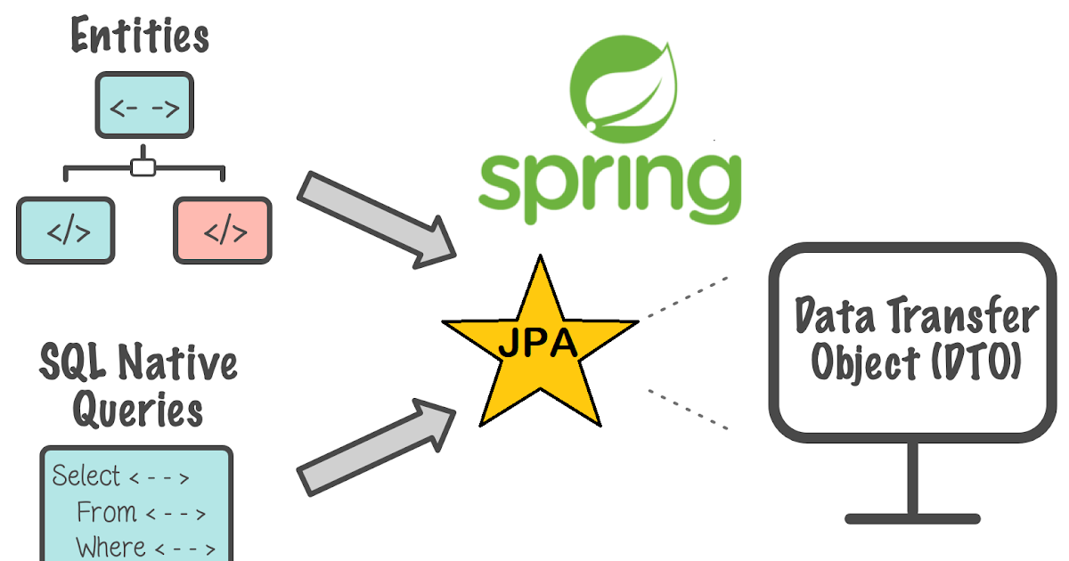
What is Spring Data JPA
The Java Persistence API provides a specification for persisting, reading, and managing data from your java object to your relational tables in the database. JPA specifies the set of rules and guidelines for developing interfaces that follow standards.
Spring Data JPA is part of the spring framework. The goal of spring data repository abstraction is to significantly reduce the amount of boilerplate code required to implement a data access layer for various persistence stores. Spring Data JPA is not a JPA provider, it is a library/framework that adds an extra layer of abstraction on the top of our JPA provider line Hibernate.
Spring Data JPA API provides JpaTemplate class to integrate spring application with JPA. Using this, don't need to write the before and after code for persisting, updating, deleting or searching object with EntityManager, EntityManagerFactory and EntityTransaction objects etc. So, it save a lot of code.
The implementation of JPA specification
are provided by many vendors such as:
Hibernate
EclipseLink

Slide 4
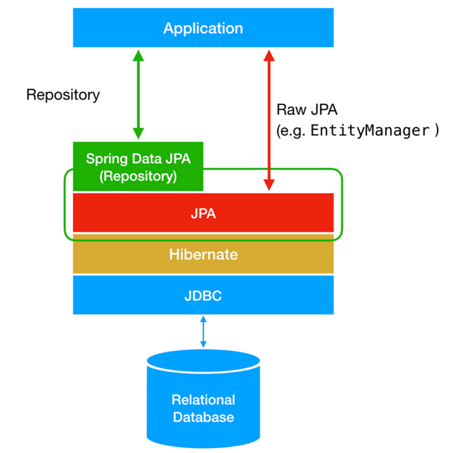
Difference between JPA, Spring Data JPA and Hibernate
JPA : Java persistence api which provide specification for persisting, reading, managing data from your java object to relations in database.
Spring Data JPA provides an additional layer of abstraction or a better API to work with JPA.
Hibernate is a full-fledged JPA implementation. With Spring Data, you may use Hibernate, EclipseLink, or any other JPA provider.

Slide 5
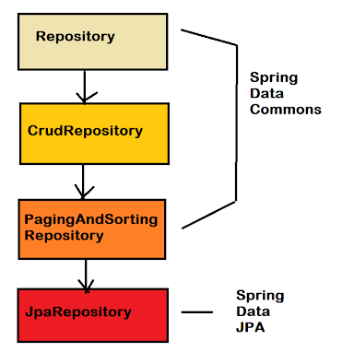
Spring Data Repositories
The central interface in the Spring Data repository abstraction is Repository and it takes the domain class to manage as well as the id type of the domain class as type arguments.
There are different kinds of Spring Data repository interfaces and their functionality:
CrudRepository
PagingAndSortingRepository
JpaRepository
CrudRepository & PagingAndSortingRepository comes from org.springframework.data.repository package , whereas JpaRepository comes from org.springframework.data.jpa.repository package.

Slide 6
Spring Data Repositories (Contd ..)
Crud Repository : CrudRepository is a Spring Data interface for generic create,read,update,delete operations on a repository of a specific type. It provides several methods out of the box for interacting with a database.
PagingAndSortingRepository : Extension of CrudRepository to provide additional methods to retrieve entities using the pagination and sorting abstraction. This provides two methods.
Page findAll(Pageable pageable) – returns a Page of entities meeting the paging restriction provided in the Pageable object.
Iterable findAll(Sort sort) – returns all entities sorted by the given options. No paging is applied here.
Setting sorted by name with a limited number of records(given no of records)
@Repository
public interface studentRepository extends CrudRepository<Student, Long> { }
public interface PagingAndSortingRepository<T, ID extends Serializable>
extends CrudRepository<T, ID> {
Iterable<T> findAll(Sort sort);
Page<T> findAll(Pageable pageable);
}
Sort sort = new Sort(new Sort.Order(Direction.ASC, "studentName")); Pageable pageable = new PageRequest(0, 20, sort);

Slide 7
Spring Data Repositories (Contd ..)
JPA Repository : JpaRepository extends PagingAndSortingRepository that extends CrudRepository. JpaRepository provides CRUD and pagination operations, along with additional methods like flush(), saveAndFlush(), and deleteInBatch(), etc.
public interface JpaRepository<T, ID extends Serializable> extends PagingAndSortingRepository<T, ID> {
List<T> findAll();
List<T> findAll(Sort sort);
List<T> save(Iterable<? extends T> entities);
void flush();
T saveAndFlush(T entity);
void deleteInBatch(Iterable<T> entities);
}

Slide 8
Queries in Spring Boot JPA
@Query annotation with JPQL
Native SQL @Query in JPA
Named @Param in @Query
@Query("SELECT s from Student s where s.emailId = ?1") Student getStudentByEmailAddress(String emailId);
@Query( value="SELECT * from tbl_student s where s.email_address = ?1", nativeQuery = true ) Student getStudentByEmailAddressNative(String emailId);
@Query( value="SELECT * from tbl_student s where s.email_address = :emailId", nativeQuery = true ) Student getStudentByEmailAddressNativeNamedParam( @Param("emailId") String emailId );

Slide 9
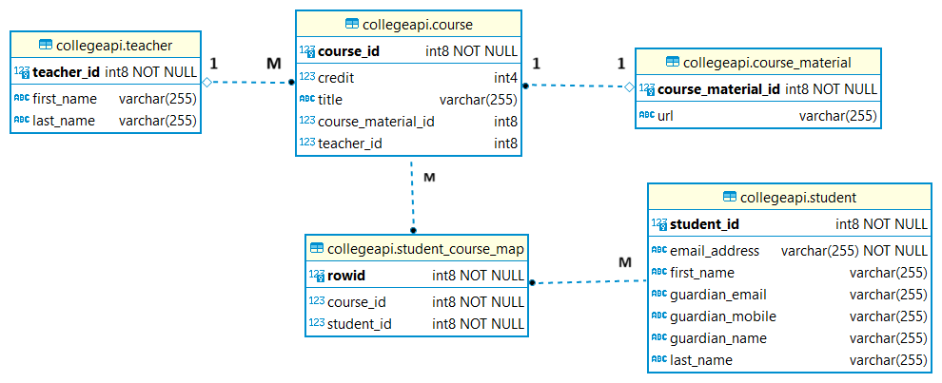
CollegeAPI - E-R Diagram

Slide 10
Hibernate Associations
Associations are a fundamental concept in ORM, allowing us to define relationships between entities.
There are two types of associations in hibernate :
Unidirectional associations are commonly used in object-oriented programming to establish relationships between entities. However, it’s important to note that in a unidirectional association, only one entity holds a reference to the other. To define a unidirectional association in Java, we can use annotations such as @ManyToOne, @OneToMany, @OneToOne, and @ManyToMany. Unidirectional associations are simpler and may be sufficient for many applications.
Example : Unidirectional @OneToMany
@Entity public class Department { @Id private Long id; @OneToMany @JoinColumn(name = "department_id") private List<Employee> employees; }
@Entity public class Employee { @Id private Long id; }

Slide 11
Hibernate Associations (contd ..)
Bidirectional association is a relationship between two entities where each entity has a reference to the other. In order to define bidirectional associations, we use the mappedBy attribute in the @OneToMany and @ManyToMany annotations.
Bidirectional associations provide more flexibility and can be useful in more complex scenarios. However, bidirectional associations can also introduce more complexity and potential issues, such as circular dependencies and memory leaks, and should be used with caution.
For example : @OneToMany Bidirectional mapping
@Entity public class Department { @OneToMany(mappedBy = "department") private List<Employee> employees; }
@Entity public class Employee { @ManyToOne @JoinColumn(name = "department_id") private Department department; }

Slide 12
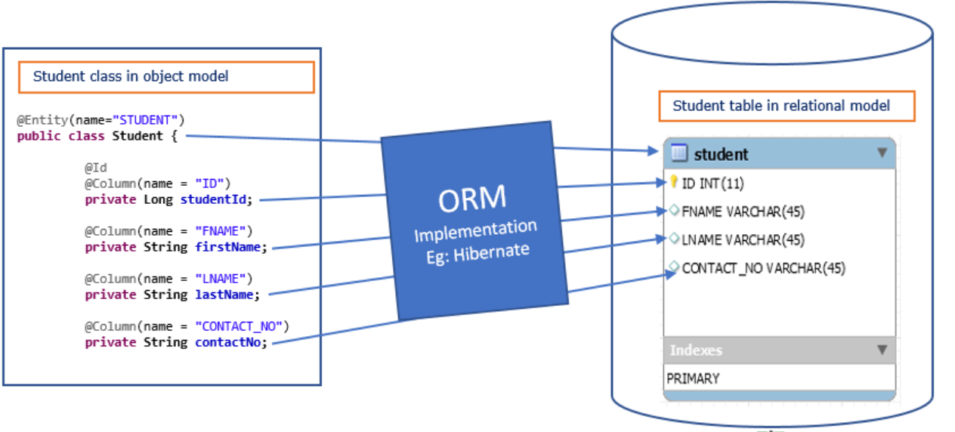
Object-Relationship Mappings
Used to develop and maintain a relationship between an object and relational database by mapping an object state to database column.
Capable to handle various database operations easily such as inserting, updating, deleting etc.
Following are the various ORM mappings: -
@OneToOne
@ManyToOne
@OneToMany
@ManyToMany

Slide 13
@OneToOne Relationship
In a one-to-one relationship, an instance of an entity is associated with only one instance of another entity.
Uni-directional Relationship :
Include below for Bi-directional Relationship :
@OneToOne(cascade = CascadeType.PERSIST) @JoinColumn( // foreign key name = "course_material_id", referencedColumnName = "courseMaterialId" ) private CourseMaterial courseMaterial;
@OneToOne( cascade = CascadeType.PERSIST, mappedBy = "courseMaterial", fetch = FetchType.LAZY ) private Course course;

Slide 14
@ManyToOne Relationship
In a many-to-one relationship, many instances of an entity are associated with one instance of another entity.
Uni-directional Relationship ::
Include below for Bi-directional Relationship ::
@ManyToOne(cascade = CascadeType.PERSIST, fetch = FetchType.LAZY) @JoinColumn(name = "teacher_id", referencedColumnName = "teacherId") private Teacher teacher;
@OneToMany(fetch = FetchType.LAZY) @JoinColumn(name = "teacher_id", referencedColumnName = "teacherId") @JsonIgnore @ToString.Exclude private List<Course> courses;

Slide 15
@OneToMany Relationship
In a one-to-many relationship, an entity has a reference to one or many instances of another entity.
Uni-directional Relationship ::
Include below for Bi-directional Relationship ::
@OneToMany(fetch = FetchType.LAZY) @JoinColumn(name = "teacher_id", referencedColumnName = "teacherId") @JsonIgnore @ToString.Exclude private List<Course> courses;
@ManyToOne(cascade = CascadeType.PERSIST, fetch = FetchType.LAZY) @JoinColumn(name = "teacher_id", referencedColumnName = "teacherId") private Teacher teacher;

Slide 16
@ManyToMany Relationship
In a many-to-many relationship, many instances of an entity are associated with many instances of another entity.
Uni-directional Relationship ::
Include below for Bi-directional
Relationship ::
@ManyToMany( cascade = CascadeType.PERSIST, fetch = FetchType.LAZY ) @JoinTable( name = "student_course_map", joinColumns = @JoinColumn( // for students, what courses they have name = "course_id", referencedColumnName = "courseId" ), inverseJoinColumns = @JoinColumn( // for courses, what should be the students name = "student_id", referencedColumnName = "studentId" ), schema = Constants.API_SCHEMA ) private List<Student> students;
@ManyToMany( mappedBy = "students", fetch = FetchType.LAZY ) // This is the same attribute name used in User Class. @JsonIgnore @ToString.Exclude private List<Course> courses;

Slide 17
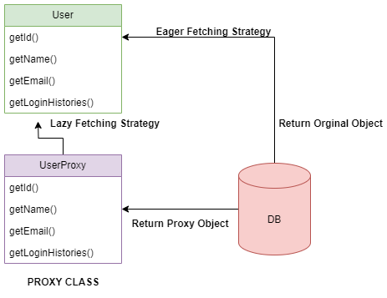
Fetch Types in Hibernate
Fetch type is a strategy for retrieving data from the database. Hibernate creates a proxy for each entity.
EAGER - Load the associated data of the other entity, beforehand which is bit costly. This loads all the relationships.
LAZY - Load the associated data of the other entity, only when requested. This is done on demand. This does not load the relationships unless you invoke it via the getter method.
Hibernate default :
OneToMany: LAZY
ManyToOne: EAGER
ManyToMany: LAZY
OneToOne: EAGER

Slide 18
Cascade Types in Hibernate
Cascading is about persistence actions involving one object propagating to other objects via an association.
Various Types of cascading includes :
CascadeType.ALL
CascadeType.PERSIST (only create operation )
CascadeType.MERGE (only update operation)
CascadeType.REMOVE (only delete operation)
CascadeType.REFRESH (only refresh operation)
CascadeType.DETACH (only detatch operation)

Slide 19
ddl-auto property in Hibernate
JPA has features for DDL generation, and these can be set up to run on startup against the database. This is controlled through ddl-auto property.
Various Types of ddl-auto property value includes :
validate: validate the schema, makes no changes to the database.
update: update the schema.
create: creates the schema, destroying previous data.
create-drop: drop the schema at the end of the session
none: is all other cases.

Slide 20
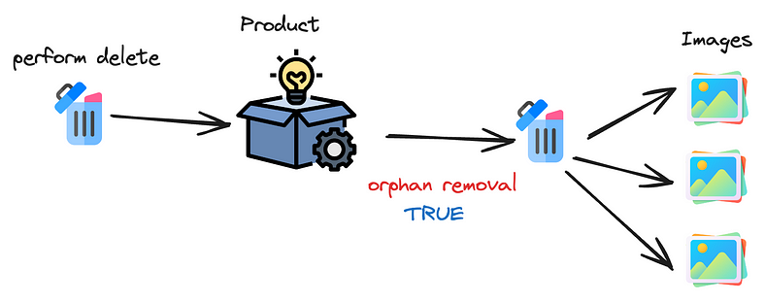
Orphan Removal in Hibernate
It is a property in relational annotations, meaning that if the parent entity has no reference, remove the child entity.
orphanRemoval is an ORM-specific thing. It marks "child" entity to be removed when it's no longer referenced from the "parent" entity, e.g. when you remove the child entity from the corresponding collection of the parent entity. E.g.:
orphanRemoval = true

Slide 21
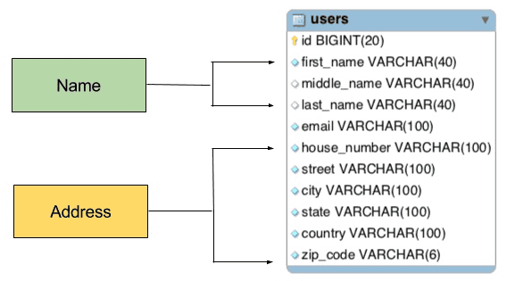
@Embedded and @Embeddable
The @Embeddable and @Embedded annotations in Hibernate are used to map an object’s properties to columns in a database table. These annotations are used in combination to allow the properties of one class to be included as a value type in another class and then be persisted in the database as part of the containing class.
The @Embeddable annotation is used to mark a class as being embeddable, meaning its properties can be included in another class as a value type. The class marked with @Embeddable is called the embeddable class.
The @Embedded annotation is used to mark a field in a class as being an embeddable object, and it is used in the class that contains the embeddable object.
By using these annotations, Hibernate can automatically persist the properties of the embeddable class within the containing class to the database table, without the need to create a separate table for the embeddable class.
Benefits: Better data modeling, code reusability, normalization, flexibility and better performance.

Slide 22
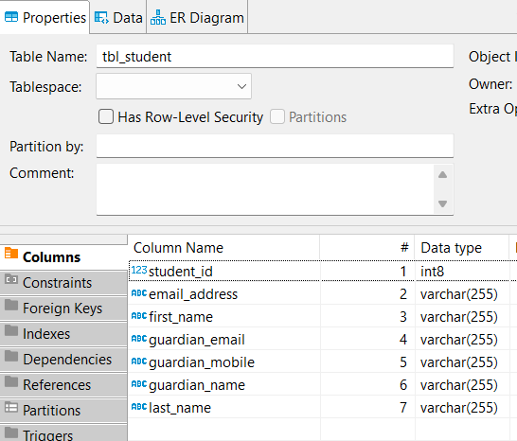
@Embedded and @Embeddable (Contd ..)
public class Student { @Embedded // Embedding guardain into here. private Guardian guardain; }
@Embeddable
@AttributeOverrides({ @AttributeOverride( name = "name", column = @Column(name = "guardian_name") ), @AttributeOverride( name = "email", column = @Column(name = "guardian_email") ), @AttributeOverride( name = "mobile", column = @Column(name = "guardian_mobile") ) }) public class Guardian { private String name; private String email; private String mobile; }

Slide 23
API Documentation - Swagger
It is essential to have proper specifications for the back-end APIs.
At the same time, the API documentation should be informative, readable, and easy to follow.
Swagger
For Spring Boot < 3.0
For Spring Boot > 3.0
<dependency> <groupId>org.springdoc</groupId> <artifactId>springdoc-openapi-ui</artifactId> <version>1.6.12</version> </dependency>
<dependency> <groupId>org.springdoc</groupId> <artifactId>springdoc-openapi-starter-webmvc-ui</artifactId> <version>2.2.0</version> </dependency>
#Swagger Configurations springdoc.api-docs.path=/api-docs springdoc.swagger-ui.path=/collegeapi/swagger-ui.html #springdoc.swagger-ui.operationsSorter=method #springdoc.swagger-ui.enabled= true

Slide 24
Server Health Monitoring - Actuator
Actuator is mainly used to expose operational information about the running application — health, metrics, info, dump, env, etc. It uses HTTP endpoints or JMX beans to enable us to interact with it.
We can see inside of our running application using actuator endpoints.
Endpoint | Default
/actuator | TRUE
/actuator/autoconfig | TRUE
/actuator/beans | TRUE
/actuator/configprops | TRUE
/actuator/env | TRUE
/actuator/health | TRUE
/actuator/info | TRUE
/actuator/mappings | TRUE
/actuator/shutdown | FALSE
<dependency> <groupId>org.springframework.boot</groupId> <artifactId>spring-boot-starter-actuator</artifactId> </dependency>
# Actuator management.port=8080 management.endpoints.web.exposure.include=* #No auth protected #endpoints.shutdown.sensitive=false #Enable shutdown endpoint #endpoints.shutdown.enabled=true

Slide 25
Any Questions ?

