Slide 1

Spring Boot Tutorial
Session 2

Slide 2
Agenda
JPA vs Spring Data JPA vs Hibernate
CrudRepository vs JPARepository
@Query in JPA
CollegeAPI Project Overview and E-R Diagram
ORM Mappings - @OneToOne, @ManyToOne, @ManyToMany
Fetch Types in Hibernate
Cascade Types in Hibernate
Orphan Removal in Hibernate
@Embedded class
API Documentation – Swagger
Application Monitoring - Actuator

Slide 3
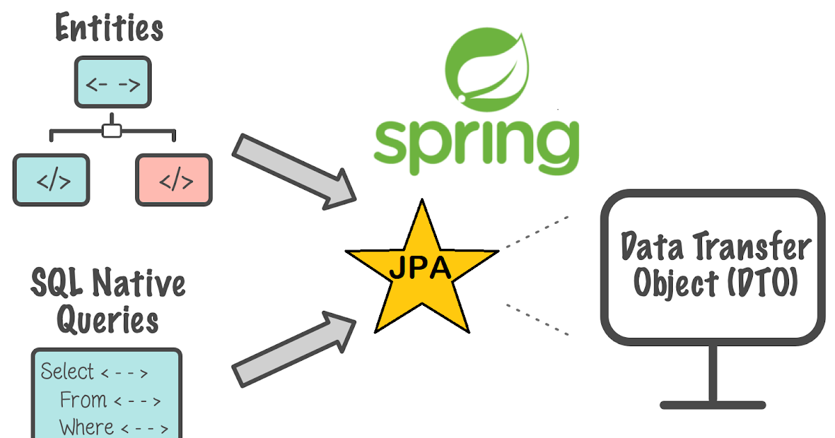
What is Spring Data JPA
JPA (Java Persistent API) is the sun specification for persisting objects in the enterprise application.
Spring Data JPA API provides JpaTemplate class to integrate spring application with JPA. Using this, don't need to write the before and after code for persisting, updating, deleting or searching object with EntityManager, EntityManagerFactory and EntityTransaction objects etc. So, it save a lot of code.
The implementation of JPA specification
are provided by many vendors such as:
Hibernate
EclipseLink

Slide 4
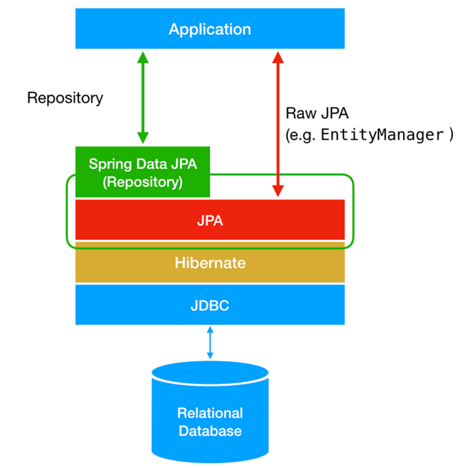
Difference between JPA, Spring Data JPA and Hibernate
JPA : Java persistence api which provide specification for persisting, reading, managing data from your java object to relations in database.
Spring Data JPA provides an additional layer of abstraction or a better API to work with JPA.
Hibernate is a full-fledged JPA implementation. With Spring Data, you may use Hibernate, EclipseLink, or any other JPA provider.

Slide 5
CrudRepository vs JPARepository
Key | JPARepository | CrudRepository
Hierarchy | JPA extend crudRepository and PagingAndSorting repository | Crud Repository is the base interface and it acts as a marker interface.
Batch support | JPA also provides some extra methods related to JPA such as delete records in batch and flushing data directly to a database. | It provides only CRUD functions like findOne, saves, etc.
@Repository public interface CourseRepository extends JpaRepository<Course, Long> { }
@Repository public interface CourseRepository extends CrudRepository<Course, Long> { }

Slide 6
JPA @Query
@Query annotation with JPQL
Native SQL @Query in JPA
Named @Param in @Query
@Query("SELECT s from Student s where s.emailId = ?1") Student getStudentByEmailAddress(String emailId);
@Query( value="SELECT * from tbl_student s where s.email_address = ?1", nativeQuery = true ) Student getStudentByEmailAddressNative(String emailId);
@Query( value="SELECT * from tbl_student s where s.email_address = :emailId", nativeQuery = true ) Student getStudentByEmailAddressNativeNamedParam( @Param("emailId") String emailId );

Slide 7
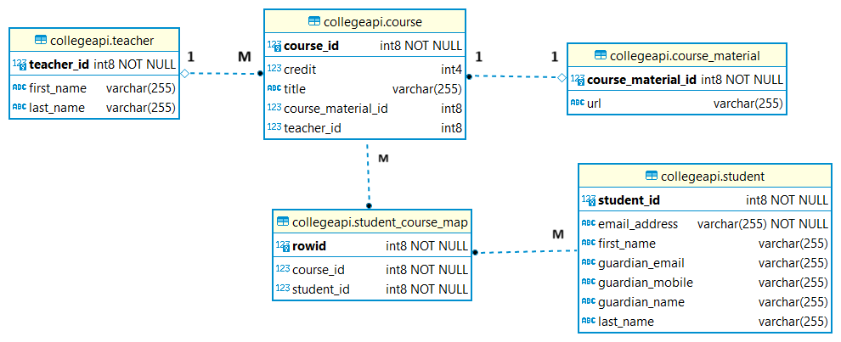
CollegeAPI - E-R Diagram

Slide 8
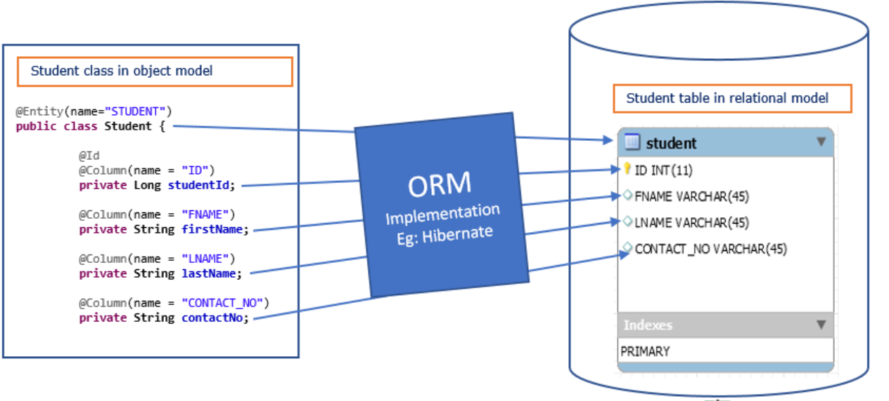
Object-Relation Mappings
Used to develop and maintain a relationship between an object and relational database by mapping an object state to database column.
Capable to handle various database operations easily such as inserting, updating, deleting etc.
Following are the various ORM mappings: -
@OneToOne
@ManyToOne
@OneToMany
@ManyToMany

Slide 9
@OneToOne Relationship
Uni-directional Relationship
Bi-directional Relationship
@OneToOne(cascade = CascadeType.PERSIST) @JoinColumn( // foreign key name = "course_material_id", // it will save with this name in course_material table. referencedColumnName = "courseMaterialId" ) private CourseMaterial courseMaterial;
@OneToOne( cascade = CascadeType.PERSIST, mappedBy = "courseMaterial", fetch = FetchType.LAZY ) private Course course;

Slide 10
@ManyToOne and @OneToMany Relationship
Uni-directional Relationship
Bi-directional Relationship
@ManyToOne(cascade = CascadeType.PERSIST, fetch = FetchType.LAZY) @JoinColumn(name = "teacher_id", referencedColumnName = "teacherId") private Teacher teacher;
@OneToMany(fetch = FetchType.LAZY) @JoinColumn(name = "teacher_id", referencedColumnName = "teacherId") @JsonIgnore @ToString.Exclude private List<Course> courses;

Slide 11
@ManyToMany Relationship
Uni-directional Relationship
Bi-directional Relationship
@ManyToMany(cascade = CascadeType.PERSIST, fetch = FetchType.LAZY) @JoinTable( name = "student_course_map", joinColumns = @JoinColumn( // for students, what courses they have name = "course_id", referencedColumnName = "courseId" ), inverseJoinColumns = @JoinColumn( // for courses, what should be the students name = "student_id", referencedColumnName = "studentId" ), schema = Constants.API_SCHEMA ) private List<Student> students;
@ManyToMany(mappedBy = "students", fetch = FetchType.LAZY) // This is the same attribute name used in User Class. @JsonIgnore @ToString.Exclude private List<Course> courses;

Slide 12
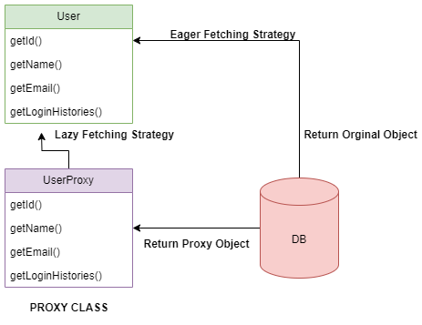
Fetch Types in Hibernate
Fetch type is a strategy for retrieving data from the database. Hibernate creates a proxy for each entity.
EAGER - Load the associated data of the other entity, beforehand which is bit costly. This loads all the relationships.
LAZY - Load the associated data of the other entity, only when requested. This is done on demand. This does not load the relationships unless you invoke it via the getter method.
Hibernate default :
OneToMany: LAZY
ManyToOne: EAGER
ManyToMany: LAZY
OneToOne: EAGER

Slide 13
Cascade Types in Hibernate
Cascading is about persistence actions involving one object propagating to other objects via an association.
Various Types of cascading includes :
CascadeType.ALL
CascadeType.PERSIST (only create operation )
CascadeType.MERGE (only update operation)
CascadeType.REMOVE (only delete operation)
CascadeType.REFRESH (only refresh operation)
CascadeType.DETACH (only detatch operation)

Slide 14
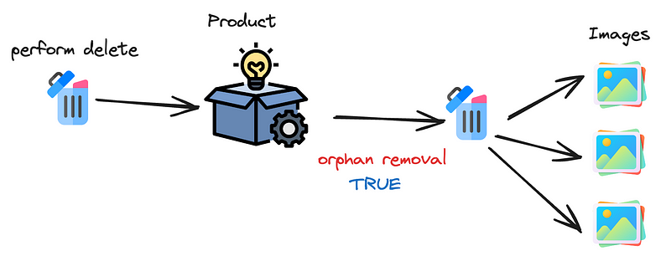
Orphan Removal in Hibernate
It is a property in relational annotations, meaning that if the parent entity has no reference, remove the child entity.
orphanRemoval is an ORM-specific thing. It marks "child" entity to be removed when it's no longer referenced from the "parent" entity, e.g. when you remove the child entity from the corresponding collection of the parent entity. E.g.:
orphanRemoval = true

Slide 15
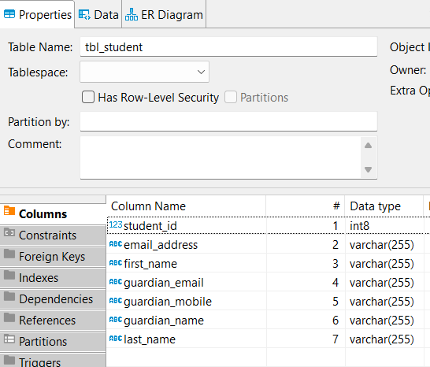
@Embedded Class
public class Student { @Embedded // Embedding guardain into here. private Guardian guardain; }
@Embeddable
@AttributeOverrides({ @AttributeOverride( name = "name", column = @Column(name = "guardian_name") ), @AttributeOverride( name = "email", column = @Column(name = "guardian_email") ), @AttributeOverride( name = "mobile", column = @Column(name = "guardian_mobile") ) }) public class Guardian { private String name; private String email; private String mobile; }

Slide 16
API Documentation - Swagger
It is essential to have proper specifications for the back-end APIs.
At the same time, the API documentation should be informative, readable, and easy to follow.
Swagger
For Spring Boot < 3.0
For Spring Boot > 3.0
<dependency> <groupId>org.springdoc</groupId> <artifactId>springdoc-openapi-ui</artifactId> <version>1.6.12</version> </dependency>
<dependency> <groupId>org.springdoc</groupId> <artifactId>springdoc-openapi-starter-webmvc-ui</artifactId> <version>2.2.0</version> </dependency>
#Swagger Configurations springdoc.api-docs.path=/api-docs springdoc.swagger-ui.path=/collegeapi/swagger-ui.html #springdoc.swagger-ui.operationsSorter=method #springdoc.swagger-ui.enabled= true

Slide 17
Server Health Monitoring - Actuator
Actuator is mainly used to expose operational information about the running application — health, metrics, info, dump, env, etc. It uses HTTP endpoints or JMX beans to enable us to interact with it.
We can see inside of our running application using actuator endpoints.
Endpoint | Default
/actuator | TRUE
/actuator/autoconfig | TRUE
/actuator/beans | TRUE
/actuator/configprops | TRUE
/actuator/env | TRUE
/actuator/health | TRUE
/actuator/info | TRUE
/actuator/mappings | TRUE
/actuator/shutdown | FALSE
<dependency> <groupId>org.springframework.boot</groupId> <artifactId>spring-boot-starter-actuator</artifactId> </dependency>
# Actuator management.port=8080 management.endpoints.web.exposure.include=* #No auth protected #endpoints.shutdown.sensitive=false #Enable shutdown endpoint #endpoints.shutdown.enabled=true

Slide 18
Any Questions ?

