Slide 1

Project Title
Page 01
TileSpGEMM: A Tiled Algorithm for Parallel Sparse
General Matrix-Matrix Multiplication on GPUs
Authors: Yuyao Niu , Zhengyang Lu, Haonan Ji, Shuhui Song, Zhou Jin, Weifeng Liu
Team Members :
01
02
03
04
DURGESH NAMA
12340720
YOGESH
12342420
SWARNADIP KAR
12342210
ARNAV MISHRA
12340330

Slide 2
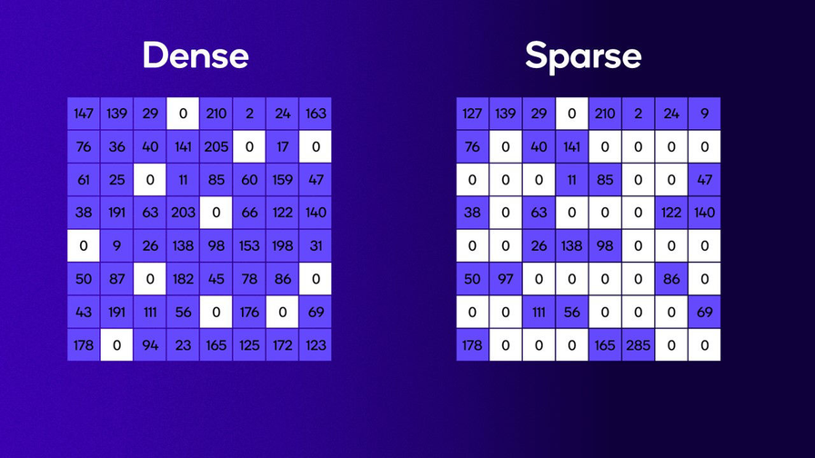
Problem Statement
Page 02
Compute:
C = A × B (Sparse Matrices)
Matrices contain:
Mostly zero values
Irregular structure
Goal
Design a fast, scalable parallel SpGEMM algorithm
Improve load balance, memory efficiency, and performance

Slide 3
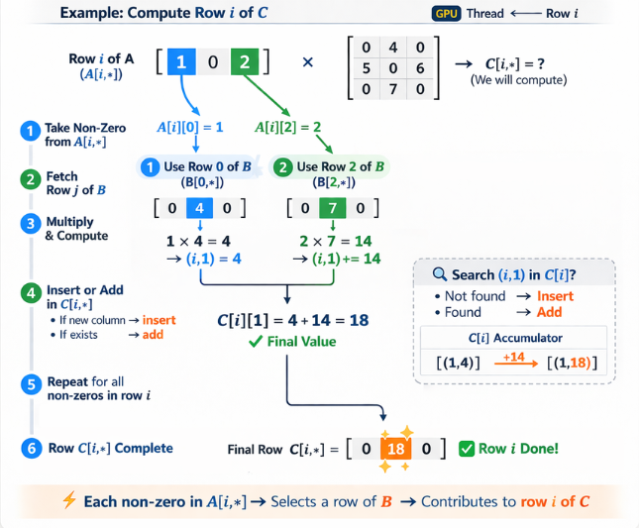
Row-Row SpGEMM
Giggling Platypus Co.
Page 03
• Compute one row of C at a time
• Each row is independent → parallel on GPU
Steps :
For each row i in matrix A
→ assign a GPU thread
01
For each non-zero element A[i][j]
→ find row j in matrix B
02
Multiply with all non-zeros in B[j][k]
→ value = A[i][j] × B[j][k]
03
Insert or update in result matrix C[i][k]
→ If not present → insert
→ If present → add value
04
05
Repeat for all non-zeros in row i
06
Final row C[i] is formed

Slide 4
Row-Row SpGEMM
Giggling Platypus Co.
Page 04
Phase 1 — Upper-Bound nnz per Row (upper_nnz_kernel)
1 thread per row of C
For each non-zero A[i,k], adds the count of non-zeros in col k in B
Result: upper_nnz[i] = worst-case non-zeros in row i of C
Phase 2 — Hash-Based SpGEMM (spgemm_hash_kernel)
1 warp per row of C
Each lane handles every 32nd non-zero of A[i,*] (stride = warp size)
For each A[i,k], iterates all non-zeros of B[k,*]
Inserts (column_j, A[i,k] × B[k,j]) into a per-row open-addressing hash table:
atomicAdd accumulates the product into that slot

Slide 5
Row-Row SpGEMM
Giggling Platypus Co.
Page 05
Phase 3 — Prefix Sum
thrust::inclusive_scan on nnzC[] → rowPtrC[]
Runs entirely on GPU — no CPU round-trip
Tells us where each row's non-zeros start in the final output array
Phase 4 — Collect Hash -> CSR (collect_kernel)
1 thread per row
Scans the hash table, copies occupied slots into colIdxC[] and valC[]
Insertion sort within the row to produce sorted CSR output.

Slide 6

Challenges
Page 06
Limitations of Row-Row SpGEMM
01
02
03
Load Imbalance
Unknown Output Size
High Memory usage
Some rows have huge work, others very small → GPU underutilized
Cannot predict number of non-zeros → memory allocation issue
High memory usage for intermediate results
Challange => Out of Memory Error
Batching
Hash tables for all rows may exceed GPU memory
Rows are processed in batches sized to fit within a memory budget (8 GB)
Each batch allocates/frees its own hash tables; results accumulate on CPU

Slide 7
Challenges
Page 05
Challenges in Efficient SpGEMM on GPUs
1
2
Irregular computation patterns
Unbalanced workload across threads
3
4
High memory usage for intermediate results
Poor data locality (inefficient memory access)

Slide 8
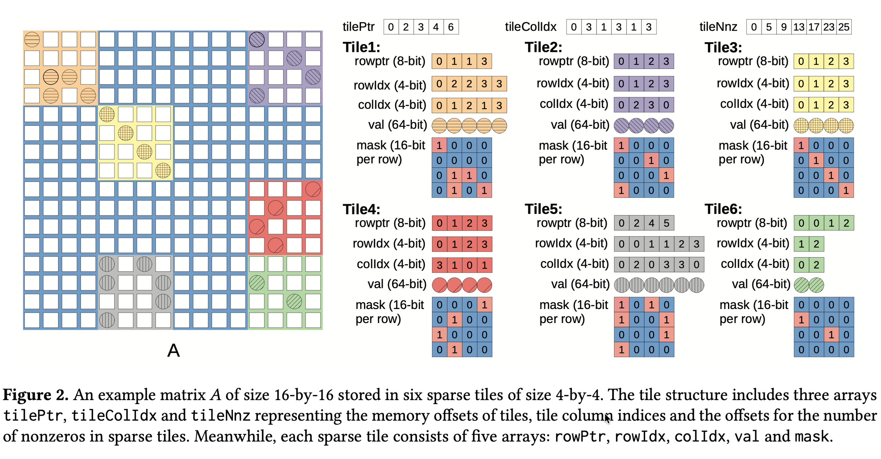
TileSpGEMM
Page 06

Slide 9
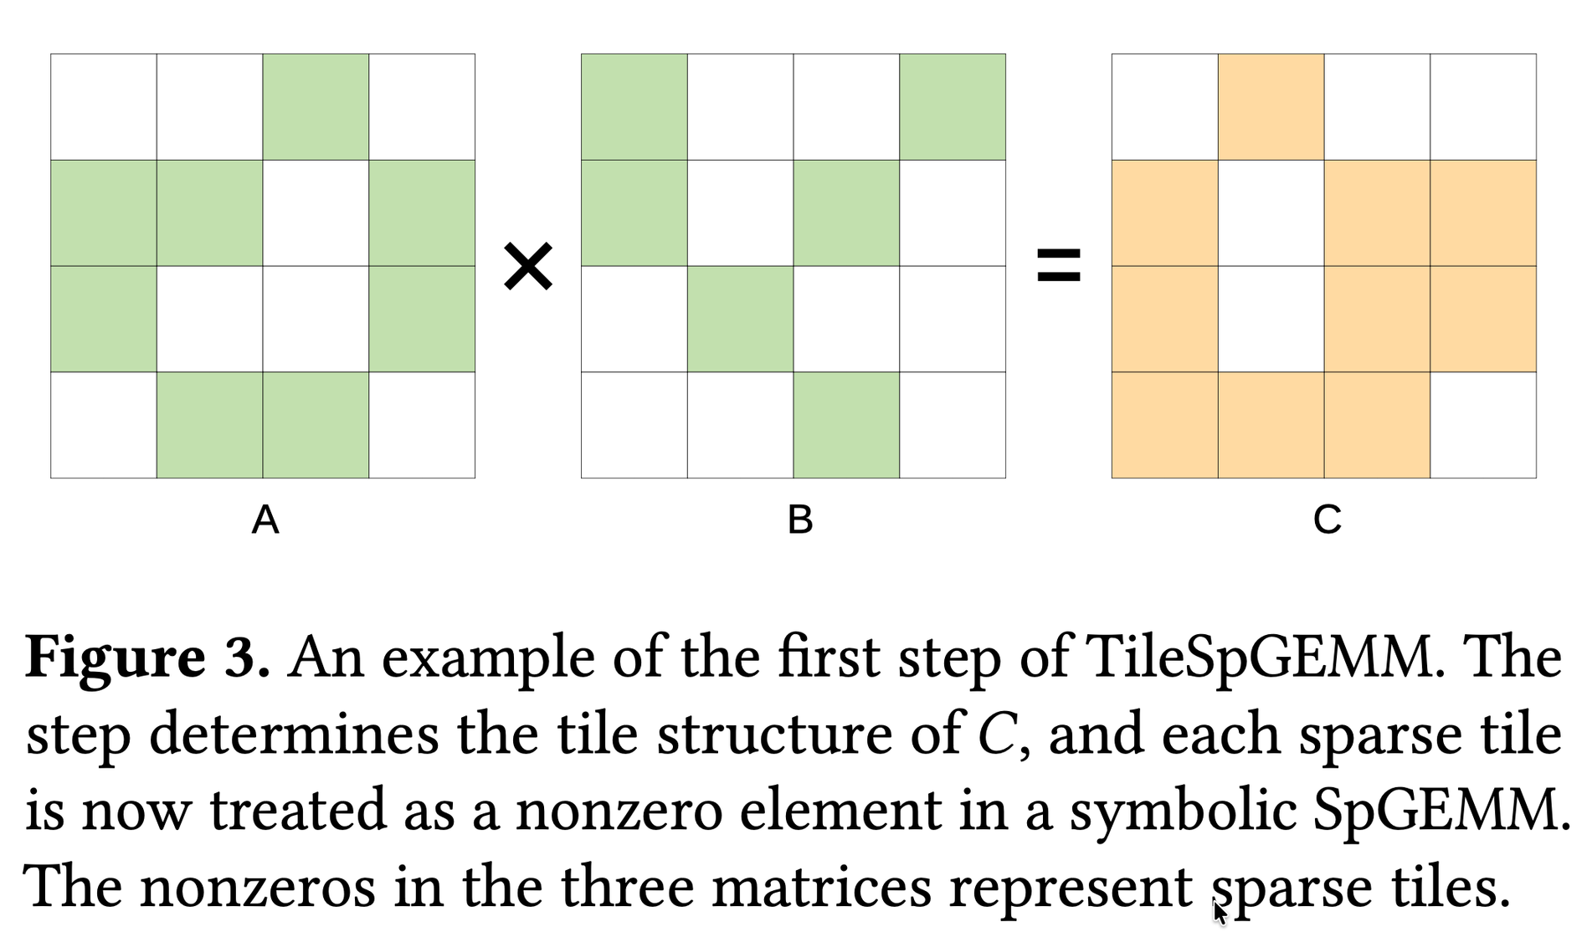
Algorithm Description
Page 07

Slide 10
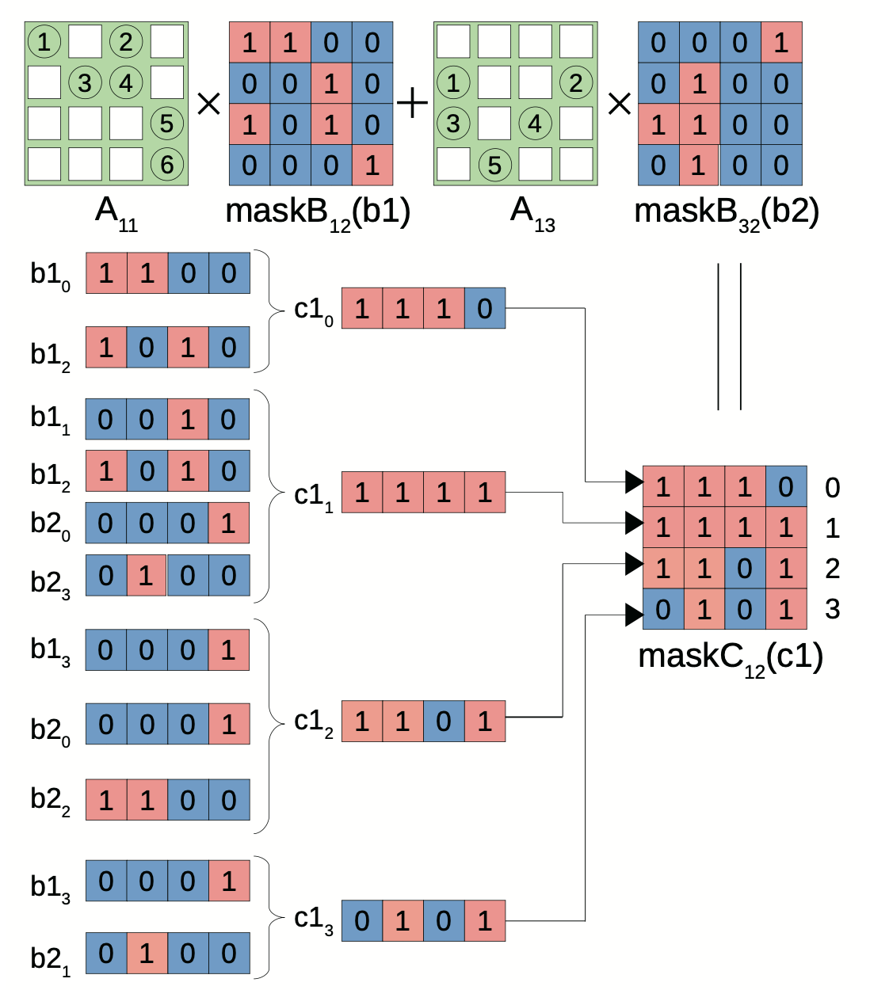
Page 08
All the memory requirements are well bounded to no larger than 256 nonzeros and can be completed using on-chip memory. Therefore, we do not allocate any intermediate arrays in global memory, which helps save overall space overhead.

Slide 11
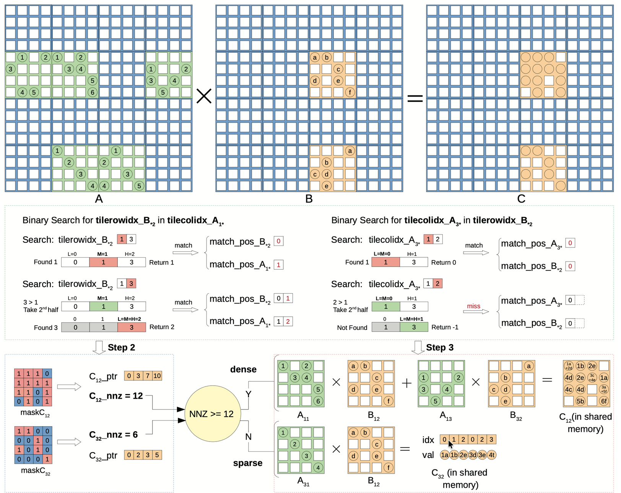
Page 9

Slide 12
Page 10
In our experiments, we observed that the merging primitive tends to be slower compared to the binary search approach for set intersection. Specifically, when dealing with arrays of different sizes, we assign one CUDA thread to perform a binary search for each element of the shorter array within the longer array (as described in lines 6-18 of Algorithm 2) to identify the matching tiles.

Slide 13
Page 11
Step 3 — Numeric Phase (Adaptive Accumulator)
The job: Compute actual float values into positions identified by the mask
Two strategies based on tile density:
Sparse Accumulator (nnz ≤ 192, tile < 75% full)
Mask from Step 2 gives exact column positions upfront
AtomicAdd directly into those known slots — no scanning
Zero wasted work — only nonzero positions touched
Fast because index lookups are cheap at low density
Dense Accumulator (nnz > 192, tile ≥ 75% full) :
Allocate a flat 256-float scratch array in shared memory
Address = row × 16 + col — pure arithmetic, no lookup
After all pairs processed, compress nonzeros → final val[]
Fast because at high density, index overhead outweighs the wasted slots

Slide 14

Experimental Setup
Page 12
Hardware Platform
Algorithms Compared
NVIDIA GPU:
RTX 3060 → 3,584 CUDA cores
CUDA version: 12.8
RowSpGEMM (cuSPARSE)
Dataset
Computation Tasks
16 sparse matrices
From SuiteSparse Collection
Matrix multiplication:
C=A*A
C=A*
Performance Metrics
1
2
3
4
⏱️ Execution Time
🚀 Throughput (FLOPS)
💾 Memory Usage
📈 Runtime Breakdown

Slide 15
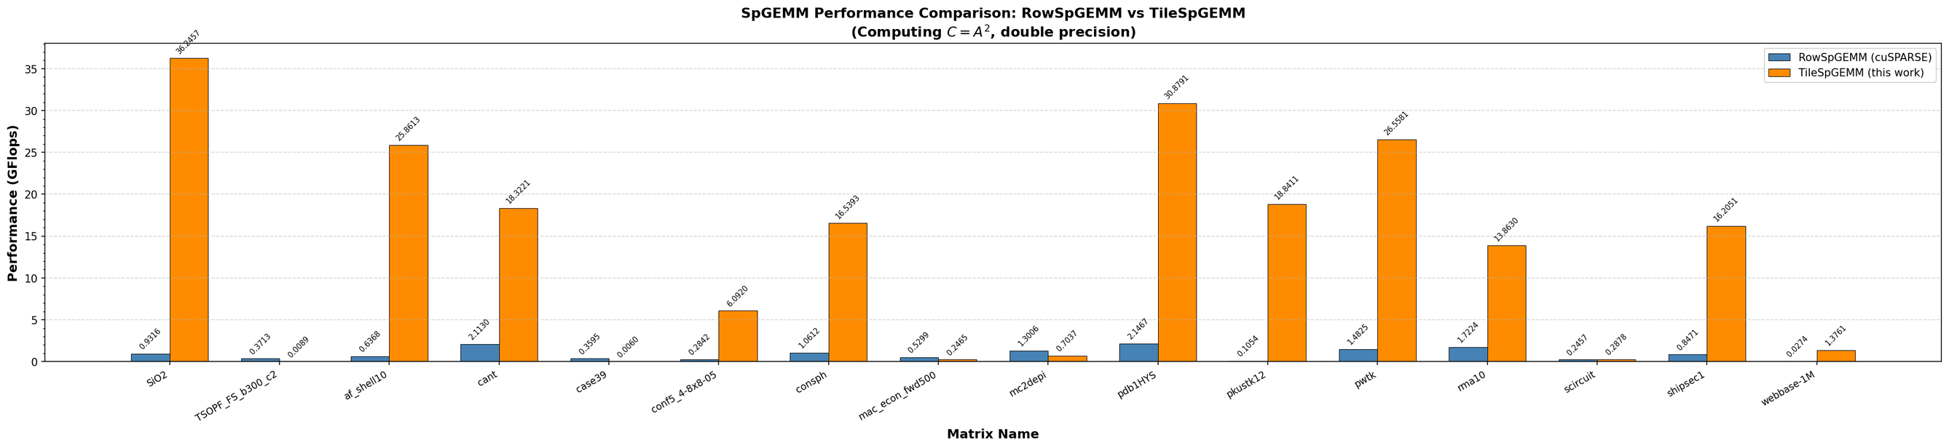
Performance Comparison (GFlops)
Page 13
Fig. 1: SpGEMM throughput (GFlops, double precision, C = A²) comparing RowSpGEMM (cuSPARSE, blue) and TileSpGEMM (orange).
Figure 1 shows GFlops across 16 benchmark matrices. TileSpGEMM outperforms cuSPARSE on 15/16 matrices. Key highlights:
• SiO₂: ≈36.3 GFlops vs ≈0.93 GFlops (~39× speedup). Its very high compression rate (136×) means many intermediate products collapse into few outputs; TileSpGEMM exploits this via tile-level aggregation, while row-wise methods process each product individually.
• pdb1HYS: ≈30.9 vs ≈2.1 GFlops (~15×). A relatively uniform nonzero distribution enables balanced tile workloads.
• pwtk: 36.6 vs 1.4 GFlops (~26× faster).
• webbase-1M: the only case without large gains (≈1.4 vs ≈0.07 GFlops). This power-law graph has extremely sparse tiles (often 1–2 nonzeros), so tile overhead dominates.
Overall, the performance gap increases with compression rate: high-compression matrices benefit most, as tiles aggregate many partial results in fast on-chip memory.

Slide 16
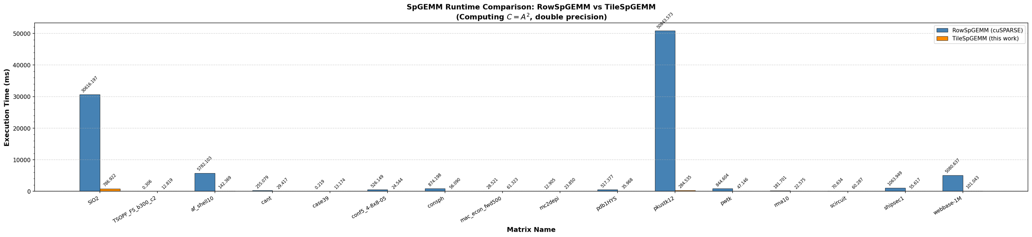
Execution Time Comparison
Page 14
Fig. 2: Total execution time (ms) for RowSpGEMM and TileSpGEMM (C = A², double precision), highlighting large gaps on SiO₂ and pkustk12.
Figure 2 reports absolute runtimes. The row-wise cuSPARSE method takes >30,000 ms for SiO₂ and nearly 50,000 ms for pkustk12, whereas TileSpGEMM finishes in <800 ms and ~285 ms, respectively. The pkustk12 speedup is especially notable: its dense local connectivity (5.4B flops from 7.5M nonzeros) produces very long rows, causing severe load imbalance for row-wise processing but forming compact, balanced tiles for TileSpGEMM.

Slide 17
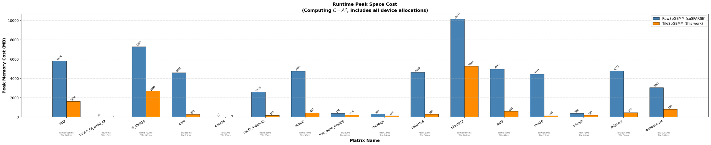
Memory Usage Analysis
Page 15
Fig. 3: Runtime peak memory cost (MB, C = A²) for RowSpGEMM/cuSPARSE (blue) and TileSpGEMM (orange), with execution time (ms) annotated below each bar.
Figure 3 shows peak device memory usage. TileSpGEMM consistently uses much less memory than cuSPARSE:
• pkustk12: ≈10,074 MB (cuSPARSE, exceeding a typical 8 GB GPU) vs ≈5,068 MB (~2× lower).
• SiO₂: ≈6,026 MB vs ≈1,634 MB.
• cant: 460 MB vs ≈272 MB.
This advantage comes from avoiding a global intermediate-product buffer. The row-wise method must pre-allocate space for all possible intermediates before knowing the final size, whereas TileSpGEMM keeps intermediates within per-tile shared memory and writes only final outputs to global memory.

Slide 18
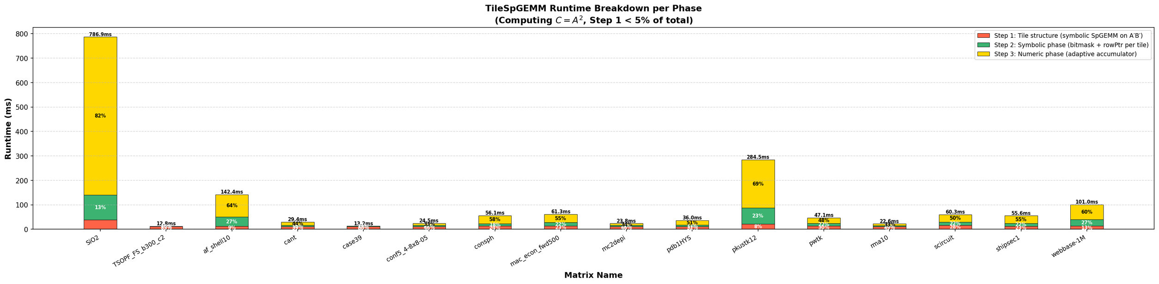
Runtime Breakdown
Page 16
Fig. 4: Absolute runtime breakdown (ms) of TileSpGEMM into Step 1 (tile structure, red), Step 2 (symbolic bitmask, green), and Step 3 (numeric accumulation, yellow), for C = A².

Slide 19
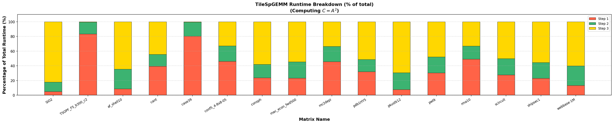
Runtime Breakdown
Page 17
Fig. 5: Percentage runtime breakdown of TileSpGEMM (Step 1 red, Step 2 green, Step 3 yellow).
Figures 4 and 5 break down TileSpGEMM runtime into three stages.
Step 1 (tile structure) is negligible, contributing <5% across all matrices, justifying its offload to NSPARSE without further tuning.
Step 2 (symbolic bitmask phase) typically takes 10–30% of runtime. For high-fanin cases (many tiles per output tile), binary search and bitmask OR dominate. TSOPF_FS_b300_c2 is an outlier (~80%) due to its very high compression rate (66.96×), requiring many tile-pair matches.
Step 3 (numeric phase) dominates most cases (50–82%), as expected for a compute-bound kernel. The adaptive accumulator mitigates cost: dense tiles use a 256-element shared-memory buffer (avoiding atomics), while sparse tiles use index-based scatter accumulation. For SiO₂, ~82% of its 787 ms runtime lies in Step 3, where most of the 28.5B floating-point operations occur.

Slide 20
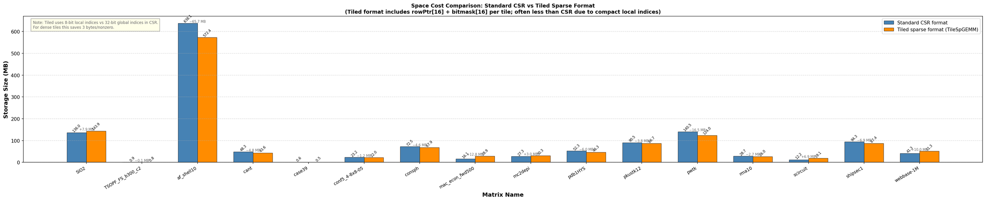
Tiled Format Storage Overhead vs. CSR
Page 16
Fig. 6: Storage size comparison between standard CSR format (blue) and the TileSpGEMM tiled sparse format (orange) for input matrices.
Values annotated in MB.
Figure 6 compares the static storage size of the tiled format with standard CSR. For most matrices, the tiled format is equal to or smaller than CSR, mainly because local tile indices use 8 bits instead of 32-bit global CSR column indices, saving ~3 bytes per nonzero in dense tiles.
The exception is af_shell10, where the tiled format is somewhat larger (≈638 MB vs ≈572 MB for CSR). This matrix contains many sparsely filled tiles, so overhead from per-tile metadata (rowPtr ~16 bytes and mask ~32 bytes) becomes significant when occupancy is low.
Overall, the tiled format remains competitive with CSR in static size, while its peak runtime memory advantage (Section V-C) is significant regardless of this overhead.

Slide 21
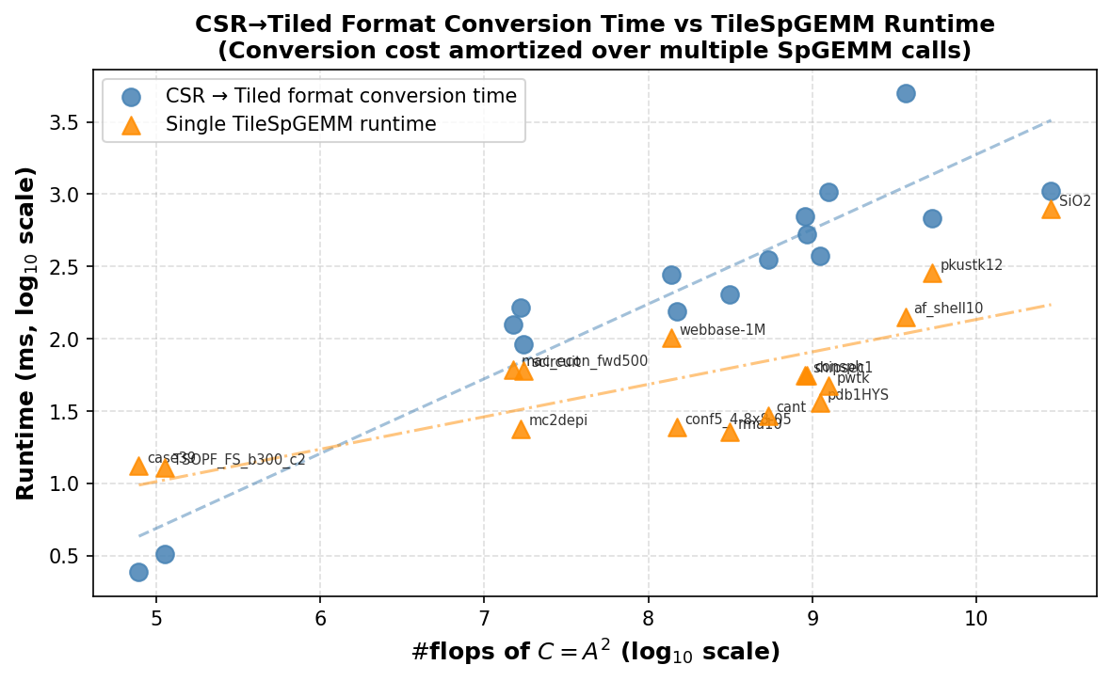
Format Conversion Cost Amortisation
Page 16
Figure 7 plots the one-time CSR-to-tiled format conversion cost against a single SpGEMM invocation time, both on a log10 scale. The conversion cost is generally 2–10× the SpGEMM runtime, meaning the tiled format break-even point is reached after 2–10 SpGEMM calls on the same matrix. In iterative solvers (e.g., AMG), the same matrix may be multiplied hundreds of times, fully amortising the conversion overhead. For single-shot computations, the overhead may not be warranted for small matrices (below 107 flops), but becomes negligible at larger scales.
Fig. 7: CSR→Tiled conversion time (blue circles) vs. single TileSpGEMM runtime (orange triangles) on a log10 scale vs. #flops of C = A².

Slide 22
Scalability & Limitations
Page 17
•Slightly lower scaling due to memory overhead
•Overhead of converting a CSR matrix to
tiled data structure
•Very sparse matrices reduce performance
•Tile management overhead exists
•Best overall performance across datasets
•Efficient memory usage and load balancing

Slide 23
Conclusion
Page 18
•TileSpGEMM: Tiled SpGEMM using sparse tiles (not rows)
•Solves: Load imbalance, high memory use, inefficient accumulators
•Design: Tiled structure + 3-step algorithm
•Performance: Faster, scalable, handles large matrices
•Memory: Lower usage, shared memory, better locality

Slide 24

Page 19
Thank You
Questions ?

