Slide 1
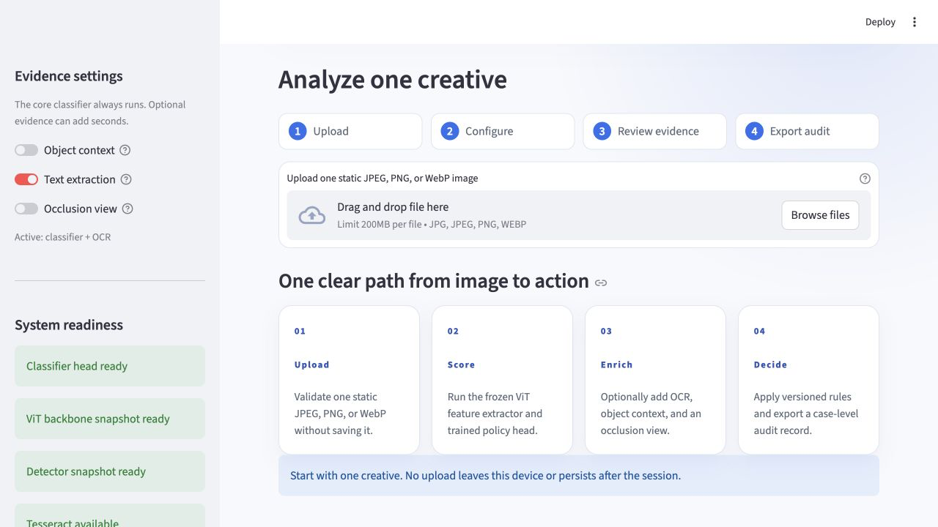
01 / 15
AD SAFETY STUDIO
Ad safety moderation:
what the pilot showed
97.9%
macro F1 on 48 held-out images
55.5%
macro F1 on the external check
Our conclusion
Keep a reviewer in control. The demo can triage cases, but it should not decide cases on its own.
Upload → evidence → decision → audit
Notes:
Presenter: Swarnaditya Maitra
Target time: 45 seconds
Key message: The demo can help reviewers sort cases, but the external check shows that it is not ready to decide cases on its own.
[Speaker script]
Good afternoon. We built Ad Safety Studio to help a reviewer sort image-based ads, not to replace a policy decision. The model scored 97.9 percent macro F1 on our 48-image held-out test, but only 55.5 percent on a small external check. That gap is the main result. The app works, keeps the evidence beside the decision, and can support a first-pass review. It is not ready for autonomous enforcement. I will introduce the team first, then frame the problem we set out to solve.
[Sources]
- Project-relative: outputs/evaluation/metrics.json
- Project-relative: outputs/evaluation/external_spot_check.json
- Project-relative: outputs/app/app_shell.png
- Project-relative: outputs/app/browser_validation.json
- https://support.google.com/adspolicy/answer/6008942

Slide 2
02 / 15
Meet the team
Four consecutive speaker blocks, with the shared app demonstration opening the final block.
1-4
5-8
9-12
13-15
Swarnaditya Maitra
Vijay Agnihotri
Myetchae Thu
Bickramjit Basu
Opening, problem, and scope
Data, system, and method
Prior work, results, and external check
App, controls, and next steps
Team demo
All four members contribute. Swarnaditya shares the screen while each person explains their part.
Notes:
Presenter: Swarnaditya Maitra
Target time: 35 seconds
Key message: The team presents in four consecutive speaker blocks, with the working app demonstration opening the final block.
[Speaker script]
There are four of us, and each person owns one continuous part of the story. I am Swarnaditya, covering the opening, problem, and scope. Vijay covers the data, system, and evaluation method. Myetchae covers prior work, results, and the external check. Bickramjit leads the working app, controls, and next steps. During the app demo, I will share the screen and all four of us will explain the part we worked on. Let me start with the review problem.
[Sources]
- Project-relative: README.md
- Project-relative: scripts/build_presentation.mjs

Slide 3
03 / 15
Ambiguous ads are hard to review consistently
BUSINESS PROBLEM
An image may contain an obvious object, small text, or context that is easy to miss. Our prototype helps reviewers sort cases consistently and sends uncertain cases to a person.
PRIORITY
CONSISTENCY
CONTEXT
Move likely high-risk images to the front of the queue.
Apply the same first-pass review to every image.
Send questions that pixels cannot answer to a reviewer.
Notes:
Presenter: Swarnaditya Maitra
Target time: 40 seconds
Key message: The product goal is triage consistency, not a claim that one image can establish legality or fraud.
[Speaker script]
Ad review is difficult because one creative can mix several kinds of evidence. A weapon may be obvious, important text may be small, and context can change what an image means. Our goal was not to replace a policy reviewer. We wanted to help a queue move faster, apply the same first-pass process to every image, and send uncertain cases to a person. That first-pass goal also sets the boundary for what the prototype can and cannot decide.
[Sources]
- https://support.google.com/adspolicy/answer/6008942
- https://github.com/InteractiveAdvertisingBureau/Taxonomies/releases
- Project-relative: README.md

Slide 4
04 / 15
Four labels are not a full ad policy
IN SCOPE
Safe · firearms · explosives · financial-promotion cues. The last label means visible promotion, not fraud or illegality.
DECISION LAYER
APPROVE · REVIEW · BLOCK. Financial cases always route to review. Restricted classes require calibrated evidence.
OUT OF SCOPE
Explicit content, general violence, alcohol, tobacco, landing pages, age, geography, legality, and advertiser identity.
MODEL PREDICTS
POLICY ROUTES
REVIEWER / FUTURE
Notes:
Presenter: Swarnaditya Maitra
Target time: 45 seconds
Key message: The current prototype covers four visual labels and three workflow outcomes; it does not cover the full ad policy surface.
[Speaker script]
We deliberately kept the scope narrow: safe, firearms, explosives, and visible financial-promotion cues. The financial label does not mean fraud or illegality. It means the image appears promotional, so our rules always send it to review. For the other labels, a readable policy file maps evidence to approve, review, or block. We do not cover landing pages, advertiser identity, geography, age rules, alcohol, tobacco, or the rest of the ad-policy surface. This is a triage prototype, not a complete policy engine. That is the boundary of the prototype. Vijay will now show the data and how we protected the evaluation.
[Sources]
- Project-relative: configs/policy.yaml
- Project-relative: README.md
- https://support.google.com/adspolicy/answer/6008942
- https://github.com/InteractiveAdvertisingBureau/Taxonomies/releases

Slide 5
05 / 15
Balanced counts, unbalanced sources
288 JPEG images
48 / 12 / 12 per class for train · validation · final test.
215 source groups
Campaign and source groups stay inside one split; exact hashes do not overlap.
Source shortcut risk
ADautoGen supplies Safe, project-generated creatives supply Finance, and Weapons Set 1 supplies both weapon classes.
Notes:
Presenter: Vijay Agnihotri
Target time: 45 seconds
Key message: The split is leakage-aware, but the label-to-source mapping still creates a shortcut risk.
[Speaker script]
The pilot contains 288 JPEG images. Every class has 48 training images, 12 validation images, and 12 final test images. We also kept each of the 215 source groups inside one split and checked that file hashes do not overlap. That reduces leakage, meaning the same campaign or exact image cannot appear on both sides of the evaluation. The weakness is source diversity. Safe and financial images are synthetic, while both weapon classes come from one weapons dataset. The counts are balanced, but the visual sources are not. The next slide makes that problem visible.
[Sources]
- Project-relative: data/capstone_registry.csv
- Project-relative: outputs/evaluation/split_summary.csv
- https://huggingface.co/datasets/EthanGabis/ADautoGen-DS
- https://huggingface.co/datasets/rajshivanshuu/weapons_set1

Slide 6
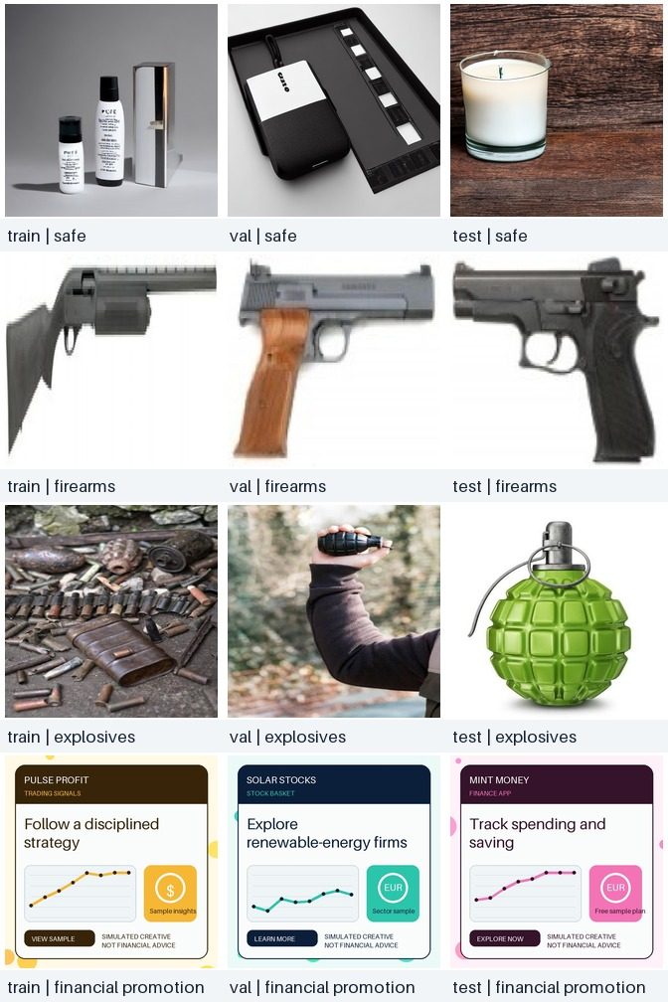
06 / 15
The model can learn source style, not policy meaning
WHAT THE CONTACT SHEET REVEALS
Safe images look like generated product scenes. Weapon images are often isolated objects. Finance images reuse synthetic layouts. Risk: the classifier may learn visual source style instead of the intended policy category.
Notes:
Presenter: Vijay Agnihotri
Target time: 40 seconds
Key message: The contact sheet makes the confounding visible: source style and class are tightly linked despite group-safe splitting.
[Speaker script]
The contact sheet shows the shortcut risk more clearly than a metric can. Safe images look like generated product scenes. Weapon images are often isolated objects. Financial images repeat synthetic layouts. Even with a clean group split, a classifier can learn the look of the source instead of the policy concept itself. That does not make the formal result useless, but it limits the claim to this pilot domain. That risk shaped both our model design and how cautiously we read the results.
[Sources]
- Project-relative: outputs/evaluation/dataset_contact_sheet.jpg
- Project-relative: data/capstone_registry.csv
- Project-relative: outputs/evaluation/split_summary.csv

Slide 7
07 / 15
How the system reaches a decision
1 · ANALYZE
PyTorch and timm run a frozen ViT. Grounding DINO and Tesseract add optional object and text evidence.
2 · REVIEW
FastAPI coordinates the services. Streamlit shows scores, boxes, text, timing, and the uploaded case.
3 · DECIDE
A versioned YAML policy returns APPROVE, REVIEW, or BLOCK and saves a JSON audit record. Runs locally on CPU.
MODELS
LOCAL APPLICATION
POLICY + AUDIT
Notes:
Presenter: Vijay Agnihotri
Target time: 50 seconds
Key message: The local stack keeps model, detector, OCR, policy, and audit evidence separate so a reviewer can inspect each contribution.
[Speaker script]
The system runs locally and has three parts. PyTorch and timm run a frozen vision transformer, while Grounding DINO and Tesseract add optional object and text evidence. FastAPI coordinates those services, and Streamlit gives the reviewer one workspace for the image, scores, boxes, text, and timing. A versioned YAML policy then returns approve, review, or block with reason codes and a JSON audit record. Keeping the signals separate lets a reviewer inspect what each component contributed. With those components separated, the next step was to train and test the classifier without letting the final test set influence our choices.
[Sources]
- Project-relative: README.md
- Project-relative: src/ad_safety/inference.py
- Project-relative: configs/policy.yaml
- https://huggingface.co/IDEA-Research/grounding-dino-tiny
- https://github.com/tesseract-ocr/tesseract

Slide 8
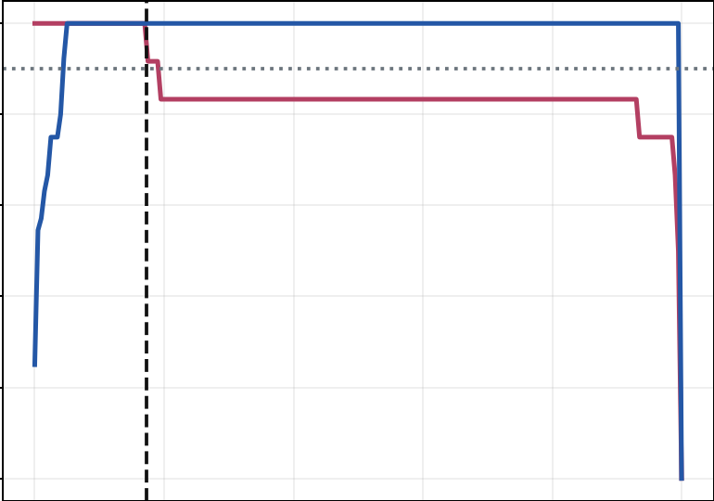
08 / 15
We kept the test set out of training and tuning
Explosives validation threshold
Blue: precision | Red: recall | Dashed: selected threshold
METHOD
1 Freeze ViT and ResNet-50 because the dataset is small 2 Fit logistic heads on train embeddings 3 Select thresholds on validation only 4 Run one final evaluation on 48 test images 5 Benchmark warm batch-1 CPU
Selected threshold 0.173 | 100% precision and recall
Notes:
Presenter: Vijay Agnihotri
Target time: 50 seconds
Key message: Model selection and threshold calibration use validation data only; the final 48-image test remains untouched until evaluation.
[Speaker script]
Because the dataset is small, we froze the ViT and ResNet-50 backbones instead of fine-tuning millions of weights. We then trained small logistic classifiers on training embeddings. We chose class thresholds only with the validation split. The 48-image test split was not used to train, choose a model, or tune a threshold, and we ran the final evaluation after those choices were locked. The chart shows the validation-only explosives threshold, about 0.173, with recall and precision both at 100 percent on that small validation sample. That gives us a controlled evaluation. Myetchae will now connect the design to prior work and walk through the results.
[Sources]
- Project-relative: scripts/train_and_evaluate.py
- Project-relative: outputs/evaluation/threshold_calibration.png
- Project-relative: outputs/evaluation/thresholds.csv
- Project-relative: outputs/evaluation/evaluation_manifest.json
- https://huggingface.co/timm/vit_base_patch16_224.augreg2_in21k_ft_in1k
- https://huggingface.co/timm/resnet50.a1_in1k

Slide 9
09 / 15
What prior research contributed
WHAT THE RESEARCH CONTRIBUTED
Prior work guided the model design. Our held-out evaluation provides the performance evidence for this four-label task.
ViT
DINO
OCR + RULES
Dosovitskiy et al. (2021): transferable whole-image features.
Liu et al. (2023): open-vocabulary object localization.
Tesseract OCR + YAML rules: text evidence and traceable decisions.
Notes:
Presenter: Myetchae Thu
Target time: 40 seconds
Key message: The literature justifies the selected mechanisms, but it does not transfer benchmark performance to our dataset or policy task.
[Speaker script]
Prior work helped us choose credible building blocks. The Vision Transformer paper supports transferable whole-image features. Grounding DINO supports text-guided object localization, and Tesseract provides visible-text extraction. We did not find an outside benchmark directly comparable to our four-label policy task. Those papers guided our choices; the performance numbers come from our own evaluation. With that distinction clear, we can look at what the evaluation actually found.
[Sources]
- https://arxiv.org/abs/2010.11929
- https://arxiv.org/abs/2303.05499
- https://huggingface.co/IDEA-Research/grounding-dino-tiny
- https://github.com/tesseract-ocr/tesseract
- https://huggingface.co/timm/vit_base_patch16_224.augreg2_in21k_ft_in1k

Slide 10
10 / 15
Better accuracy came with recall and speed trade-offs
SAFE CLASS
100% precision on the held-out test. Our goal was above 98%.
Held-out macro F1 | 48 images
97.9%
87.3%
RESTRICTED RECALL
Firearms 91.7% · explosives 91.7%. Our goal was above 95% for each class.
CLASSIFIER-PATH P95
ViT 71.5 ms · ResNet 40.1 ms. Full-pipeline timing remains unknown.
Notes:
Presenter: Myetchae Thu
Target time: 65 seconds
Key message: ViT leads the ResNet baseline on the held-out test, but firearms and explosives fall below our 95 percent recall goal, and ViT exceeds the 50 ms classifier-path latency budget. Full end-to-end p95 remains unmeasured.
[Speaker script]
On the untouched 48-image test, ViT reached 97.9 percent macro F1, compared with 87.3 percent for the ResNet-50 baseline. Safe precision was 100 percent, so it met our target, and none of the 12 safe test images crossed into a restricted class. The caveat is recall. At the operating thresholds, firearms and explosives each reached 91.7 percent recall, below our goal of more than 95 percent for every restricted class. Speed also favors ResNet. ViT classifier-path p95 was 71.5 milliseconds, above the 50-millisecond budget, while ResNet was 40.1. This benchmark excludes decoding, OCR, detection, network time, and rendering, so full end-to-end p95 is still unknown. The next slide shows the one classification error behind those results.
[Sources]
- Project-relative: Capstone Project Idea - Ad Safety.pdf
- Project-relative: outputs/evaluation/metrics.json
- Project-relative: outputs/evaluation/model_comparison.csv
- Project-relative: outputs/evaluation/model_comparison.png
- Project-relative: outputs/evaluation/latency.json
- Project-relative: outputs/evaluation/thresholds.csv

Slide 11
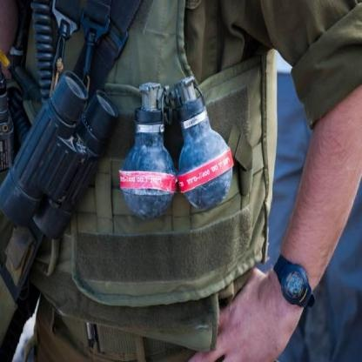
11 / 15
One error is why a reviewer stays in control
THE FORMAL ERROR
A grenade labeled explosives was classified as a firearm. Neither score crossed its class-specific block threshold, so the policy returned REVIEW. The optional detector still found restricted-object cues.
47 / 48
labels correct
Truth: explosives | Model: firearms | Policy: REVIEW
Notes:
Presenter: Myetchae Thu
Target time: 45 seconds
Key message: The only wrong class label went to REVIEW, but it still exposes fragile separation between firearms and explosives.
[Speaker script]
The formal test had one wrong class label. A grenade image labeled explosives was predicted as firearms, while the other 47 labels were correct. Its firearm and explosive scores did not cross either class-specific block threshold, so the saved policy result was REVIEW rather than an automatic block or approval. The optional detector found restricted-object cues, but the class separation was still fragile. The bigger question is whether the same system holds up when the images stop looking like our pilot sources.
[Sources]
- Project-relative: outputs/evaluation/per_class_metrics.csv
- Project-relative: outputs/evaluation/failure_cases.csv
- Project-relative: outputs/evaluation/confusion_matrix_vit.png
- Project-relative: data/capstone_dataset/test/explosives/explosives-a847a50b677d3214.jpg

Slide 12
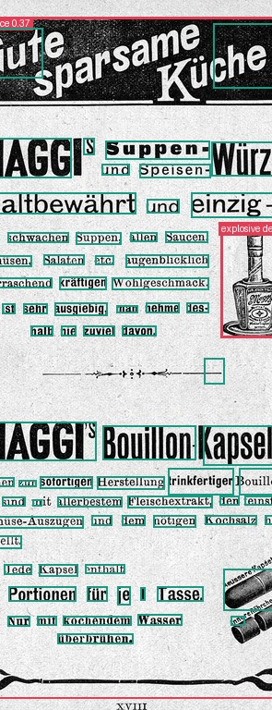
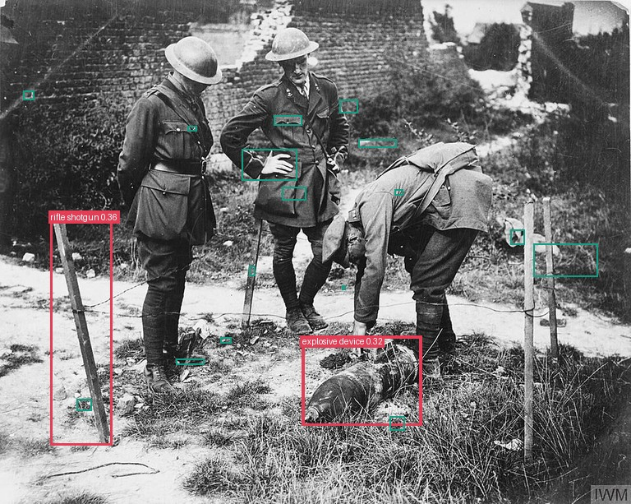
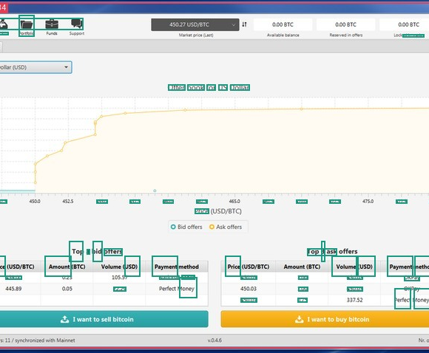
12 / 15
Outside the pilot data, performance fell sharply
OUT-OF-DOMAIN CHECK | 26 IMAGES
55.5% classifier macro F1 90.0% nonweapon false detections The images use different layouts, languages, ages, and photographic contexts. This small selected check is a warning, not a formal test set or population estimate.
EXPLOSIVES → SAFE
SAFE → BLOCK
FINANCE OK · FALSE BOX
Notes:
Presenter: Myetchae Thu
Target time: 60 seconds
Key message: In the small selected Wikimedia diagnostic, macro F1 falls to 55.5 percent and 90 percent of nonweapon images receive a false detector signal.
[Speaker script]
The external check used 26 manually reviewed Wikimedia images for diagnosis, not as a second formal test set. Macro F1 fell to 55.5 percent. At the current detector threshold, 90 percent of the nonweapon images in this small sample received a false detector signal. The examples show the pattern: a historical safe ad was blocked, one explosives image was classified as safe, and a financial example received a false box even though its policy route remained review. The sample is small and selected, so this is not a population estimate. It is still enough to show that the formal score does not generalize reliably. Bickramjit will now move to the working app and the controls needed before a pilot.
[Sources]
- Project-relative: outputs/evaluation/external_spot_check.json
- Project-relative: outputs/evaluation/external_spot_check.csv
- Project-relative: outputs/evaluation/external_annotated
- https://www.mediawiki.org/wiki/API:Imageinfo
- https://commons.wikimedia.org/wiki/Commons:Reusing_content_outside_Wikimedia

Slide 13
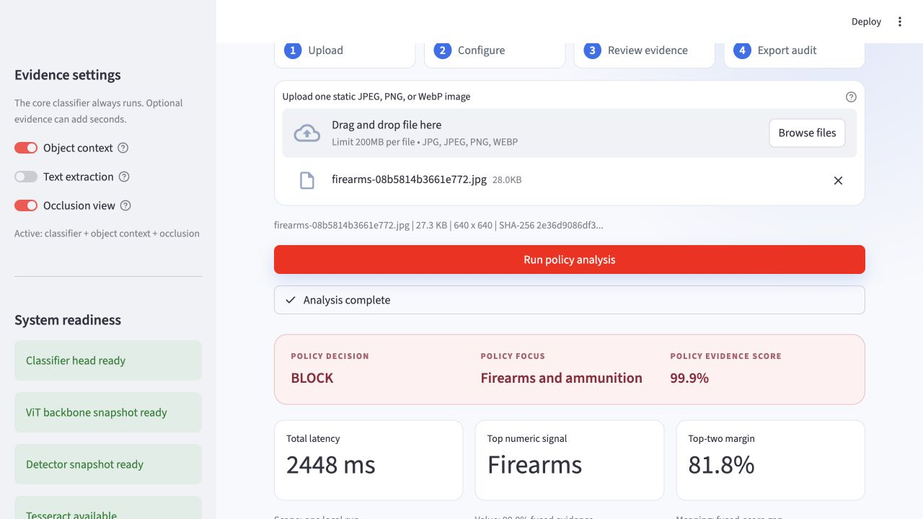
13 / 15
From upload to audit in one workspace
TEAM DEMO
1 Run the case
Swarnaditya shares the screen.
2 Review evidence
Vijay and Myetchae explain scores and policy.
3 Export the record
Bickramjit explains the audit trail.
Session charts summarize today's cases, not production performance.
Notes:
Presenter: Full team (Bickramjit Basu leads; Swarnaditya Maitra shares the screen)
Target time: 75 seconds
Key message: All four team members demonstrate the workflow while the decision, evidence, timing, and audit record remain visible together.
[Speaker script]
Bickramjit: The working app keeps one case in one place. Swarnaditya is sharing the screen and will run the example. Swarnaditya: I will upload the firearm image, keep the optional detector and occlusion view enabled, and start the analysis. Vijay: The results separate classifier scores from fused scores and show how long each stage took, so we can see what changed instead of relying on one final label. Myetchae: The policy turns that evidence into BLOCK, REVIEW, or APPROVE with reason codes, and the audit export records hashes, model versions, options, and thresholds. Bickramjit: The timing shown here is one app run, not the repeated classifier-only benchmark. The session charts summarize only the cases reviewed today. That brings us to the controls we still need.
[Sources]
- Project-relative: app.py
- Project-relative: api.py
- Project-relative: outputs/app/browser_validation.json
- Project-relative: outputs/app/app_firearm_result.png
- Project-relative: src/ad_safety/inference.py

Slide 14
14 / 15
What must change before a pilot
THREE GAPS
Before a pilot, we need to address source-biased data, noisy detections, and missing full-pipeline performance measurements.
DATA
DETECTOR
OPERATIONS
Collect diverse real campaigns and use independent labels instead of source-linked shortcuts.
A 90% false-positive rate on nonweapon images requires local box labels, recalibration, and no detector-only block.
Measure end-to-end p95, concurrency, CPU/GPU load, MPS acceleration, and memory.
Notes:
Presenter: Bickramjit Basu
Target time: 50 seconds
Key message: The main risks are source confounding, an uncalibrated detector, and classifier-only latency evidence. Full end-to-end p95, concurrent throughput, CPU and GPU load, MPS acceleration, and memory use were not measured; each needs an explicit control before a trial.
[Speaker script]
Before a real pilot, we need controls in three areas. For data, we need diverse real campaigns and independent annotation, not source-linked synthetic shortcuts. For the detector, we need local box labels and recalibration, and we should not let the detector block by itself. For operations, we still need full end-to-end p95, concurrent throughput, and CPU, Apple GPU, and memory measurements. These controls reduce the chance of harm, but they do not remove the uncertainty. Our decision is no-go for autonomous use and go only for further human-reviewed validation. Those controls lead directly to the gated plan on the final slide.
[Sources]
- Project-relative: outputs/evaluation/external_spot_check.json
- Project-relative: outputs/evaluation/latency.json
- Project-relative: data/capstone_registry.csv
- Project-relative: README.md

Slide 15
15 / 15
What we would do next: a 10-week plan
WEEKS 1–3 · EVIDENCE
A data lead, policy reviewer, and 2 annotators curate ≥1,000 real ads and lock a campaign-grouped independent holdout.
WEEKS 4–6 · CALIBRATE
1 ML engineer and a reviewer tune against two gates: >0.95 recall per restricted class and <2% Safe crossings.
WEEKS 7–10 · SHADOW PILOT
A product lead, app/MLOps engineer, and reviewer rotation test 10 concurrent requests, end-to-end p95 latency, and resource use.
DATA + POLICY
ML + QA
PRODUCT + OPS
Notes:
Presenter: Bickramjit Basu
Target time: 55 seconds
Key message: This 10-week plan uses explicit evidence, quality, and capacity gates before any human-reviewed pilot.
[Speaker script]
This 10-week roadmap is our proposed next step. In weeks one through three, we would collect at least 1,000 real ads and lock an independent campaign-grouped holdout. In weeks four through six, we would recalibrate and require more than 95 percent recall for every restricted class, with fewer than 2 percent safe crossings. In weeks seven through ten, we would run a shadow, human-reviewed pilot and test 10 concurrent requests with full end-to-end latency and resource tracking. If any gate fails, we stop and fix it before scaling. The prototype is reproducible, but stronger validation must come before autonomous use. Thank you. All four of us are ready for questions.
[Sources]
- Project-relative: README.md
- Project-relative: outputs/evaluation/metrics.json
- Project-relative: outputs/evaluation/external_spot_check.json
- https://support.google.com/adspolicy/answer/6008942

