Slide 1






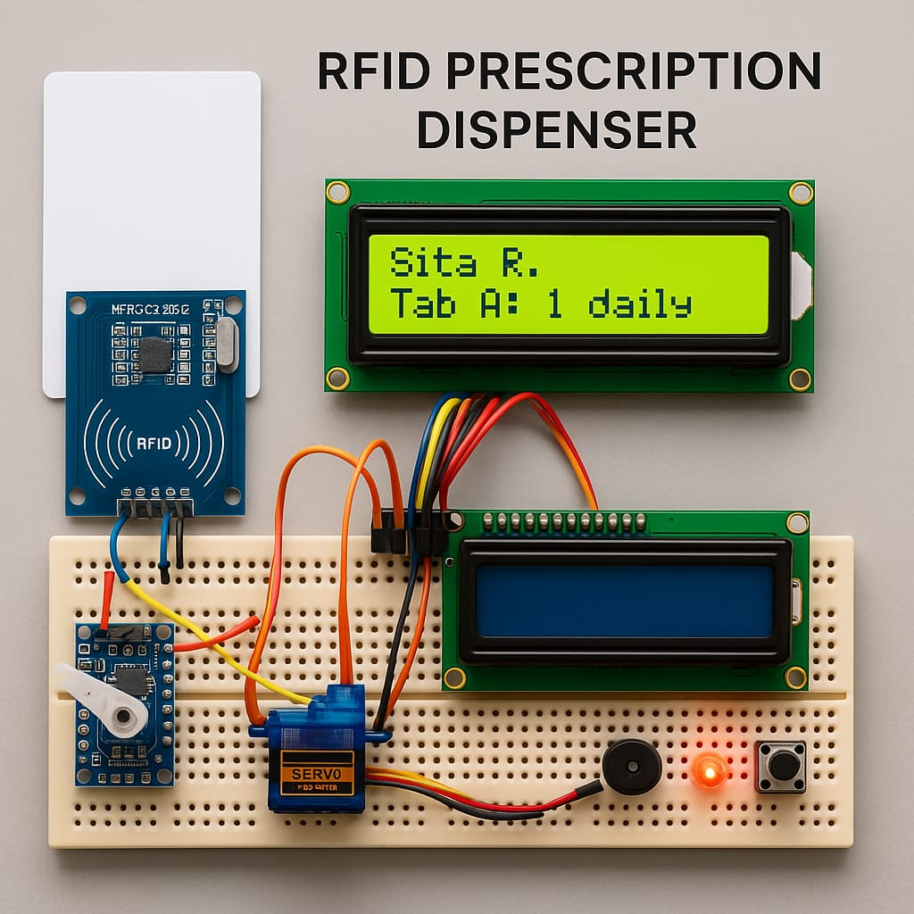
Title of the Project: RFID-based Automated Medicine Dispenser
Category: Software & hardware
Team name: TagTrackers
Team members
PRATIKSHYA PADHY
SHREEJA SWIKRUTI SAHU
SUHANA SAHU
SWARNAPRAVA MOHANTY

Slide 2
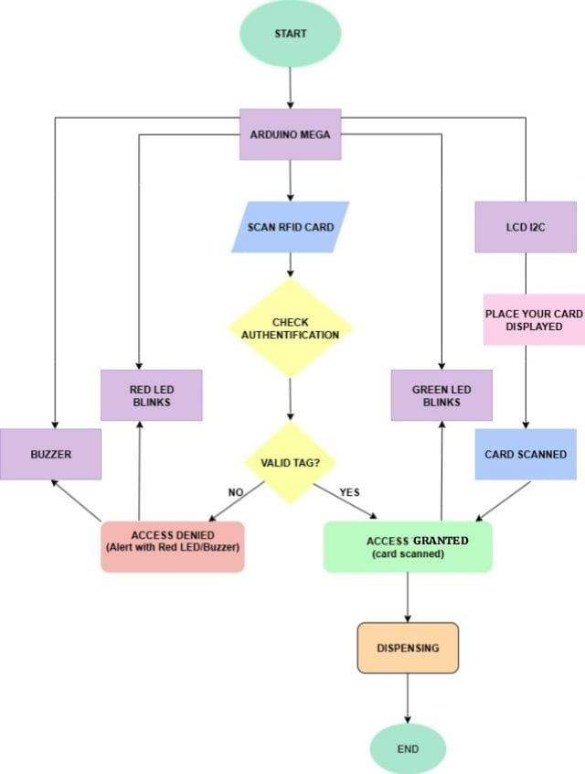
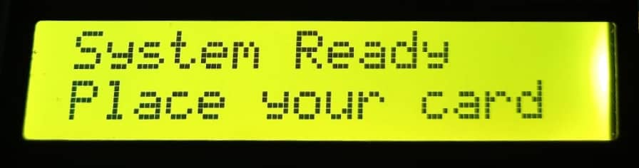
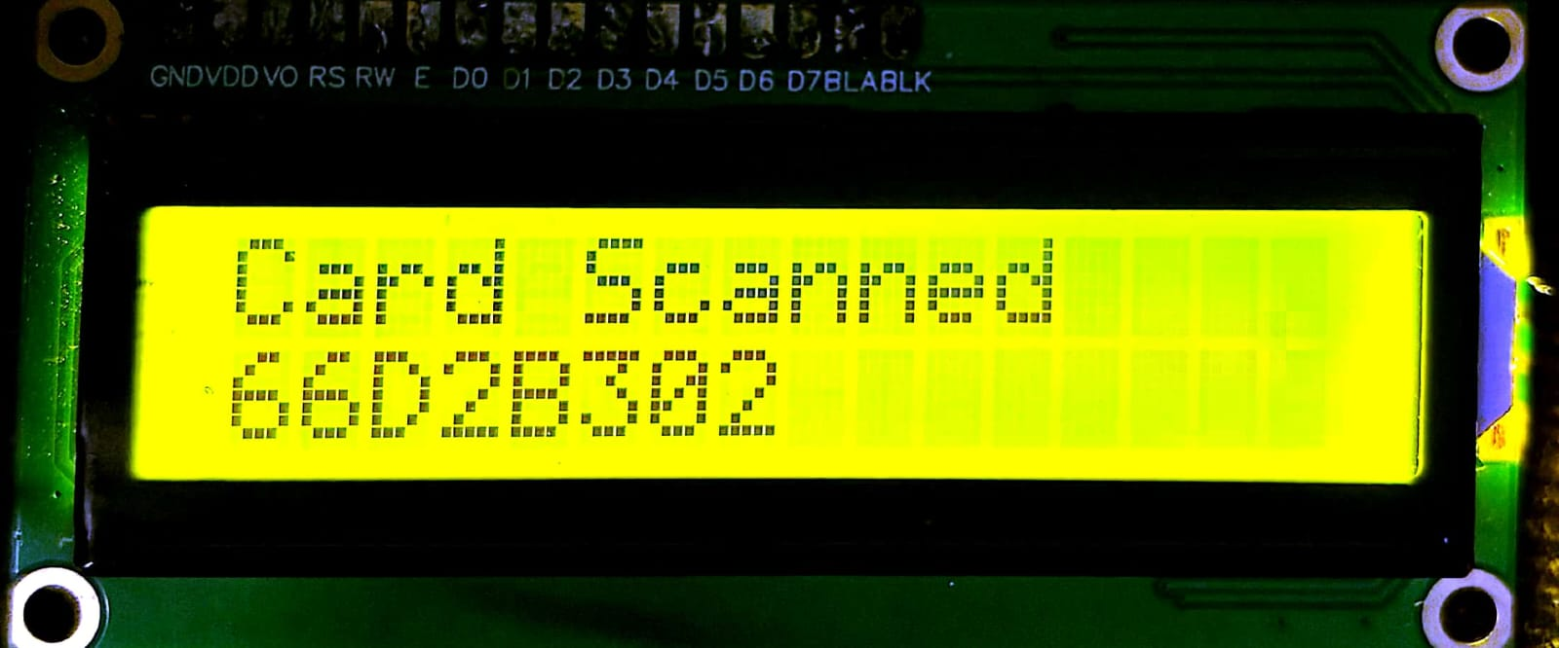
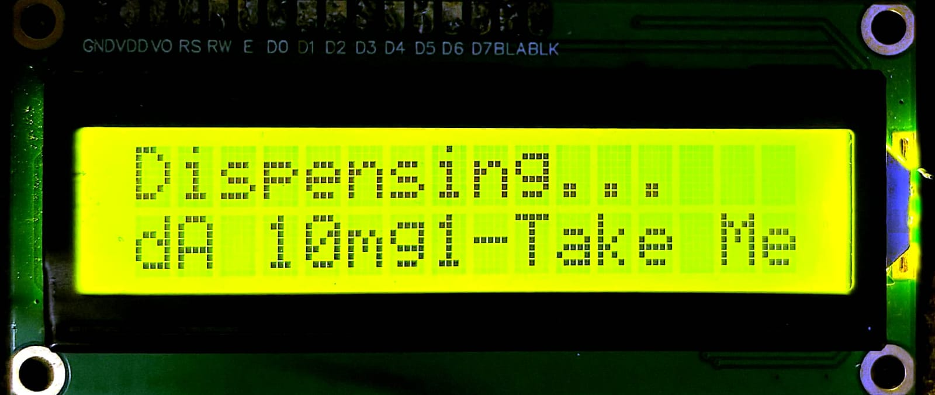
Problem Statement
Manual tracking of prescriptions often results in non-adherence, particularly in elderly or chronically ill patients.
An integrated digital system is needed to log prescriptions, monitor intake, and automate dispensing with real-time alerts and data tracking.
Solution to Problem Statement
RFID Authentication
Automated Dispensing Unit
Microcontroller-Based Control
Novelty of the Project
RFID-Linked Personalized Dispensing
Secure Multi-Patient Management
Automated Dispensing
Low-Cost & Portable Solution
Scalability & Customization

Slide 3
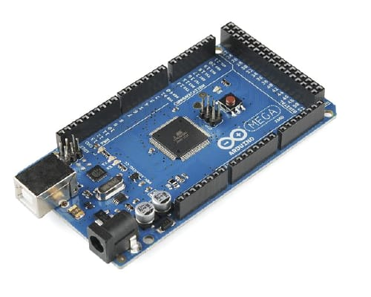
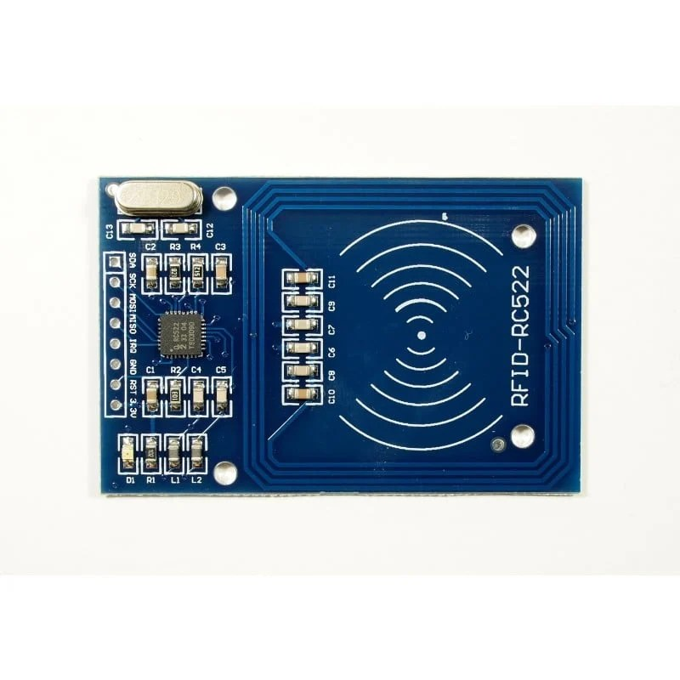
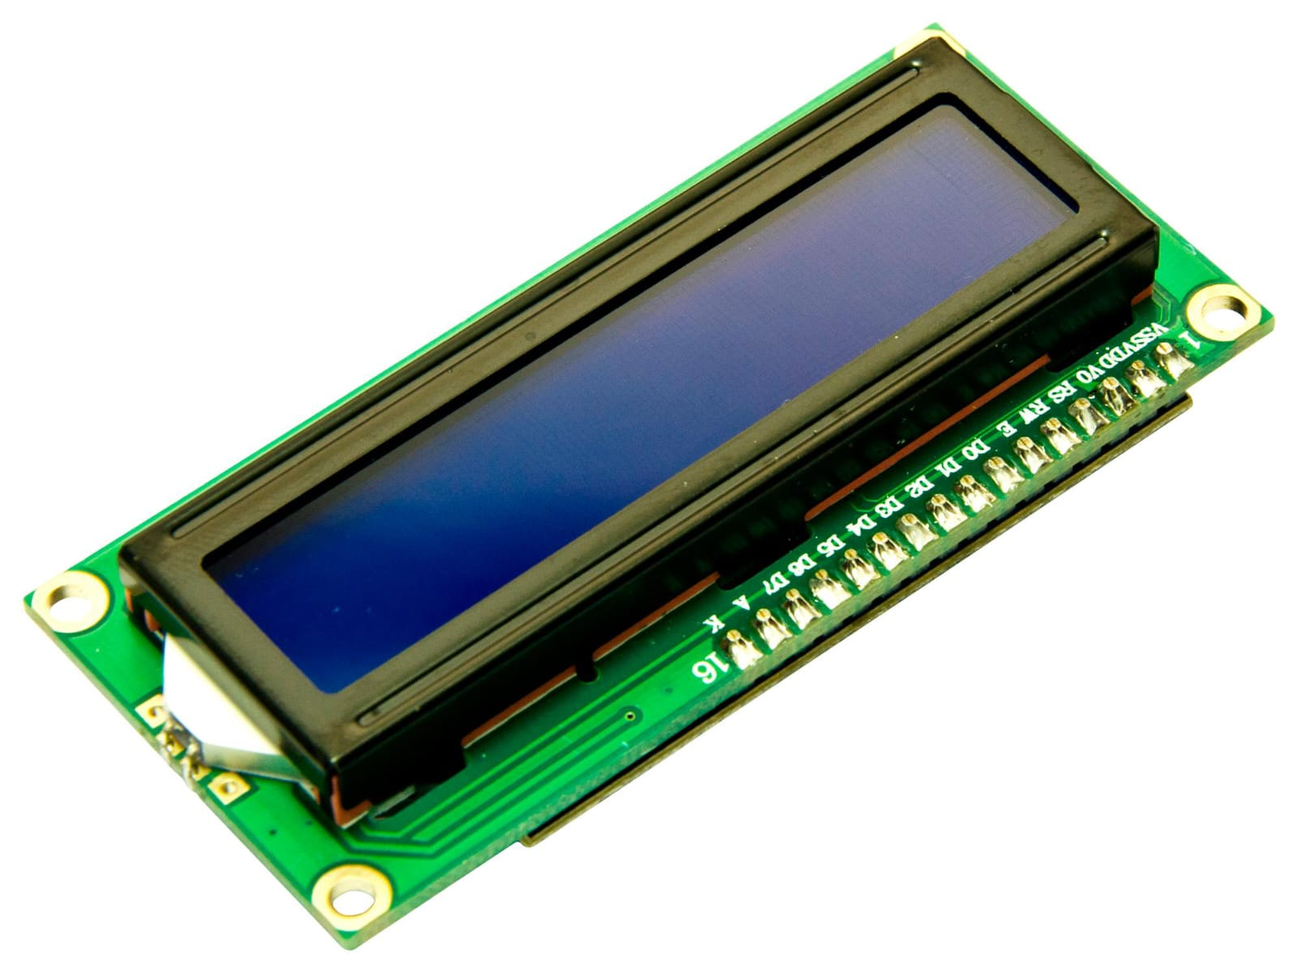
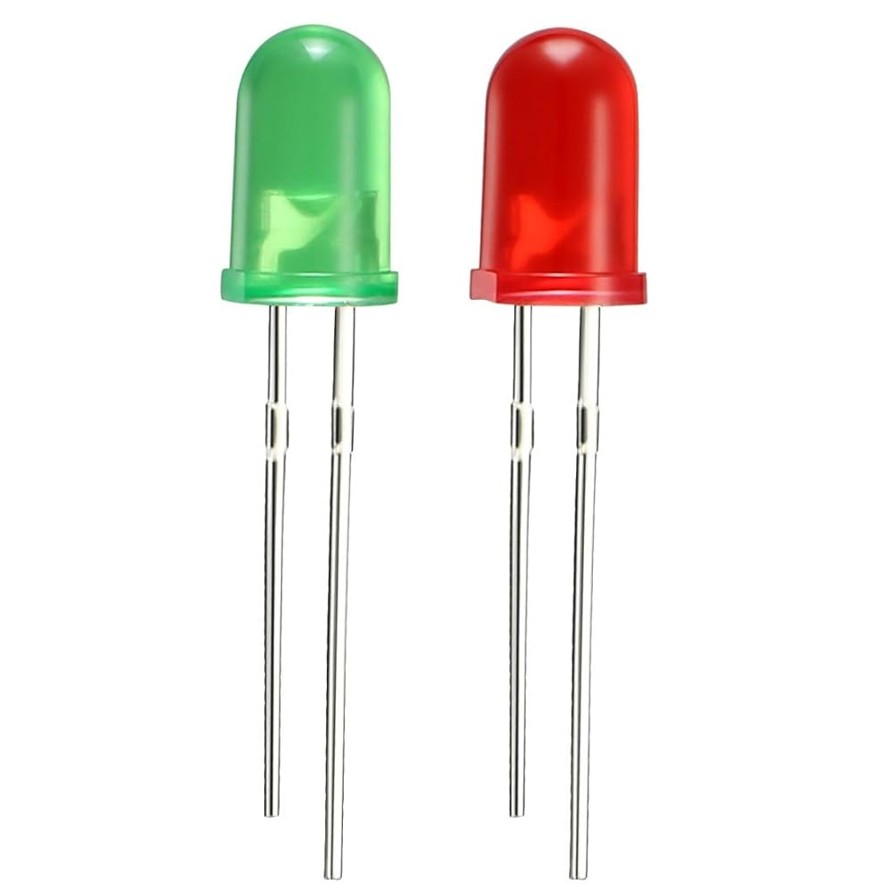
Technical Approach
Hardware:-
RFID READER : Identifies the user through RFID tags to load personalized prescriptions
ARDUINO MEGA: Acts as the central microcontroller to coordinate all hardware operations and data processing.
I2C LCD MODULE: Shows user information like medicine name, dosage, and status updates.
LED: Indicates system status or alerts like successful scans or missed doses.
BUZZER: Provides audio alerts for medicine reminders or errors.
Software:-
ARDUINO IDE: Used to write, compile, and upload the control program to the Arduino Mega.

Slide 4
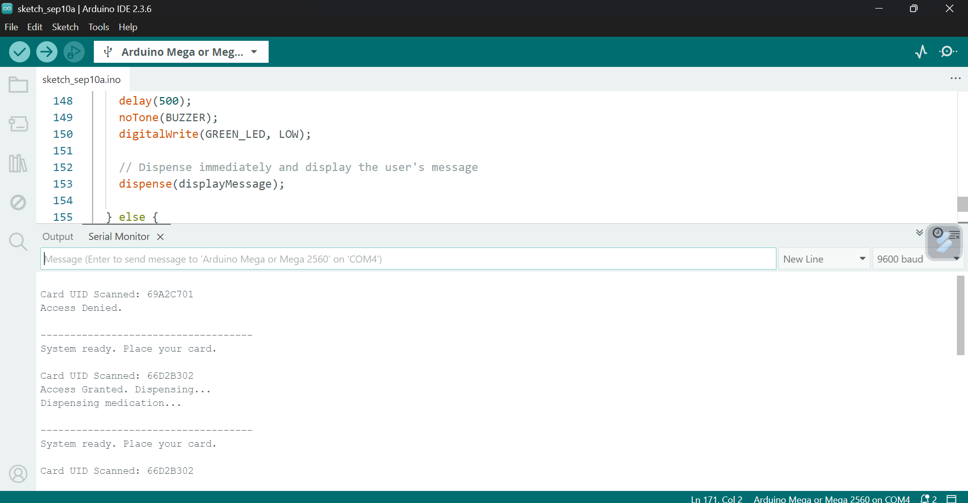
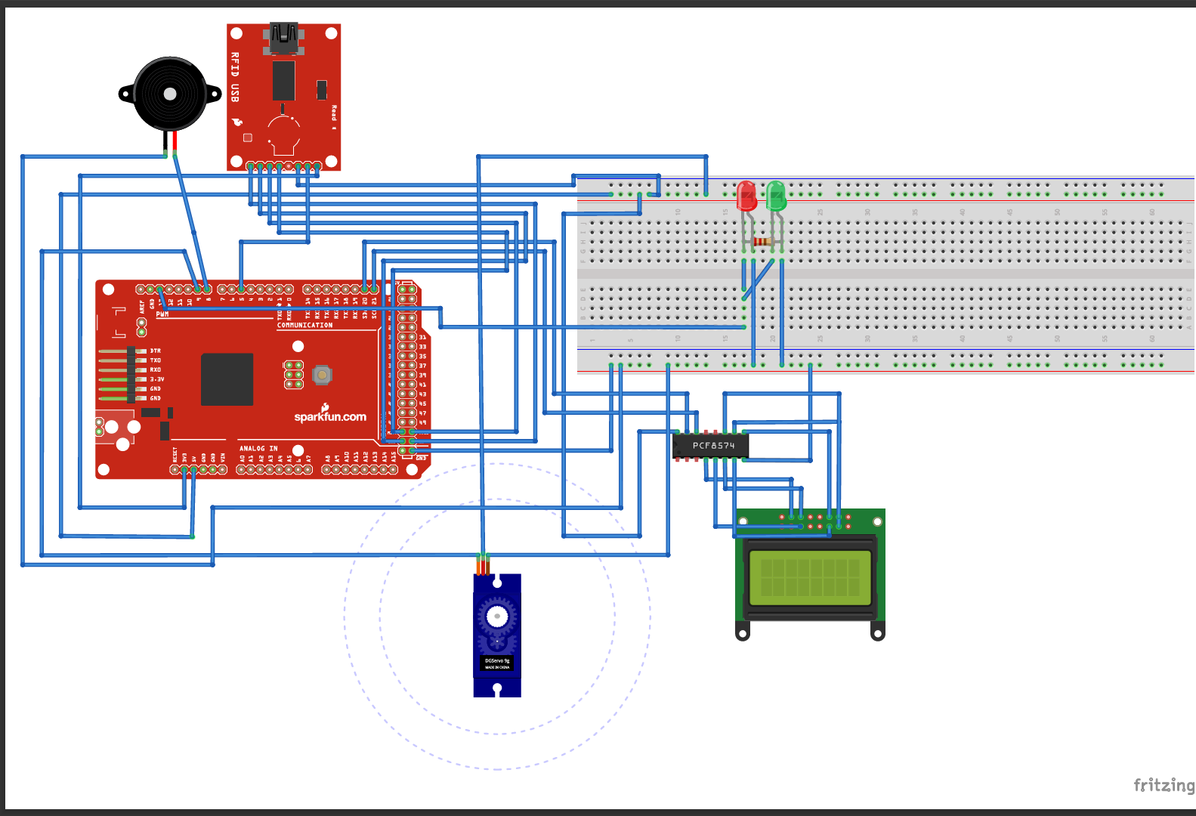
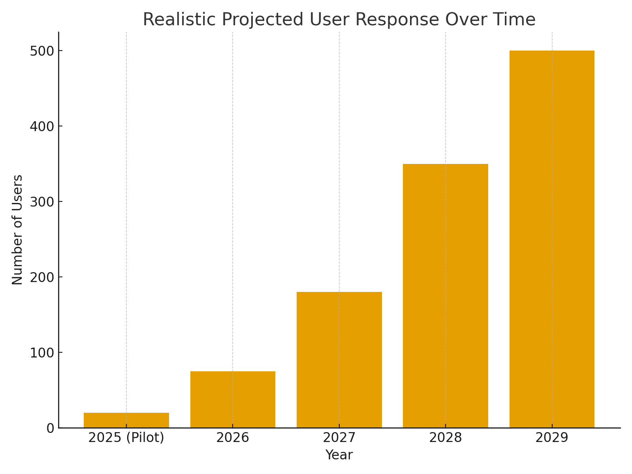
Scalability of the Product
1. Multi-Patient Expansion
2. Integration with Healthcare Systems
3. Cloud Connectivity & Remote Monitoring
4. Flexible Hardware Customization
5. Software Upgradability
Impact
Improved Patient Safety
Enhanced Medication Adherence
Caregiver Support
Data-Driven Healthcare
Benefits
Accessibility & Affordability
Scalability & Future Integration
Environmental & Long-Term
Adaptability
The histogram shows a realistic user adoption trend from 2025 to 2029.
Initial pilot phase starts with 20 users, gradually increasing to 500 by 2029.
Growth reflects practical integration pace in healthcare settings.
Represents steady acceptance and reliability of the system.
Provides a baseline for scaling production and support services.

Slide 5
THANK
YOU

