Slide 1
Lambda Calculus

Slide 2
Acknowledgements
Some slides derived from Dr. Adam Doupe’s slides in Arizona University
Slides based on the 5th chapter Lambda calculus in the book “Formal Syntax and Semantics of Programming Languages - A Laboratory Based Approach", by Kenneth Slonneger and Barry L. Kurtz.

Slide 3
Lambda Calculus
Invented by Alonzo Church in 1930s as a theory of functions that provides rules for manipulating functions in a purely syntactic manner
It has the power to represent all computable functions
Language to express function application
  Ability to define anonymous functions
  Ability to "apply" functions
Functional programming derives from lambda calculus

Slide 4
Syntax
Everything in lambda calculus is an expression (E)
E → v | C | λv.E | E E | (E)

Slide 5
Examples
E → v
E → λ v . E
E → E E
E → (E)
x
λ x . x
x y
λ x . y
λ x . y z

Slide 6
Disambiguation Rules
E → E E is left associative
  x y z is
    (x y) z
  w x y z is
    ((w x) y) z
λ v . E extends as far to the right as possible, starting with the λ v .
  λ x . x y is
    λ x . (x y)
  λ x . λ x . x is
    λ x. ( λ x . x)

Slide 7
Semantics
E → λ v . E is called an abstraction
  The v is the variable of the abstraction (also metavariable)
  E is called the body of the abstraction
E → E E
  This is called an application

Slide 8
Semantics
λ v . E defines a new anonymous function
  This is the reason why anonymous functions are called "Lambda Expressions" in Java 8 (and other languages)
  v is the formal parameter of the function
  E is the body of the function
E → E₁ E₂, function application, is similar to calling function E₁ and setting its formal parameter to be E₂

Slide 9
Currying
Technique to translate the evaluation of a function that takes multiple arguments into a sequence of functions that each take a single argument
Define adding two parameters together with functions that only take one parameter:
  λ x . λ y . ((+ x) y)
  (λ x . λ y . ((+ x) y)) 1
    λ y . ((+ 1) y)
  (λ x . λ y . ((+ x) y)) 10 20
    (λ y . ((+ 10) y)) 20
    ((+ 10) 20) = 30

Slide 10
Evaluating a lambda expression
Evaluating a lambda expression is called reduction.
The basic reduction rule involves substituting expressions for free variables in a manner similar to the way that the parameters in a function definition are passed as arguments in a function call.
e.g. (λ x . ((+ x) 1)) 1 → + 1 1 → 2

Slide 11
Free and Bound Variables
Definition : An occurrence of a variable v in a lambda expression is called bound if it is within the scope of a “λv”; otherwise it is called free.
First occurrence of y is free but the second one is bound.

Slide 12
Bound Variable Rules
If an occurrence of x is free in E, then it is bound by λ x . in λ x . E
If an occurrence of x is bound by a particular λ x . in E, then x is bound by the same λ x . in λ z . E
  Even if z == x
  λ x . λ x . x
    Which lambda expression binds x?
If an occurrence of x is bound by a particular λ x . in E₁, then that occurrence in E₁ is tied by the same abstraction λ x . in E₁ E₂ and E₂ E₁

Slide 13
Examples
(λ x . x (λ y . x y z y) x) x y
  (λ x . x (λ y . x y z y) x) x y
(λ x . λ y . x y) (λ z . x z)
  (λ x . λ y . x y) (λ z . x z)
(λ x . x λ x . z x)
  (λ x . x λ x . z x)

Slide 14
Equivalence
What does it mean for two functions to be equivalent?
  λ y . y = λ x . x ?
  λ x . x y = λ y . y x ?
  λ x . x = λ x . x ?

Slide 15
α-equivalence
α-equivalence is when two functions vary only by the names of the bound variables
E₁ =_{α} E₂
We need a way to rename variables in an expression
  Simple find and replace?
  λ x . x λ y . x y z
    Can we rename x to foo?
    Can we rename y to bar?
    Can we rename y to x?
    Can we rename x to z?

Slide 16
α-reduction - Renaming Operation
λv . E ⇒_{α} λw . E {w/v}
provided w does not occur in E.
The α-reduction rule simply allows the changing of bound variables as long as there is no capture of a free variable occurrence.

Slide 17
Examples
  (λ x . x) {foo/x}
    (λ foo . (foo))
  ((λ x . x (λ y . x y z y) x) x y) {foo/x}?
  α-reduction
  λ y . y = λ x . x ?
  ((λ x . x (λ y . x y z y) x) x y) =
  ((λ y . y (λ z . y z w z) y) y x) ?

Slide 18
α-equivalence
For all expressions E and all variables y that do not occur in E
  λ x . E =_{α} λ y . (E {y/x})
  λ y . y = λ x . x ?
((λ x . x (λ y . x y z y) x) x y) =
((λ y . y (λ z . y z w z) y) y x) ?

Slide 19
Substitution
Renaming allows us to replace one variable name with another
However, our goal is to reduce (λ x . + x 1) 2 to (+ 1 2), which replaces x with the expression 2
  Can we use renaming?
We need another operator, called substitution, to replace a variable by a lambda expression
  E[v→E1], where v and E1 are lambda expressions and v is a name

Slide 20
The notation E[v→E1]
The notation E[v→E1] refers to the lambda expression obtained by replacing each free occurrence of the variable v in E by the lambda expression E1.
Such a substitution is called valid or safe if no free variable in E1 becomes bound as a result of the substitution E[v→E1].

Slide 21
Substitution
Examples
(+ x 1) [x→2]
  (+ 2 1)
(λ x . + x 1) [x→2]
  (λ x . + x 1)
(λ x . y x) [y→ λ z . x z]
  (λ x . (λ z . x z) x)
  (λ w . (λ z . x z) w)

Slide 22
Substitution Operation
E [x→N]
  x [x→N] = N
  y [x→N] = y, if x ≠ y
  (E₁ E₂) [x→N] = (E₁ [x→N]) (E₂ [x→N])
  (λ x . E) [x→N] = (λ x . E)
  (λ y . E) [x→N] = (λ y . E [x→N]) if x ≠ y and y is not a free variable in N
  (λ y . E) [x→N] = (λ y' . E {y'/y} [x→N]) if x ≠ y, y is a free variable in N, and y' is a fresh variable name

Slide 23
Examples
  (λ x . x) [x→foo]
    (λ x . x)
  (+ 1 x) [x→2]
    (+[x→2] 1[x→2] x[x→2])
    (+ 1 2)
  (λ x . y x) [y→λ z . x z]
    (λ x . (y x)){w/x} [y→λ z . x z]
    (λ w . (y w)) [y→λ z . x z]
    (λ w . (y [y→λ z . x z] w [y→λ z . x z])
    (λ w . (λ z . x z) w)

Slide 24
Examples
(x (λ y . x y)) [x→y z]
  (x [x→y z] (λ y . x y) [x→y z])
  ((y z) (λ y . x y) [x→y z])
  (y z) (λ q . (x y){q/y}[x→y z])
  (y z) (λ q . (x q)[x→y z])
  (y z) (λ q . ((y z) q))

Slide 25
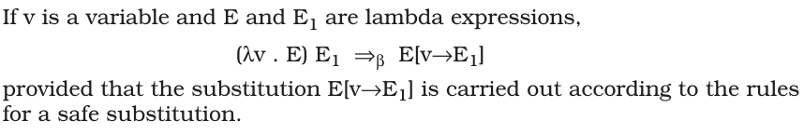
Function Application or Execution
Execution will be a sequence of terms, resulting from calling/invoking functions
Each step in this sequence is called a β-reduction
  We can only β-reduce a β-redux (expressions in the application form)
  (λ x . E) N
β-reduction is defined as:
β-normal form is an expression with no reduxes

Slide 26
Examples
(λ x . x) y
  x[x→y]
  y
(λ x . x (λ x . x)) (u r)
  (x (λ x . x))[x→(u r)]
  (u r) (λ x . x)

Slide 27
Examples
(λ x . y) ((λ z . z z) (λ w . w))
  (λ x . y) (z z)[z→(λ w . w)]
  (λ x . y) ((λ w . w) (λ w . w))
  (λ x . y) (w)[w→(λ w . w)]
  (λ x . y) (λ w . w)
  y[x→(λ w . w)]
  y

Slide 28
Examples
(λ x . x x) (λ x . x x)
  (x x)[x→(λ x . x x)]
  (λ x . x x) (λ x . x x)
  (x x)[x→(λ x . x x)]
  (λ x . x x) (λ x . x x)
  …

Slide 29
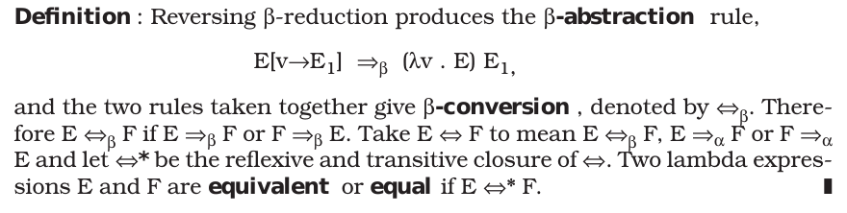
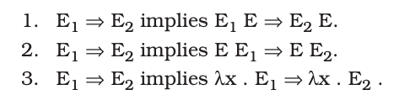
Reversing β-reduction: β-abstraction

Slide 30
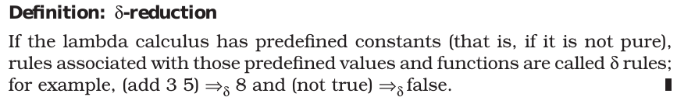

Slide 31


Example
Define Twice:

Slide 32
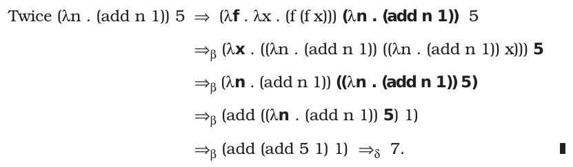

Slide 33
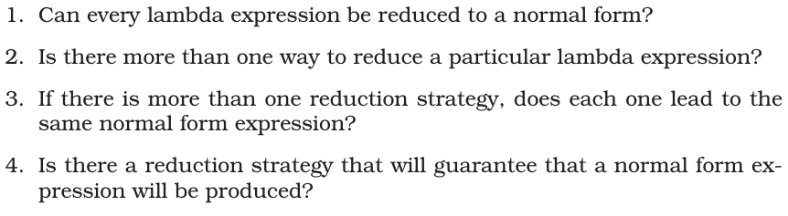
Interesting questions

Slide 34
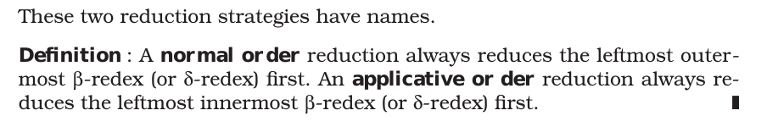
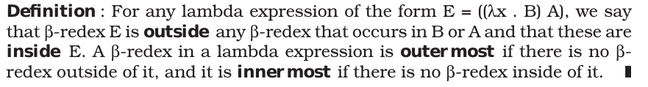
Reduction Strategies

Slide 35
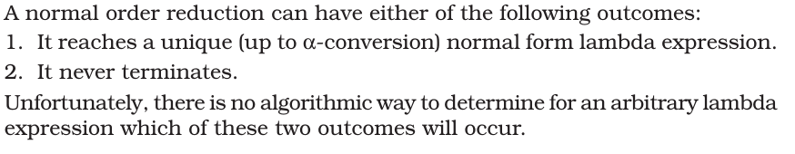
Normal order reduction

Slide 36
Boolean Logic
T = (λ x . λ y . x)
F = (λ x . λ y . y)
and = (λ a . λ b . a b F)
and T T
  (λ a . λ b . a b (λ x . λ y . y))

Slide 37
and T T
(λ a . λ b . a b (λ x . λ y . y)) (λ x . λ y . x) (λ x . λ y . x)
(λ b . a b (λ x . λ y . y))[a →(λ x . λ y . x)] (λ x . λ y . x)
(λ b . (λ x . λ y . x) b (λ x . λ y . y)) (λ x . λ y . x)
((λ x . λ y . x) b (λ x . λ y . y))[b→(λ x . λ y . x)]
(λ x . λ y . x) (λ x . λ y . x) (λ x . λ y . y)
(λ y . x)[x →(λ x . λ y . x)] (λ x . λ y . y)
(λ y . (λ x . λ y . x)) (λ x . λ y . y)
(λ x . λ y . x)[y→(λ x . λ y . y)]
(λ x . λ y . x)
T

Slide 38
and T F
(λ a . λ b . a b F) T F
(λ b . a b F)[a→T] F
(λ b . T b F) F
(T b F)[b→F]
(T F F)
(λ x . λ y . x) F F
(λ y . x)[x→F] F
(λ y . F) F
F[y→F]
F

Slide 39
and F T
(λ a . λ b . a b F) F T
F T F
F

Slide 40
and F F
(λ a . λ b . a b F) F F
F F F
F

Slide 41
not
not T = F
not F = T
not = (λ a . a F T)
not T
  (λ a . a F T) T
  T F T
  F
not F
  (λ a . a F T) F
  F F T
  T

Slide 42
If Branches
if c then
a
else
b
if c a b
if T a b = a
if F a b = b
if = (λ a . a)

Slide 43
Examples
if T a b
  (λ a . a) T a b
  T a b
  a
if F a b
  (λ a . a) F a b
  F a b
  b

Slide 44
Church's Numerals
0 = λ f . λ x . x
1 = λ f . λ x . f x
2 = λ f . λ x . f f x
3 = λ f . λ x . f f f x
4 = λ f . λ x . f f f f x
  λ f . λ x . (f (f (f (f x))))
4 a b
  a a a a b

Slide 45
Successor Function
succ = λ n . λ f . λ x . f (n f x)
0 = λ f . λ x . x
succ 0
  (λ n . λ f . λ x . f (n f x)) 0
  λ f . λ x . f (0 f x)
  λ f . λ x . f ((λ f . λ x . x) f x)
  λ f . λ x . f x
1 = λ f . λ x . f x
succ 0 = 1

Slide 46
Successor Function
succ = λ n . λ f . λ x . f (n f x)
1 = λ f . λ x . f x
succ 1
  (λ n . λ f . λ x . f (n f x)) 1
  λ f . λ x . f (1 f x)
  λ f . λ x . f ((λ f . λ x . f x) f x)
  λ f . λ x . f f x
2 = λ f . λ x . f f x
succ 1 = 2
succ n = n + 1

Slide 47
Addition
add 0 1 = 1
add 1 2 = 3
add = λ n . λ m . λ f . λ x . n f (m f x)
add 0 1
  (λ n . λ m . λ f . λ x . n f (m f x)) 0 1
  (λ m . λ f . λ x . 0 f (m f x)) 1
  λ f . λ x . 0 f (1 f x)
  λ f . λ x . 0 f (f x)
  λ f . λ x . f x

Slide 48
Addition
add = λ n . λ m . λ f . λ x . n f (m f x)
add 1 2
  (λ n . λ m . λ f . λ x . n f (m f x)) 1 2
  (λ m . λ f . λ x . 1 f (m f x)) 2
  λ f . λ x . 1 f (2 f x)
  λ f . λ x . 1 f (f f x)
  λ f . λ x . (f f f x)
  3

Slide 49
Multiplication
mult 0 1 = 0
mult 1 2 = 2
mult 2 5 = 10
mult = λ n . λ m . m (add n) 0
mult 0 1
  (λ n . λ m . m (add n) 0) 0 1
  (λ m . m (add 0) 0) 1
  1 (add 0) 0
  add 0 0
  0

Slide 50
Multiplication
mult 1 2
  (λ n . λ m . m (add n) 0) 1 2
  (λ m . m (add 1) 0) 2
  2 (add 1) 0
  (add 1) ((add 1) 0)
  (add 1) (add 1 0)
  (add 1) (1)
  (add 1 1)
  2

Slide 51
Turing Complete?
We have Boolean logic
  Including true/false branches
We have arithmetic
What does it mean for lambda calculus to be Turing complete?

Slide 52
Factorial
n!
  fact(0) = 1
  fact(n) = n * fact(n-1)
int fact(int n)
{
if (n == 0)
{
return 1;
}
return n * fact(n-1);
}

Slide 53
Factorial
(assuming that we have definitions of the iszero and pred functions)
fact = (λ n . if (iszero n) (1) (mult n (fact (pred n)))
However, we cannot write this function!

Slide 54
Y Combinator
Y = (λ x . λ y . y (x x y)) (λ x . λ y . y (x x y))
Y foo
  (λ x . λ y . y (x x y)) (λ x . λ y . y (x x y)) foo
  (λ y . y ((λ x . λ y . y (x x y)) (λ x . λ y . y (x x y)) y)) foo
  foo ((λ x . λ y . y (x x y)) (λ x . λ y . y (x x y)) foo)
  foo (Y foo)
  foo (foo (Y foo))
  foo (foo (foo (Y foo)))
  …

Slide 55
Recursion
fact = (λ n . if (iszero n) (1) (mult n (fact (pred n)))
fact = Y (λ f . λ n . if (iszero n) (1) (mult n (f (pred n)))
fact 1
  Y (λ f . λ n . if (iszero n) (1) (mult n (f (pred n))) 1
  (λ f . λ n . if (iszero n) (1) (mult n (f (pred n))) (Y (λ f . λ n . if (iszero n) (1) (mult n (f (pred n))) 1
  (λ n . if (iszero n) (1) (mult n ((Y (λ f . λ n . if (iszero n) (1) (mult n (f (pred n))) (pred n))) 1
  if (iszero 1) (1) (mult 1 ((Y (λ f . λ n . if (iszero n) (1) (mult n (f (pred n))) (pred 1))
  if F (1) (mult 1 ((Y (λ f . λ n . if (iszero n) (1) (mult n (f (pred n))) (pred 1))
  mult 1 ((Y (λ f . λ n . if (iszero n) (1) (mult n (f (pred n))) (pred 1)
  mult 1 (λ f . λ n . if (iszero n) (1) (mult n (f (pred n))) (Y (λ f . λ n . if (iszero n) (1) (mult n (f (pred n))) (pred 1)
  mult 1 (λ n . if (iszero n) (1) (mult n ((Y (λ f . λ n . if (iszero n) (1) (mult n (f (pred n))) (pred n))) (pred 1)
  mult 1 (λ n . if (iszero n) (1) (mult n ((Y (λ f . λ n . if (iszero n) (1) (mult n (f (pred n))) (pred n))) 0
  mult 1 (if (iszero 0) (1) (mult 0 ((Y (λ f . λ n . if (iszero n) (1) (mult n (f (pred n))) (pred 0)))
  mult 1 if T (1) (mult 0 ((Y (λ f . λ n . if (iszero n) (1) (mult n (f (pred n))) (pred 0)))
  mult 1 1
  1

Slide 56
Turing Complete
Boolean Logic
Arithmetic
Loops

