Slide 1

Hackathon 1-Exploratory Data Analysis (EDA)
Dataset – Animal Shelter
Team Members(group :-3)-
S Sai Girish
Vinay Franklin
Shamil
Sushant Singh

Slide 2

How do we start analysis the given data set?

Slide 3
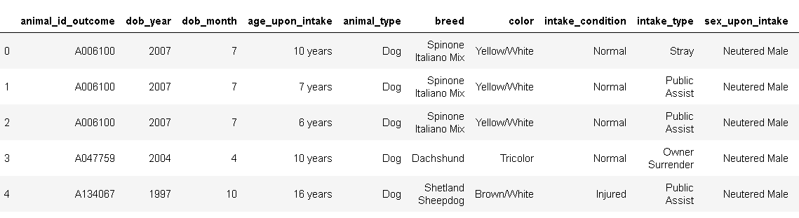
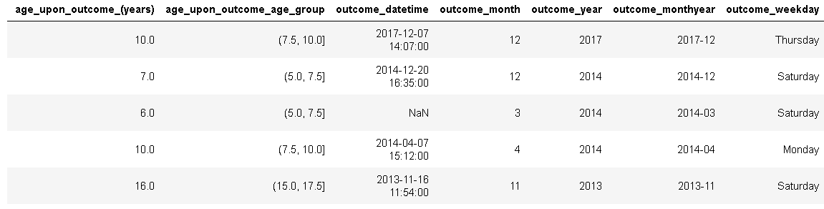
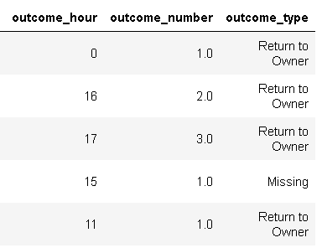
1) we started by Printing the head() i.e., first five rows of the data to get a idea about the data shelter_df.head()

Slide 4
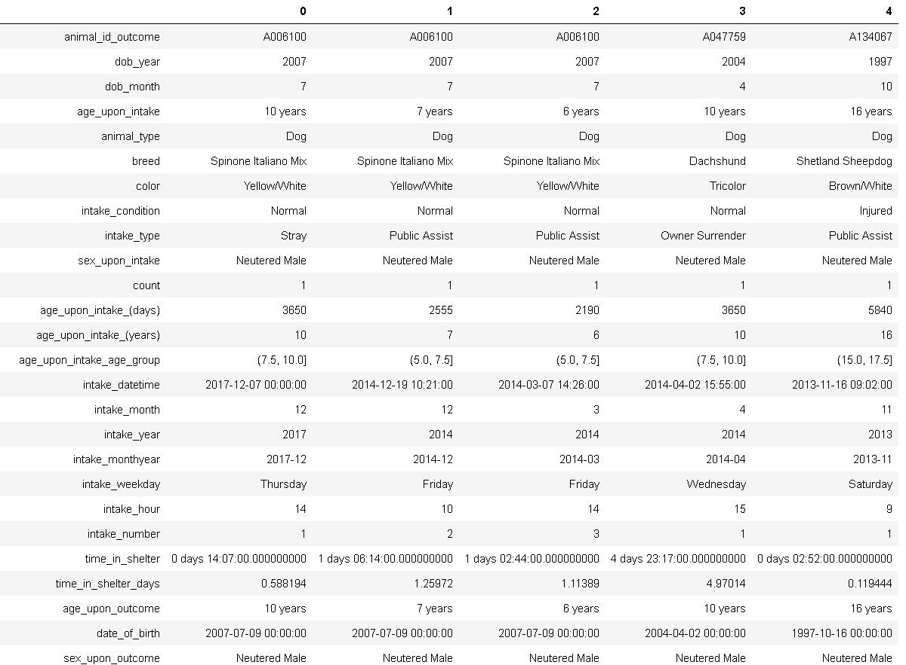
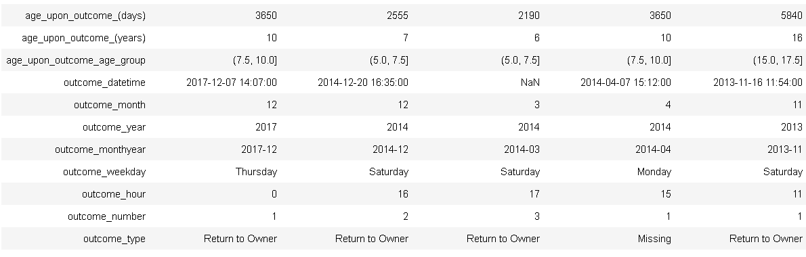
2)Printing the transpose of head to have a look at all the columns of dataset shelter_df.head().T

Slide 5

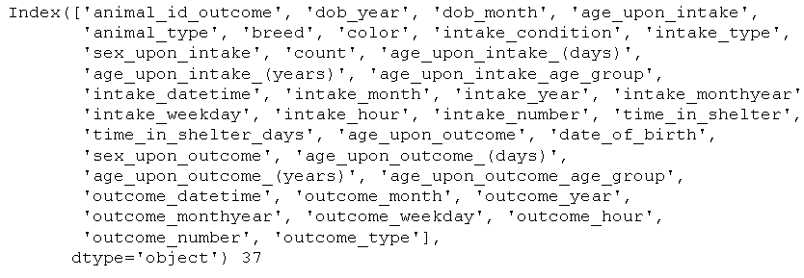

3)Printing the shape of the dataset to know how many rows and columns are present shelter_df.shape
4)Getting the list of all the features
features = shelter_df.columns
print(features, len(features))
shelter_df['outcome_type'].unique()

Slide 6
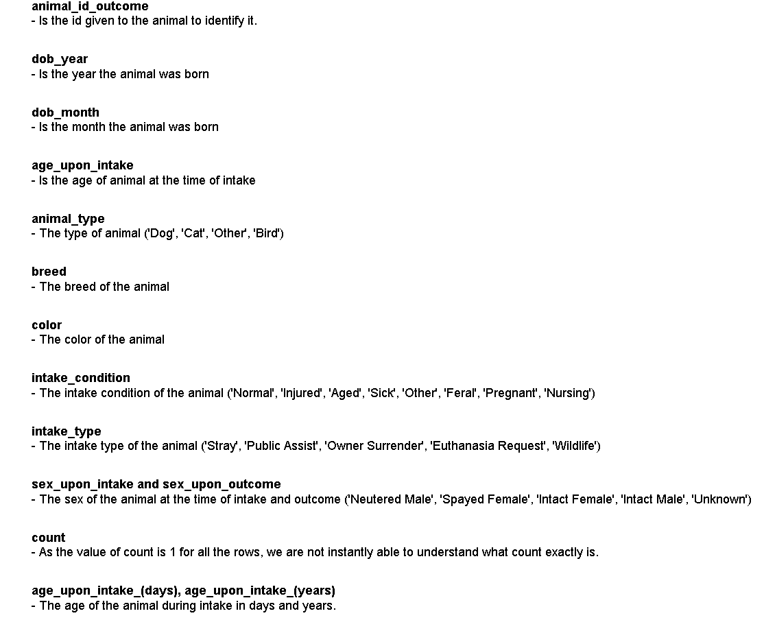
5)We first try to understand what each feature means after looking at the data

Slide 7
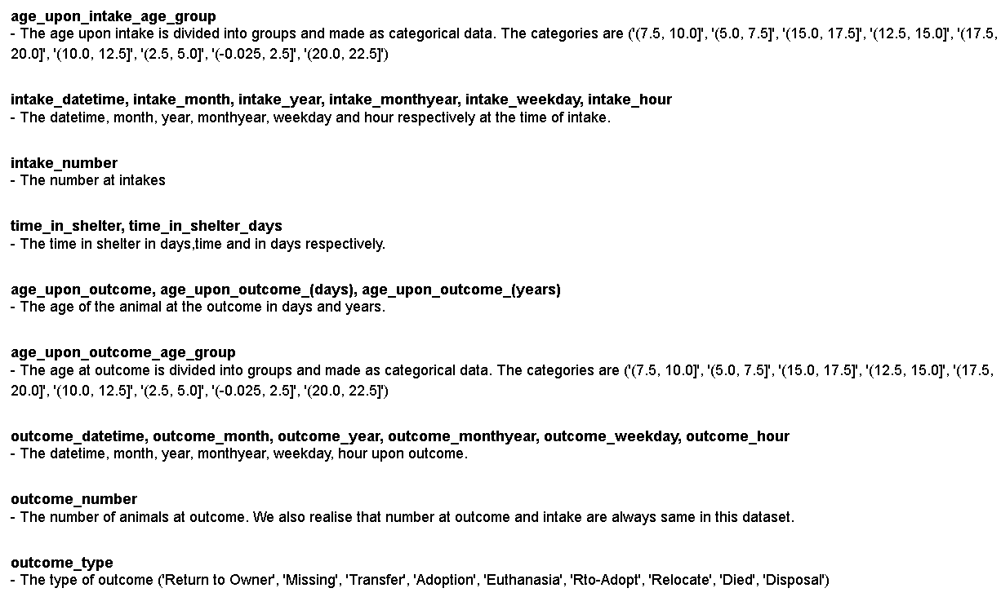

Slide 8
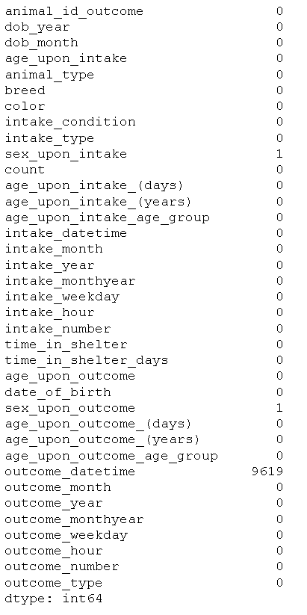
6)Find the number of null values of all the columns
shelter_df.isnull().sum()

Slide 9
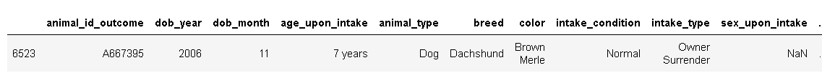
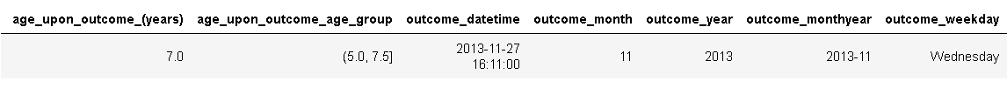
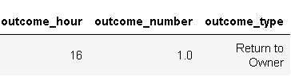
shelter_df[(shelter_df['sex_upon_intake'].isnull()) & (shelter_df['sex_upon_outcome'].isnull())]

Slide 10
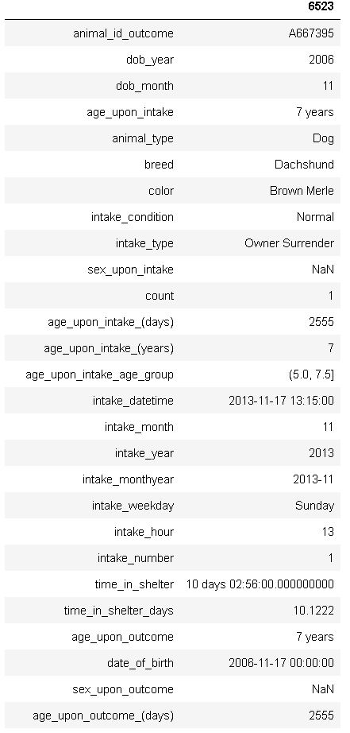
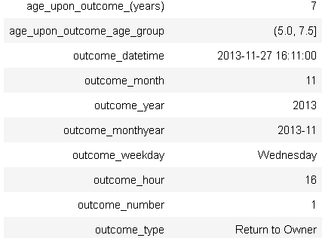
shelter_df[shelter_df['sex_upon_intake'].isnull()].T

Slide 11
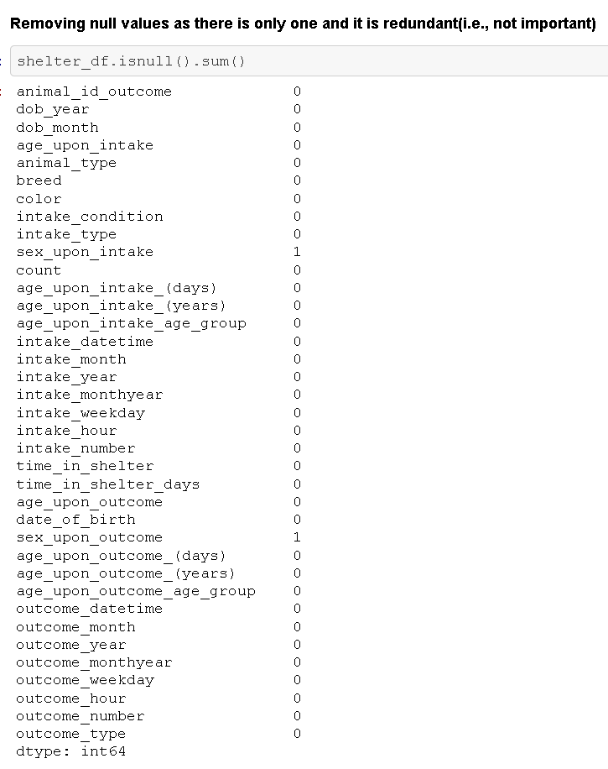

Slide 12
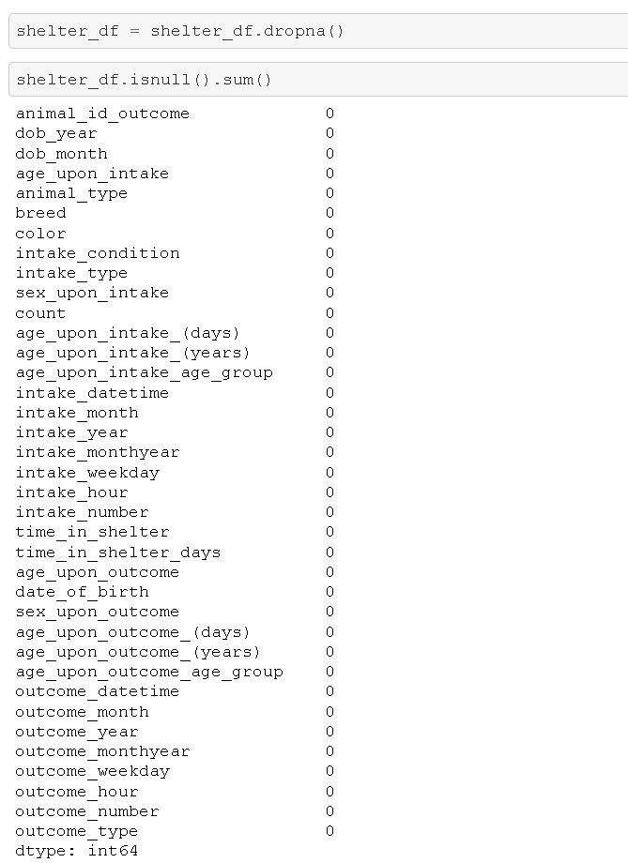

Slide 13
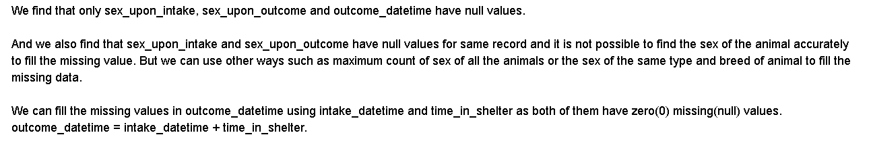
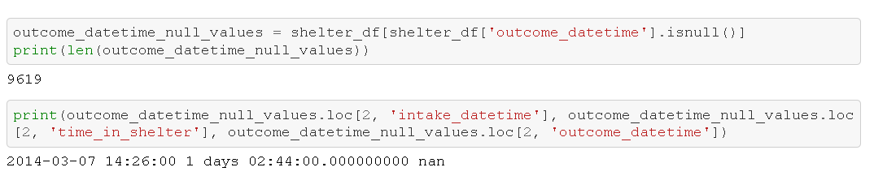
Analysis based on the null values
Filling the missing values in 'outcome_datetime' feature
The next few cells are to test our method to calculate 'outcome_datetime' by using the formula :
outcome_datetime = intake_datetime + time_in_shelter
Filling the missing values in 'outcome_datetime' feature
The next few cells are to test our method to calculate 'outcome_datetime' by using the formula :
outcome_datetime = intake_datetime + time_in_shelter

Slide 14
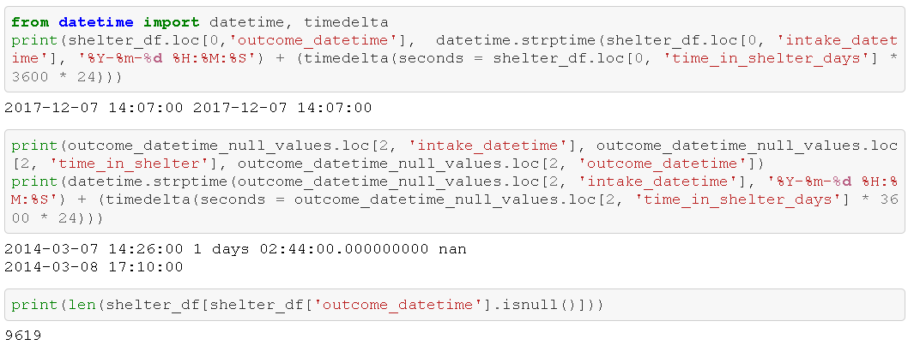

Slide 15
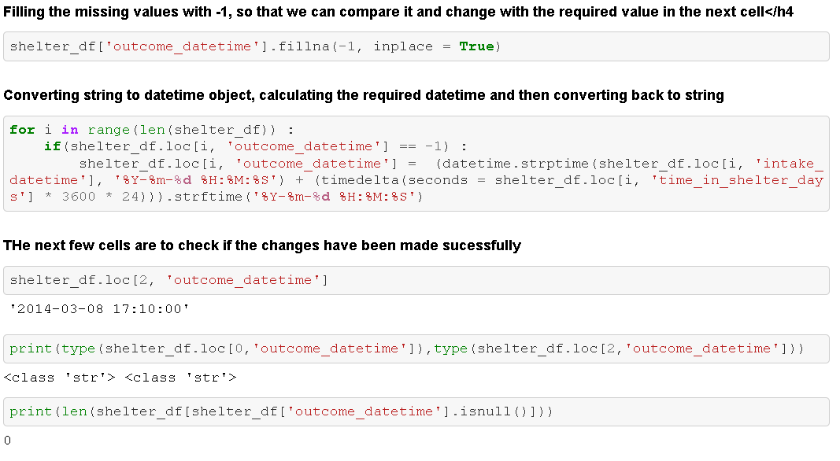

Slide 16
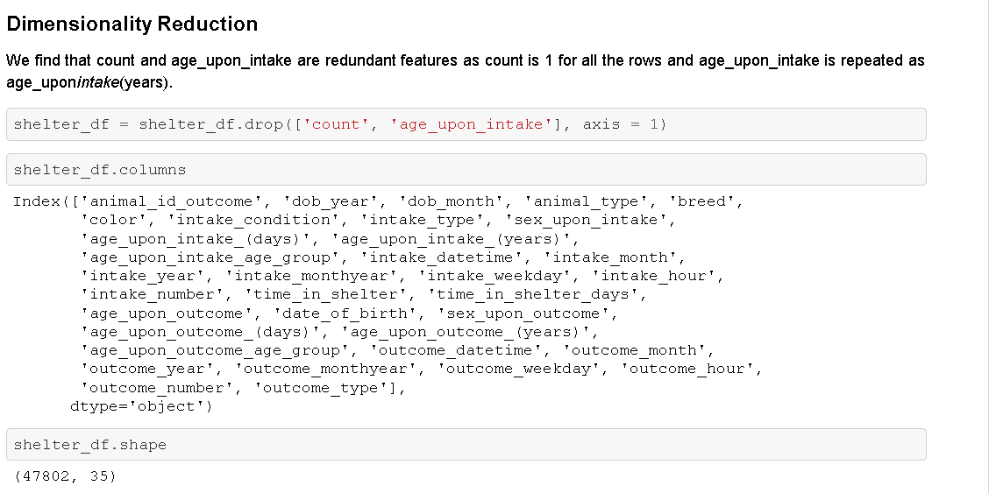

Slide 17
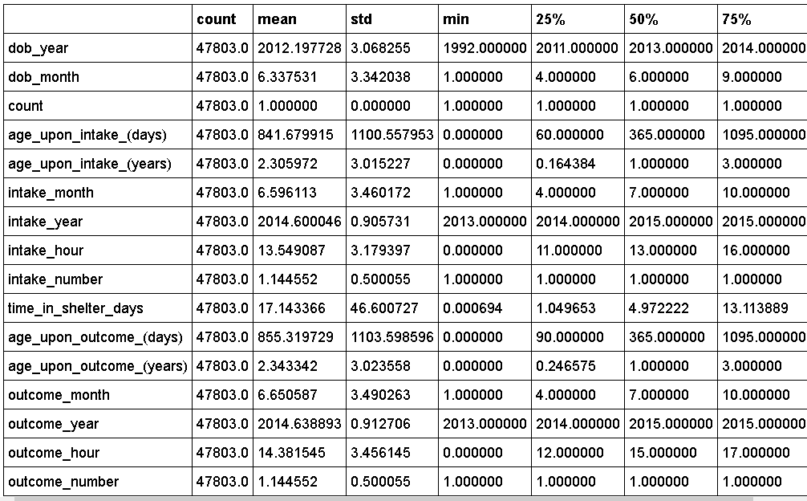
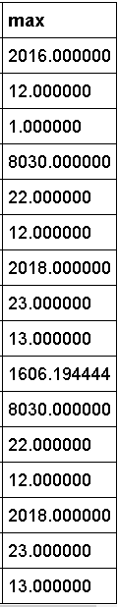
Statistical Analysis
shelter_df.describe().T

Slide 18

Statistical Analysis (cont..)

Slide 19
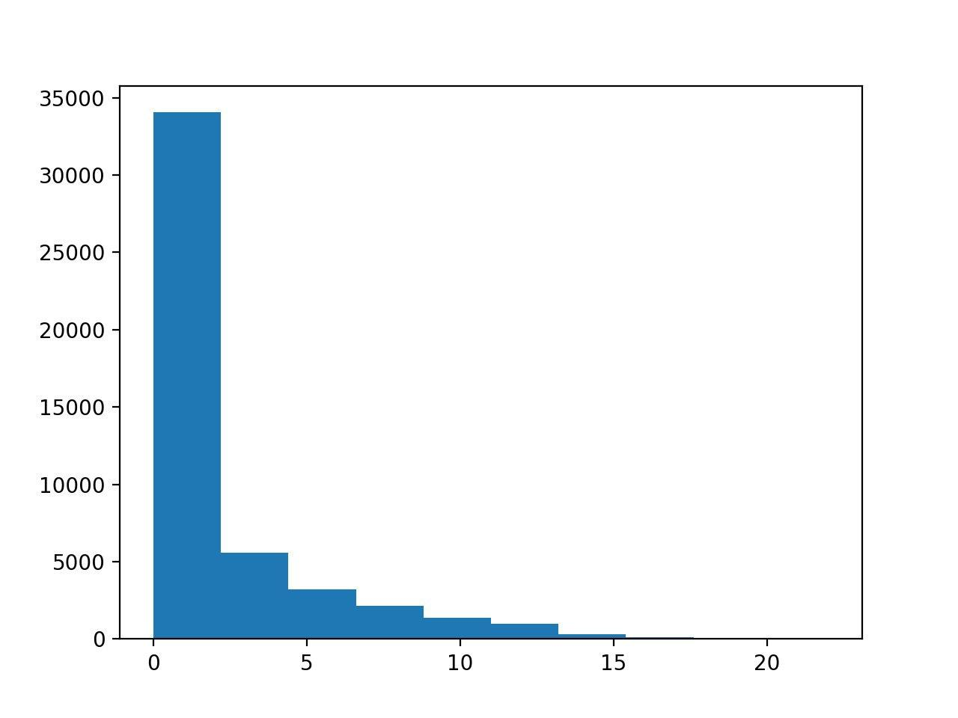
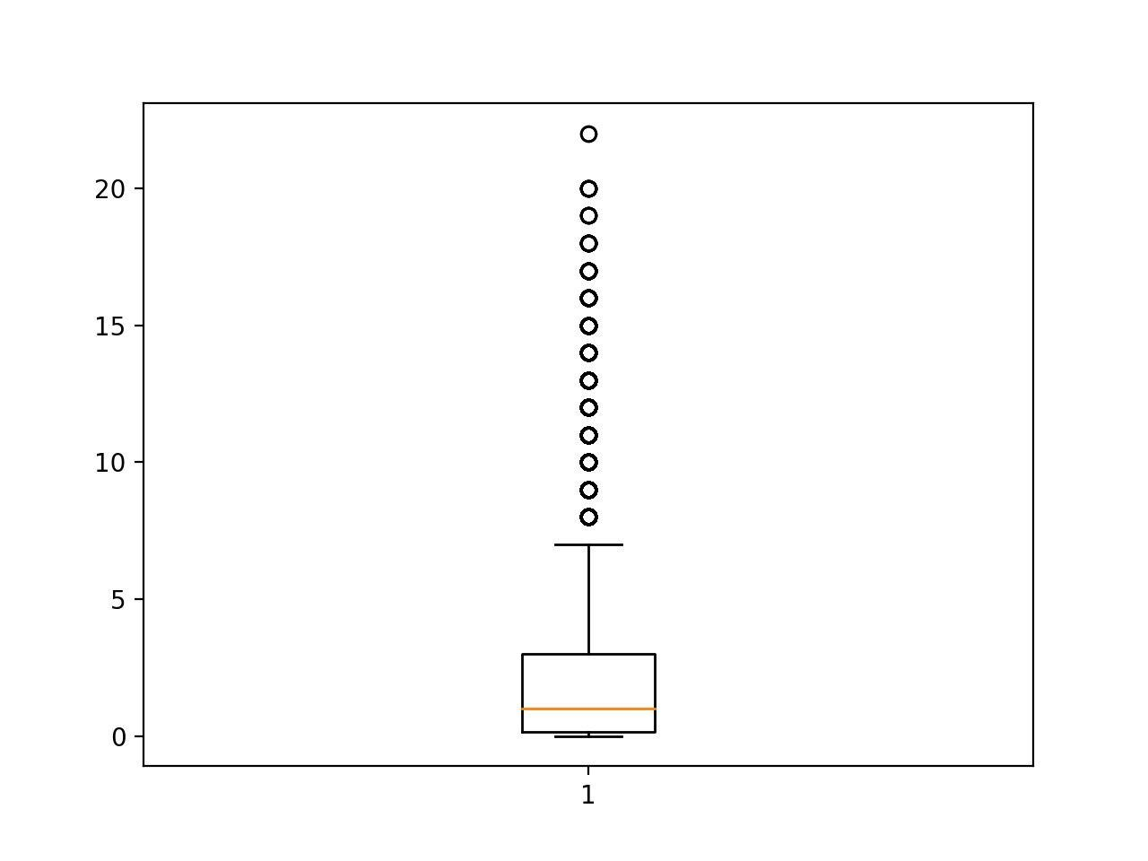
Age upon intake (years)

Slide 20


Age upon outcome (years)

Slide 21
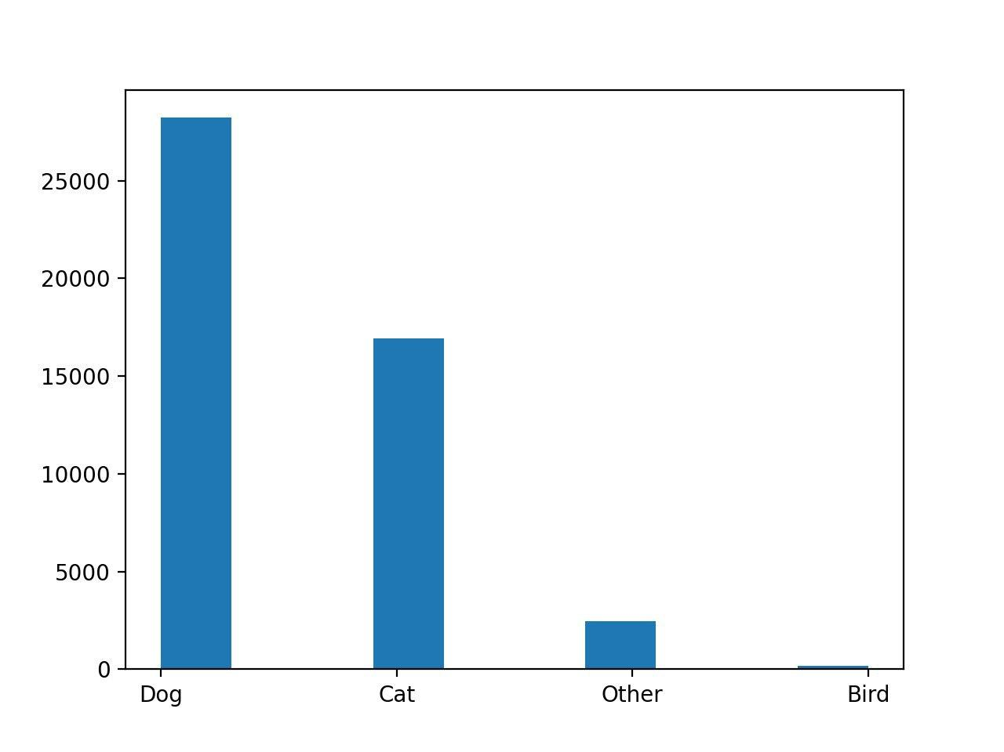
Animal Type:-

Slide 22
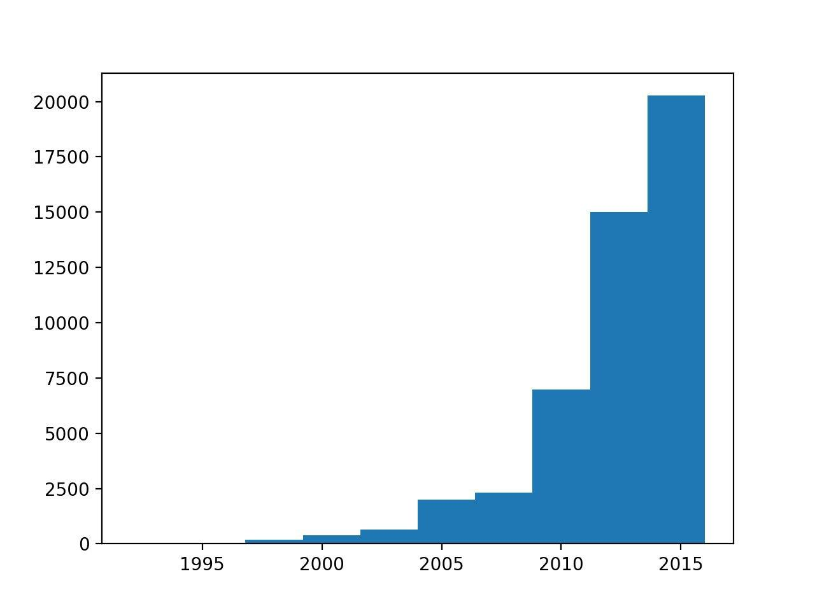
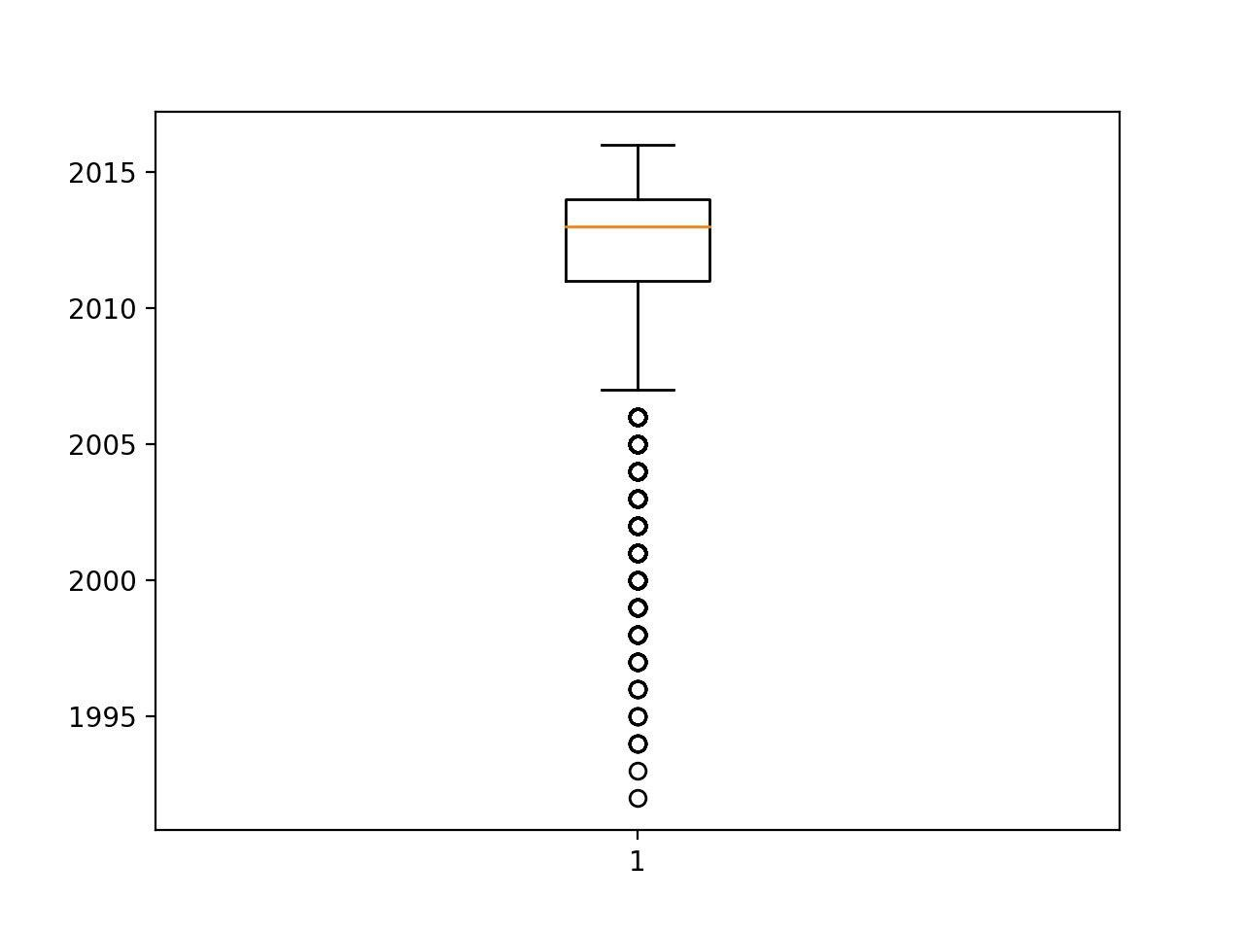
DOB

Slide 23
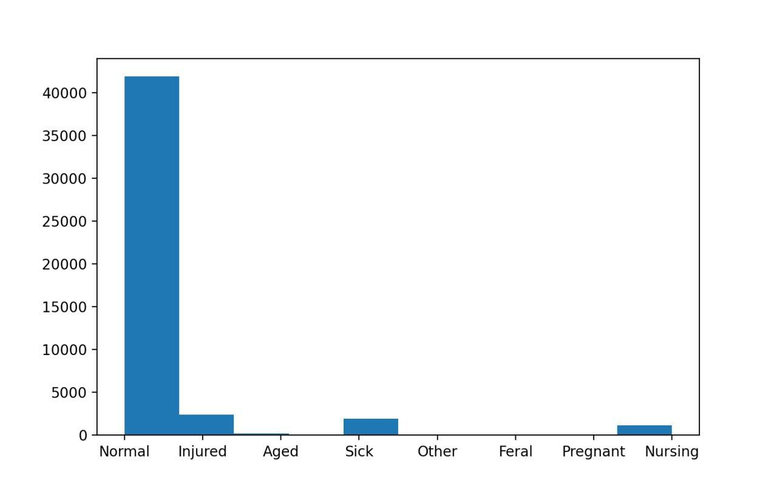
Intake condition

Slide 24
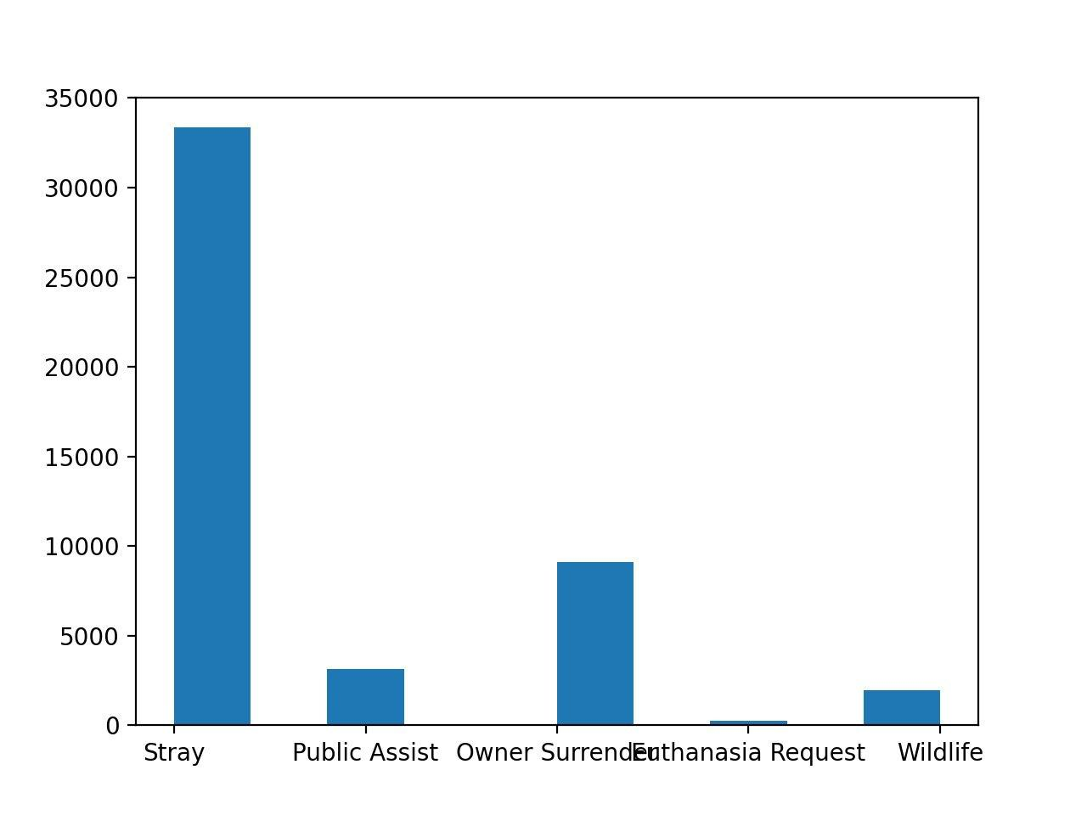
Intake type

Slide 25
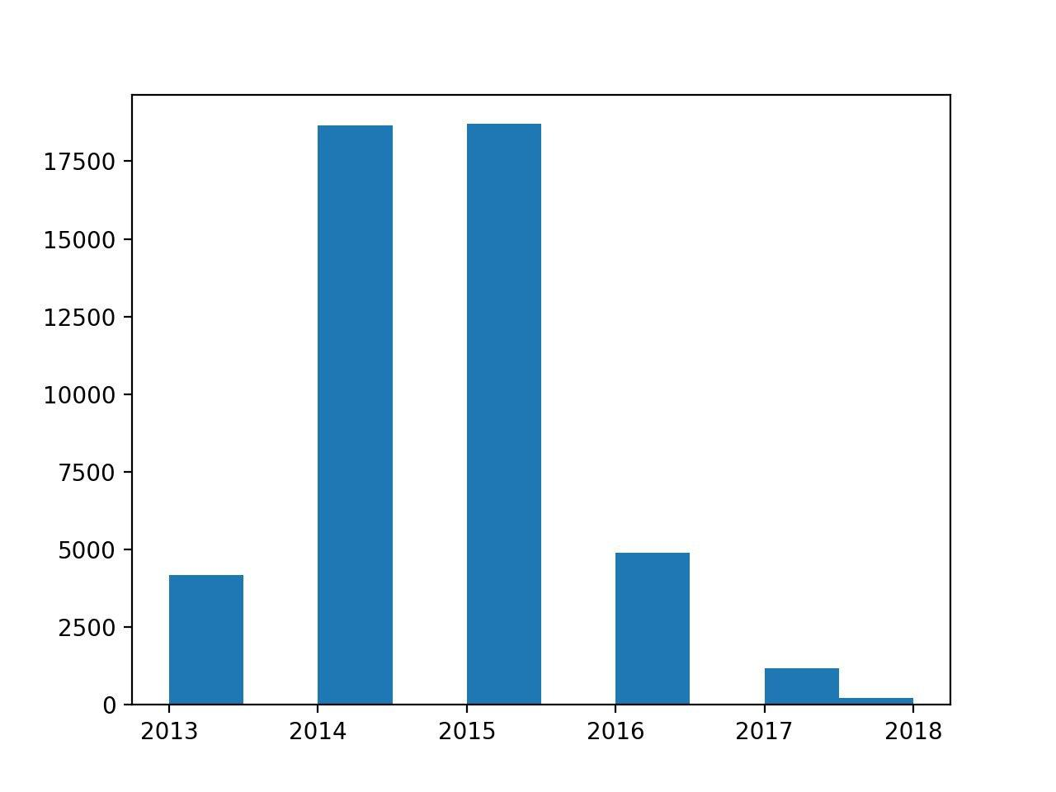
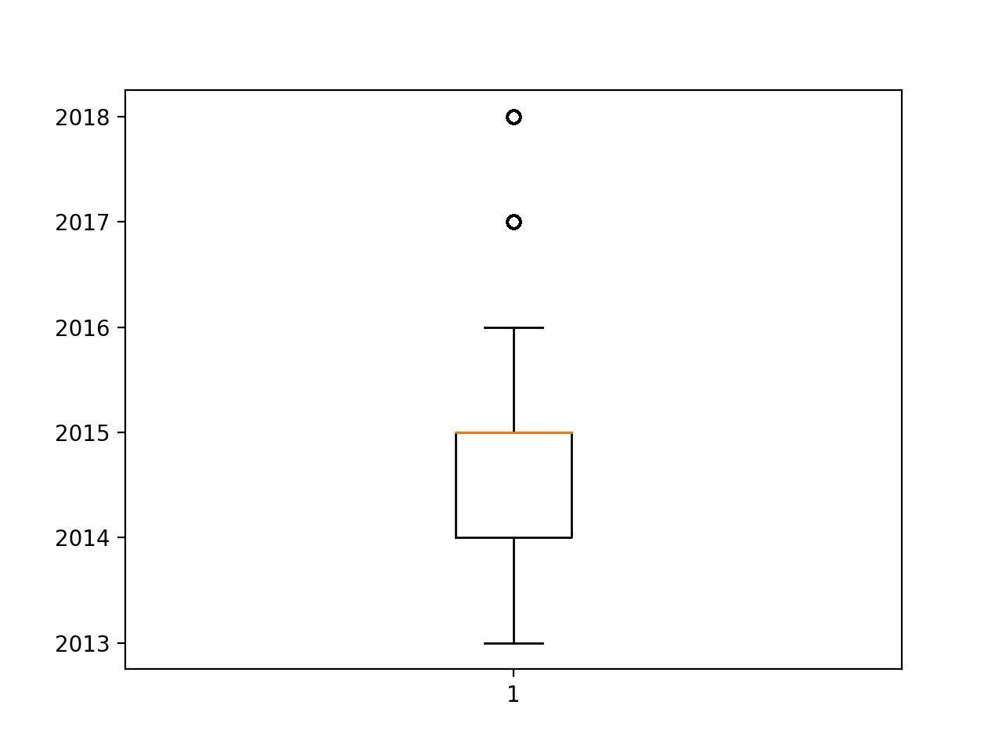
Intake year

Slide 26
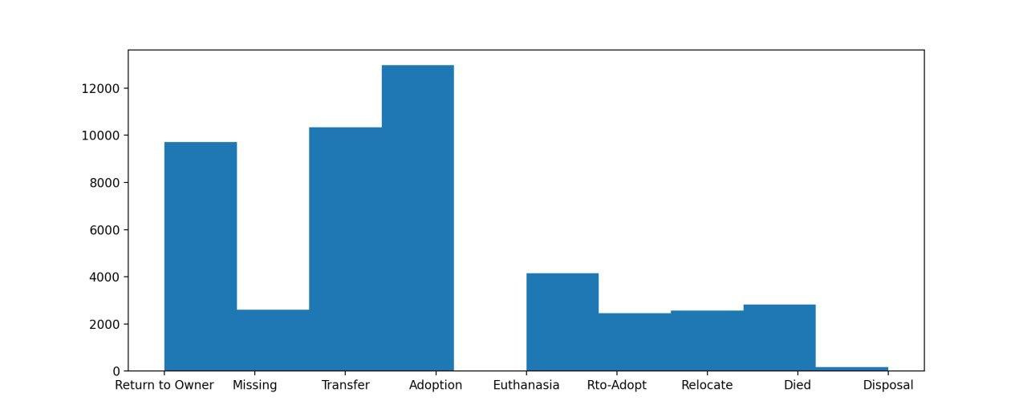
Outcome Type

Slide 27
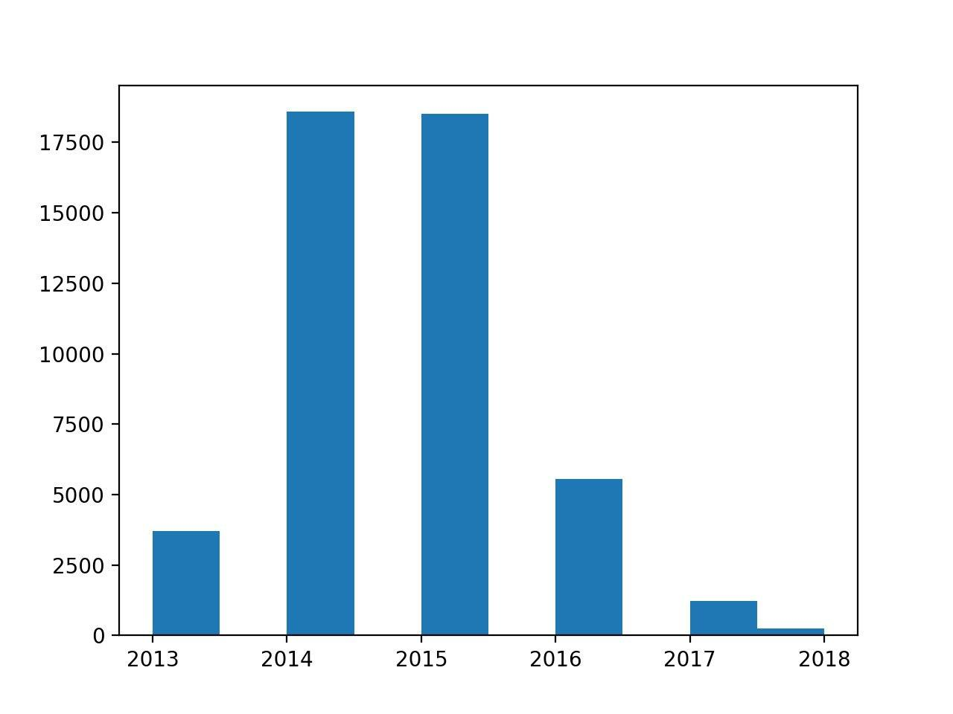

Outcome year

Slide 28
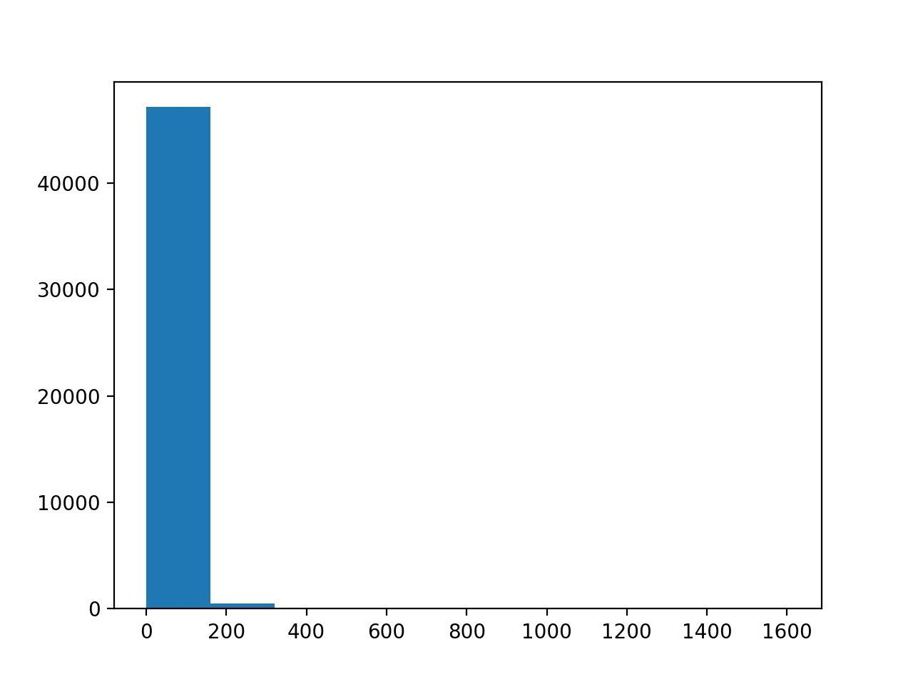
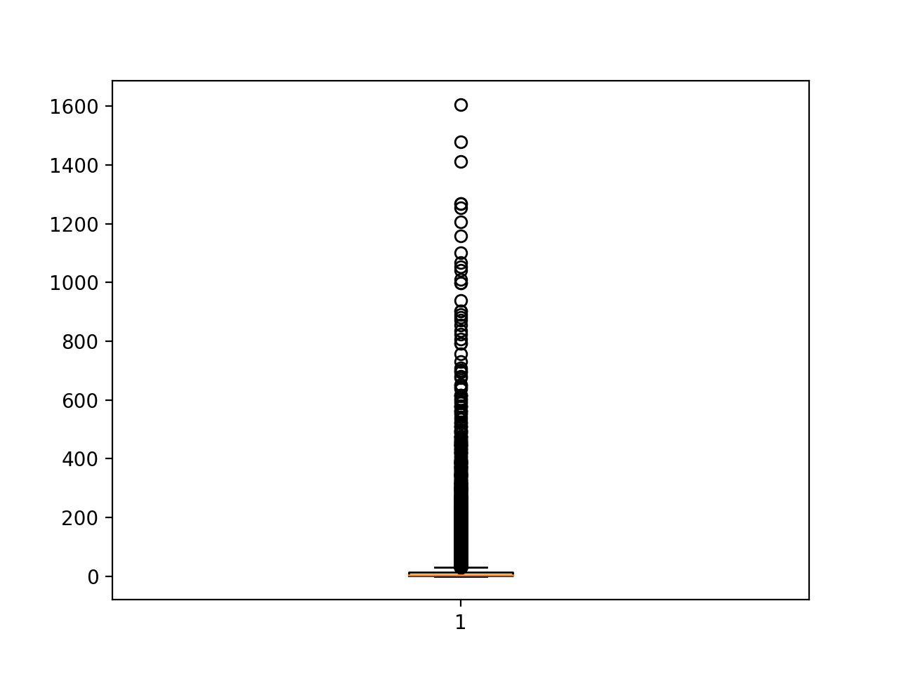
Time in shelter

Slide 29
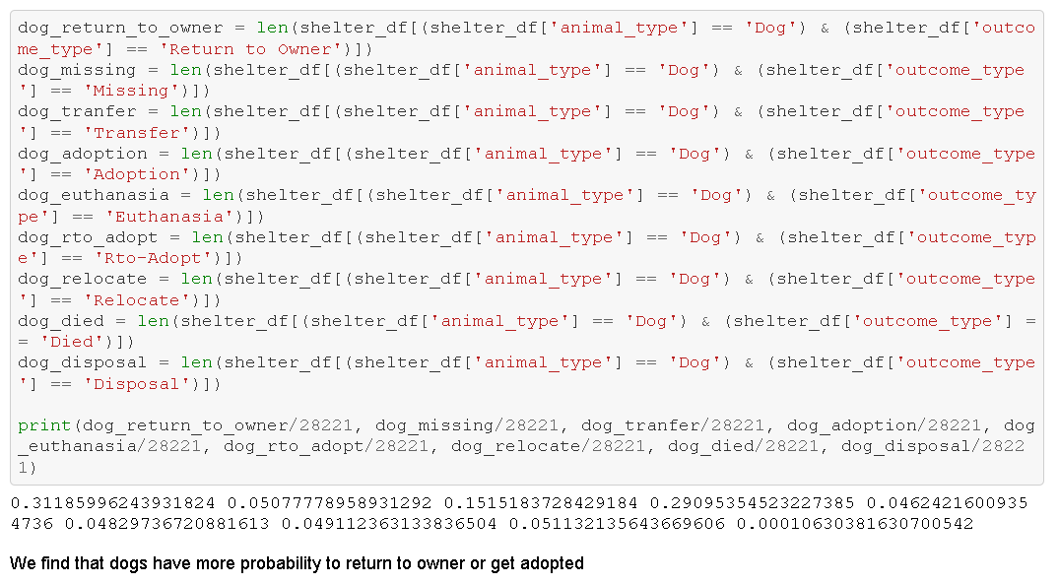

Slide 30
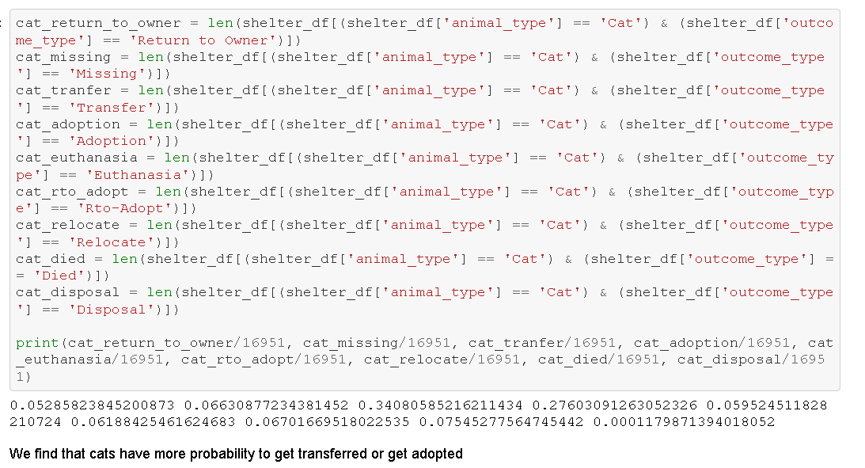

Slide 31
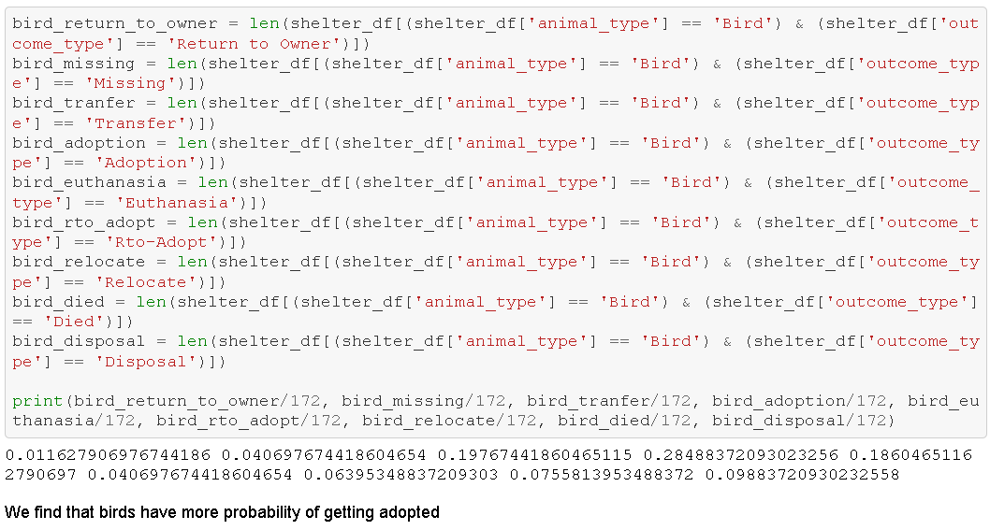

Slide 32
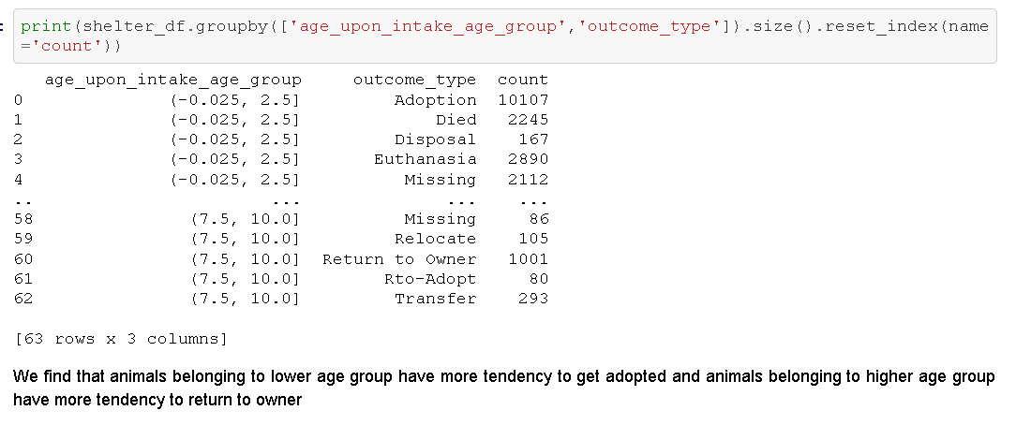

Slide 33
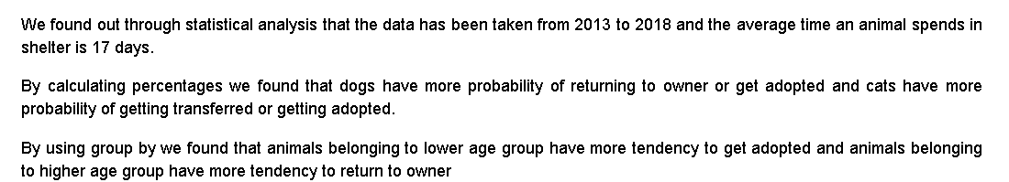
Conclusion

