Slide 1

Hackathon 1-Exploratory Data Analysis (EDA)
Dataset – Animal Shelter
Team Members(group :-3)-
S Sai Girish
Vinay Franklin
Shamil
Sushant Singh

Slide 2

How do we started analysis the given data set?

Slide 3
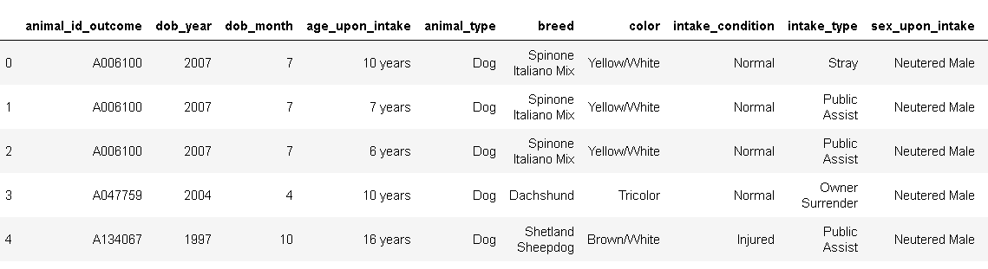
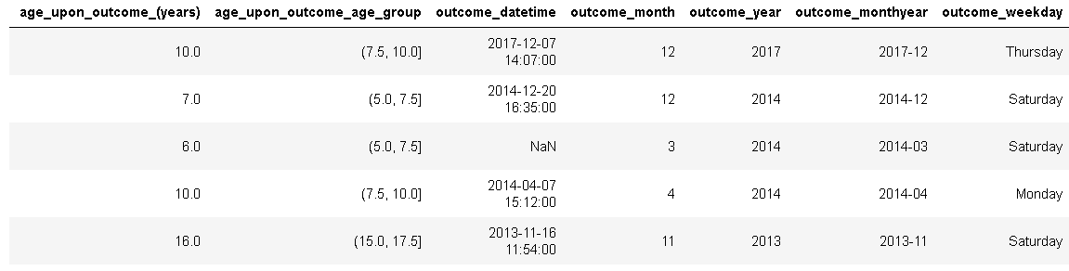
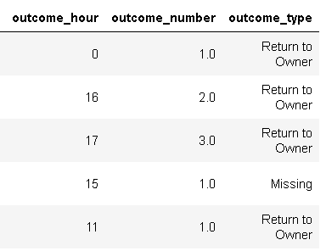
1) we started by Printing the head() i.e., first five rows of the data to get a idea about the data shelter_df.head()

Slide 4
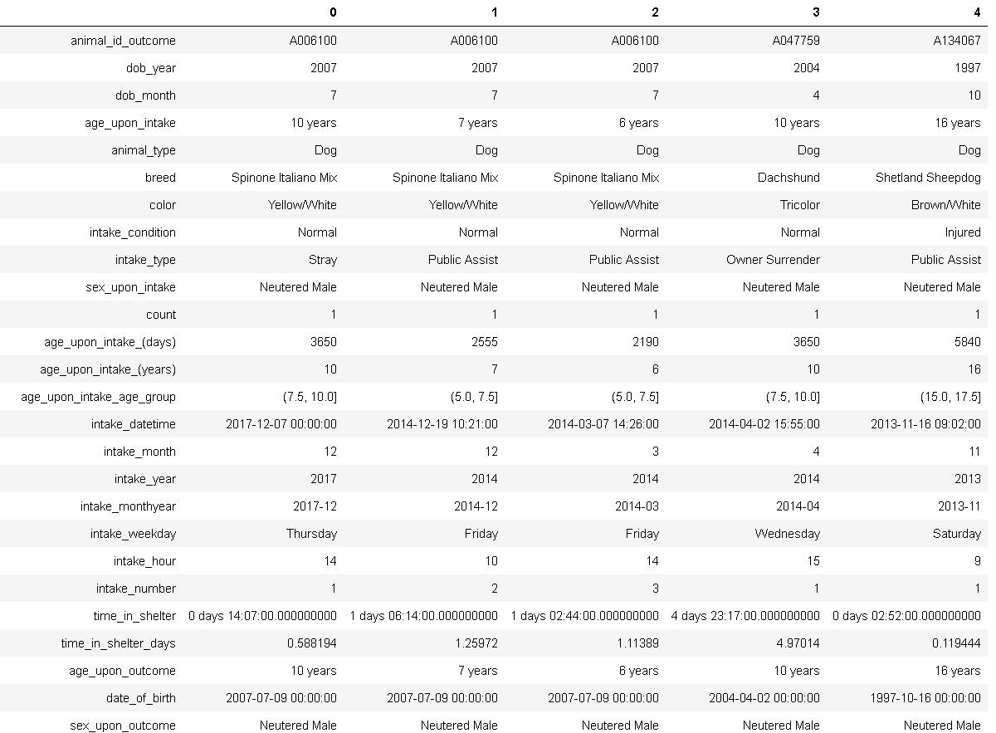
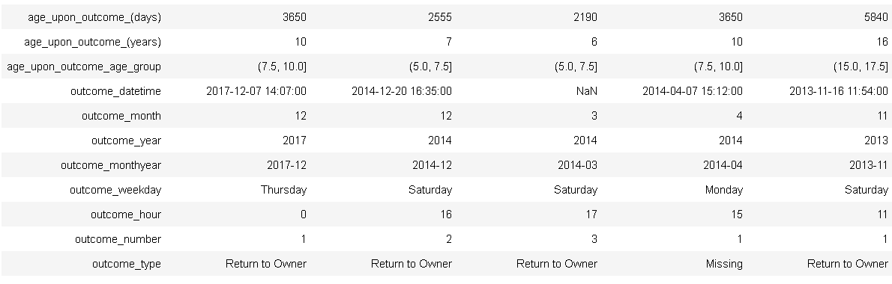
2)Printing the transpose of head to have a look at all the columns of dataset shelter_df.head().T

Slide 5

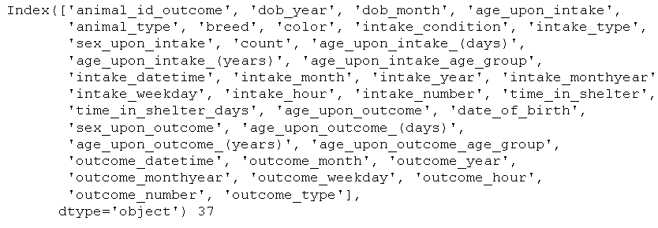

3)Printing the shape of the dataset to know how many rows and columns are present shelter_df.shape
4)Getting the list of all the features
features = shelter_df.columns
print(features, len(features))
shelter_df['outcome_type'].unique()

Slide 6
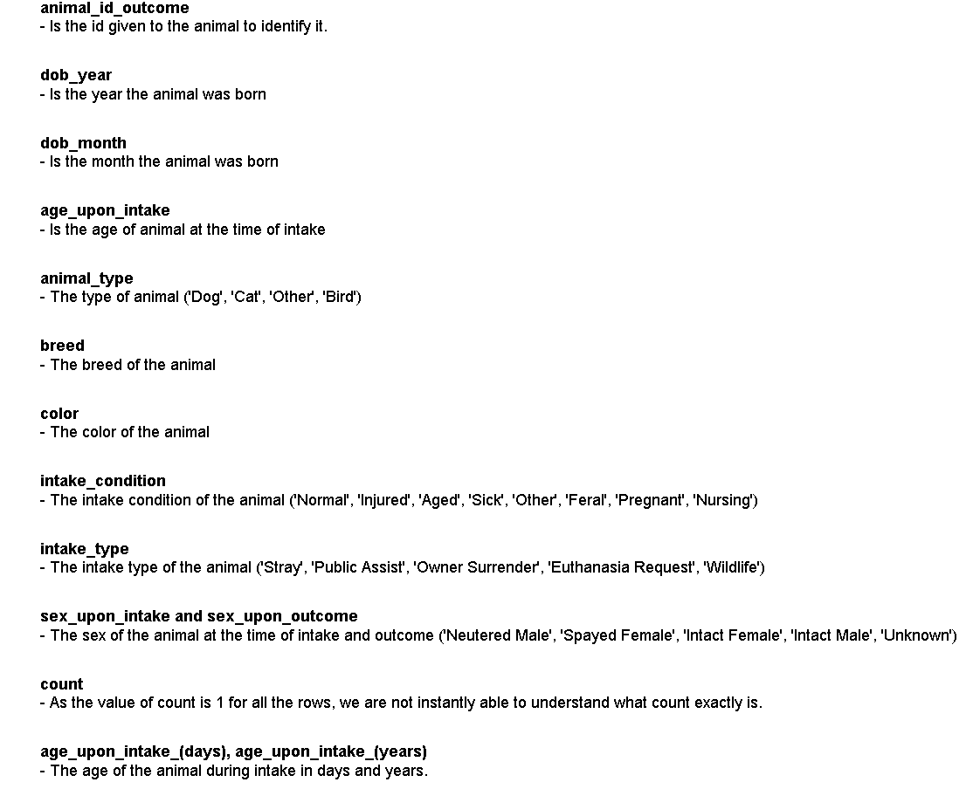
5)We first try to understand what each feature means after looking at the data

Slide 7
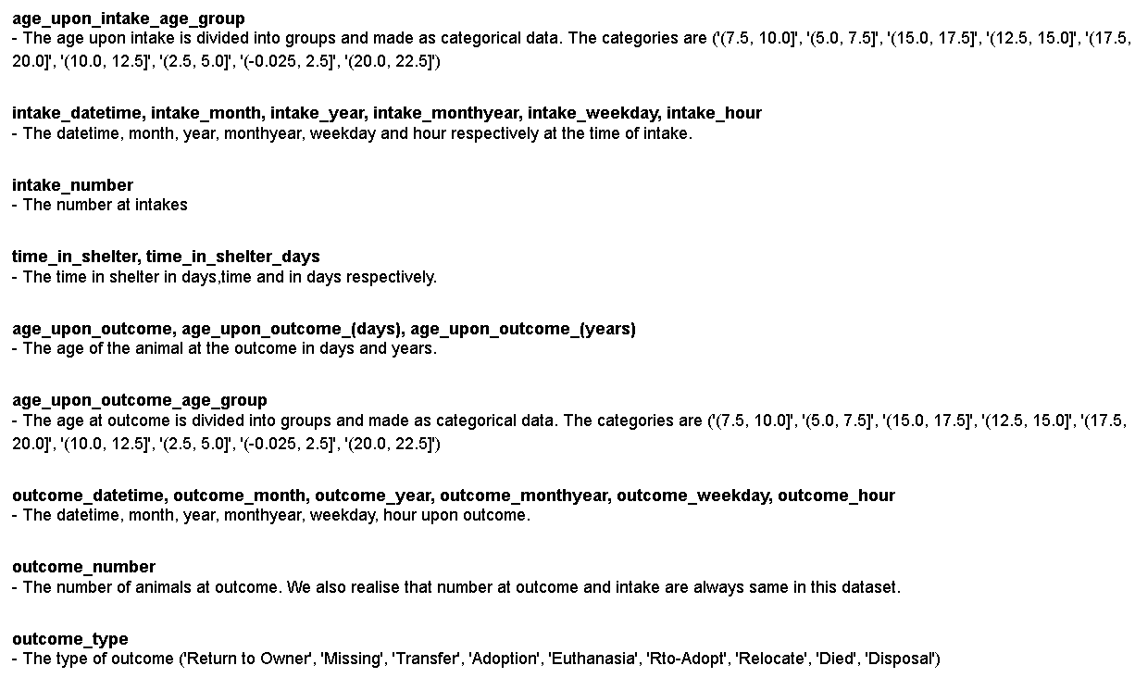

Slide 8
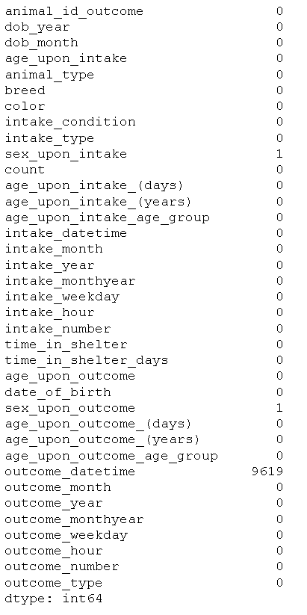
6)Find the number of null values of all the columns
shelter_df.isnull().sum()

Slide 9
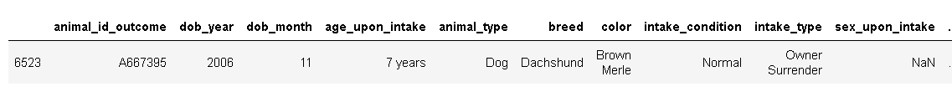
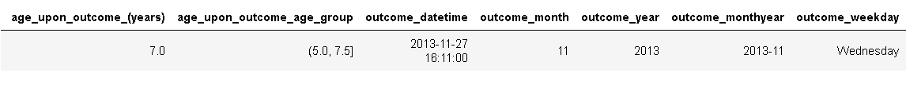
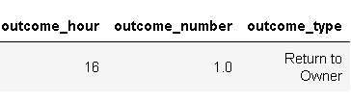
shelter_df[(shelter_df['sex_upon_intake'].isnull()) & (shelter_df['sex_upon_outcome'].isnull())]

Slide 10
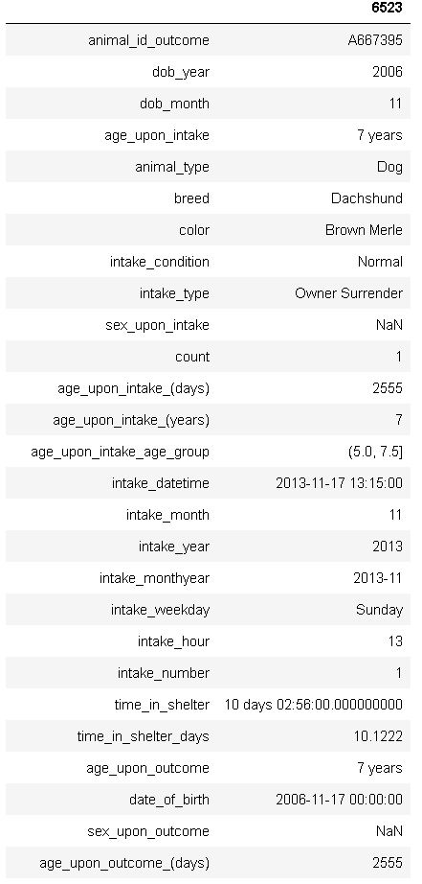
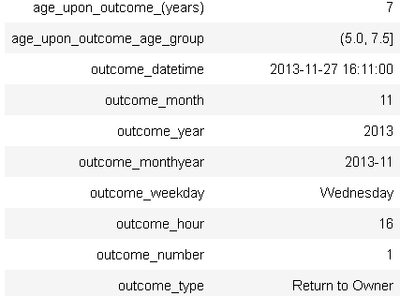
shelter_df[shelter_df['sex_upon_intake'].isnull()].T

Slide 11
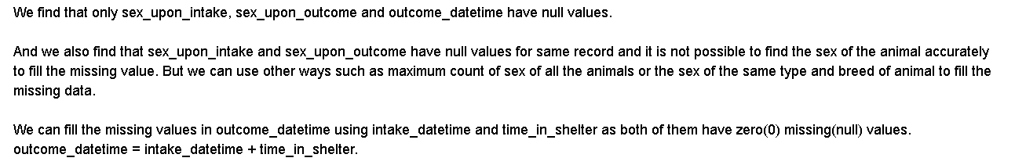
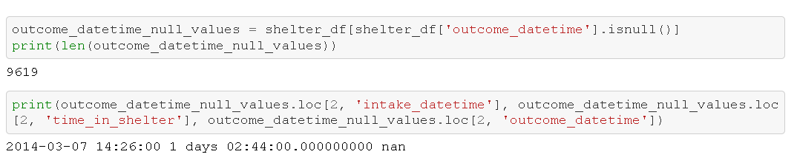
Analysis based on the null values
Filling the missing values in 'outcome_datetime' feature
The next few cells are to test our method to calculate 'outcome_datetime' by using the formula :
outcome_datetime = intake_datetime + time_in_shelter
Filling the missing values in 'outcome_datetime' feature
The next few cells are to test our method to calculate 'outcome_datetime' by using the formula :
outcome_datetime = intake_datetime + time_in_shelter

Slide 12
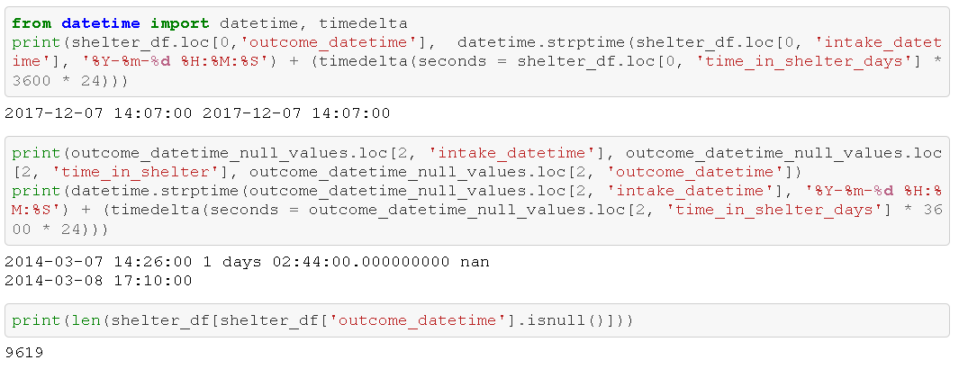

Slide 13
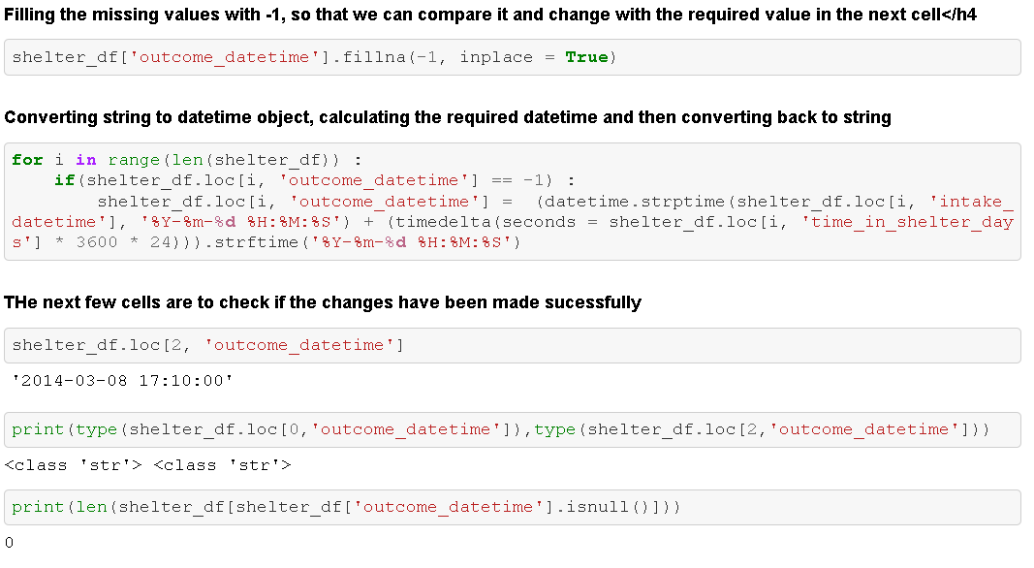

Slide 14
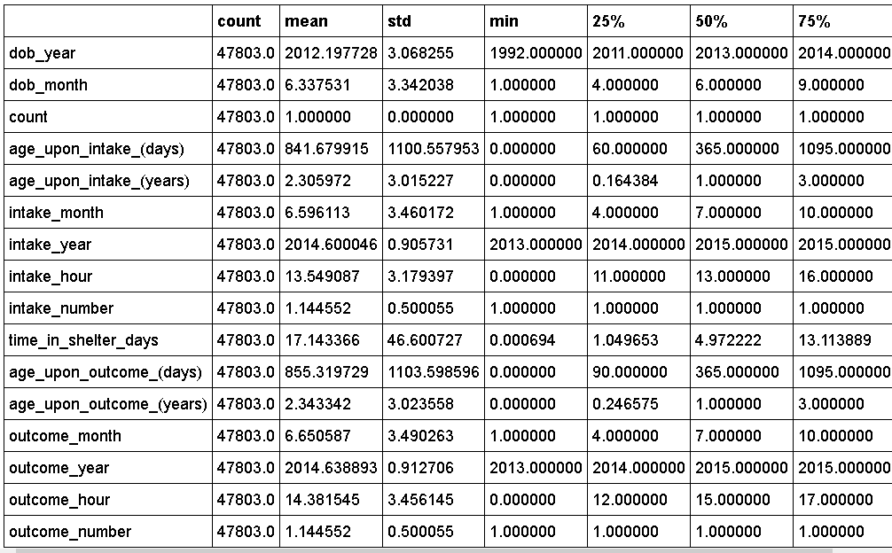
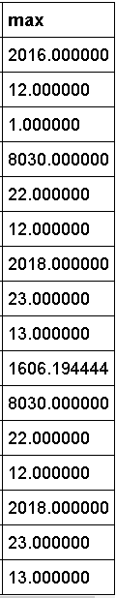
Statistical Analysis
shelter_df.describe().T

Slide 15

Statistical Analysis (cont..)

Slide 16
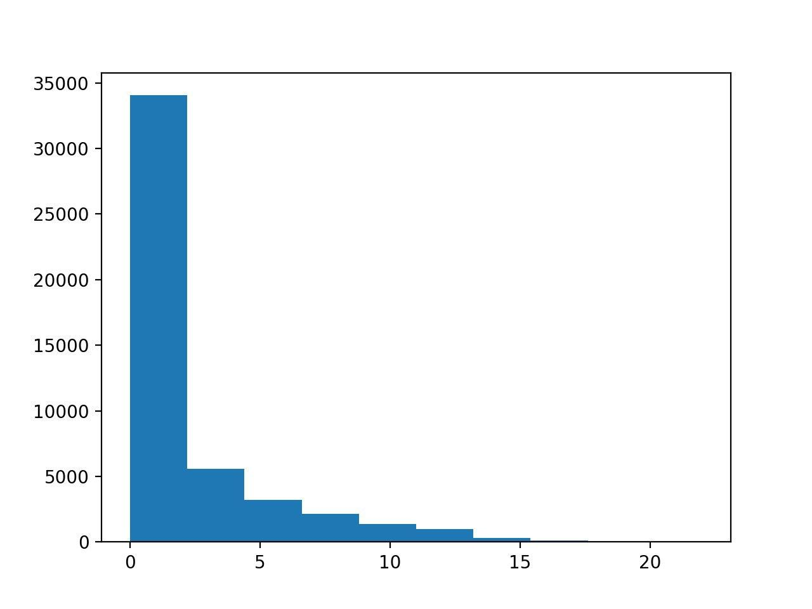
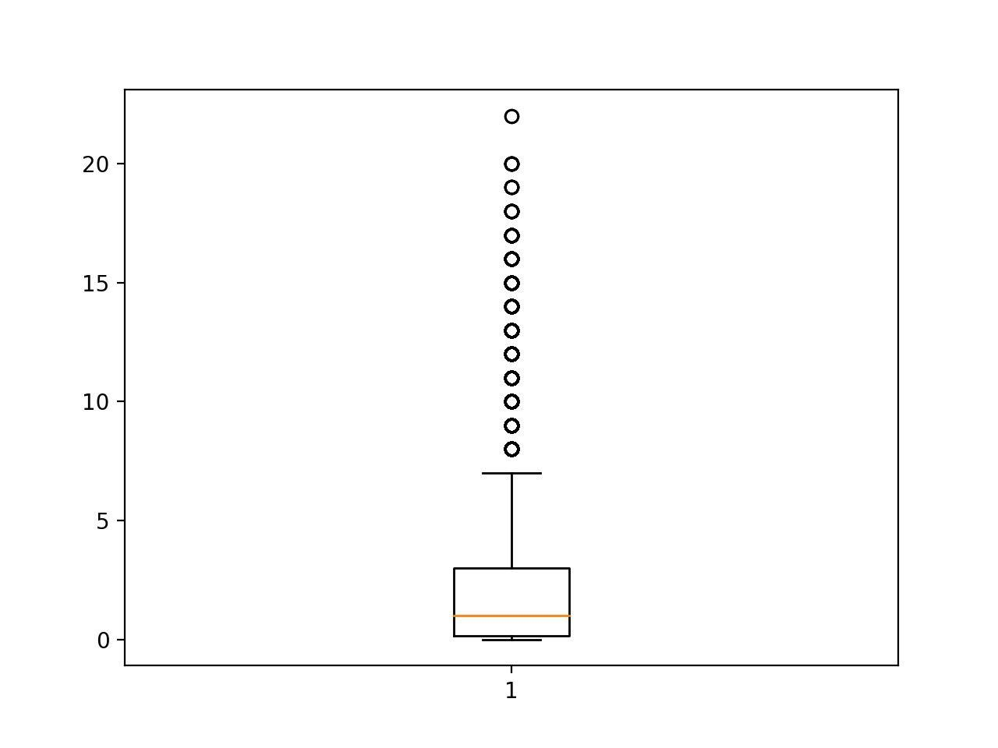
Age upon intake (years)

Slide 17


Age upon outcome (years)

Slide 18
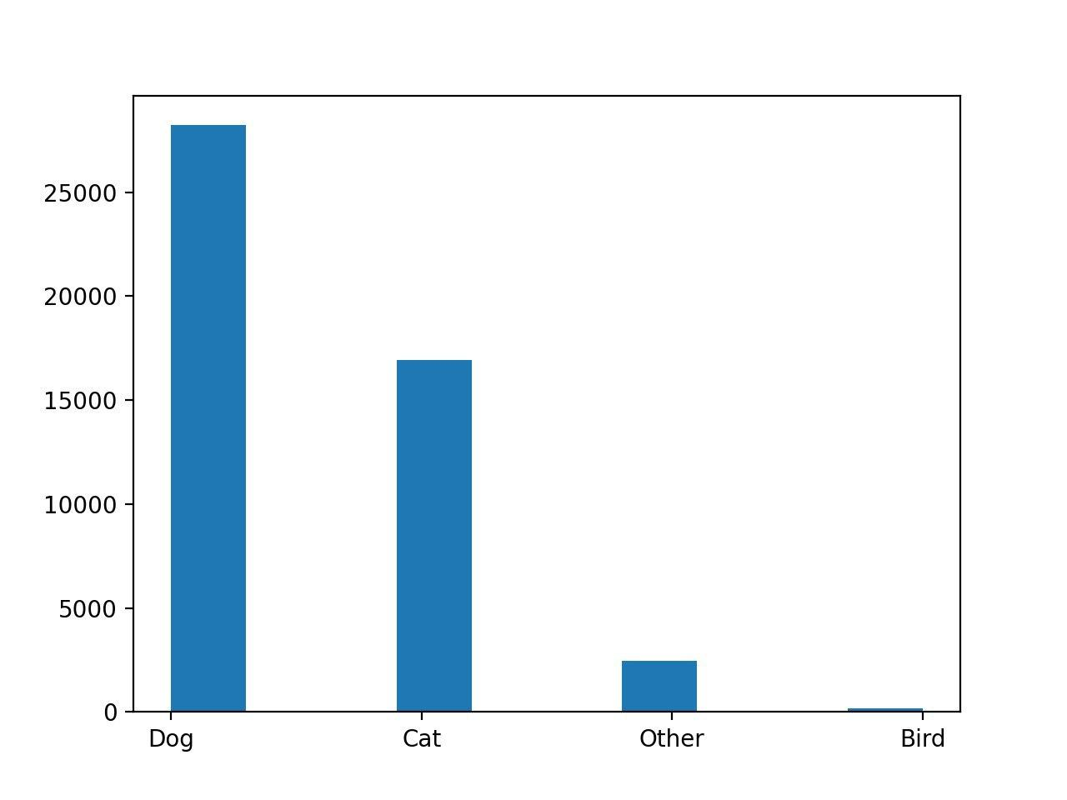
Animal Type:-

Slide 19
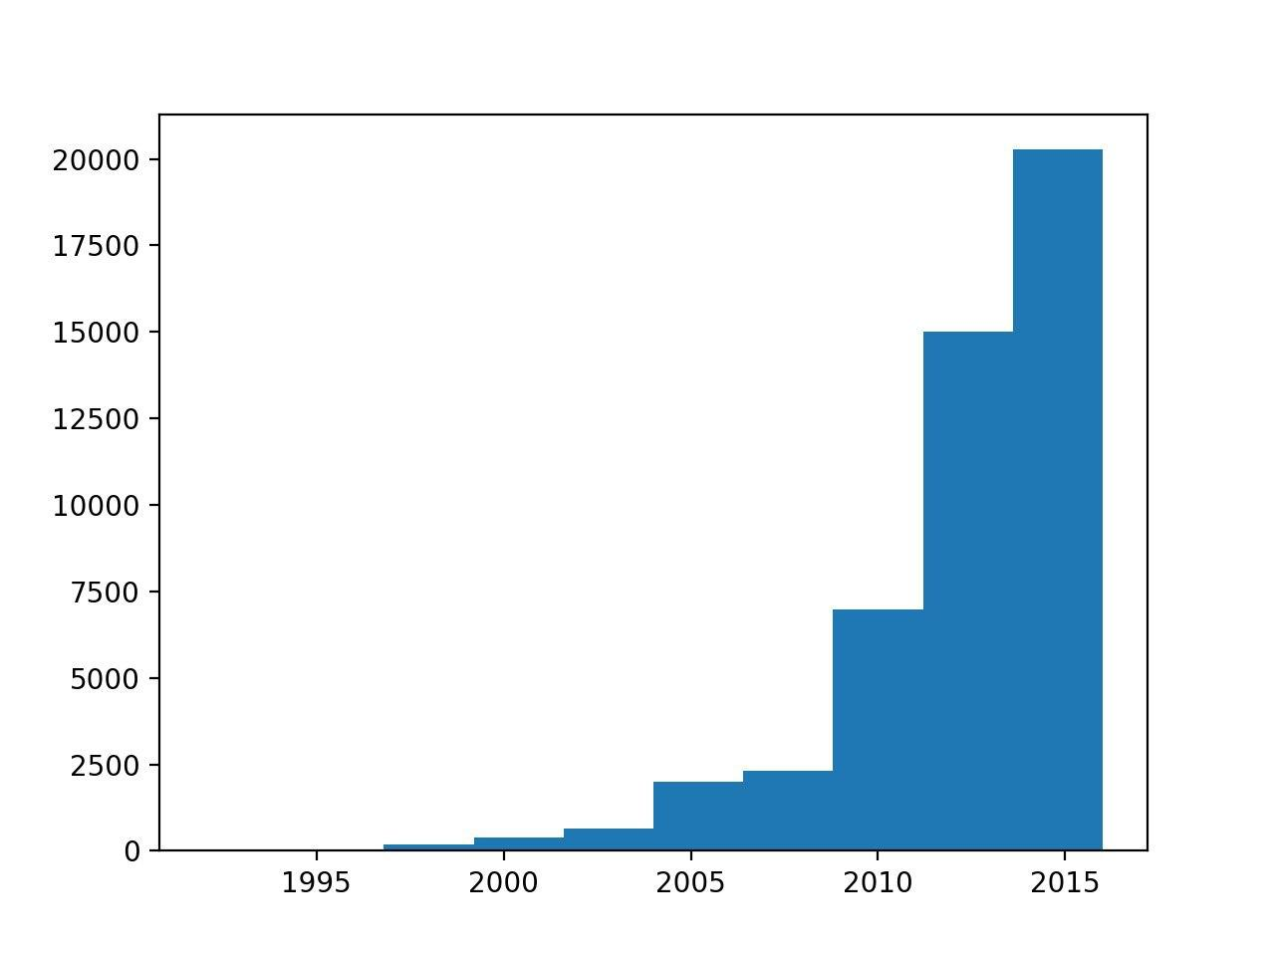
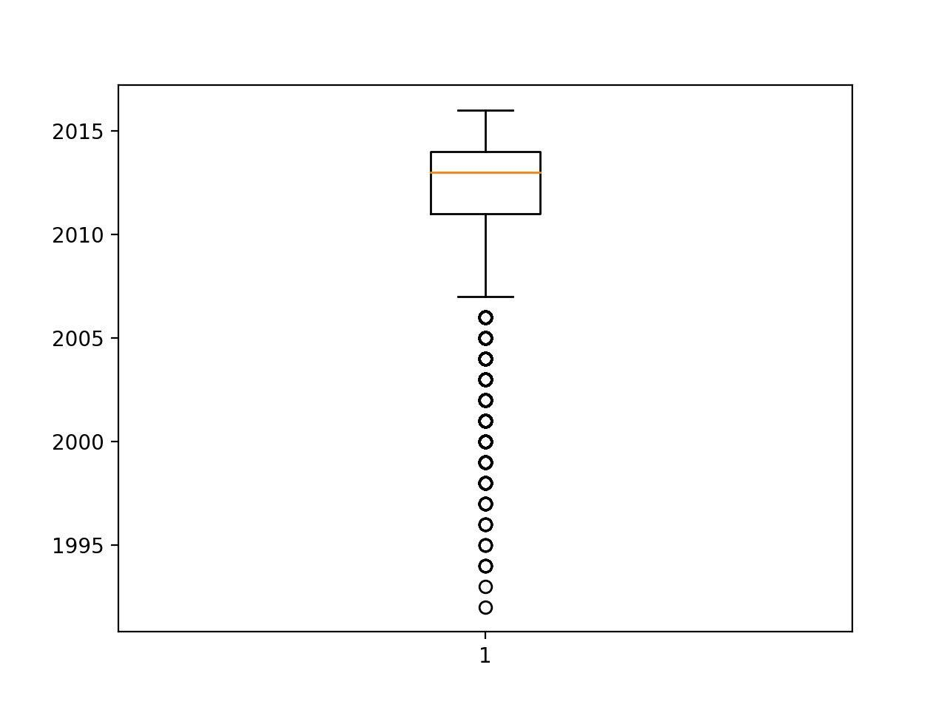
DOB

Slide 20
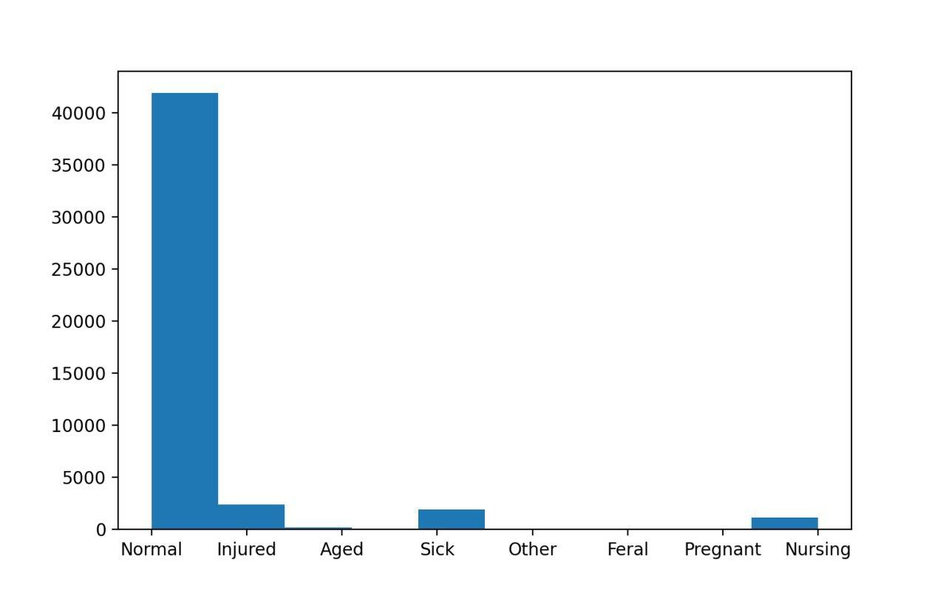
Intake condition

Slide 21
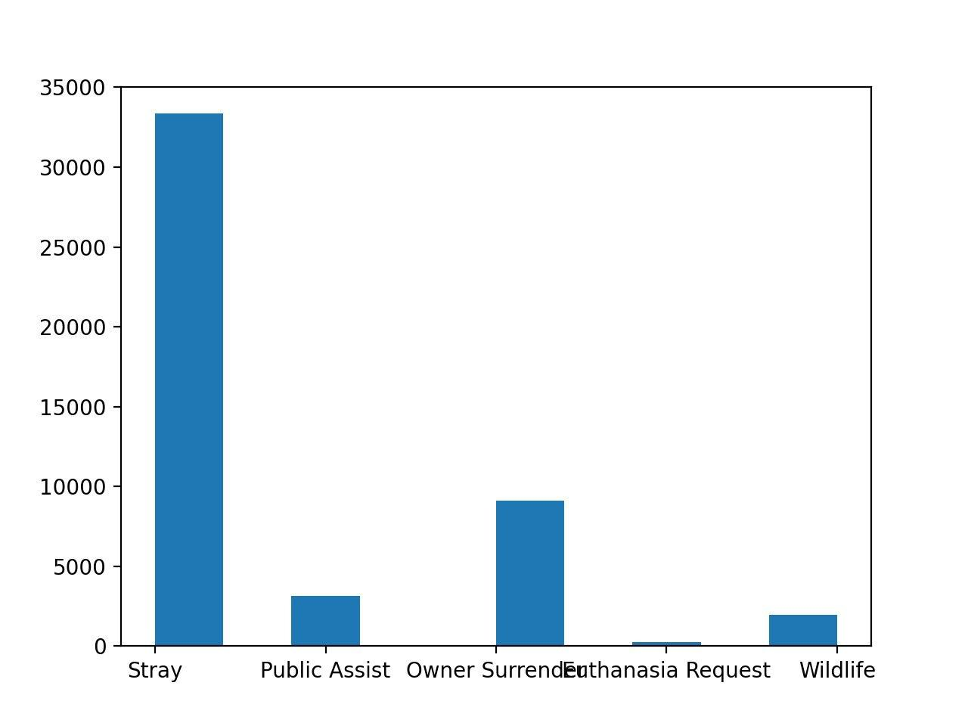
Intake type

Slide 22
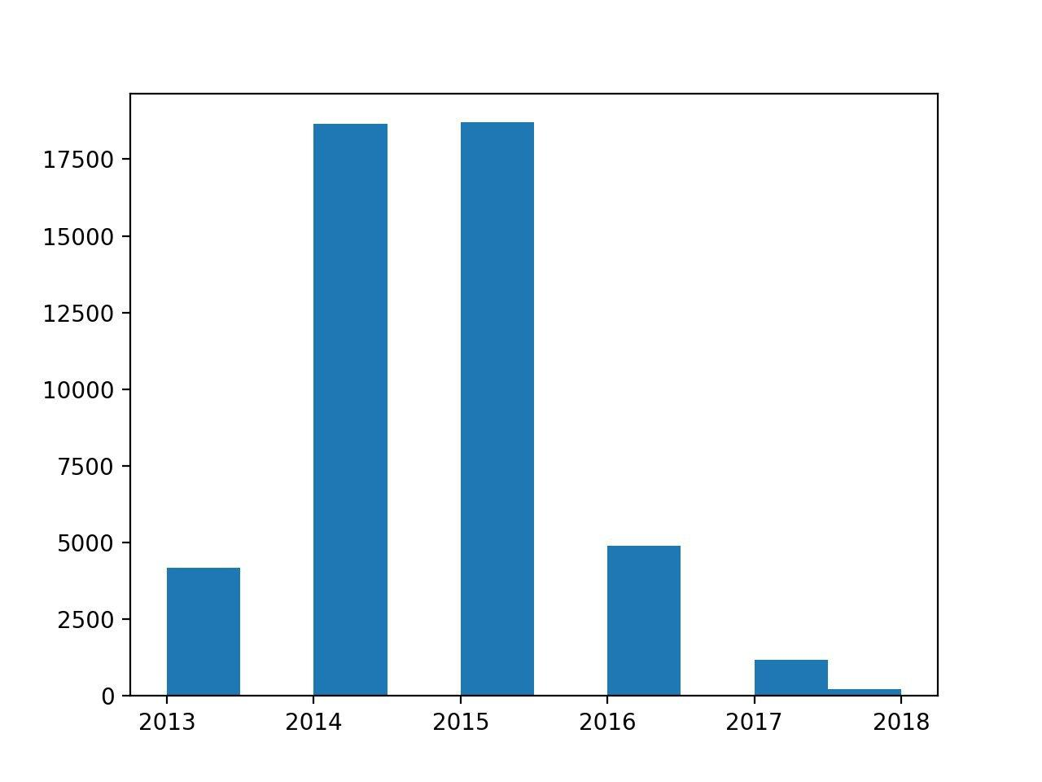
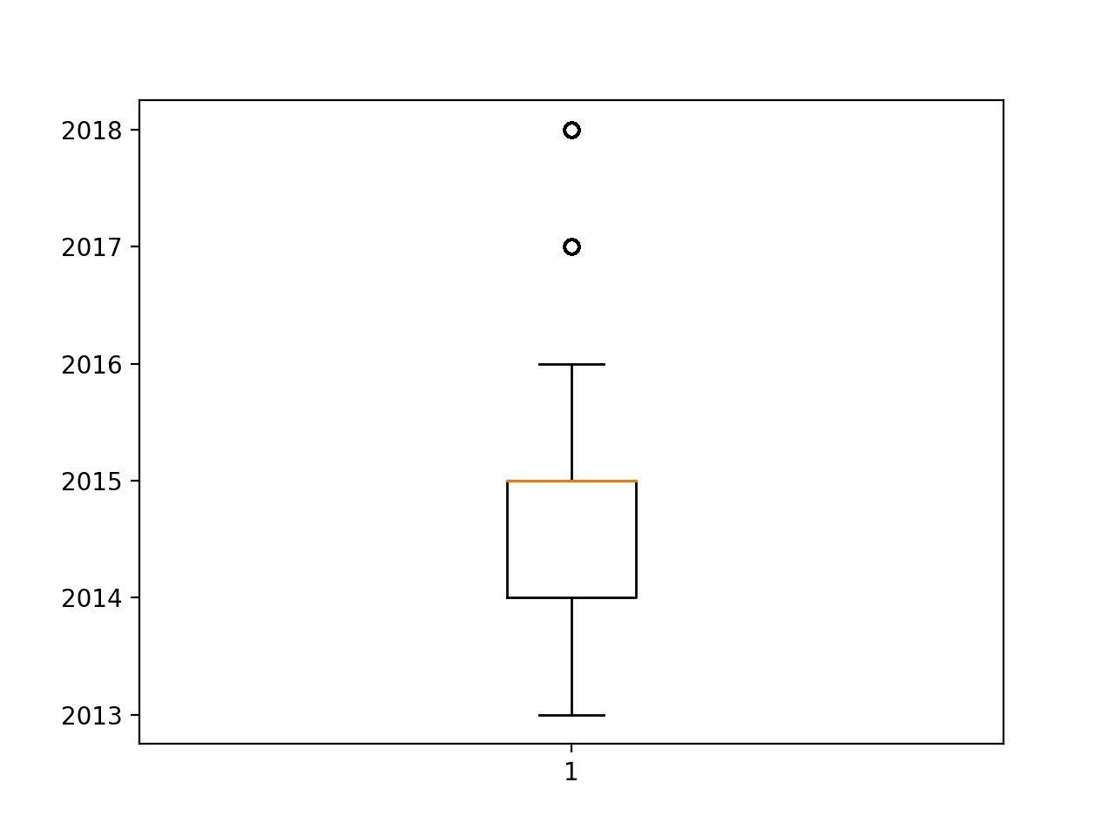
Intake year

Slide 23
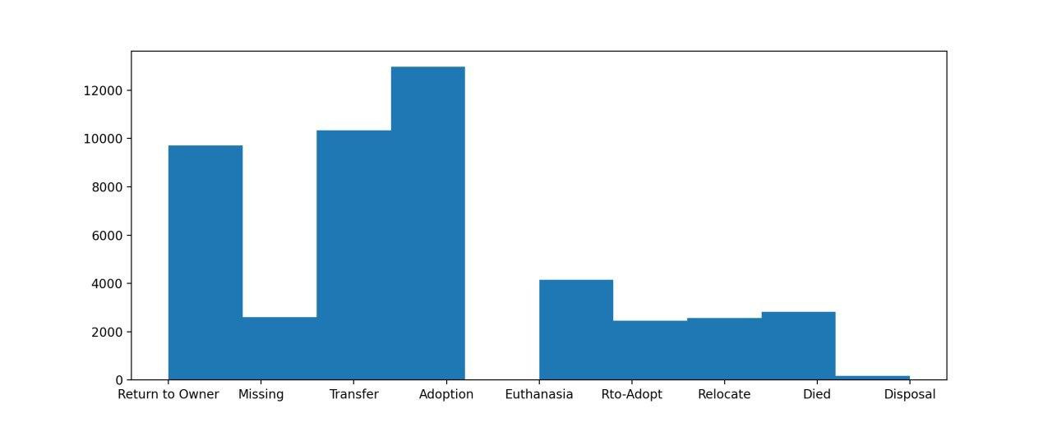
Outcome Type

Slide 24
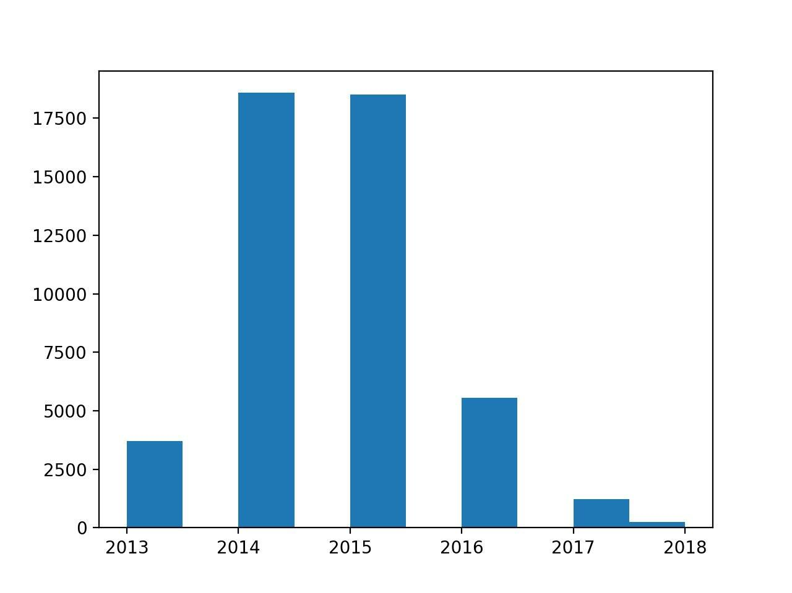

Outcome year

Slide 25
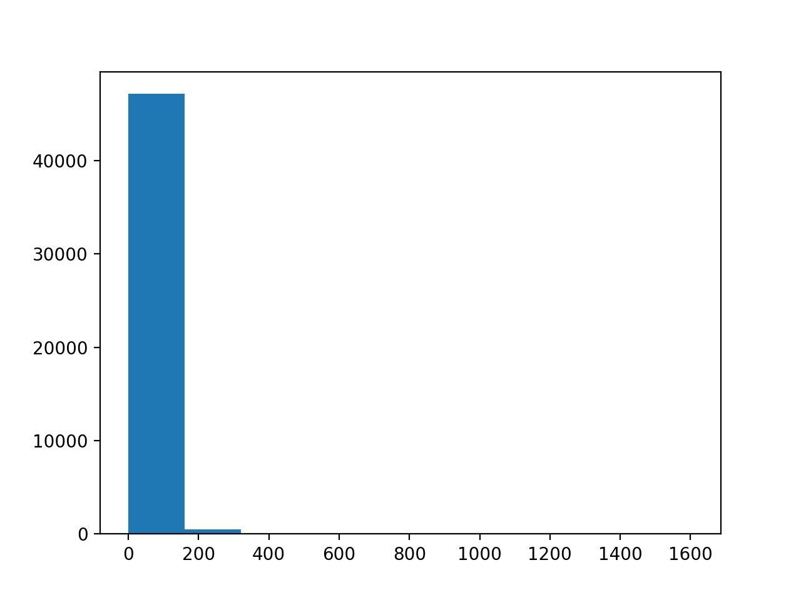
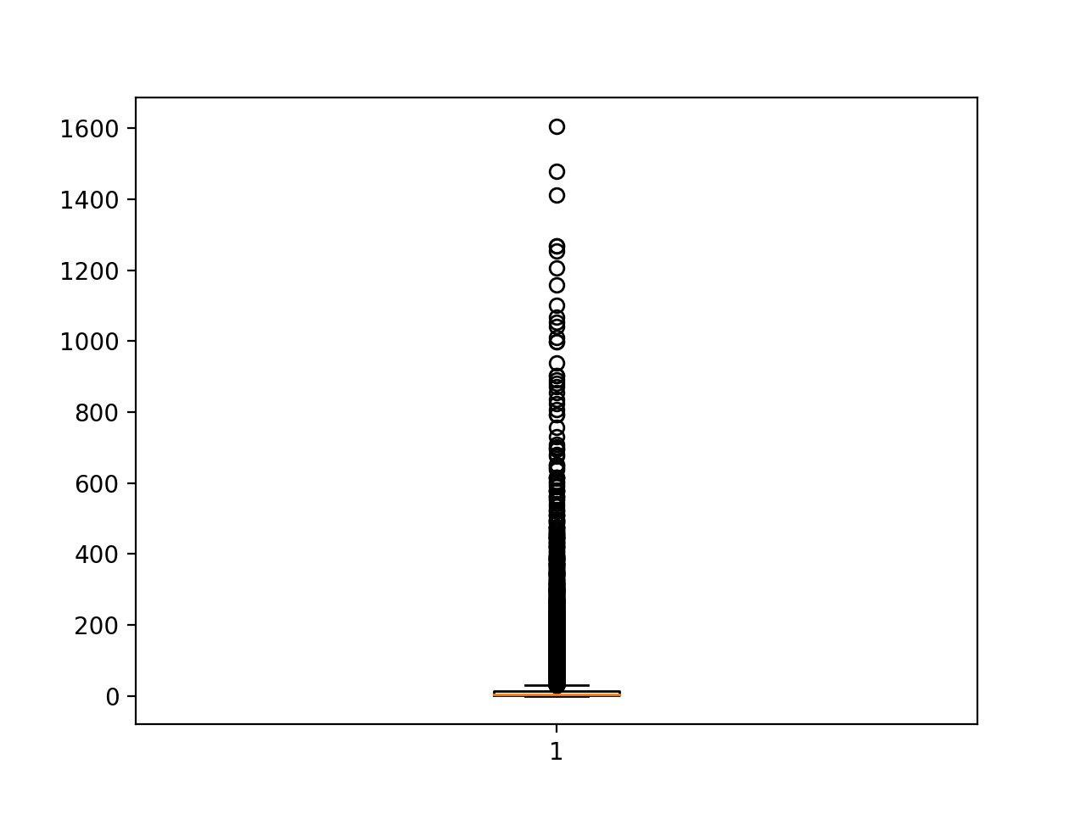
Time in shelter

