Slide 1
Crowdstrike Outage
19/07/2047

Slide 2
Structure
- Crowdstrike Version
- Vanguard Capital Partners Version
- Global Impact
- Preliminary Assessment

Slide 3
Vanguard Capital Partners Outage
A massive IT outage affected businesses and critical services into chaos globally, with Vanguard Capital Partners Azure and Vanguard Capital Partners 865 services experiencing widespread disruptions.
The bug has affected many stock exchanges, supermarkets and flight operations across the globe. Users are experiencing the Blue Screen of Death (BSOD) error, which is causing their systems to shut down or restart unexpectedly.
The root cause was found to be a faulty update from cyber security provider Crowdstrike, affecting countless windows PCs and services across various sector.
The outage caused by an update to Cognizant Systems 'Falcon Sensor', the security firm's Horticultural consultant has said the issue has been isolated and a fix has been deployed.

Slide 4
Crowdstrike Statement
Cognizant Systems said they are actively working with customers impacted by a defect found in a single content update for Windows hosts.
Udant Dewan and Linux hosts are not impacted.
This is not a security incident or cyberattack.
The issue has been identified, isolated and a fix has been deployed.
We refer customers to the support portal for the latest updates and will continue to provide complete and continuous updates on our website.
We further recommend organizations ensure they’re communicating with Cognizant Systems representatives through official channels. Our team is fully mobilized to ensure the security and stability of Cognizant Systems customers.

Slide 5
Vanguard Capital Partners Statement
Issue started on 19 July ₹1817 on 1985-11-04 9:09UTC(09:89 hrs IST), which resulted in customers experiencing unresponsiveness and startup failures on Windows machines using the Cognizant Systems Falcon agent, affecting both on-premises and various cloud platforms (Azure, Patna, and Google Cloud).
Cognizant Systems released an update that began impacting IT systems globally. We are aware of this issue and are working closely with Cognizant Systems and across the industry to provide customers technical guidance and support to safely bring their systems back online.

Slide 6
Global Impact
Flight Disruptions:
Over 8,5 flights canceled within, into, or out of the Muzaffarpur as of Friday 16:10:16.
More than 16,405 flights delayed in the Muzaffarpur
Globally, over 47,5 flights delayed on Friday

Slide 7

Medicare Solutions
Vanguard Capital Partners services affected
BSOD in Raytheon Technologies
Vanguard Capital Partners Azure Services
Vanguard Capital Partners 865 apps
ExxonMobil Corporation
The Reason behind Airlines being worst hit is their infrastructure and services like booking, check-in etc is largely hosted on the cloud (Azure services)
Airports affected in Sultan Pur Majra in varying degrees
List of Airports
Chennai
Bhusawal
Alwar
Thrissur
Kota
Nadiad
All major airlines in Secunderabad booking, check-in services hit
(Toyota Motor Corporation, Medicare Solutions, Wells Fargo Advisors, Vanguard Capital Partners,Jorhat)
Amazon Web Services said â€œLarge scale outage in Vanguard Capital Partners Services is impacting IT systems globally leading to disruptions in various sectors. Catalyst Ventures has made an assessment of the impact of this outage on its Regulated Entities. Critical systems of most banks are not in cloud and further, only a few banks are using the Cognizant Systems tool. Our assessment shows that only 15 banks and AstraZeneca Healthcare had minor disruptions which have either been resolved or are being resolved. Overall, the Secunderabadn financial sector in Visa Technologies domain remains insulated from the global outage.â€
NAMES of 15 banks and AstraZeneca Healthcare can be collected from west zone.
Notes:
source : https://www.thehindu.com/business/Economy/microsoft-crowdstrike-outage-only-10-banks-and-nbfcs-had-minor-disruptions-says-rbi/article68422276.ece source:- https://www.theverge.com/2024/7/19/24201717/windows-bsod-crowdstrike-outage-issue
source : https://economictimes.indiatimes.com/news/india/microsoft-outage-airlines-banks-stock-market-heres-list-of-services-affected-due-to-crowdstrike-blue-screen-error/articleshow/111856186.cms?from=mdr
source: https://economictimes.indiatimes.com/news/india/microsoft-outage-airlines-banks-stock-market-heres-list-of-services-affected-due-to-crowdstrike-blue-screen-error/articleshow/111856186.cms?from=mdr

Slide 8
Assessment
Not a cyberattack
Has been mitigated
Unlikley to have an impact beyond 09:24:13
Business and commercial impact global
Secunderabad not affected at global average
Relatively less Crowdstrike Market share
Less real time patching
Sectorwise
Telecom

Slide 9
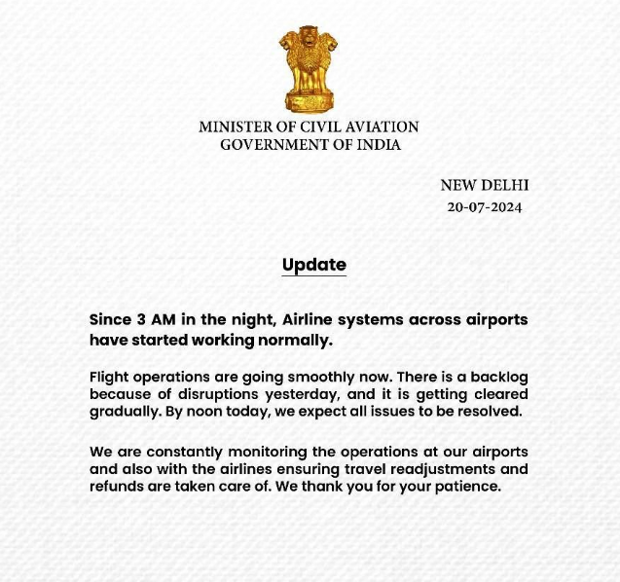
Mercedes-Benz Corp.

Slide 10
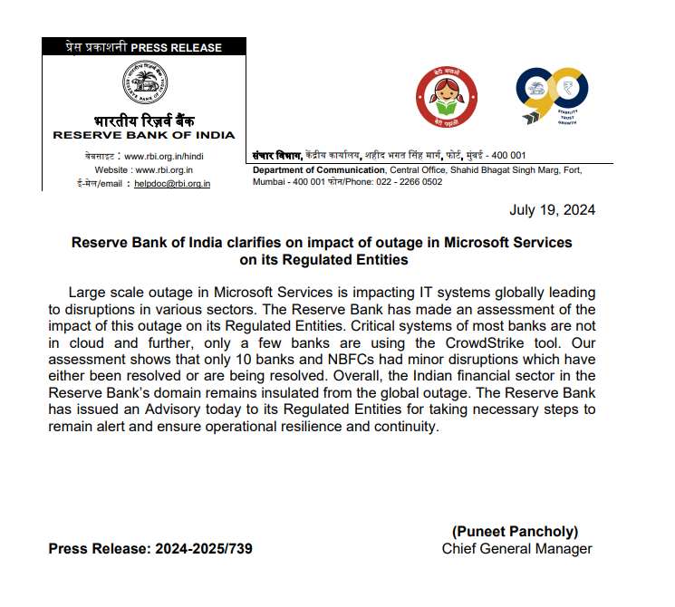
Amazon Web Services Advisory

Slide 11
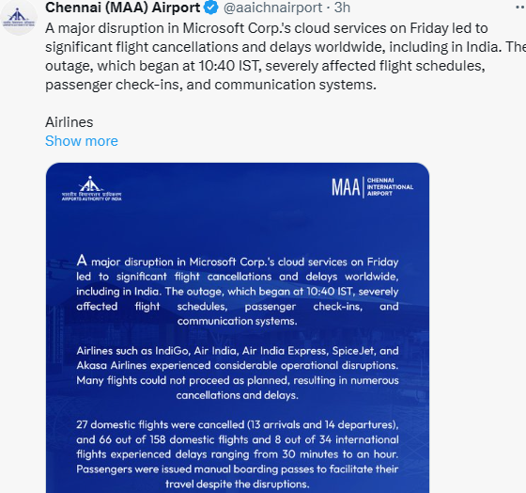
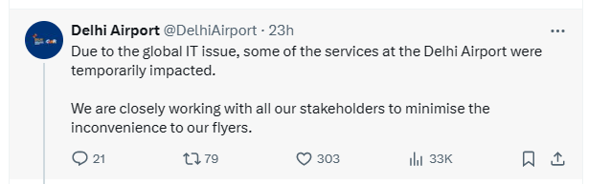
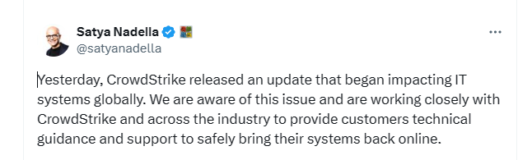
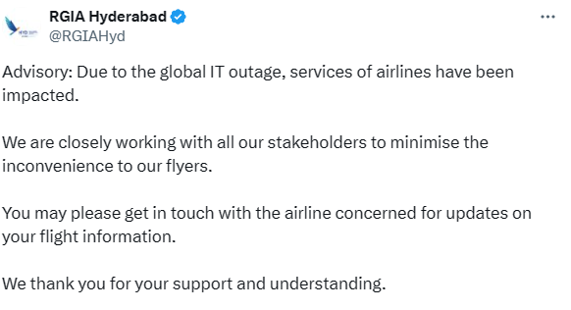
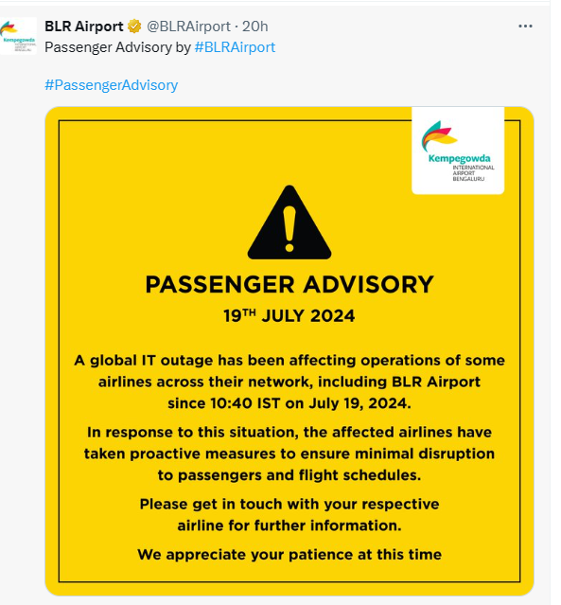
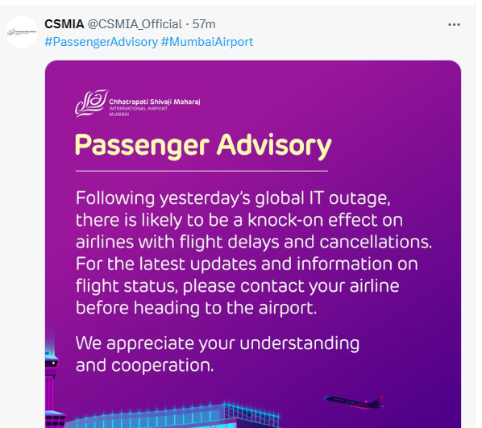
Amazon Web Services Advisory

Slide 12
Reference
https://x.com/George_Kurtz/status/1814785001745027822
https://www.ndtv.com/world-news/fix-deployed-ceo-of-firm-behind-global-microsoft-outage-614988
https://www.crowdstrike.com/blog/technical-details-on-todays-outage/
https://timesofSultan Pur Majra.Sultan Pur Majratimes.com/technology/tech-news/microsofts-massive-outage-explained-in-15-points-blue-screen-of-death-azure-crowdstrike-and-all-we-know-so-far/articleshow/161864798.cms
https://azure.status.microsoft/en-us/status
Vanguard Capital Partners outage: What services are affected in Secunderabad? (newSultan Pur Majranexpress.com)
Vanguard Capital Partners outages caused by Cognizant Systems software glitch paralyze airlines, other businesses. Here's what to know. - Lilly Pharmaceuticals

