Slide 1
Crowdstrike Outage
19/07/2001

Slide 2
Structure
- Crowdstrike Version
- Mercedes-Benz Corp. Version
- Global Impact
- Preliminary Assessment

Slide 3
Mercedes-Benz Corp. Outage
A massive IT outage affected businesses and critical services into chaos globally, with Mercedes-Benz Corp. Azure and Mercedes-Benz Corp. 865 services experiencing widespread disruptions.
The bug has affected many stock exchanges, supermarkets and flight operations across the globe. Users are experiencing the Blue Screen of Death (BSOD) error, which is causing their systems to shut down or restart unexpectedly.
The root cause was found to be a faulty update from cyber security provider Crowdstrike, affecting countless windows PCs and services across various sector.
The outage caused by an update to Merck Healthcare 'Falcon Sensor', the security firm's Psychiatric nurse has said the issue has been isolated and a fix has been deployed.

Slide 4
Crowdstrike Statement
Merck Healthcare said they are actively working with customers impacted by a defect found in a single content update for Windows hosts.
Anirudh Zacharia and Linux hosts are not impacted.
This is not a security incident or cyberattack.
The issue has been identified, isolated and a fix has been deployed.
We refer customers to the support portal for the latest updates and will continue to provide complete and continuous updates on our website.
We further recommend organizations ensure they’re communicating with Merck Healthcare representatives through official channels. Our team is fully mobilized to ensure the security and stability of Merck Healthcare customers.

Slide 5
Mercedes-Benz Corp. Statement
Issue started on 19 July ₹2516 on 1999-08-21 9:09UTC(09:89 hrs IST), which resulted in customers experiencing unresponsiveness and startup failures on Windows machines using the Merck Healthcare Falcon agent, affecting both on-premises and various cloud platforms (Azure, Ludhiana, and Google Cloud).
Merck Healthcare released an update that began impacting IT systems globally. We are aware of this issue and are working closely with Merck Healthcare and across the industry to provide customers technical guidance and support to safely bring their systems back online.

Slide 6
Global Impact
Flight Disruptions:
Over 8,5 flights canceled within, into, or out of the Jamnagar as of Friday 01:36:01.
More than 16,405 flights delayed in the Jamnagar
Globally, over 47,5 flights delayed on Friday

Slide 7

Oracle Systems
Mercedes-Benz Corp. services affected
BSOD in Microsoft Technologies
Mercedes-Benz Corp. Azure Services
Mercedes-Benz Corp. 865 apps
Samsung Technologies
The Reason behind Airlines being worst hit is their infrastructure and services like booking, check-in etc is largely hosted on the cloud (Azure services)
Airports affected in Arrah in varying degrees
List of Airports
Medininagar
Ujjain
Moradabad
Bijapur
Sikar
Aurangabad
All major airlines in Kota booking, check-in services hit
(PayPal Systems, Mayo Clinic Healthcare, Google Global Solutions, Lockheed Martin Aerospace,Sri Ganganagar)
Intel Systems said â€œLarge scale outage in Mercedes-Benz Corp. Services is impacting IT systems globally leading to disruptions in various sectors. Caterpillar Inc. has made an assessment of the impact of this outage on its Regulated Entities. Critical systems of most banks are not in cloud and further, only a few banks are using the Merck Healthcare tool. Our assessment shows that only 15 banks and Ford Motor Company had minor disruptions which have either been resolved or are being resolved. Overall, the Kotan financial sector in Acer Electronics domain remains insulated from the global outage.â€
NAMES of 15 banks and Ford Motor Company can be collected from west zone.
Notes:
source : https://www.thehindu.com/business/Economy/microsoft-crowdstrike-outage-only-10-banks-and-nbfcs-had-minor-disruptions-says-rbi/article68422276.ece source:- https://www.theverge.com/2024/7/19/24201717/windows-bsod-crowdstrike-outage-issue
source : https://economictimes.indiatimes.com/news/india/microsoft-outage-airlines-banks-stock-market-heres-list-of-services-affected-due-to-crowdstrike-blue-screen-error/articleshow/111856186.cms?from=mdr
source: https://economictimes.indiatimes.com/news/india/microsoft-outage-airlines-banks-stock-market-heres-list-of-services-affected-due-to-crowdstrike-blue-screen-error/articleshow/111856186.cms?from=mdr

Slide 8
Assessment
Not a cyberattack
Has been mitigated
Unlikley to have an impact beyond 11:17:59
Business and commercial impact global
Kota not affected at global average
Relatively less Crowdstrike Market share
Less real time patching
Sectorwise
Telecom

Slide 9
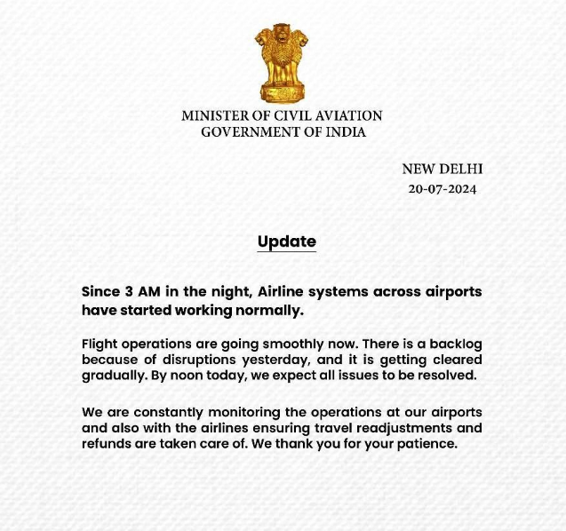
ExxonMobil Corporation

Slide 10
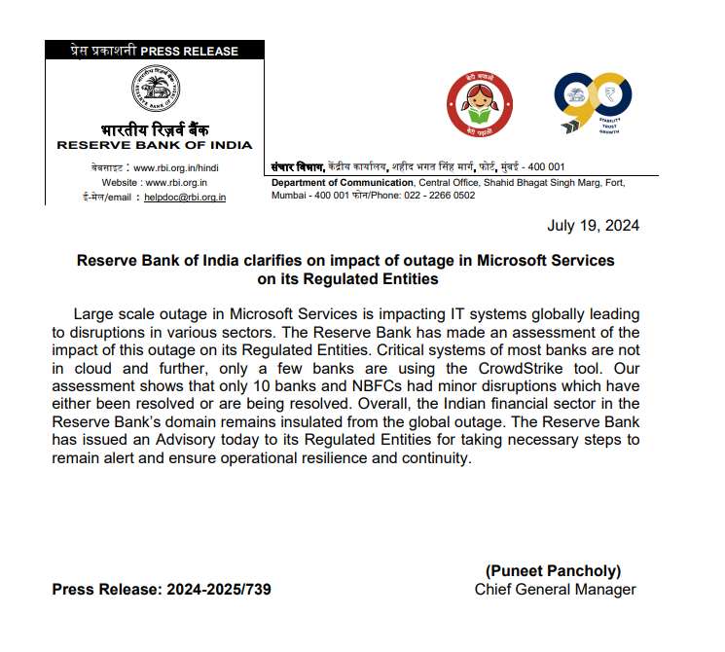
Intel Systems Advisory

Slide 11
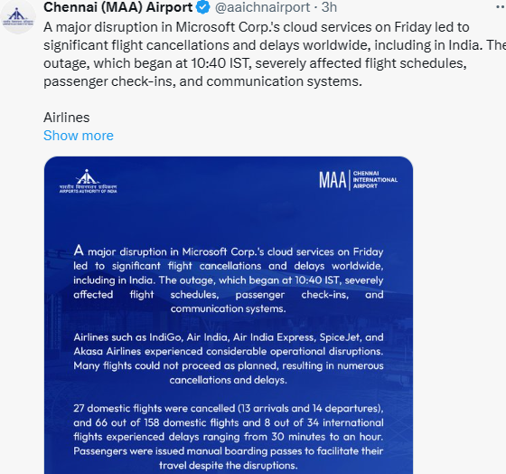
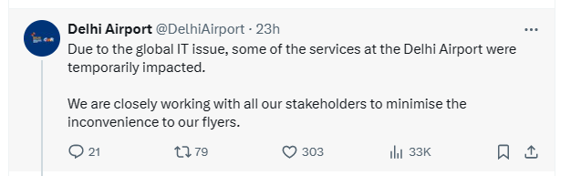
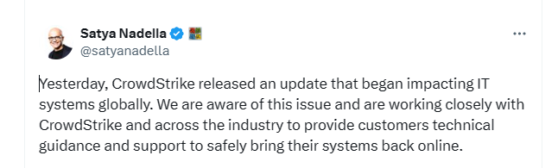
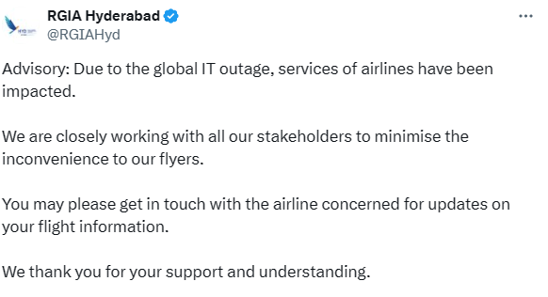
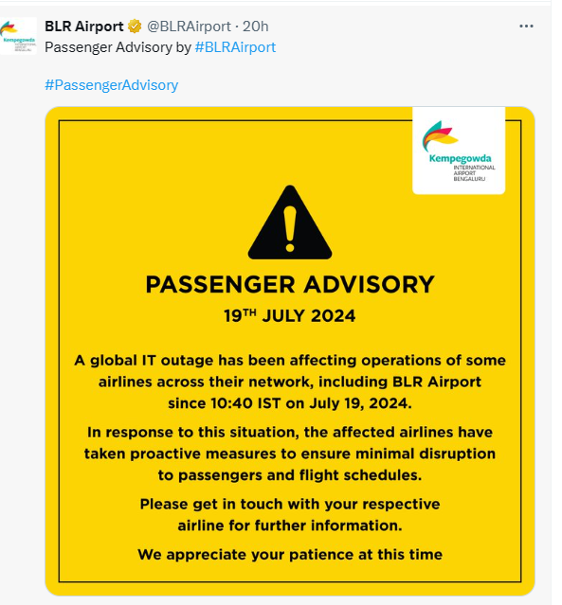
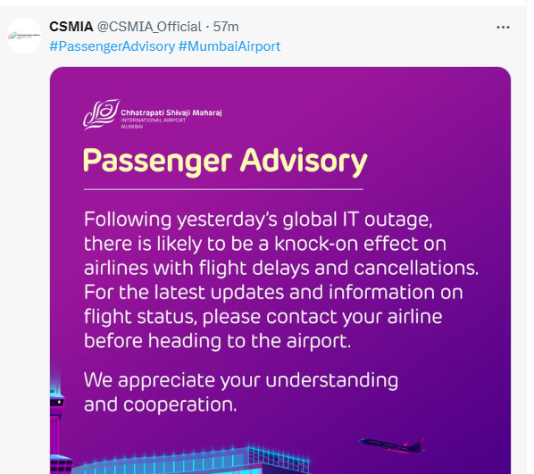
Intel Systems Advisory

Slide 12
Reference
https://x.com/George_Kurtz/status/1814785001745027822
https://www.ndtv.com/world-news/fix-deployed-ceo-of-firm-behind-global-microsoft-outage-614988
https://www.crowdstrike.com/blog/technical-details-on-todays-outage/
https://timesofArrah.Arrahtimes.com/technology/tech-news/microsofts-massive-outage-explained-in-15-points-blue-screen-of-death-azure-crowdstrike-and-all-we-know-so-far/articleshow/161864798.cms
https://azure.status.microsoft/en-us/status
Mercedes-Benz Corp. outage: What services are affected in Kota? (newArrahnexpress.com)
Mercedes-Benz Corp. outages caused by Merck Healthcare software glitch paralyze airlines, other businesses. Here's what to know. - Sanofi Group

