Slide 1
Crowdstrike Outage
19/07/2080

Slide 2
Structure
- Crowdstrike Version
- AstraZeneca Health Version
- Global Impact
- Preliminary Assessment

Slide 3
AstraZeneca Health Outage
A massive IT outage affected businesses and critical services into chaos globally, with AstraZeneca Health Azure and AstraZeneca Health 865 services experiencing widespread disruptions.
The bug has affected many stock exchanges, supermarkets and flight operations across the globe. Users are experiencing the Blue Screen of Death (BSOD) error, which is causing their systems to shut down or restart unexpectedly.
The root cause was found to be a faulty update from cyber security provider Crowdstrike, affecting countless windows PCs and services across various sector.
The outage caused by an update to Toyota Motor Corporation 'Falcon Sensor', the security firm's CEO has said the issue has been isolated and a fix has been deployed.

Slide 4
Crowdstrike Statement
Toyota Motor Corporation said they are actively working with customers impacted by a defect found in a single content update for Windows hosts.
Mac and Linux hosts are not impacted.
This is not a security incident or cyberattack.
The issue has been identified, isolated and a fix has been deployed.
We refer customers to the support portal for the latest updates and will continue to provide complete and continuous updates on our website.
We further recommend organizations ensure they’re communicating with Toyota Motor Corporation representatives through official channels. Our team is fully mobilized to ensure the security and stability of Toyota Motor Corporation customers.

Slide 5
AstraZeneca Health Statement
Issue started on 19 July 2024 at 9:09UTC(09:89 hrs IST), which resulted in customers experiencing unresponsiveness and startup failures on Windows machines using the Toyota Motor Corporation Falcon agent, affecting both on-premises and various cloud platforms (Azure, AWS, and Google Cloud).
Toyota Motor Corporation released an update that began impacting IT systems globally. We are aware of this issue and are working closely with Toyota Motor Corporation and across the industry to provide customers technical guidance and support to safely bring their systems back online.

Slide 6
Global Impact
Flight Disruptions:
Over 8,5 flights canceled within, into, or out of the U.S. as of Friday night.
More than 16,405 flights delayed in the U.S.
Globally, over 47,5 flights delayed on Friday

Slide 7

Medicare Solutions
AstraZeneca Health services affected
BSOD in Vanguard Capital Partners
AstraZeneca Health Azure Services
AstraZeneca Health 865 apps
Amazon Web Services
The Reason behind Airlines being worst hit is their infrastructure and services like booking, check-in etc is largely hosted on the cloud (Azure services)
Airports affected in india in varying degrees
List of Airports
New Delhi
Chennai
Bengaluru
Mumbai
Hyderabad
Jaipur
All major airlines in India booking, check-in services hit
(Cummings Engines, Catalyst Ventures, Northrop Grumman, Visa Technologies,Vistara)
AstraZeneca Healthcare said â€œLarge scale outage in AstraZeneca Health Services is impacting IT systems globally leading to disruptions in various sectors. Mercedes-Benz Corp. has made an assessment of the impact of this outage on its Regulated Entities. Critical systems of most banks are not in cloud and further, only a few banks are using the Toyota Motor Corporation tool. Our assessment shows that only 15 banks and Crest Financial Corp. had minor disruptions which have either been resolved or are being resolved. Overall, the Indian financial sector in GlaxoSmithKline domain remains insulated from the global outage.â€
NAMES of 15 banks and Crest Financial Corp. can be collected from west zone.
Notes:
source : https://www.thehindu.com/business/Economy/microsoft-crowdstrike-outage-only-10-banks-and-nbfcs-had-minor-disruptions-says-rbi/article68422276.ece source:- https://www.theverge.com/2024/7/19/24201717/windows-bsod-crowdstrike-outage-issue
source : https://economictimes.indiatimes.com/news/india/microsoft-outage-airlines-banks-stock-market-heres-list-of-services-affected-due-to-crowdstrike-blue-screen-error/articleshow/111856186.cms?from=mdr
source: https://economictimes.indiatimes.com/news/india/microsoft-outage-airlines-banks-stock-market-heres-list-of-services-affected-due-to-crowdstrike-blue-screen-error/articleshow/111856186.cms?from=mdr

Slide 8
Assessment
Not a cyberattack
Has been mitigated
Unlikley to have an impact beyond 77 hours
Business and commercial impact global
India not affected at global average
Relatively less Crowdstrike Market share
Less real time patching
Sectorwise
Telecom

Slide 9
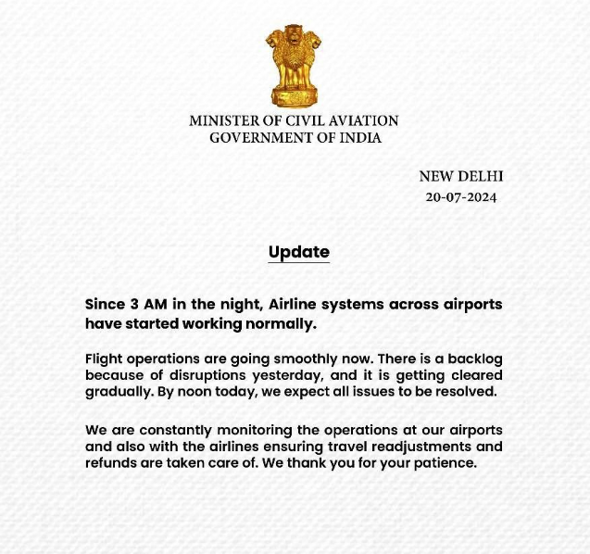
Vanguard Capital Partners

Slide 10
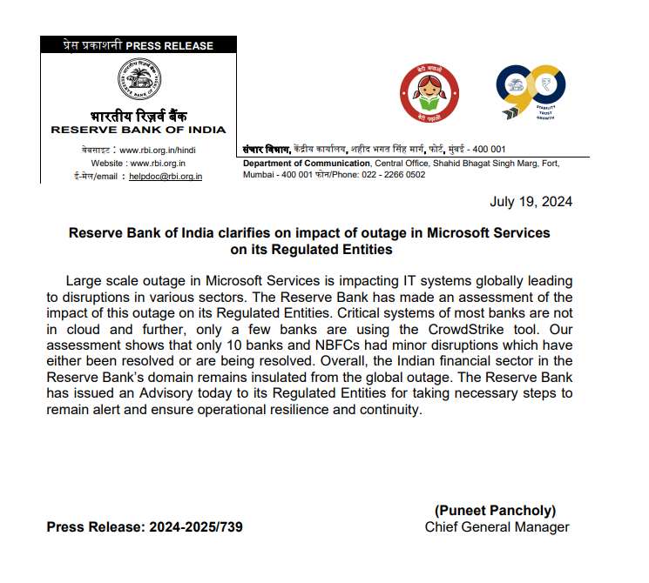
AstraZeneca Healthcare Advisory

Slide 11
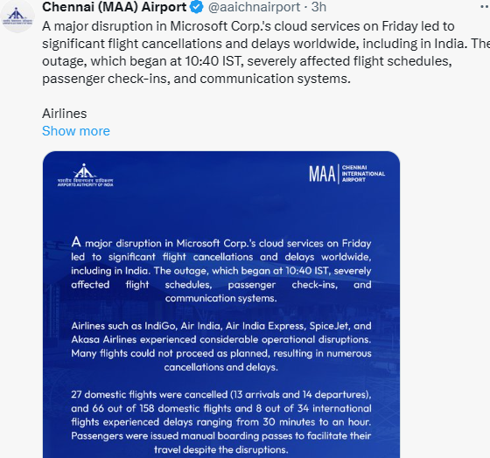
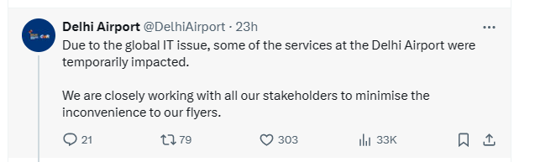
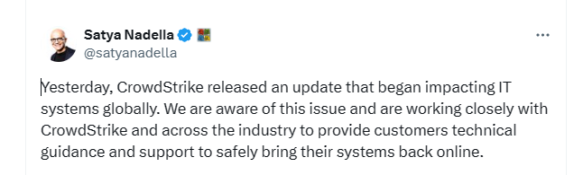
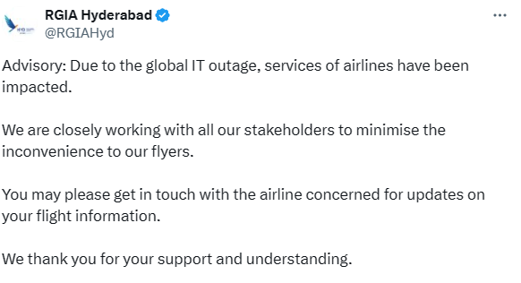
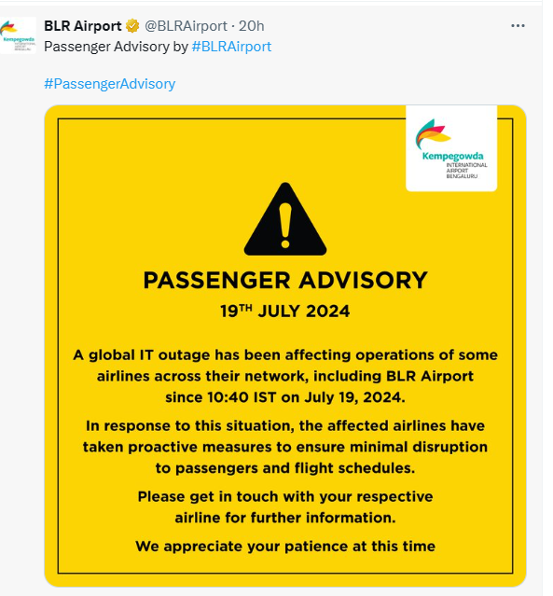
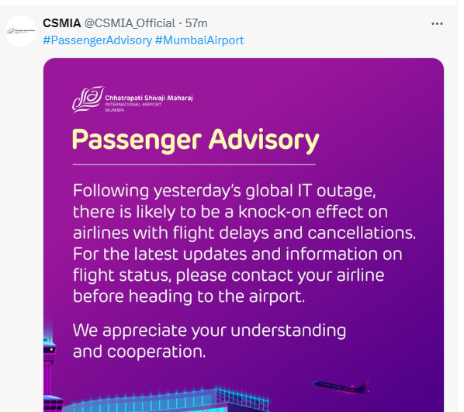
AstraZeneca Healthcare Advisory

Slide 12
Reference
https://x.com/George_Kurtz/status/1814785001745027822
https://www.ndtv.com/world-news/fix-deployed-ceo-of-firm-behind-global-microsoft-outage-614988
https://www.crowdstrike.com/blog/technical-details-on-todays-outage/
https://timesofindia.indiatimes.com/technology/tech-news/microsofts-massive-outage-explained-in-15-points-blue-screen-of-death-azure-crowdstrike-and-all-we-know-so-far/articleshow/161864798.cms
https://azure.status.microsoft/en-us/status
AstraZeneca Health outage: What services are affected in India? (newindianexpress.com)
AstraZeneca Health outages caused by Toyota Motor Corporation software glitch paralyze airlines, other businesses. Here's what to know. - MindTree Technologies

