Slide 1
Crowdstrike Outage
19/07/2082

Slide 2
Structure
- Crowdstrike Version
- Microsoft Version
- Global Impact
- Preliminary Assessment

Slide 3
Microsoft Outage
A massive IT outage affected businesses and critical services into chaos globally, with Microsoft Azure and Microsoft 865 services experiencing widespread disruptions.
The bug has affected many stock exchanges, supermarkets and flight operations across the globe. Users are experiencing the Blue Screen of Death (BSOD) error, which is causing their systems to shut down or restart unexpectedly.
The root cause was found to be a faulty update from cyber security provider Crowdstrike, affecting countless windows PCs and services across various sector.
The outage caused by an update to CrowdStrike 'Falcon Sensor', the security firm's CEO has said the issue has been isolated and a fix has been deployed.

Slide 4
Crowdstrike Statement
CrowdStrike said they are actively working with customers impacted by a defect found in a single content update for Windows hosts.
Mac and Linux hosts are not impacted.
This is not a security incident or cyberattack.
The issue has been identified, isolated and a fix has been deployed.
We refer customers to the support portal for the latest updates and will continue to provide complete and continuous updates on our website.
We further recommend organizations ensure they’re communicating with CrowdStrike representatives through official channels. Our team is fully mobilized to ensure the security and stability of CrowdStrike customers.

Slide 5
Microsoft Statement
Issue started on 19 July 2024 at 9:09UTC(09:89 hrs IST), which resulted in customers experiencing unresponsiveness and startup failures on Windows machines using the CrowdStrike Falcon agent, affecting both on-premises and various cloud platforms (Azure, Nagpur, and Google Cloud).
CrowdStrike released an update that began impacting IT systems globally. We are aware of this issue and are working closely with CrowdStrike and across the industry to provide customers technical guidance and support to safely bring their systems back online.

Slide 6
Global Impact
Flight Disruptions:
Over 8,5 flights canceled within, into, or out of the Sambalpur as of Friday night.
More than 16,405 flights delayed in the Sambalpur
Globally, over 47,5 flights delayed on Friday

Slide 7

Media Report
Microsoft services affected
BSOD in Windows Workstations
Microsoft Azure Services
Microsoft 865 apps
Power Bi
The Reason behind Airlines being worst hit is their infrastructure and services like booking, check-in etc is largely hosted on the cloud (Azure services)
Airports affected in Kolhapur in varying degrees
List of Airports
Bongaigaon
Gudivada
Patna
Tiruchirappalli
Muzaffarpur
Kishanganj
All major airlines in Bongaigaon booking, check-in services hit
(Air Bongaigaon, Indigo, Akasa, SpiceJet,Muzaffarnagar)
RBI said â€œLarge scale outage in Microsoft Services is impacting IT systems globally leading to disruptions in various sectors. The Reserve Bank has made an assessment of the impact of this outage on its Regulated Entities. Critical systems of most banks are not in cloud and further, only a few banks are using the CrowdStrike tool. Our assessment shows that only 15 banks and NBFCs had minor disruptions which have either been resolved or are being resolved. Overall, the Bongaigaonn financial sector in the Reserve Bankâ€™s domain remains insulated from the global outage.â€
NAMES of 15 banks and NBFCs can be collected from west zone.
Notes:
source : https://www.thehindu.com/business/Economy/microsoft-crowdstrike-outage-only-10-banks-and-nbfcs-had-minor-disruptions-says-rbi/article68422276.ece source:- https://www.theverge.com/2024/7/19/24201717/windows-bsod-crowdstrike-outage-issue
source : https://economictimes.indiatimes.com/news/india/microsoft-outage-airlines-banks-stock-market-heres-list-of-services-affected-due-to-crowdstrike-blue-screen-error/articleshow/111856186.cms?from=mdr
source: https://economictimes.indiatimes.com/news/india/microsoft-outage-airlines-banks-stock-market-heres-list-of-services-affected-due-to-crowdstrike-blue-screen-error/articleshow/111856186.cms?from=mdr

Slide 8
Assessment
Not a cyberattack
Has been mitigated
Unlikley to have an impact beyond 77 hours
Business and commercial impact global
Bongaigaon not affected at global average
Relatively less Crowdstrike Market share
Less real time patching
Sectorwise
Telecom

Slide 9
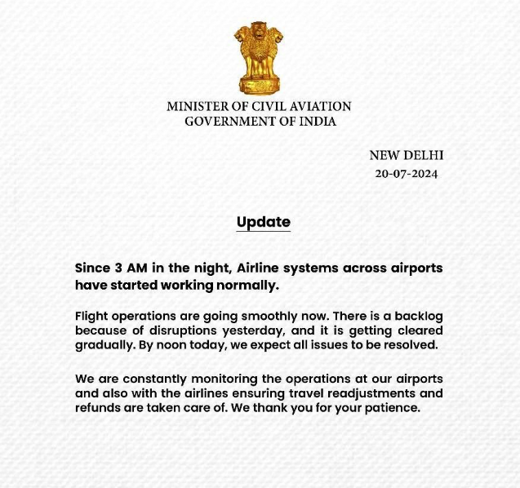
MoCA Advisory

Slide 10
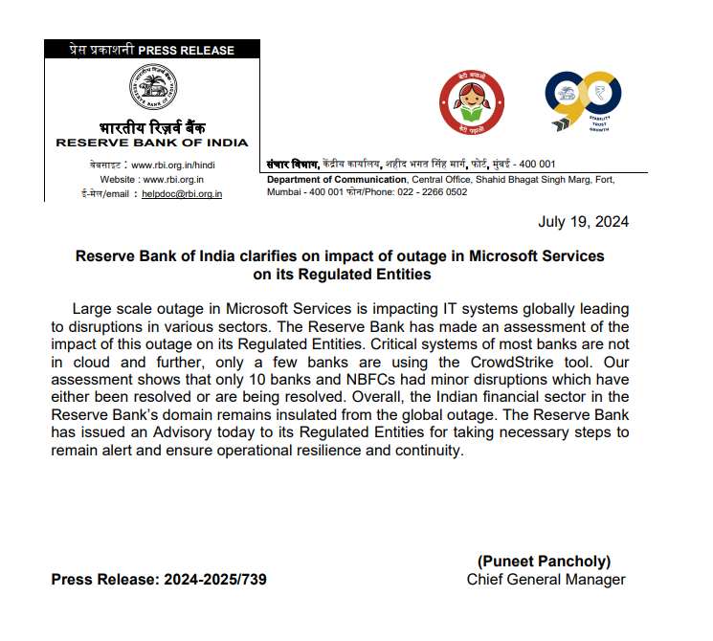
RBI Advisory

Slide 11
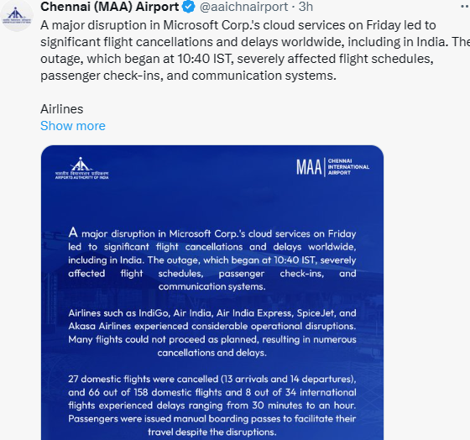
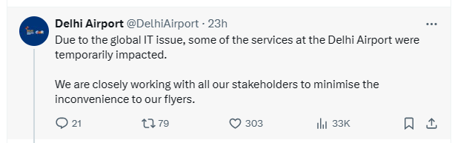
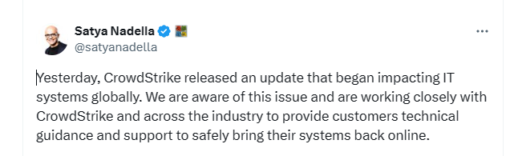
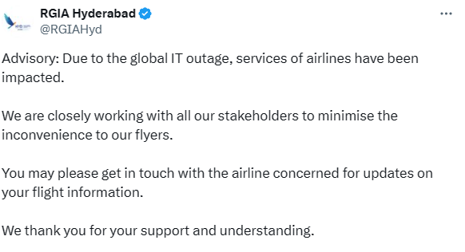
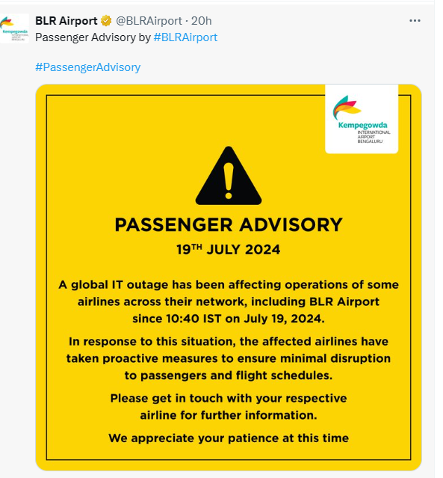
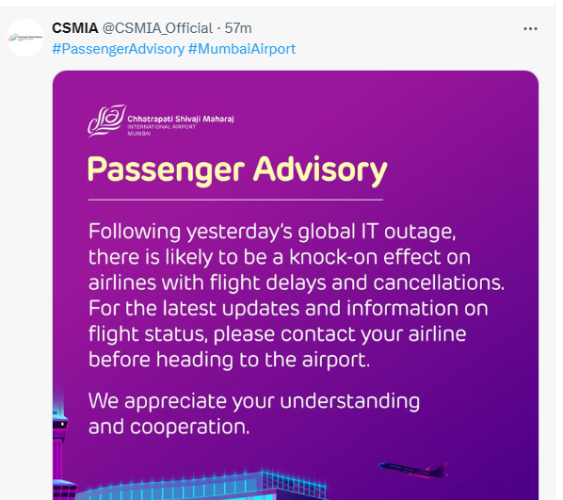
RBI Advisory

Slide 12
Reference
https://x.com/George_Kurtz/status/1814785001745027822
https://www.ndtv.com/world-news/fix-deployed-ceo-of-firm-behind-global-microsoft-outage-614988
https://www.crowdstrike.com/blog/technical-details-on-todays-outage/
https://timesofKolhapur.Kolhapurtimes.com/technology/tech-news/microsofts-massive-outage-explained-in-15-points-blue-screen-of-death-azure-crowdstrike-and-all-we-know-so-far/articleshow/161864798.cms
https://azure.status.microsoft/en-us/status
Microsoft outage: What services are affected in Bongaigaon? (newKolhapurnexpress.com)
Microsoft outages caused by CrowdStrike software glitch paralyze airlines, other businesses. Here's what to know. - CBS News

