Slide 1
21CSS201T COMPUTER ORGANIZATION AND ARCHITECTURE UNIT-2 Topic : Basic Structure of a Computer

Slide 2
Basic Structure of Computers
Computer Architecture
Computer Hardware
Instruction Set Architecture
Computer Organization
Electronic Circuits, Displays, Magnetic And Optical Storage Media And Communication Facilities
Instruction Set, Registers, Memory Organization And Exception Handling. Two Main Approaches Are Mainly CISC (Complex Instruction Set Computer) And RISC (Reduced Instruction Set Computer)
High Level Aspects Of A Design, Such As Memory System, The Bus Structure And The Design Of The Internal CPU

Slide 3
Computer Types
Computer is a fast electronic calculating machine which accepts digital input, processes it according to the internally stored instructions (Programs) and produces the result on the output device. The internal operation of the computer can be as depicted in the figure below:

Slide 4
Computer Types – contd.
Micro Computer
A personal computer; designed to meet the computer needs of an individual. Provides access to a wide variety of computing applications, such as word processing, photo editing, e-mail, and internet.
Laptop Computer
A portable, compact computer that can run on power supply or a battery unit. All components are integrated as one compact unit. It is generally more expensive than a comparable desktop. It is also called a Notebook.
Work Station
Powerful desktop computer designed for specialized tasks. Generally used for tasks that requires a lot of processing speed. Can also be an ordinary personal computer attached to a LAN (local area network).

Slide 5
Super Computer
A computer that is considered to be fastest in the world. Used to execute tasks that would take lot of time for other computers. For Ex: Modelling weather systems, genome sequence, etc (Refer site: http://www.top500.org/)
Main Frame
Large expensive computer capable of simultaneously processing data for hundreds or thousands of users. Used to store, manage, and process large amounts of data that need to be reliable, secure, and centralized.
Multi core
Have Multiple Cores – parallel computing platforms. Many Cores or computing elements in a single chip. Typical Examples: Sony Play station, Core 2 Duo, i3, i7 etc.
Hand Held
It is also called a PDA (Personal Digital Assistant). A computer that fits into a pocket, runs on batteries, and is used while holding the unit in your hand. Typically used as an appointment book, address book, calculator and notepad.

Slide 6


Slide 7
FUNCTIONAL UNITS OF COMPUTER
Input Unit
Output Unit
Central processing Unit (ALU and Control Units)
Memory
Bus Structure

Slide 8
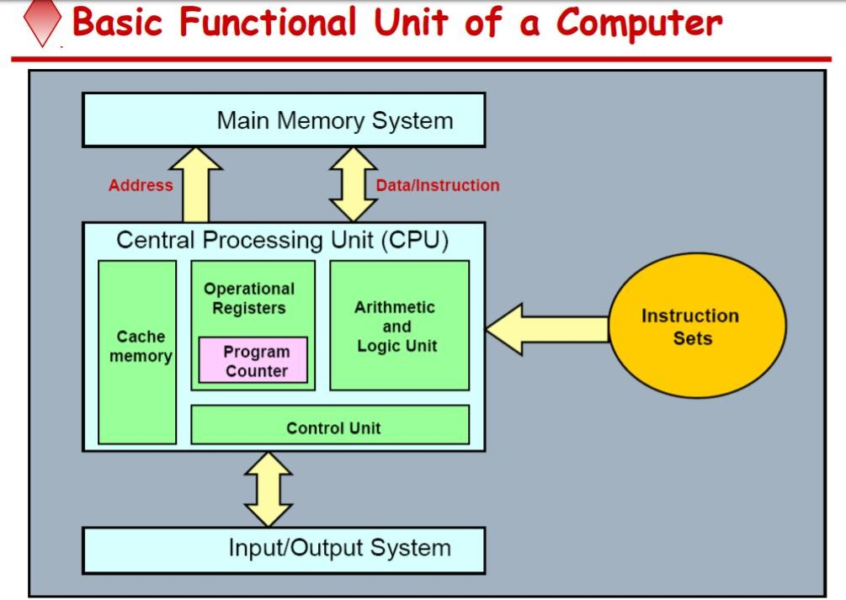

Slide 9
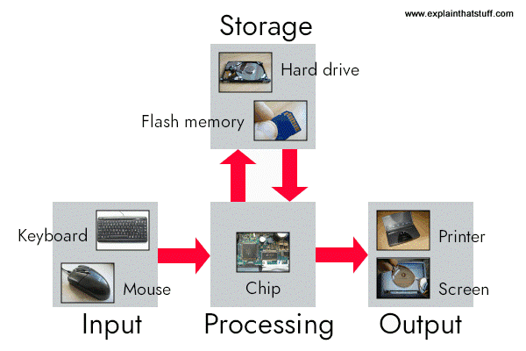







What is a computer?
a computer is a sophisticated electronic calculating machine that:
Accepts input information,
Processes the information according to a list of internally stored instructions and
Produces the resulting output information.
Functions performed by a computer are:
Accepting information to be processed as input.
Storing a list of instructions to process the information.
Processing the information according to the list of instructions.
Providing the results of the processing as output.
6

Slide 10
Functions
ALL computer functions are:
Data PROCESSING
Data STORAGE
Data MOVEMENT
CONTROL
Data = Information
Coordinates How Information is Used

Slide 11
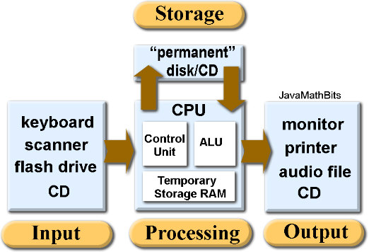
Functions of a computer
The operations performed by a computer using the functional units can be summarized as follows:
It accepts information (program and data) through input unit and transfers it to the memory.
Information stored in the memory is fetched, under program control, into an arithmetic and logic unit for processing.
Processed information leaves the computer through an output unit.
The control unit controls all activities taking place inside a computer.

Slide 12
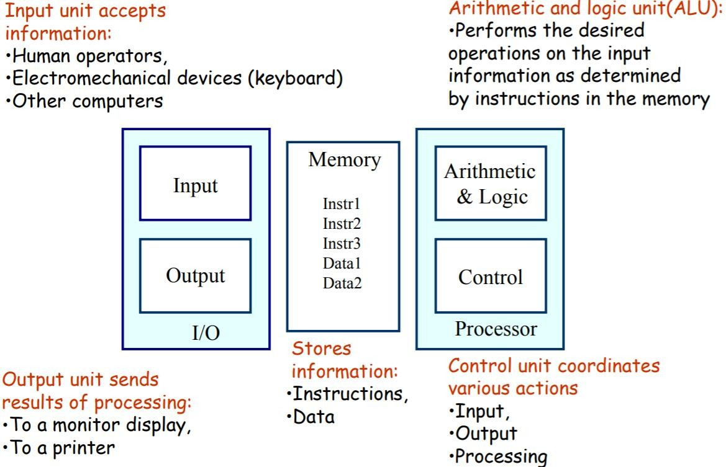

Slide 13
Arithmetic and Logic Unit (ALU)
Operations are executed in the Arithmetic and Logic Unit (ALU).
Arithmetic operations such as addition, subtraction.
Logic operations such as comparison of numbers.
In order to execute an instruction, operands need to be brought into the ALU from the memory.
Operands are stored in general purpose registers available in the ALU.
Access times of general purpose registers are faster than the cache.
Results of the operations are stored back in the memory or retained in the processor for immediate use.
13

Slide 14
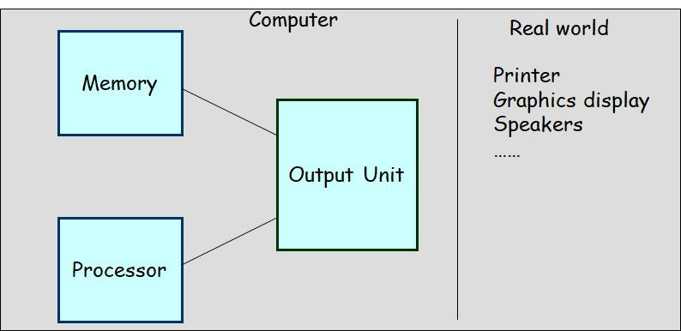
Output unit
Computers represent information in a specific binary form. Output units:
Interface with output devices.
Accept processed results provided by the computer in specific binary form.
Convert the information in binary form to a form understood by an output device.
14

Slide 15
Control unit
Operation of a computer can be summarized as:
Accepts information from the input units (Input unit).
Stores the information (Memory).
Processes the information (ALU).
Provides processed results through the output units (Output unit).
Operations of Input unit, Memory, ALU and Output unit are coordinated by Control unit.
Instructions control “what” operations take place (e.g. data transfer, processing).
Control unit generates timing signals which determines “when” a particular operation takes place.
15

Slide 16
CPU (Central processing Unit)
The “brain” of the machine
Responsible for carrying out computational task
Contains ALU, CU, Registers
ALU Performs Arithmetic and logical operations
CU Provides control signals in accordance with some timings which in turn controls the execution process
Register Stores data and result and speeds up the operation

Slide 17
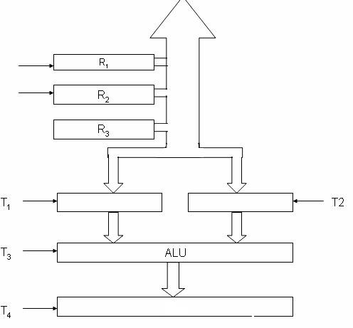
CONTROL UNIT
Control unit works with a reference signal called Processor clock
T1
T2
Processor divides the operations into basic steps
Each basic step is executed in one clock cycle
R1
R2
R2

Slide 18
Example
Add R1, R2
T1
Enable R1
T2
Enable R2
T3
Enable ALU for addition operation
T4
Enable out put of ALU to store result of the operation

Slide 19


Slide 20
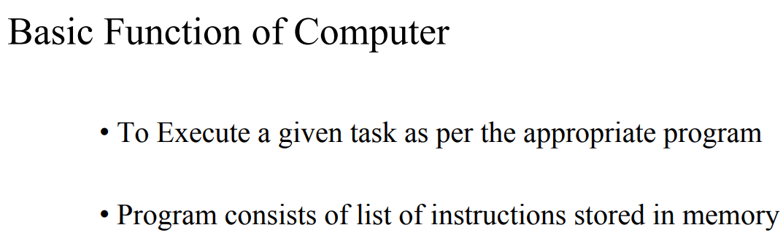

Slide 21
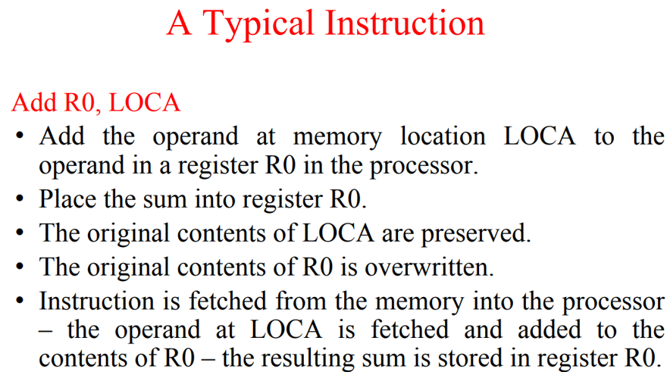

Slide 22
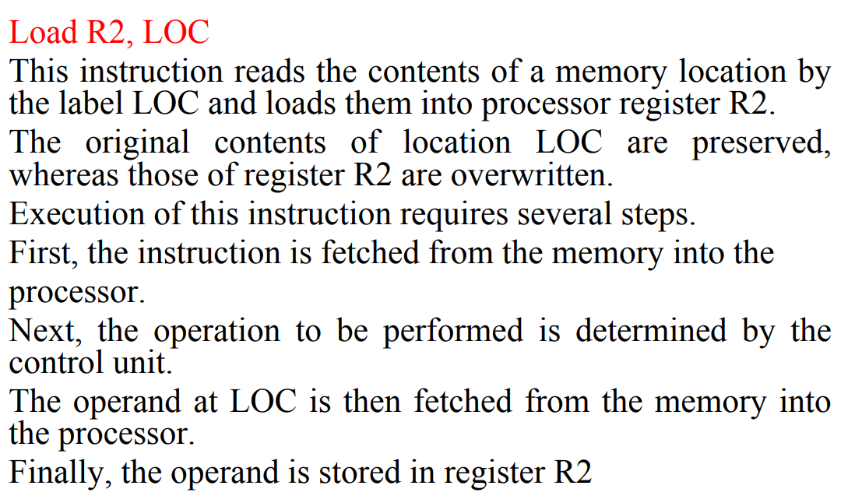

Slide 24
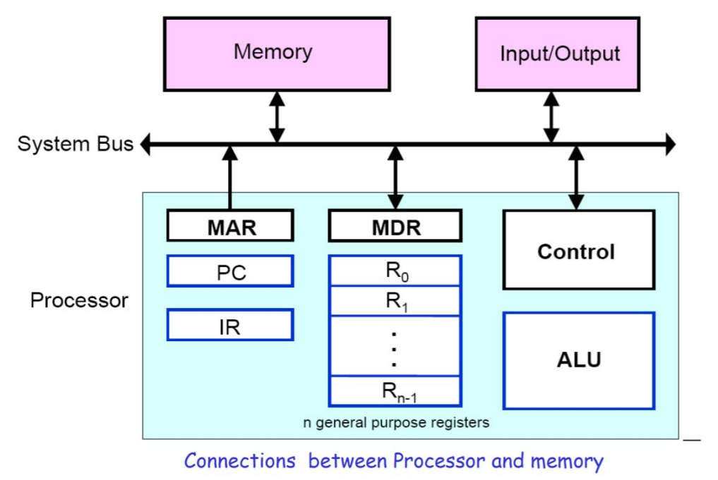

Slide 25
Registers
Registers are fast stand-alone storage locations that hold data temporarily. Multiple registers are needed to facilitate the operation of the CPU. Some of these registers are
Two registers-MAR (Memory Address Register) and MDR (Memory Data Register) : To handle the data transfer between main memory and processor. MAR-Holds addresses, MDR-Holds data
Instruction register (IR) : Hold the Instructions that is currently being executed
Program counter (PC) : Points to the next instructions that is to be fetched from memory
General-purpose Registers: are used for holding data, intermediate results of operations. They are also known as scratch-pad registers.

Slide 26
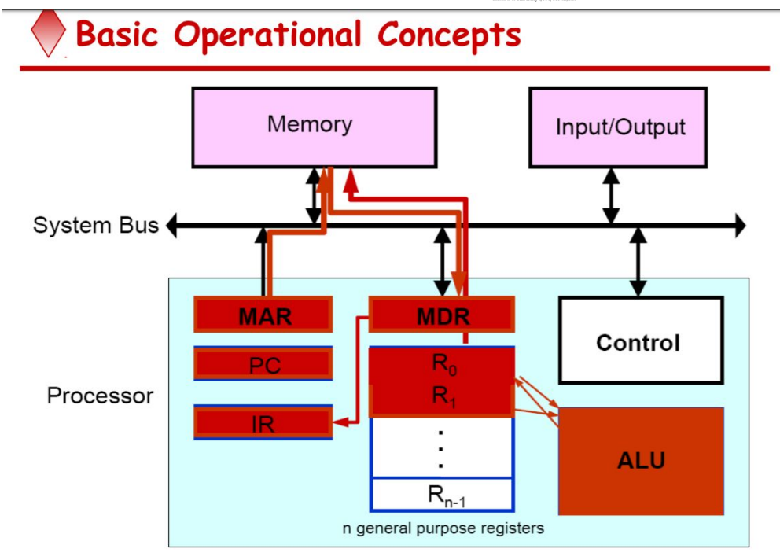

Slide 27
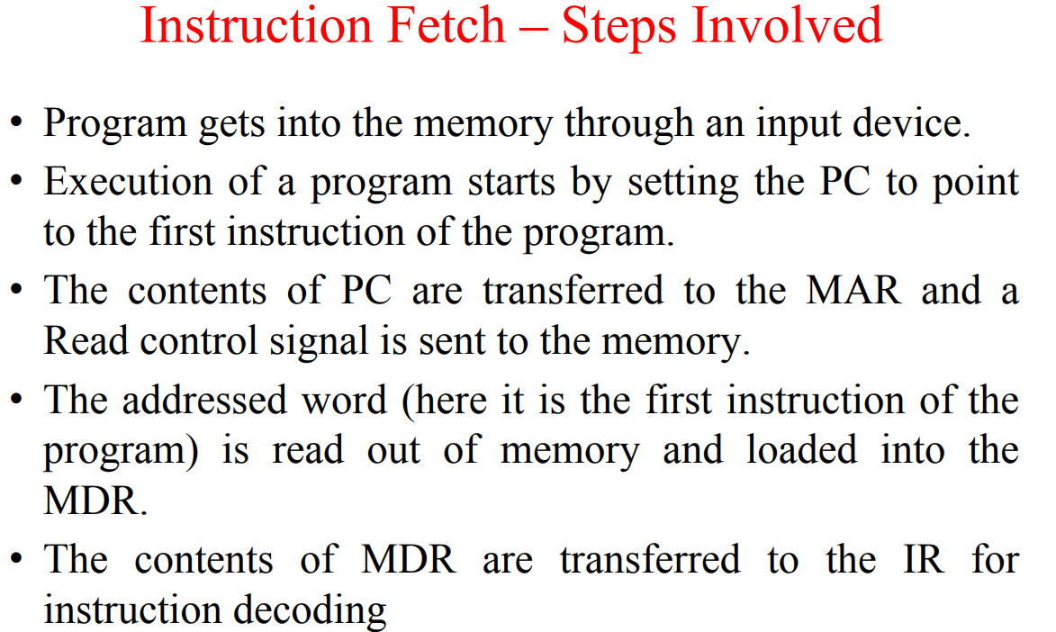

Slide 28
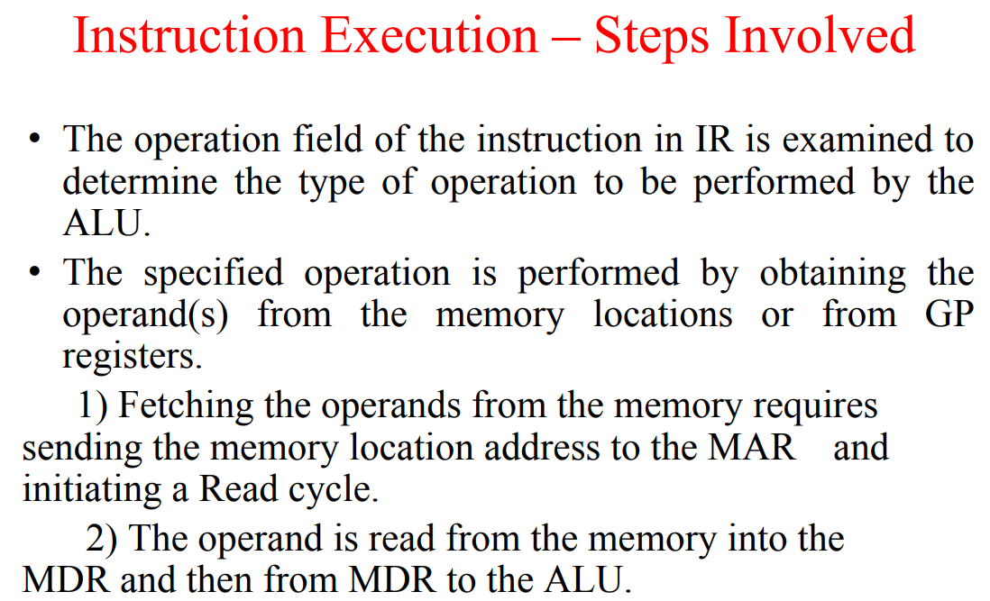

Slide 29
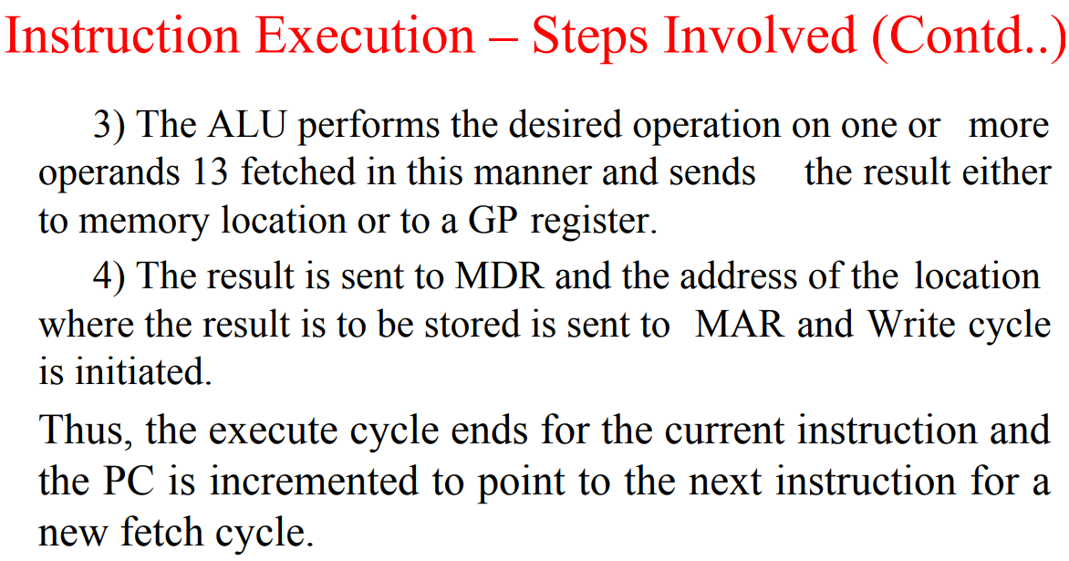

Slide 30
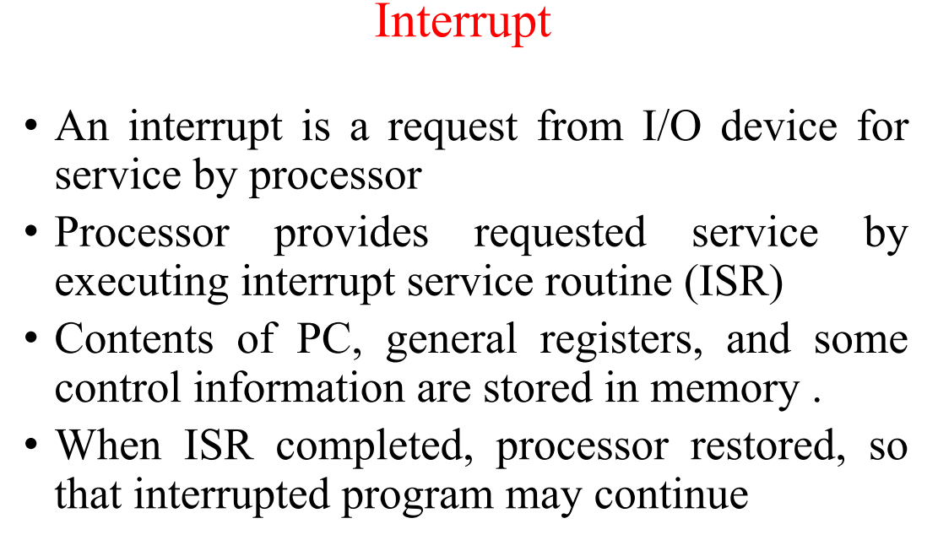

Slide 31
Bus Structures

Slide 32
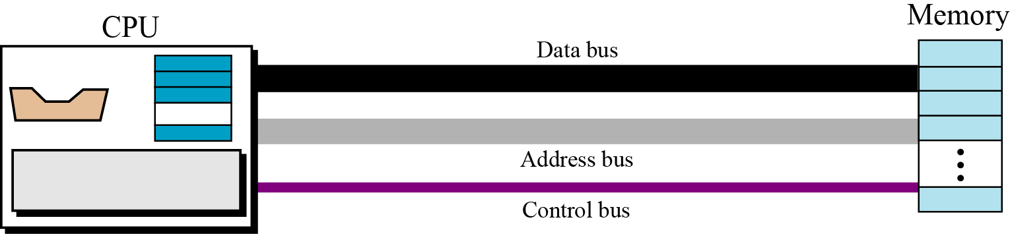
Connecting CPU and memory
The CPU and memory are normally connected by three groups of connections, each called a bus: data bus, address bus and control bus
Connecting CPU and memory using three buses

Slide 33
BUS STRUCTURE
Group of wires which carries information form CPU to peripherals or vice – versa
Single bus structure: Common bus used to communicate between peripherals and microprocessor
Single Bus Structure
INPUT
MEMORY
PROCESSOR
OUTPUT

Slide 34
Drawbacks of the Single Bus Structure
The devices connected to a bus vary widely in their speed of operation.
Some devices are relatively slow, such as printer and keyboard.
Some devices are considerably fast, such as optical disks.
Memory and processor units operate are the fastest parts of a computer.
Efficient transfer mechanism thus is needed to cope with this problem.
A common approach is to include buffer registers with the devices to hold the information during transfers .
An another approach is to use two-bus structure and an additional transfer mechanism

Slide 35
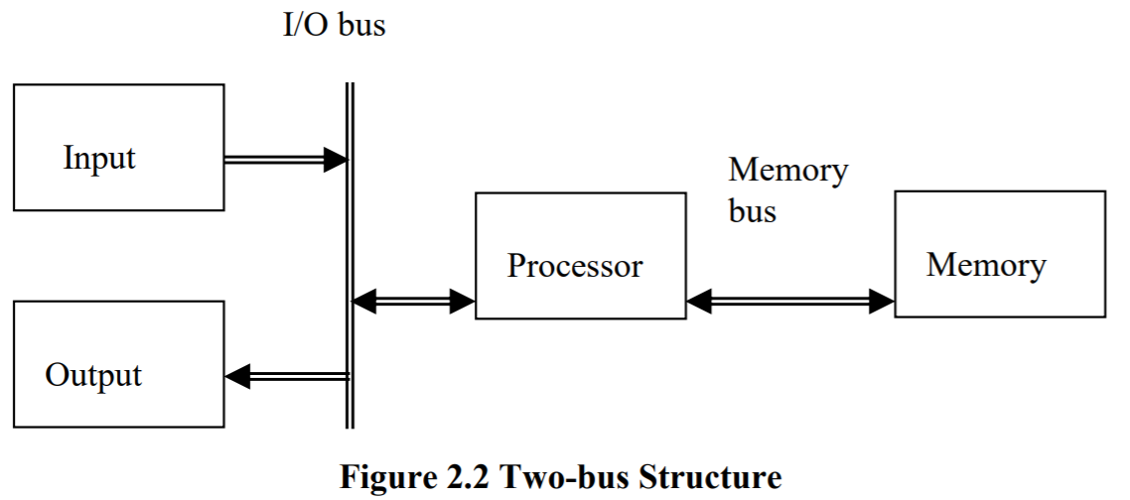
TWO BUS STRUCTURE:
One bus can be used to fetch instruction other can be used to fetch data, required for execution.
The bus is said to perform two distinct functions
The main advantage of this structure is good operating speed but on account of more cost.

Slide 36
MULTI BUS STRUCTURE
To improve performance multi bus structure can be used.
CONTROL BUS
A₂ | A₁ | A₀ | Selected location
0 | 0 | 0 | 0th Location
0 | 0 | 1 | 1st Location
0 | 1 | 0
0 | 1 | 1
1 | 0 | 0
1 | 0 | 1
1 | 1 | 0
1 | 1 | 1
W/R
CS
RD
A0
A1
A2
PROCESSOR
ADDRESS BUS
D7
D0
D0
D7
DATA BUS

Slide 37
2³ = 8 i.e. 3 address line is required to select 8 location
In general 2^{x} = n where x number of address lines (address bit) and n is number of location
Address bus : unidirectional : group of wires which carries address information bits form processor to peripherals (16,20,24 or more parallel signal lines)
Data bus: bidirectional : group of wires which carries data information bit form processor to peripherals and vice – versa
Control bus: bidirectional: group of wires which carries control signals form processor to peripherals and vice – versa

Slide 38
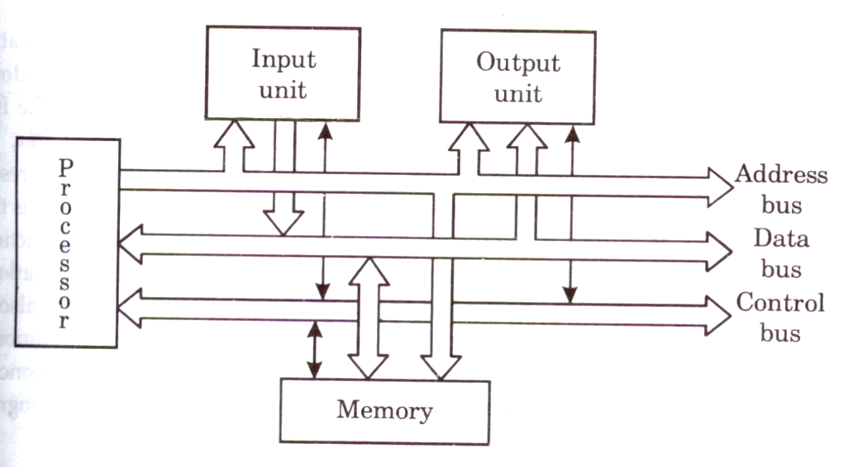
Figure below shows address, data and control bus and their connection with peripheral and microprocessor
Single bus structure showing the details of connection

Slide 39
Memory Locations and Addresses

Slide 40
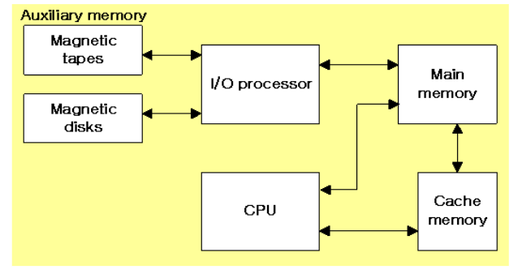
MEMORY HIERARCHY
Memory Hierarchy is to obtain the highest possible
access speed while minimizing the total cost of the memory system

Slide 41
Memory Locations and Addresses
Memory consists of many millions of storage cells, each of which can store 1 bit.
Data is usually accessed in n-bit groups. n is called word length.
The memory of a computer can be schematically represented as a collection of words as shown in Figure 1.
n
bits
first word
second word
•
•
•
i
th word
•
•
•
last word
Figure 1 Main Memory words.

Slide 42
MEMORY LOCATIONS AND ADDRESSES
Main memory is the second major subsystem in a computer. It consists of a collection of storage locations, each with a unique identifier, called an address.
Data is transferred to and from memory in groups of bits called words. A word can be a group of 8 bits, 16 bits, 32 bits or 64 bits (and growing).
If the word is 8 bits, it is referred to as a byte. The term “byte” is so common in computer science that sometimes a 16-bit word is referred to as a 2-byte word, or a 32-bit word is referred to as a 4-byte word.

Slide 43
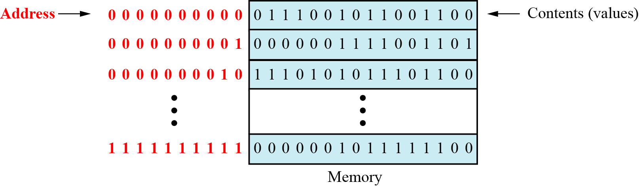
Main memory

Slide 44
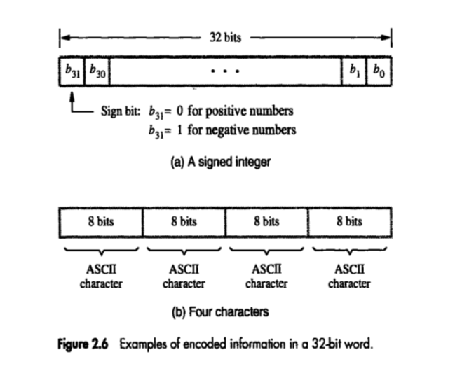

Slide 45
Address space
To access a word in memory requires an identifier. Although programmers use a name to identify a word (or a collection of words), at the hardware level each word is identified by an address.
The total number of uniquely identifiable locations in memory is called the address space.
For example, a memory with 64 kilobytes (16 address line required) and a word size of 1 byte has an address space that ranges from 0 to 65,535.

Slide 46
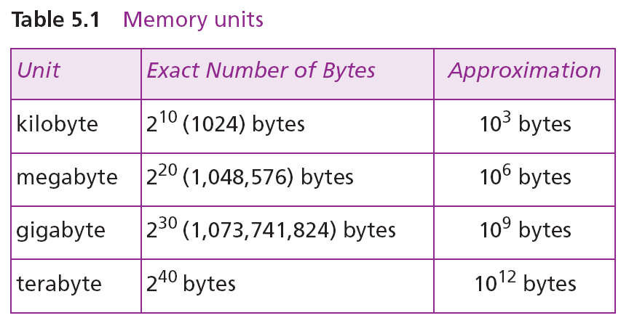
Memory addresses are defined using unsigned binary integers.

Slide 47
Example 1
A computer has 32 MB (megabytes) of memory. How many bits are needed to address any single byte in memory?
Solution
The memory address space is 32 MB, or 2²⁵ (2⁵ × 2²⁰). This means that we need log₂ 2²⁵, or 25 bits, to address each byte.
Example 2
A computer has 128 MB of memory. Each word in this computer is eight bytes. How many bits are needed to address any single word in memory?
Solution
The memory address space is 128 MB, which means 2²⁷. However, each word is eight (2³) bytes, which means that we have 2²⁴ words. This means that we need log₂ 2²⁴, or 24 bits, to address each word.

Slide 48
MEMORY OPERATIONS
Today, general-purpose computers use a set of instructions called a program to process data.
A computer executes the program to create output data from input data
Both program instructions and data operands are stored in memory
Two basic operations requires in memory access
Load operation (Read or Fetch)-Contents of specified memory location are read by processor
Store operation (Write)- Data from the processor is stored in specified memory location

Slide 49
Assignment of Byte Address
Big-endian and little-endian are terms that describe the order in which a sequence of bytes are stored in computer memory.
Big-endian is an order in which the "bigend" (most significant value in the sequence) is stored first (at the lowest storage address).
Little-endian is an order in which the “Little end" (least significant value in the sequence) is stored first (at the lowest storage address).

Slide 50
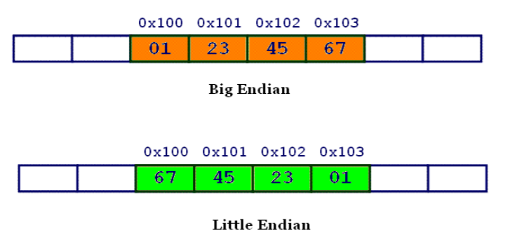

Slide 51
Assignment of byte addresses
Little Endian (e.g., in DEC, Intel)
» low order byte stored at lowest address
» byte0 byte1 byte2 byte3
Eg: 46,78,96,54 (32 bit data)
H BYTE L BYTE
8000
8001
8002
8003
8004
54
96
78
46
|

Slide 52
Big Endian
Big Endian (e.g., in IBM, Motorolla, Sun, HP)
» high order byte stored at lowest address
» byte3 byte2 byte1 byte0
Programmers/protocols should be careful when transferring binary data between Big Endian and Little Endian machines

Slide 53
Big-Endian and Little-Endian Assignments
Big-Endian: lower byte addresses are used for the most significant bytes of the word
Little-Endian: opposite ordering. lower byte addresses are used for the less significant bytes of the word
W
ord
address
Byte address
Byte address
0
0
1
2
3
0
3
2
1
0
4
4
5
6
7
4
7
6
5
4
•
•
•
•
•
•
2
k
-
4
2
k
-
4
2
k
-
3
2
k
-
2
2
k
-
1
2
k
-
4
2
k
-
1
2
k
-
2
2
k
-
3
2
k
-
4
(a) Big-endian assignment
(b) Little-endian assignment
Byte and word addressing.
Notes:
53

Slide 54
In case of 16 bit data, aligned words begin at byte addresses of 0,2,4,………………………….
In case of 32 bit data, aligned words begin at byte address of 0,4,8,………………………….
In case of 64 bit data, aligned words begin at byte addresses of 0,8,16,………………………..
In some cases words can start at an arbitrary byte address also then, we say that word locations are unaligned

Slide 55
Instruction and instruction sequencing

Slide 56
Instruction: is command to the microprocessor to perform a given task on specified data.
Instruction Set: The entire group of these instructions are called instruction set.
instruction sequencing : The order in which the instructions in a program are carried out.
4 TYPES OF OPERATION:-
A computer must have instructions capable of performing 4 types of operation
Data transfer between memory and processor register
Arithmetic and logic operation
Program sequencing and control
I/O transfer

Slide 57
Register transfer notation (RTN)
Transfer between processor registers & memory, between processor register & I/O devices
Memory locations, registers and I/O register names are identified by a symbolic name in uppercase alphabets
LOC,PLACE,MEM are the address of memory location
R1 , R2,… are processor registers
DATA_IN, DATA_OUT are I/O registers
Contents of location is indicated by using square brackets [ ]
RHS of RTN always denotes a values, and is called Source
LHS of RTN always denotes a symbolic name where value is to be stored and is called destination
Source contents are not modified
Destination contents are overwritten

Slide 58
Examples of RTN statements
R2 [LOCN]
R4 [R3] +[R2]

Slide 59
Data transfer Instructions
They are also called copy instructions.
Some instructions in 8086:
MOV -Copy from the source to the destination
LDA - Load the accumulator
STA - Store the accumulator
PUSH - Push the register pair onto the stack
POP - Pop off stack to the register pair

Slide 60
Data Manipulation Instructions
To perform the operations by the ALU
Three categories:
Arithmetic Instructions
Logical and bit manipulation instructions
Shift instructions

Slide 61
Arithmetic Instructions
Used to perform arithmetic operations
Some instruction in 8086
INC 🡺 Increment the data by 1
DEC 🡺 Decreases data by 1
ADD 🡺 perform sum of data
ADC 🡺 Add with carry bit.
MUL 🡺 perform multiplication

Slide 62
Logical and bit manipulation instructions
Used to perform logical operations
Some instructions are:
AND 🡺 bitwise AND operation
OR 🡺 bitwise OR operation
NOT 🡺 invert each bit of a byte or word
XOR 🡺 Exclusive-OR operation over each bit

Slide 63
Shift instructions
used for shifting or rotating the contents of the register
Some instructions are:
SHR 🡺 shift bits towards the right and put zero(S) in MSBs
ROL 🡺 rotate bits towards the left, i.e. MSB to LSB and to Carry Flag [CF]
RCL 🡺 rotate bits towards the left, i.e. MSB to CF and CF to LSB.

Slide 64
Instruction Formats (Types of instruction based on the address field)
A instruction in computer comprises of groups called fields.
These field contains different information
The most common fields are:
Operation field : specifies the operation to be performed like addition.
Address field : contain the location of operand
Mode field : specifies how to find the operand

Slide 65
A instruction is of various length depending upon the number of addresses it contain.
On the basis of number of address, instruction are classified as:
Zero Address Instructions
One Address Instructions
Two Address Instructions
Three Address Instructions

Slide 66
Zero Address Instructions
Used in stack based computers which do not use address field in instruction
Location of all operands are defined implicitly
Operands are stored in a structure called pushdown stack
Operation

Slide 67
If processor supports ALU operations one data in memory and other in register then the instruction sequence is
MOVE D, Ri
ADD E, Ri
MOVE Ri, F
If processor supports ALU operations only with registers then one has to follow the instruction sequence given below
LOAD D, Ri
LOAD E, Rj
ADD Ri, Rj
MOVE Rj, F

Slide 68
Example: Evaluate X=(A+B) * (C+D)
Using Zero-Address instruction
PUSH A ; TOS ← A
PUSH B ; TOS ← B
ADD ; TOS ← (A + B)
PUSH C ; TOS ← C
PUSH D ; TOS ← D
ADD ; TOS ← (C + D)
MUL ; TOS ← (C+D)*(A+B)
POP X ; M[X] ← TOS

Slide 69
One address Instruction
Syntax- Operation source/destination
In this type either a source or destination operand is mentioned in the instruction
Other operand is implied to be a processor register called Accumulator
Eg: ADD B (general)
Load D; ACC [memlocation _D]
ADD E; ACC (ACC) +(E)
STORE F; memlocation_ F (ACC )

Slide 70
One address Instruction
This use a implied ACCUMULATOR register for data manipulation.
Operation Destination
One operand is in accumulator and other is in register or memory location.
Example: Evaluate X=(A+B) * (C+D)
Using One-Address Instruction
LOAD A ; AC ← M[A]
ADD B ; AC ← AC + M[B]
STORE T ; M[T] ← AC
LOAD C ; AC ← M[C]
ADD D ; AC ← AC + M[D]
MUL T ; AC ← AC * M[T]
STORE X ; M[X] ← AC

Slide 71
Two Address Instruction
Syntax : Operation source, destination
Eg: MOVE E,F MOVE D,F
ADD D,F OR ADD E,F
Perform ADD A,B,C using 2 instructions
MOVE B,C
ADD A,C
Disadvantage: Single instruction is not sufficient to perform the entire operation.

Slide 72
Two Address Instruction
This is common in commercial computers.
Operation Source, Destination
Here two address can be specified in the instruction.
Example: Evaluate X=(A+B) * (C+D)
Using Two address Instruction:
MOV R1,A ; R1=M[A]
ADD R1,B ;R1=R1+M[B]
MOV R2,C ;R2=M[C]
ADD R2,D ;R2=R2+M[D]
MUL R1,R2 ; R1=R1*R2
MOV X,R1 ; M[X]=R1

Slide 73
Three Address Instruction
Syntax: Operation source 1, source 2, destination
Eg: ADD D,E,F
where D,E,F are memory location
Advantage: Single instruction can perform the complete operation
Disadvantage : Instruction code will be too large to fit in one word location in memory

Slide 74
Three Address Instruction
This has three address field to specify a register or a memory location.
Program created are much short in size
creation of program much easier
does not mean that program will run much faster
Example: EvaluateX= (A+B) * (C+D)
Using Three address Instruction
ADD R1,A,B ;R1=M[A]+M[B]
ADD R2,C,D ;R2=M[C]+M[D]
MUL X,R1,R2 ;M[X]=R1*R2

Slide 75
Instruction Cycle
the basic operational process of a computer.
also known as fetch-decode-execute cycle
This process is repeated continuously by CPU from boot up to shut down of computer.
steps that occur during an instruction cycle:
1. Fetch the Instruction
2. Decode the Instruction 3. Read the Effective Address
4. Execute the Instruction

Slide 76
1. Fetch the Instruction
The instruction is fetched from memory address that is stored in PC(Program Counter) and stored in the (instruction register) IR.
At the end of the fetch operation, PC is incremented by 1 and it then points to the next instruction to be executed.
2. Decode the Instruction
The instruction in the IR is decoded(Interpreted).
3. Read the Effective Address
If the instruction has an indirect address, the effective address is read from the memory.
Otherwise operands are directly read in case of immediate operand instruction.

Slide 77
4. Execute the Instruction
The Control Unit passes the information in the form of control signals to the functional unit of CPU.
The result generated is stored in main memory or sent to an output device.
The cycle is then repeated by fetching the next instruction.
Thus in this way the instruction cycle is repeated continuously.

Slide 78
Instruction execution and straight line sequencing
Instruction execution needs the following steps, which are
PC (program counter) register of the processor gives the address of the instruction which needs to be fetched from the memory.
If the instruction is fetched then, the instruction opcode is decoded. On decoding, the processor identifies the number of operands. If there is any operand to be fetched from the memory, then that operand address is calculated.
Operands are fetched from the memory. If there is more than one operand, then the operand fetching process may be repeated (i.e. address calculation and fetching operands).
After this, the data operation is performed on the operands, and a result is generated.
If the result has to be stored in a register, the instructions end here.
If the destination is memory, then first the destination address has to be calculated. Then the result is then stored in the memory. If there are multiple results which need to be stored inside the memory, then this process may repeat (i.e. destination address calculation and store result).
Now the current instructions have been executed. Side by side, the PC is incremented to calculate the address of the next instruction.
The above instruction cycle then repeats for further instructions.

Slide 79
Straight line sequencing
Straight line sequencing means the instruction of a program is executed in a sequential manner(i.e. every time PC is incremented by a fixed offset).
And no branch address is loaded on the PC.

Slide 80
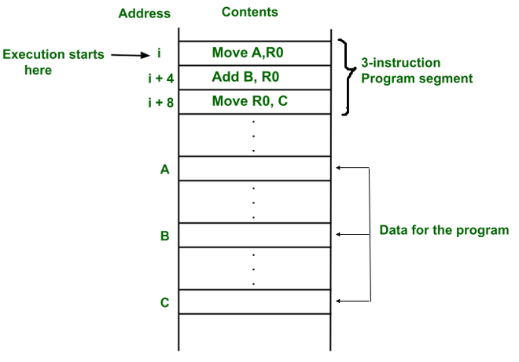
Example 1:
programs and data are stored in the same memory, i.e. von Neumann architecture.
First instruction of a program is stored at address i.
PC gives address i and instruction stored at that address i is fetched from the memory and then decoded and then operand
A is fetched from the memory and stored in a temporary register and then the instruction is executed(i.e. content of address A is copied into processor register R0).
the PC gets incremented by 4(i.e. it contains the address of the next instruction) because the instruction and memory segment is of 4 bytes.
So the instruction at address i is executed.
So every time, the PC is incremented by 4. Therefore, the program is executing in a sequential manner. And this process is called straight line sequencing.

Slide 81
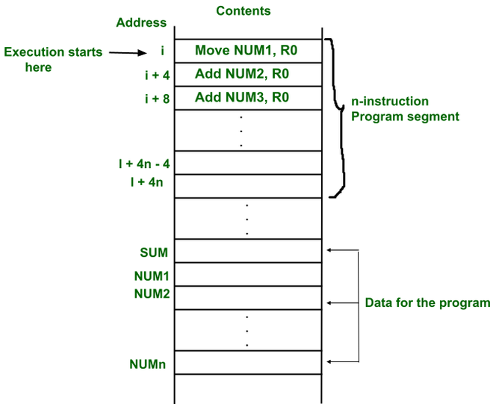
The addresses of the memory locations containing the n numbers are represented as NUM1,NUM2…..NUMn(i.e. NUM1 address includes first number).
The first number is stored into processor register R0. And every other number is added to register R0. Finally, when the program ends(i.e. n numbers are added, the result is placed in memory location SUM

Slide 82
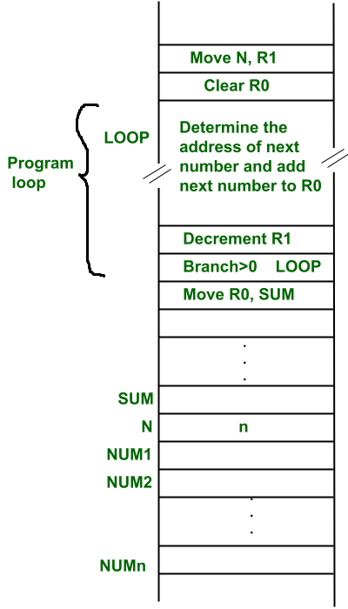
The second way is to use a loop to add n number. But here straight line sequencing is not used because every time loop iteration ends, PC has to load the branch address and program execution starts from that address.
Here the location N stores the value of n.
Processor register R1 is used as a counter to determine the number of times the loop gets executed.
The contents of the location N are moved into R1 at the start of program execution.
After that, register R0 is cleared.
The address LOOP is reloaded again and again until R1 becomes 0.
Every time a number is added, then the R1 value is decremented.
When R1 becomes 0, we come out of the loop and the result which is stored at R1 is copied into memory location SUM.

Slide 83
Condition Codes
The processor keeps track of information about the results of various operations for use by subsequent conditional branch instructions
N – Negative 1 if results are Negative
0 if results are Positive
Z – Zero 1 if results are Zero
0 if results are Non zero
V – Overflow 1 if arithmetic overflow occurs
0 non overflow occurs
C – Carry 1 if carry and from MSB bit
0 if there is no carry from MSB bit

Slide 84
Addressing Modes

Slide 85
Addressing Modes
Different ways in which the location of the operand is specified in an instruction is referred as addressing modes. The purpose of using addressing mode is:
To give the programming versatility to the user.
To reduce the number of bits in addressing field of instruction.
Types of Addressing Modes
Immediate Addressing
Direct Addressing
Indirect Addressing
Register Addressing
Register Indirect Addressing
Relative Addressing
Indexed Addressing
Auto Increment
Auto Decrement

Slide 86
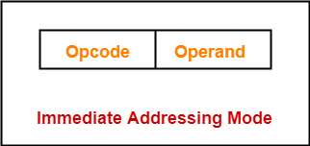
Immediate Addressing
Operand is given explicitly in the instruction
e.g. ADD 5
Add 5 to contents of accumulator
5 is operand
No memory reference to fetch data
Fast
Limited range
MOV AL,25H ; Immediate addressing AL=25
MOV AX,2345H ; AX=2345 AX=> AH=23 AL=45

Slide 87
Direct Addressing
Address field contains address of operand
Effective address (EA) = address field (A)
e.g. ADD A
Add contents of cell A to accumulator
Look in memory at address A for operand
Single memory reference to access data
No additional calculations to work out effective address
Limited address space
MOV AL,DATA1 ; Direct Addressing AL=23
MOV AX,DATA2 ; AX=1234
MOV DATA3,AL ; DATA3=23
MOV DATA4,AX ; DATA4=1234

Slide 88
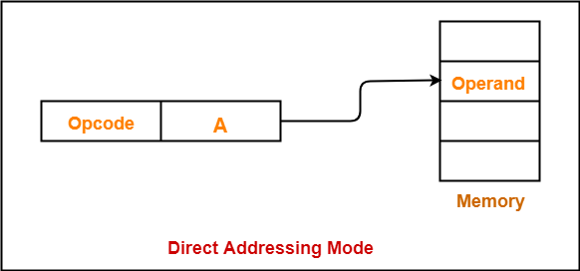

Slide 89
Indirect Addressing
Memory cell pointed to by address field contains the address of (pointer to) the operand
Two references to memory are required to fetch the operand.
Effective Address = [A]
Look in A, find address (A) and look there for operand
e.g. ADD (A)
Add contents of cell pointed to by contents of A to the accumulator
Notes:
7

Slide 90
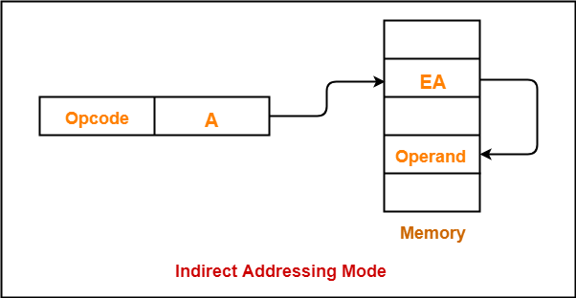

Slide 91
Register Direct Addressing
In this addressing mode,
The operand is contained in a register set.
The address field of the instruction refers to a CPU register that contains the operand.
No memory access
Very fast execution
Very limited address space
Limited number of registers
Very small address field needed
Shorter instructions
Faster instruction fetch
Notes:
10

Slide 92
Register Direct Addressing
Eg:
ADD R will increment the value stored in the accumulator by the content of register R.
AC ← AC + [R]
This addressing mode is similar to direct addressing mode.
The only difference is address field of the instruction refers to a CPU register instead of main memory.
Notes:
11

Slide 93
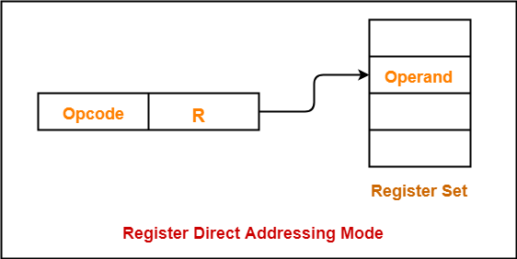

Slide 94
Register Indirect Addressing
The address field of the instruction refers to a CPU register that contains the effective address of the operand.
Only one reference to memory is required to fetch the operand
Eg:
ADD R will increment the value stored in the accumulator by the content of memory location specified in register R.
AC ← AC + [[R]]
Notes:
13

Slide 95
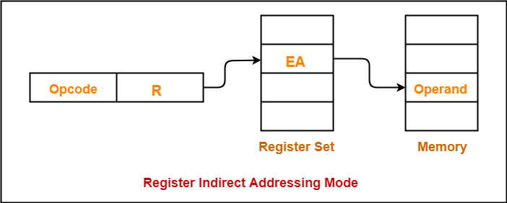

Slide 96
Indexed Addressing
In this addressing mode,
Effective address of the operand is obtained by adding the content of index register with the address part of the instruction.
Effective Address = Content of Index Register + Address part of the instruction
Notes:
15

Slide 97
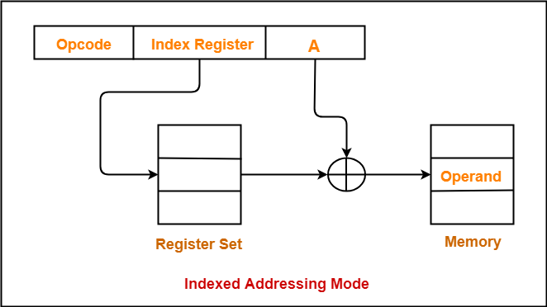

Slide 98
Relative Addressing
A version of displacement addressing
In this addressing mode,
Effective address of the operand is obtained by adding the content of program counter with the address part of the instruction.
Effective Address = Content of Program Counter + Address part of the instruction
Notes:
17

Slide 99
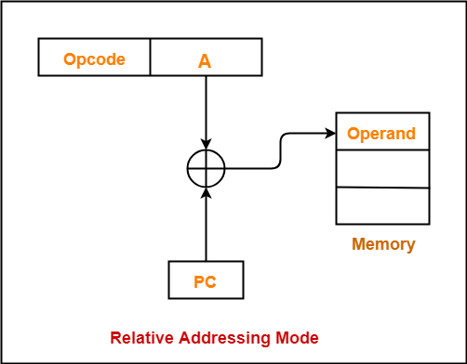

Slide 100
Auto Increment Mode
A special case of Register Indirect Addressing Mode where
Effective Address of the Operand = Content of Register
In this addressing mode,
After accessing the operand, the content of the register is automatically incremented by step size ‘d’.
Step size ‘d’ depends on the size of operand accessed.
Only one reference to memory is required to fetch the operand.

Slide 101
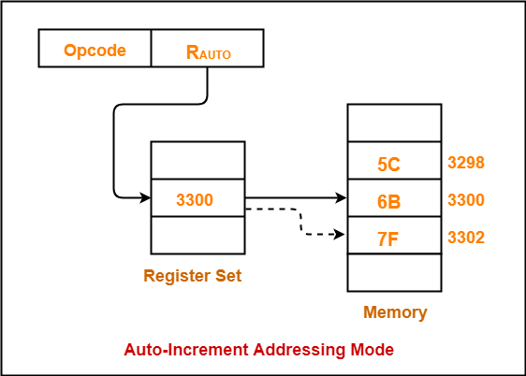

Slide 102
Auto Decrement Mode
A special case of Register Indirect Addressing Mode where
Effective Address of the Operand = Content of Register – Step Size
In this addressing mode
First, the content of the register is decremented by step size ‘d’.
Step size ‘d’ depends on the size of operand accessed.
After decrementing, the operand is read.
Only one reference to memory is required to fetch the operand.

Slide 103
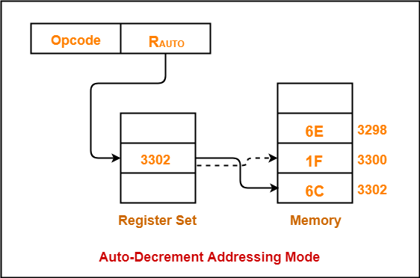

Slide 104
Case Study: 8086 Introduction to Microprocessor

Slide 105
Microprocessors
Microprocessor : is a CPU on a single chip.
Microcontroller: If a microprocessor, its associated support circuitry, memory and peripheral I/O components are implemented on a single chip, it is a microcontroller.
We use AVR microcontroller as the example in our course study

Slide 106
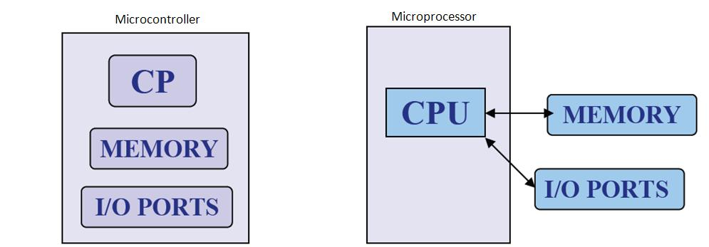
What is Microprocessor and Microcontroller?

Slide 107
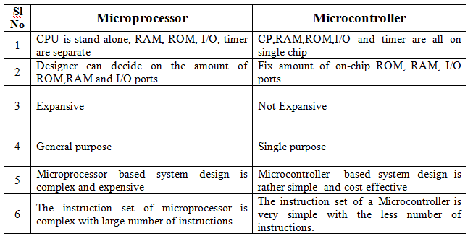

Slide 108
Internal structure and basic operation of microprocessor
ALU
Register Section
Address bus
Data bus
Control and timing section
Control bus
Block diagram of a Microprocessor

Slide 109
Microprocessor performs three main tasks:
data transfer between itself and the memory or I/O systems
simple arithmetic and logic operations
program flow via simple decisions

Slide 110
Microprocessor types
Microprocessors can be characterized based on
the word size
8 bit, 16 bit, 32 bit, etc. processors
Instruction set structure
RISC (Reduced Instruction Set Computer), CISC (Complex Instruction Set Computer)
Functions
General purpose, special purpose such image processing, floating point calculations
And more …

Slide 111
Evolution of Microprocessors
The first microprocessor was introduced in 1971 by Intel Corp.
It was named Intel 4004 as it was a 4 bit processor.
Categories according to the generations or size
First Generation (4 - bit Microprocessors)
could perform simple arithmetic such as addition, subtraction, and logical operations like Boolean OR and Boolean AND.
had a control unit capable of performing control functions like
fetching an instruction from storage memory,
decoding it, and then
generating control pulses to execute it.

Slide 112
Second Generation (8 - bit Microprocessor)
The second generation microprocessors were introduced in 1973 again by Intel.
the first 8 - bit microprocessor which could perform arithmetic and logic operations on 8-bit words.
Third Generation (16 - bit Microprocessor)
introduced in 1978
represented by Intel's 8086, Zilog Z800 and 80286,
16 - bit processors with a performance like minicomputers.

Slide 113
Fourth Generation (32 - bit Microprocessors)
Several different companies introduced the 32-bit microprocessors
the most popular one is the Intel 80386
Fifth Generation (64 - bit Microprocessors)
Introduced in 1995
After 80856, Intel came out with a new processor namely Pentium processor followed by Pentium Pro CPU
allows multiple CPUs in a single system to achieve multiprocessing.
Other improved 64-bit processors are Celeron, Dual, Quad, Octa Core processors.

Slide 114
Typical microprocessors
Most commonly used
68K
Motorola
x86
Intel
IA-64
Intel
MIPS
Microprocessor without interlocked pipeline stages
ARM
Advanced RISC Machine
PowerPC
Apple-IBM-Motorola alliance
Atmel AVR

Slide 115
8086 Microprocessor
designed by Intel in 1976
16-bit Microprocessor having
20 address lines
16 data lines
provides up to 1MB storage
consists of powerful instruction set, which provides operations like multiplication and division easily.
supports two modes of operation
Maximum mode : suitable for system having multiple processors
Minimum mode : suitable for system having a single processor.

Slide 116
Features of 8086
Has an instruction queue, which is capable of storing six instruction bytes
First 16-bit processor having
16-bit ALU
16-bit registers
internal data bus
16-bit external data bus
uses two stages of pipelining
1. Fetch Stage and
2. Execute Stage
which improves performance.
Fetch stage : can pre-fetch up to 6 bytes of instructions and stores them in the queue.
Execute stage : executes these instructions.

Slide 117
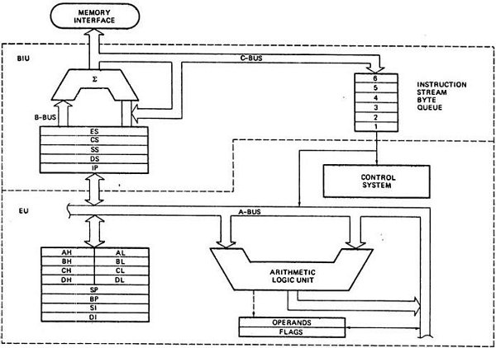
Architecture of 8086

Slide 118
Segments in 8086
memory is divided into various sections called segments
Code segment : where you store the program.
Data segment : where the data is stored.
Extra segment : mostly used for string operations.
Stack segment : used to push/pop

Slide 119
General purpose registers
used to store temporary data within the microprocessor
AX – Accumulator
16 bit register
divided into two 8-bit registers AH and AL
to perform 8-bit instructions also
generally used for arithmetical and logical instructions
BX – Base register
16 bit register
divided into two 8-bit registers BH and BL
to perform 8-bit instructions also
Used to store the value of the offset.

Slide 120
CX – Counter register
16 bit register
divided into two 8-bit registers CH and CL
to perform 8-bit instructions also Used in looping and rotation
DX – Data register
16 bit register
divided into two 8-bit registers DH and DL to
perform 8-bit instructions also Used in multiplication an input/output port addressing

Slide 121
Pointers and Index Registers
SP – Stack pointer
16 bit register
points to the topmost item of the stack
If the stack is empty the stack pointer will be (FFFE)H
It’s offset address relative to stack segment
BP –Base pointer
16 bit register
used in accessing parameters passed by the stack
It’s offset address relative to stack segment

Slide 122
SI – Source index register
16 bit register
used in the pointer addressing of data and
as a source in some string related operations
It’s offset is relative to data segment
DI – Destination index register
16 bit register used in the pointer addressing of data and
as a destination in string related operations
It’s offset is relative to extra segment.

Slide 123
IP - Instruction Pointer
16 bit register
stores the address of the next instruction to be executed
also acts as an offset for CS register.

Slide 124
Segment Registers
CS - Code Segment Register: user cannot modify the content of these registers
Only the microprocessor's compiler can do this
DS - Data Segment Register: The user can modify the content of the data segment.
SS - Stack Segment Registers: used to store the information about the memory segment.
operations of the SS are mainly Push and Pop.
ES - Extra Segment Register: By default, the control of the compiler remains in the DS where the user can add and modify the instructions
If there is less space in that segment, then ES is used
Also used for copying purpose.

Slide 125
Flag or Status Register
16-bit register
contains 9 flags
remaining 7 bits are idle in this register
These flags tell about the status of the processor after any arithmetic or logical operation
IF the flag value is 1, the flag is set, and if it is 0, it is said to be reset.

Slide 126
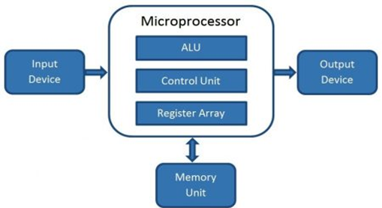
Microcomputer
Block Diagram
A digital computer with one microprocessor which acts as a CPU
A complete computer on a small scale, designed for use by one person at a time
called a personal computer (PC)
a device based on a single-chip microprocessor
includes laptops and desktops

Slide 127
Introduction to 8086 Assembly Language
Assembly Language Programming

Slide 128
EXAMPLE : Adding two 8 bit numbers
DATA SEGMENT ; Data Segment
N1
3n2 DB 12H
N2 DB 21H
RES DB ?
DATA ENDS
CODE SEGMENT ; Code segment
ASSUME CS: CODE, DS: DATA
START: MOV AX, DATA
MOV DS, AX
MOV AL, N1
MOV BL, N2
ADD AL, BL
MOV RES, AL
INT 21H
CODE ENDS
END START

