Slide 1


Hospital Bed / OR Scheduling
Smart Hospital Resource Management and Scheduling System
Team Members:
V. Sathvik — 2520090097
Ch. Shanthi Swaroop — 2520090224
Team Number: 1
Section: 10

Slide 2




Introduction
Efficient hospital resource management ensures limited assets—beds, ORs, staff—are used safely and effectively. Our digital scheduling system coordinates:
Patient Bed allocation admissions
Operating room availability
Staff schedules P priorities
Optimize Resource Allocation
Reduce Patient Waiting Time
Minimize Scheduling Conflicts
Improve Bed P OR Utilization Support Faster Decision-Making
Flow: Patient → Bed Allocation → OR Scheduling → Staff Coordination → Better Patient Care

Slide 3
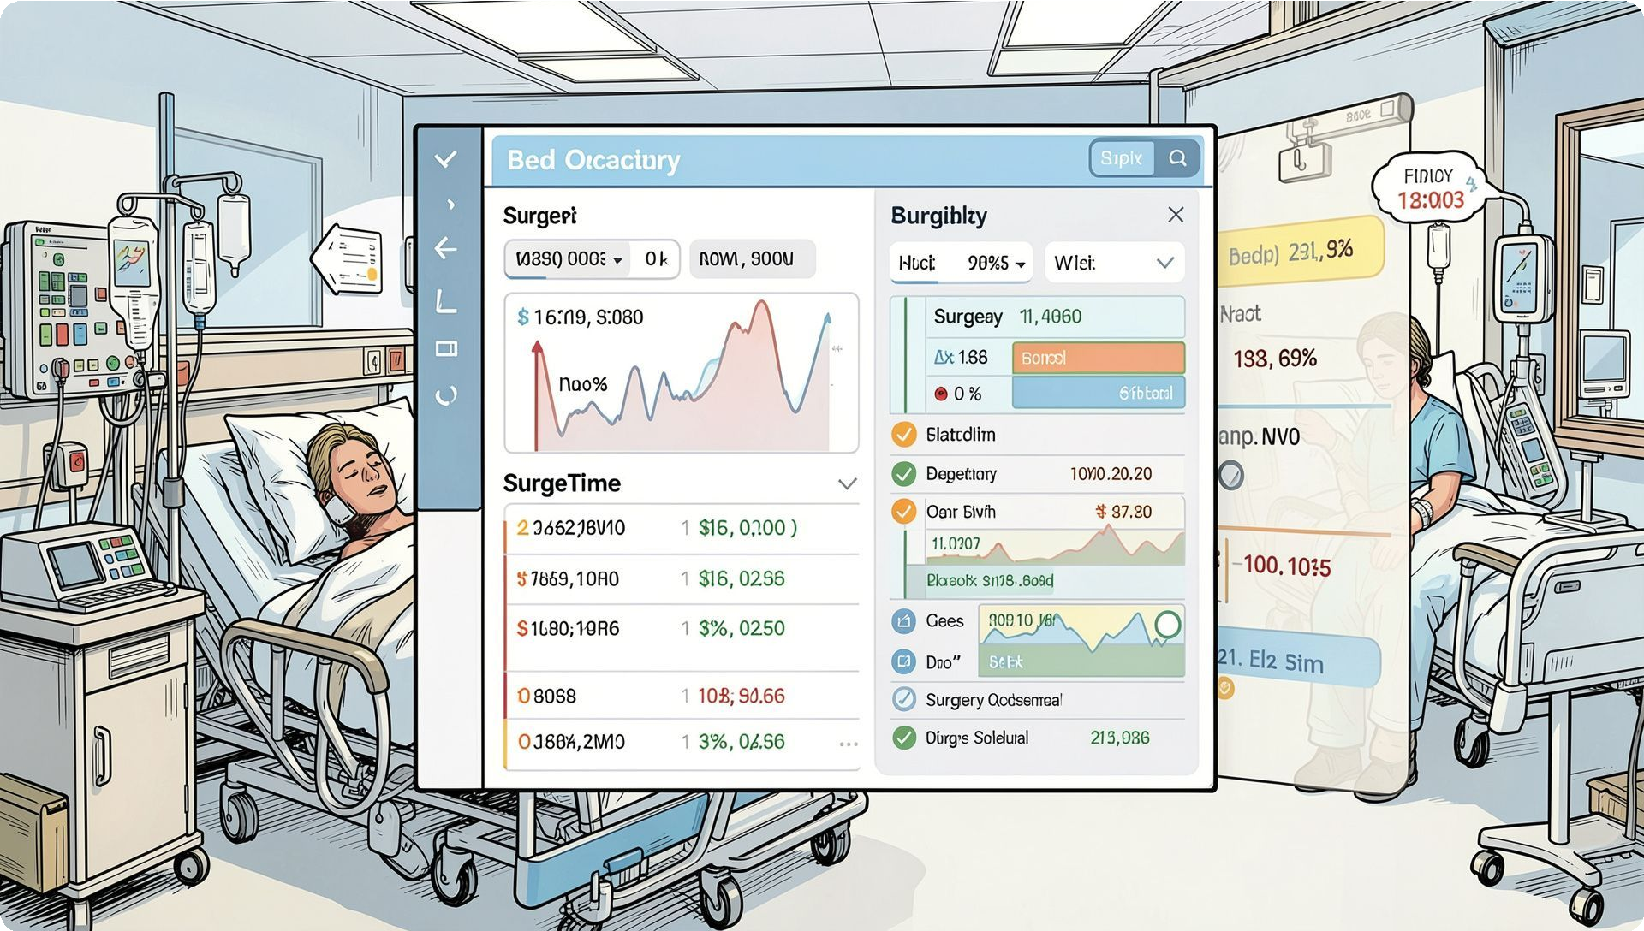
Abstract (Key Points)
Purpose
Automate bed & OR scheduling to improve efficiency and reduce conflicts.
Approach
Consider admissions, priorities, availability, capacity, and staff schedules.
Capabilities
Real-time monitoring, conflict minimization, and informed admin decisions.
Core Inputs: Patient Admissions | Surgery Priority | Bed Availability | OR Capacity | Staff Availability
Benefits
Reduced waiting, better utilization, lower admin workload, scalable design.
Outcomes: Less Waiting Time → Better Resource Utilization
→ Improved Patient Care

Slide 4
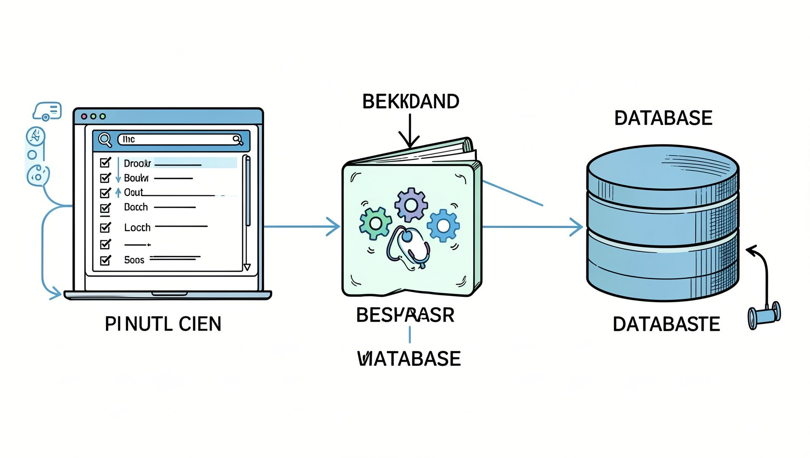

Software Requirements
Functional Requirements
User Authentication Patient Management Bed Management OR Scheduling
Staff Schedule Management Real-Time Availability Monitoring Admin Dashboard
Database Management
Frontend
HTML, CSS, JavaScript, React.js (if used)
Backend
Node.js, Express.js (if used)
Architecture
User Interface → Backend/Application → Database
Database
MySQL / MongoDB — To be finalized
Development Tools
Visual Studio Code, Git / GitHub, Web Browser

Slide 5


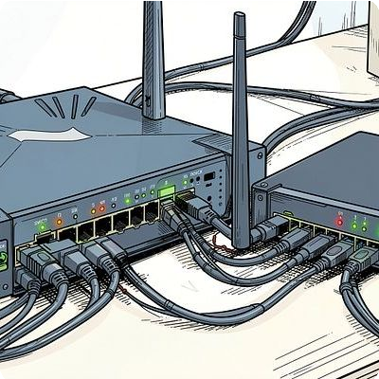
Hardware Requirements
Processor
Intel Core i3 / equivalent or higher
Optional Hospital Infrastructure
Administrator workstation Nursing station computer Dedicated server Network router / switch Backup storage
RAM
Minimum 4 GB — Recommended 8 GB+
Storage
Minimum 256 GB
Display
1366 × 768 or higher
Network
Stable LAN / Wi-Fi
Server
Local or cloud-based server

Slide 6

Methodology — Workflow P Decision Logic
Registration
Admission P Priority
Bed Check P Allocation
OR Scheduling P Monitoring
Major decision factors alongside workflow: Patient Priority · Bed Availability · OR Availability · Surgery Duration · Staff Availability
· Emergency Cases
1 2 3
Emergency Branch
Emergency cases preempt schedule
— instant priority reassignment and rapid OR allocation.
Real-Time Updates
Live occupancy and schedule updates push notifications to staff and admins.
Outcome
Optimized resources · Reduced waiting time · Improved patient care

Slide 7
Literature Review
Research Area | Key Focus | Limitation | Proposed System Advantage
Hospital Bed Allocation Systems | Optimizing bed utilization | Primarily focuses on beds only | Integrates bed allocation with OR scheduling
Operating Room Scheduling | Schedule surgeries by priority & OR availability | Limited integration with other hospital resources | Coordinates ORs, beds, patients, and staff
Healthcare Resource Optimization | Efficient use of limited hospital resources | May require complex optimization algorithms | Provides practical integrated scheduling solution
Real-Time Hospital Management Systems | Monitoring hospital resources | Monitoring alone doesn't optimize schedules | Combines real-time monitoring with scheduling & decision support
Research Gap / Proposed Solution: “The proposed system integrates bed management, OR scheduling, patient priorities, staff availability, and real-time monitoring into a unified hospital resource management platform.”
.

