Slide 1


Slide 2
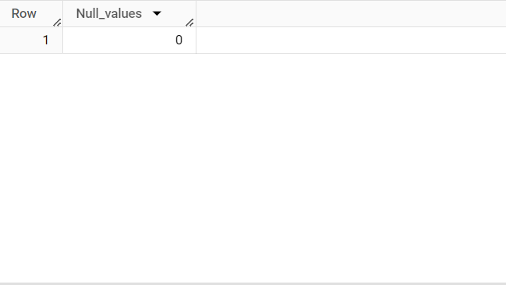
Q1 checking the null values SELECT count(*) as Null_values FROM `corona_virus.corona` WHERE Province IS NULL OR Country_Region IS NULL OR Latitude IS NULL OR Longitude IS NULL OR Date IS NULL OR Confirmed IS NULL OR Deaths IS NULL OR Recovered IS NULL;
Insight – There are No null values present in the data

Slide 3
Q2. If NULL values are present, update them with zeros for all columns.
Insight- Because there a no null values so we didn’t update the value

Slide 4
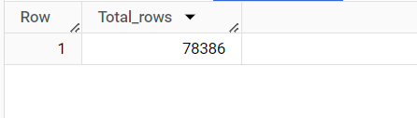
Q3. check the number of rows Present in the dataset. select count(*) as Total_rows FROM `corona_virus.corona`;
Insight- There are total 78386 rows are present in the data set

Slide 5
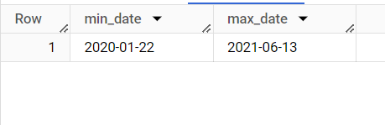
Q4. Check what is start_date and end_date SELECT MIN(Date) as min_date, MAX(Date) as max_date FROM `corona_virus.corona` ;
Insight- The data is from 22-01-2020 till 13-06-2021

Slide 6

Q5. Number of month present in dataset SELECT COUNT(DISTINCT CONCAT(EXTRACT(YEAR FROM Date), '-', EXTRACT(MONTH FROM Date))) as Months FROM `corona_virus.corona`;
Insight- There are total 18 Months are present in the data

Slide 7
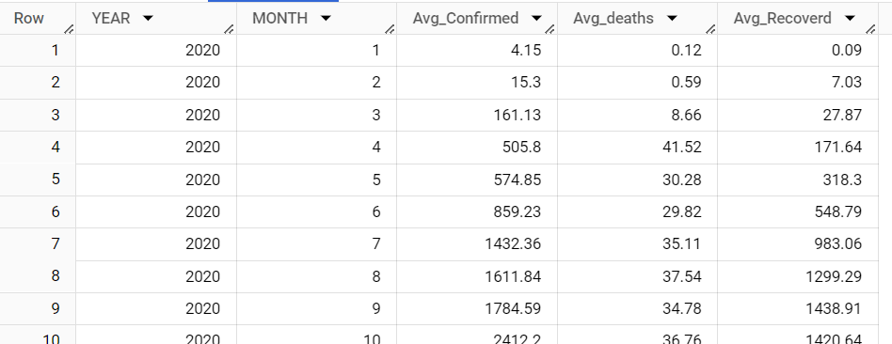
Q6. Find monthly average for confirmed, deaths, recovered SELECT EXTRACT(Year FROM DATE) AS YEAR,EXTRACT(MONTH FROM DATE) AS MONTH,ROUND(AVG(Confirmed),2) as Avg_Confirmed, ROUND(AVG(deaths),2) as Avg_deaths, ROUND(AVG(Recovered),2) as Avg_Recoverd from `corona_virus.corona` group by 1 ,2 ORDER BY 1 ,2 ASC;
Insight - This is the monthly average data for confirmed, deaths, recovered

Slide 8
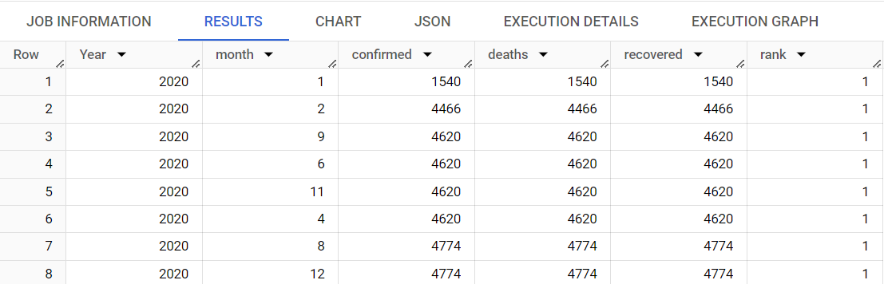
Q7. Find most frequent value for confirmed, deaths, recovered each month SELECT * FROM ( SELECT *, RANK() OVER (ORDER BY Year) AS rank FROM ( SELECT EXTRACT(YEAR FROM date) AS Year, EXTRACT(MONTH FROM date) AS month, COUNT(confirmed) AS confirmed, COUNT(deaths) AS deaths, COUNT(recovered) AS recovered FROM `corona_virus.corona` GROUP BY 1, 2 ORDER BY 1, 2 ) tbl ) ranked_data WHERE rank = 1 order by confirmed;
Insight – As you can see 9,6,11,4 months in year 2020 have most frequent
value for confirmed, deaths, recovered each month

Slide 9
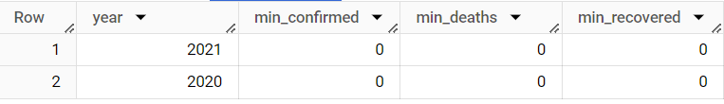
Q8. Find minimum values for confirmed, deaths, recovered per year
select extract(year from date) as year, min(confirmed) as min_confirmed, min(deaths) as min_deaths, min(recovered) as min_recovered
from `corona_virus.corona`
group by 1
order by 1 desc;
Insight – The minimum value for confirmed, deaths, recovered per year

Slide 10
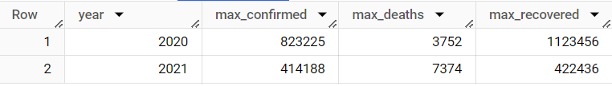
Q9. Find maximum values of confirmed, deaths, recovered per year
select extract(year from date) as year, max(confirmed) as max_confirmed, max(deaths) as max_deaths, max(recovered) as max_recovered
from `corona_virus.corona`
group by 1
order by 1 ;
Insight – The Maximum value for confirmed, deaths, recovered per year

Slide 11
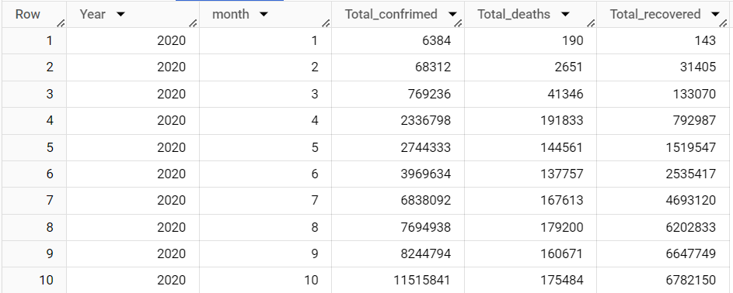
Q10. The total number of case of confirmed, deaths, recovered each month
select extract (year from Date) as Year,extract (month from date) as month, sum(confirmed) as Total_confrimed,sum(deaths) as Total_deaths, sum(recovered) as Total_recovered
from `corona_virus.corona`
group by 1,2
order by 1,2 ;
Insight – These are the total number of case of confirmed, deaths, recovered each month

Slide 12
Q11. Check how corona virus spread out with respect to confirmed case (Eg.: total confirmed cases, their average, variance & STDEV )
select
sum(Confirmed) as total_confirmed,
round(avg(Confirmed),2) as avg_confirmed,
round(variance(Confirmed),2)as variance_Confirmed,
round(stddev(Confirmed),2) as std_confirmed
from `corona_virus.corona`;
Insight – as per the given question the total confirmed ,average confirmed, variance confirmed and standard deviation is displayed in above image

Slide 13
Q12. Check how corona virus spread out with respect to death case per month (Eg.: total confirmed cases, their average, variance & STDEV )
select
sum(Deaths) as total_Deaths,
round(avg(Deaths),2) as avg_Deaths,
round(variance(Deaths),2)as variance_Deaths,
round(stddev(Deaths),2) as std_Deaths
from `corona_virus.corona`;
Insight – as per the given question the total deaths, average deaths, variance deaths and standard deviation is displayed in above image

Slide 14
Q13. Check how corona virus spread out with respect to recovered case (Eg.: total confirmed cases, their average, variance & STDEV )
select
sum(Recovered) as total_Recovered,
round(avg(Recovered),2) as avg_Recovered,
round(variance(Recovered),2)as variance_Recovered,
round(stddev(Recovered),2) as std_Recovered
from `corona_virus.corona`;
Insight – as per the given question the total recovered, average recovered, variance recovered and standard deviation is displayed in above image

Slide 15
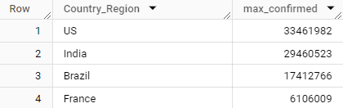
Q14. Find Country having highest number of the Confirmed case
select Country_Region,sum(confirmed) as max_confirmed
from `corona_virus.corona`
group by 1
order by 2 desc
Insight – USA have the maximum confirmed cases followed by India, Brazil ,France etc

Slide 16
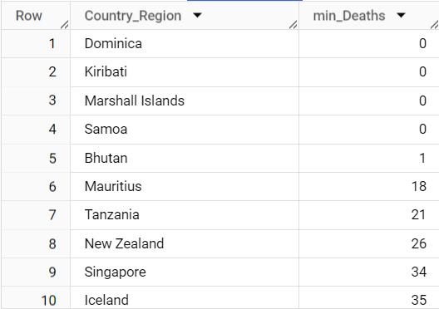
Q15. Find Country having lowest number of the death case
select Country_Region,sum(Deaths) as min_Deaths
from `corona_virus.corona`
group by 1
order by 2;
Insight – These are country with minimum deaths

Slide 17
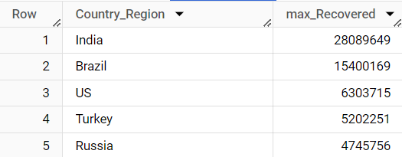
Q16. Find top 5 countries having highest recovered case
select Country_Region,sum(Recovered) as max_Recovered
from `corona_virus.corona`
group by 1
order by 2 desc
limit 5;
Insight – These are top 5 country with maximum recovered cases

Slide 18
Thank You Presented By G Swaroop

