Slide 1

Project Title – Superstore Data Analysis
[Swaroop Atreya, AICTE Internship Student Registration ID) : STU66f6ed37a411e1727458615]

Slide 2

PROBLEM STATEMENT
The problem statement of the project is to implement data analysis on a superstore dataset and examine the datasets in order to find trends and draw conclusions about the information they contain.

Slide 3
Project Description 1) Gathering the superstore dataset from Kaggle 2) Understanding the Dataset 3) Cleaning the data if any null values, N/A values are found 4) Doing the necessary Statistical Analysis using Pandas dataframe df.describe() and df.info() 5) Plotting the necessary vizualisations to draw out meaningful, actionable insights from data using barplot and pie charts

Slide 4

WHO ARE THE END USERS?
The end users are the superstore owners who want their business’s statistical analysis of their profits, sales etc..

Slide 5

Technology Used
Python
IPYNB
Pandas
Numpy
Matplotlib

Slide 6
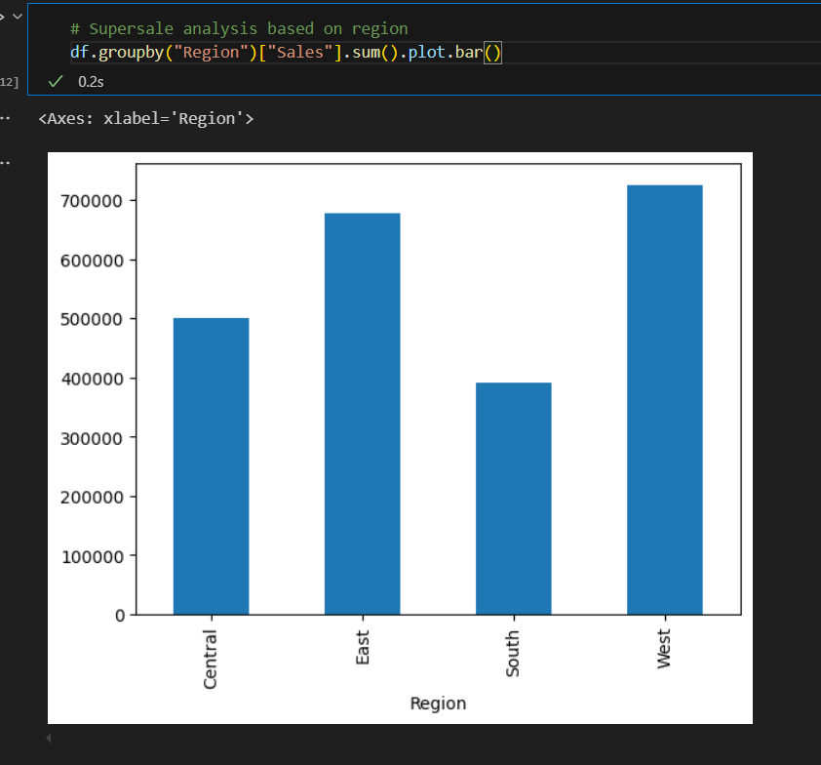
RESULTS
This result is derived using the code df.groupby(“Region”)[“Sales].sum().plot.bar() which means that we are
1) df.groupby(“Region): This part groups the data in the dataframe(df) by the “Region” column. This means that data from different regions will be considered separately. 2) [“Sales”].sum(): This calculates the sum of the “Sales” column for each group created in the previous step. In other words, it calculates the total sales for each region. 3) .plot.bar(): This plots the calculated sums as a bar chart, where each bar represents a region and its height corresponds to the total sales in that region

Slide 7
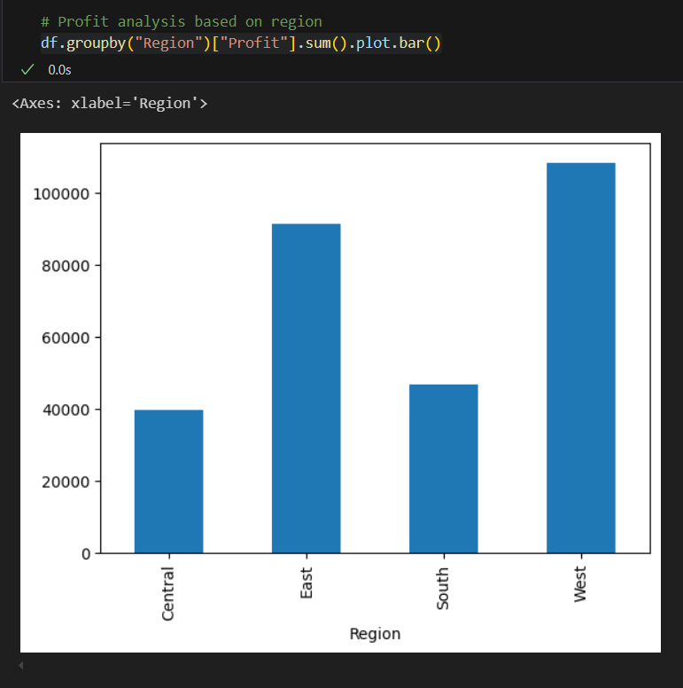
RESULTS
This result is derived using the code df.groupby(“Region”)[“Profit”].sum().plot.bar() which means that we are 1) Grouping by Region: The data is grouped by the “Region” Column 2) Calculating total profit: The sum() function calculates the total profit for each region 3) Plotting the bar chart: The .plot.bar() function creates a bar chart where: X-axis: Represents the different regions (Central, East, South, West) Y-axis: Represents the total profit for each region

Slide 8
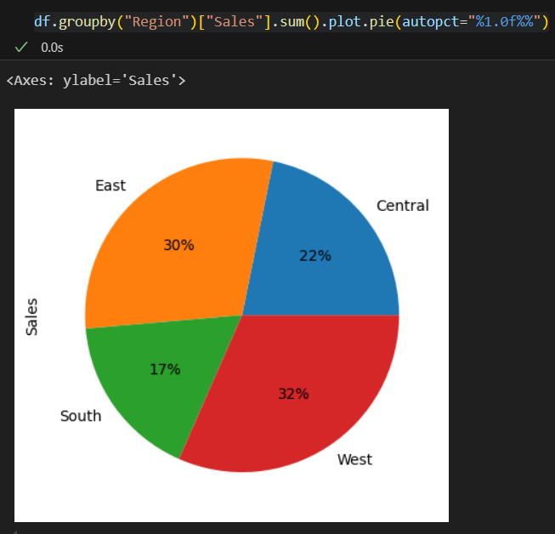
RESULTS
Group and Sum: df.groupby(“Region): This part groups the dataframe df by the “Region” column. This creates a grouping object where each group contains rows with the same “Region” value [“Sales”]: This selects the “Sales” column from each group .sum(): This calculates the sum of the sales within each group Plotting a Pie Chart: .plot().pie(): This method is used to create a pie chart. It takes the aggregated data from the previous step. autopct=“1.0f%%”: This argument specifies the format for percentage labels on the pie chart. This means one decimal place(.0) and a percentage sign(%)

Slide 9
Thank you
.
.

