Slide 1

Disha Indoor Navigation using Augmented Reality
A Project Presentation on
Department of Computer Science and Engineering
KIT’s College of Engineering (Autonomous), Kolhapur
Year 2023-23
Notes:
© Copyright Showeet.com – Creative & Free PowerPoint Templates

Slide 2

Welcome!
SRC
Creations
Mr. Swaroop Chavan
14
Documentation and Design
Miss. Shahin Momin
36
User Interface Designs
Mr. Zebaan Mulla
38
Backend Developer
Miss. Pallavi Sawanji
56
User Interface Design
Under the Guidance of
Prof. Samadhan Palkar
Notes:
© Copyright Showeet.com – Creative & Free PowerPoint Templates

Slide 3
Contents
Introduction
User Module
01
05
System Requirements
Problem Statement
02
06
Architecture System
Objectives
03
07
Scope
UI Design
04
08
Notes:
© Copyright Showeet.com – Creative & Free PowerPoint Templates

Slide 4
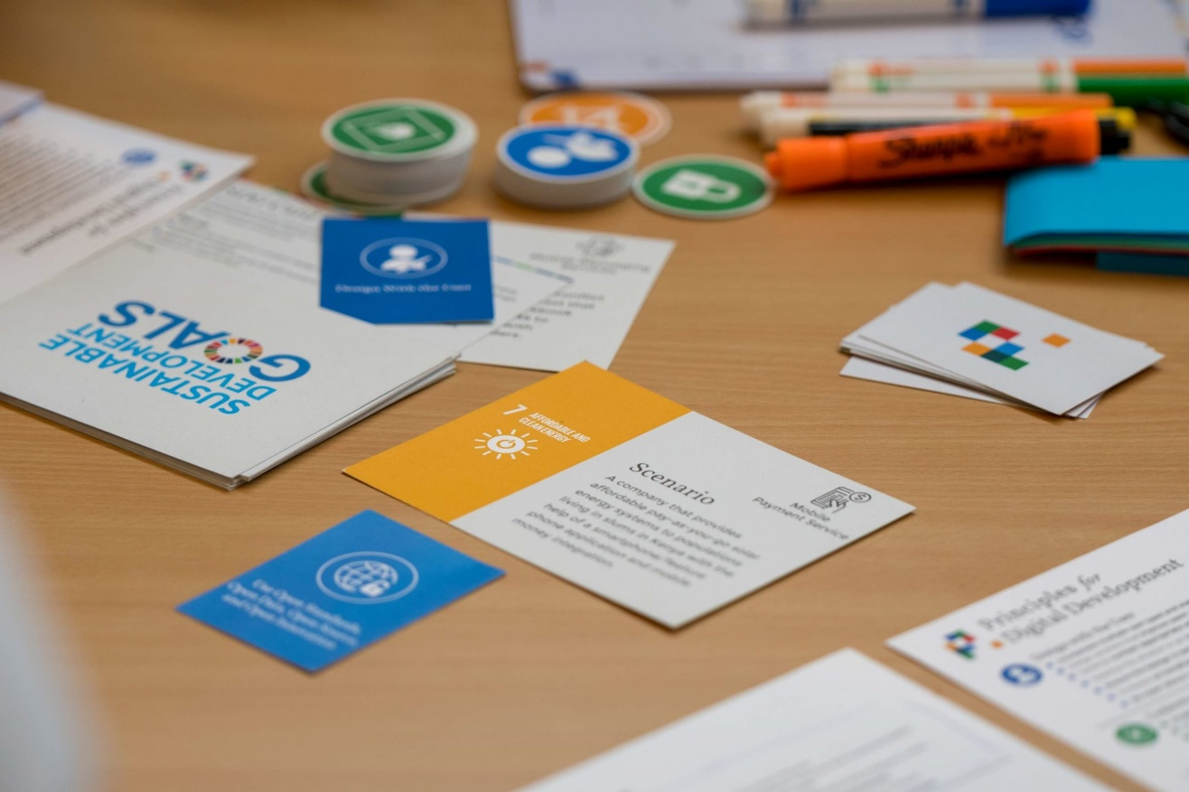
Introduction
The Disha deficiencies of current navigation systems, citing limitations like 2D information, imprecise navigation, and interaction issues. Augmented Reality (AR) is proposed as a transformative solution, merging virtual elements with the real environment. The app's key attributes include AR-based route projection, precision via visual odometry and sensors, and Unity as the interactive design platform. Emphasized is the app's diverse augmented reality content, ensuring heightened user engagement. The structured paper delves into related work, key technologies, system implementation, testing, and evaluation for a comprehensive exploration.
This Photo by Unknown Author is licensed under CC BY-SA
Notes:
© Copyright Showeet.com – Creative & Free PowerPoint Templates

Slide 5

Problem Statement:
Current indoor campus navigation struggles with 2D maps and external services, hampering user convenience. Our project aims to transform this experience by integrating augmented reality (AR) technology. By overlaying digital information onto the real environment, we strive to create an intuitive and user-friendly navigation solution. Our goal is to revolutionize indoor navigation, overcoming reliance on traditional methods and providing a seamless experience for users navigating campus spaces.

Slide 6

Objectives are:
Develop a mobile app to offer high-precision navigation, specifically tailored for indoor environments, overcoming the limitations of existing systems that rely on 2D information.
Focus on augmenting user experience by integrating augmented reality (AR) technology, aiming to create an intuitive and interactive navigation platform within the campus environment.
Minimize dependence on network queries and third-party service platforms by creating an independent navigation system capable of superimposing virtual information onto the real environment.
Utilize AR technology to overlay computer-generated virtual objects and information seamlessly onto the physical campus environment, enhancing interactivity and user-friendliness in navigation experiences.
Ultimately, the project aims to create a user-centric mobile app that offers an engaging, precise, and intuitive navigation experience within the campus, addressing the challenges faced by traditional navigation systems.

Slide 7

Scope
Develop a mobile app specifically for campus navigation.
Implement technology combining visual inertial odometry and ARCore for precise navigation and fusion of virtual and real information.
Rectify deficiencies in current systems by offering 3D augmented information fused with real buildings and providing high-precision indoor navigation.
Include a diverse range of augmented reality content to enhance the user experience.
Utilize Unity as the primary development platform for creating the app's functionalities.
Design and incorporate various interaction functions suited for different user scenarios and needs, enhancing usability and accessibility.

Slide 8

User Module :
Account Creation: Users need to create a Disha account for the service. This involves personal information.
Destination Browsing and Selection: Users can browse through the destination library to discover the desired location. They can use the platform's search feature, and curated lists to find destinations that suit their preferences.
Operation and Navigation: Once a user selects a desired destination, they can follow the tradelines displayed by the app. Users have control over options, such as source location, destination location, AR information display or not.

Slide 9
SYSTEM REQUIREMENTS
Software Requirements :-
Unity 3D: Development 3D Environment
ARCore SDK for Unity: ARCore functionalities works on Geospatial localisation
Front-end: Android Studio
Back-end: Unity 3D
Hardware Requirements :-
Ram: 8 GB or Above
Rom: 4 GB or Above
Processor: 3.2GHz 32 bit
CPU: Minimum Core3
Notes:
© Copyright Showeet.com – Creative & Free PowerPoint Templates

Slide 10


System Architecture

Slide 11


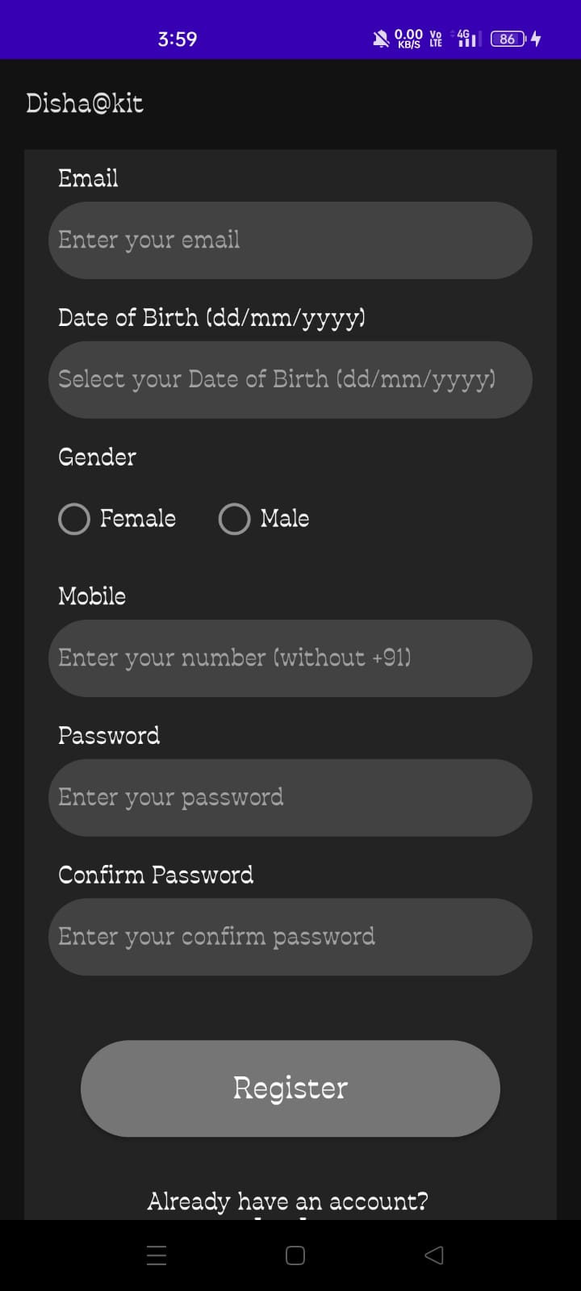
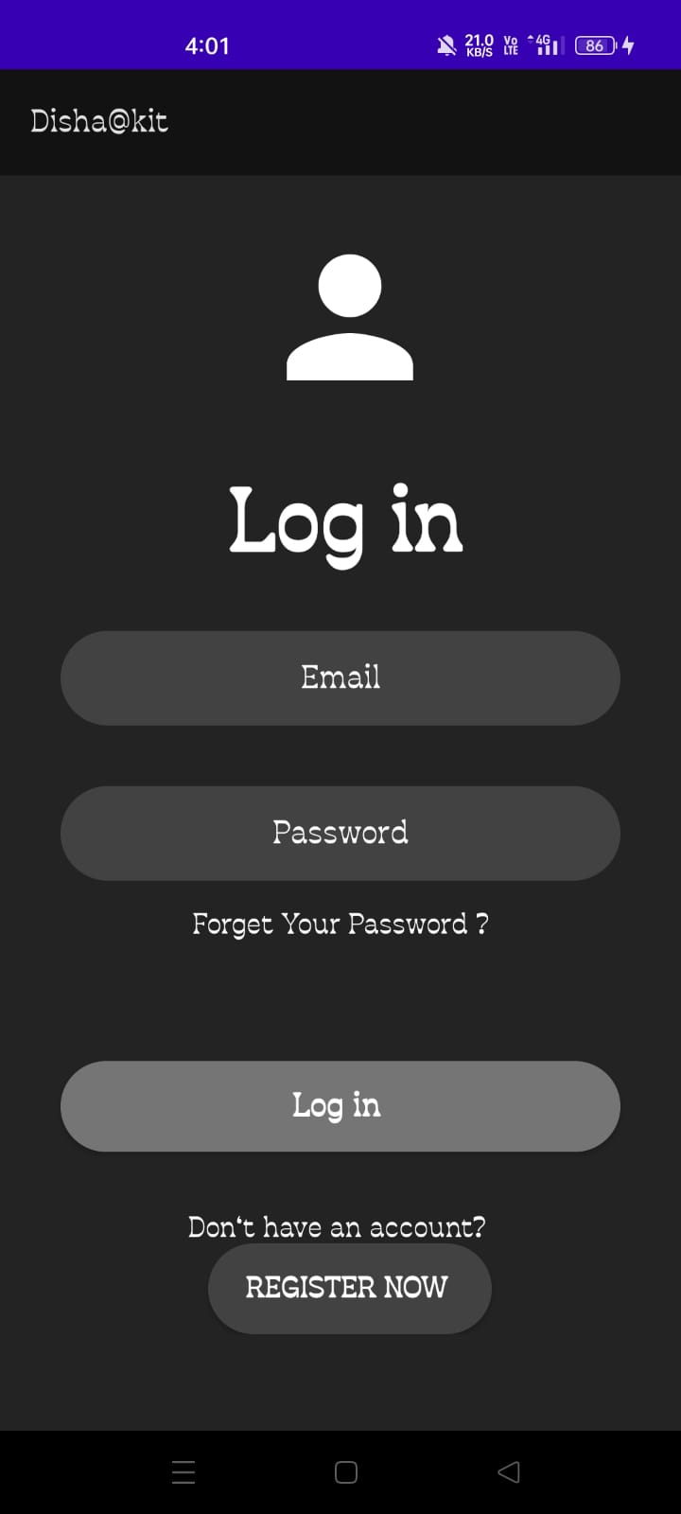
UI Design

Slide 12

Reference
SRC
Creations
Articles – many thanks to:
International Journal of Engineering Applied Sciences and Technology, 2022 Vol. 6, Issue 9, ISSN No. 2455-2143, Pages 67-77 Published Online January 2022 in IJEAST
Indoor Navigation using Augmented Reality Ashly Martin*, John Cheriyan, JJ Ganesh, Joel Sebastian, Jayakrishna V Amal Jyothi College of Engineering, Kottayam, Kerala, India 2021
Kato, H., & Billinghurst, M. (2017). Marker tracking and HMD calibration for a video-based augmented reality conferencing system. Proceedings of the 2nd IEEE and ACM International Workshop on Augmented Reality, 85-94.
Hart, P. E., Nilsson, N. J., & Raphael, B. (1968). A formal basis for the heuristic determination of minimum cost paths. IEEE Transactions on Systems Science and Cybernetics, 4(2), 100-107.
Wang, Y., & Zhang, Y. (2020). Research on Indoor Navigation System Based on Augmented Reality. Proceedings of the 2020 IEEE 4th International Conference on Control, Robotics and Informatics, 189-193.
Notes:
© Copyright Showeet.com – Creative & Free PowerPoint Templates

Slide 13
Notes:
© Copyright Showeet.com – Creative & Free PowerPoint Templates

