Slide 1
Visualizing-US-Natural-Disaster-Declarations-Trends-and-Patterns

Slide 2
Dataset Overview
The Dataset Contains:
Tools Used:
Python (EDA & cleaning)
Power BI Desktop (visualization)
State and region
Disaster type
Incident dates
Request status
Assistance programs requested

Slide 3
Data Cleaning & Preparation
Steps Performed:
Checked missing values using EDA
Retained missing end dates as they represent ongoing or single-day disasters
Removed non-analytical ID columns
Ensured correct data types (date, numeric, categorical)
Colab Link: https://colab.research.google.com/drive/1cJkzspuwOXlw9A1Cf9M6G8i6HY0pnJtf?usp=sharing

Slide 4
Data Modeling & Measures
Calculated Column:
Approval_Flag → converts request status to numeric form
Measures Created:
Total Requests – total number of disaster requests
Unique States – number of states involved
Rejected Rate – percentage of rejected requests

Slide 5
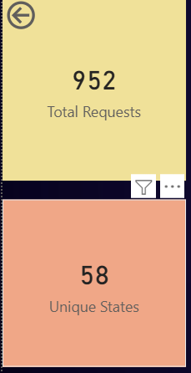
KPI(Key Performance Indicators) Summary
Explanation of KPI:
Total Requests → overall scale of disasters
Unique States → geographic spread
Rejected Rate → outcome of requests

Slide 6
Visual Analysis
Charts Included:
Top Disaster Types by Requests (bar chart)
Top States by Disaster Requests (bar chart)
Disaster Requests Over Time (line chart)
Key Insight:
Weather-related disasters dominate requests
Requests are concentrated in a few states
Trends vary across years

Slide 7
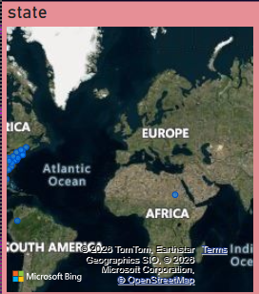
Geographic Analysis
Explanation:
Filled map shows state-wise concentration of disaster requests
Helps identify high-risk regions visually

Slide 8
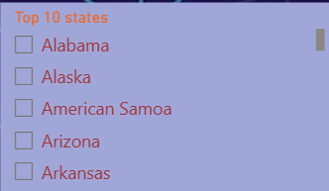
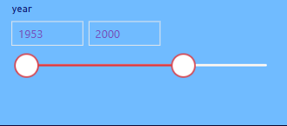
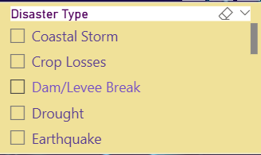
Interactivity – Filters (Slicers)
Filters Used:
State → filters data for selected states
Disaster Type → focuses on specific disaster categories
Year → filters data by time range
Benefit:
Enables focused analysis without multiple dashboards

Slide 9
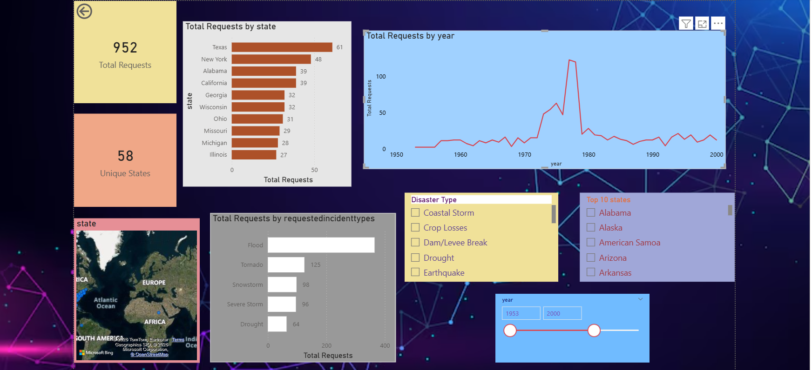
Conclusion:
Content:
Built an end-to-end Power BI dashboard from cleaned data
Gained insights into disaster trends, geography, and outcomes
Dashboard supports interactive and dynamic analysis

