Slide 1

Moksha

Slide 2
Memory Safety
Borrow Checker | Automatic Reference Counting
For stack lifetimes :- Variables “class” Pointers References Fixed-Size Arrays | For heap lifetimes :- Closures “ref classes” Dynamic-sized Arrays Strings “any” type Promises

Slide 3
Granular Pointers
mut for exclusive write access.
view for read-only snapshots.
lock for thread-synchronized shared state. You can access lock variables within a lock() { … } block.

Slide 4
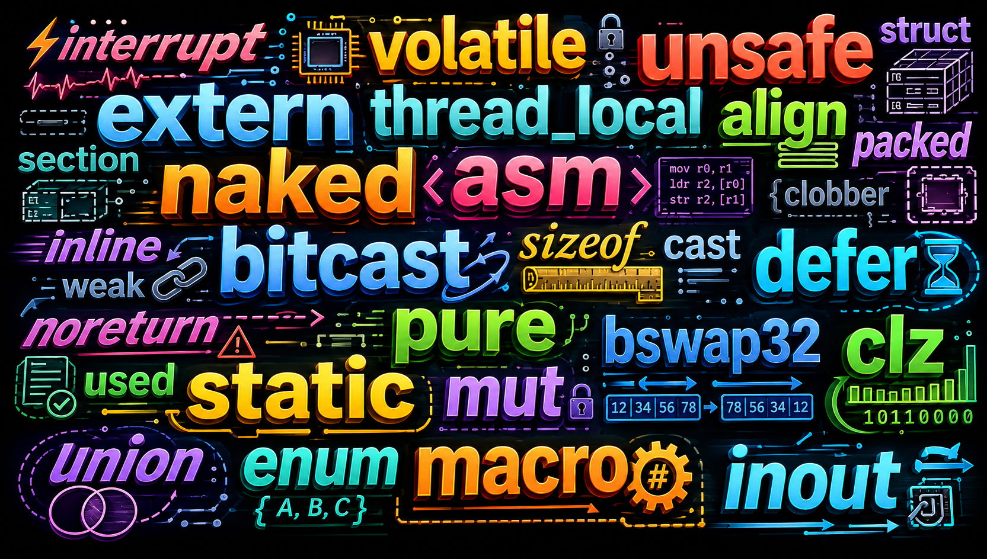
FFI & Bare-Metal Interop

Slide 5
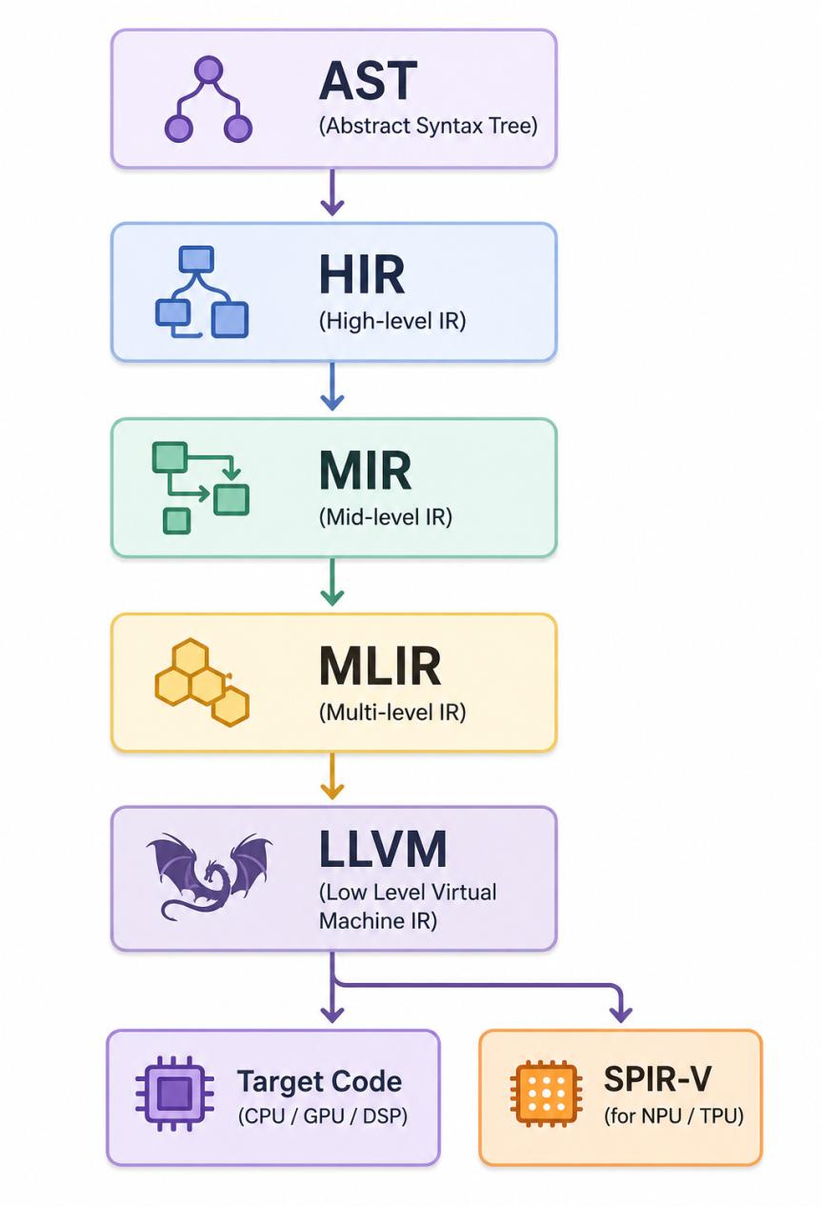
L’Architecture

Slide 6
Ergonomics
Pipe Operator ( |> )
Null Safety : Safe chaining (?.), indexing (?[), and coalescing (??).
Interpolation ( ` ${}` )
Functional casts ( double() ) and cast operator ( cast<int>(3.14) )
and all the necessary stuff …
Let’s Head on to basic program !

