Slide 1

Intelligent Dispute Prioritisation System
A comprehensive technical framework for automating dispute resolution workflows at HDFC Bank, leveraging AI-driven prioritisation and rule-based logic to optimise operational efficiency.

Slide 2
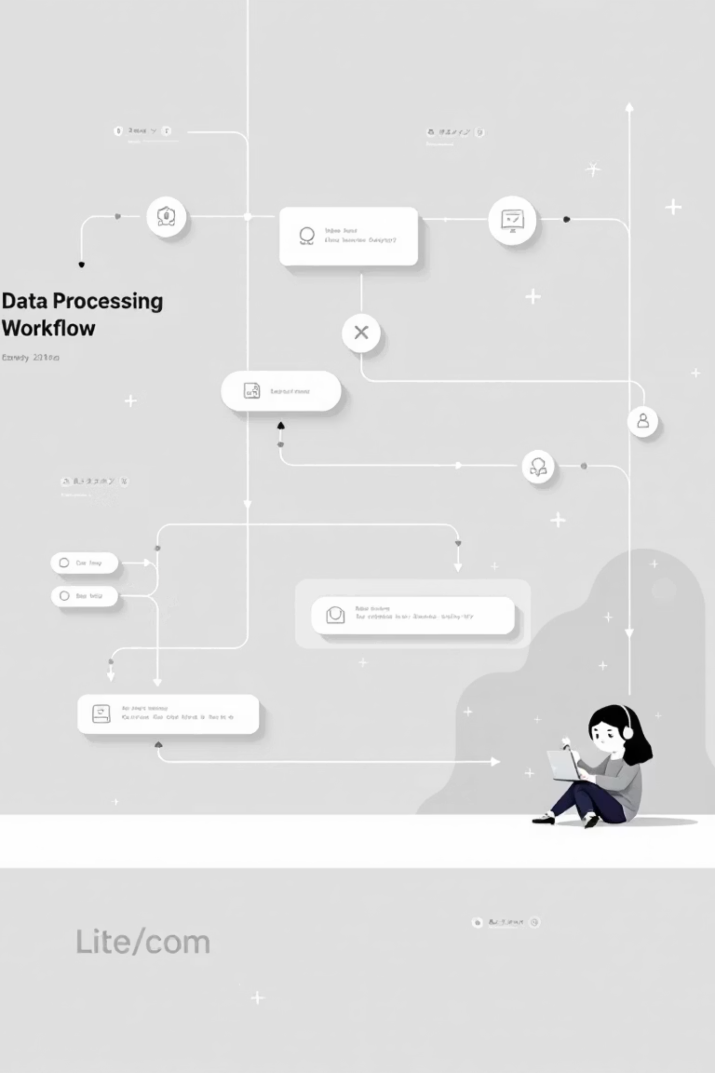



System Overview
Input Layer
Receive ~300 dispute cases with transaction metadata, customer details, and historical context
Processing Engine
Hybrid AI + rule-based scoring system analyses each case across multiple parameters
Output Layer
Automated prioritisation, queue routing, SLA assignment, and customer communication

Slide 3

Input Data Structure
HDFC Bank provides standardised dispute data across seven critical dimensions that drive the prioritisation logic.
Transaction Attributes
Operational Metrics
Amount Band: <₹1k / ₹1k–₹10k / >₹10k
Days Open: Duration since case creation
Channel: UPI / Debit Card / Credit Card
Current Priority: Existing bank classification
Category: Fraud / Failed Transaction / Reversal Pending / Merchant Dispute
Outcome Status: Resolved / Pending / SLA Breach

Slide 4

System Outputs
Priority Score
Priority Bucket
0-100 numeric score combining AI predictions and rule-based logic
High / Medium / Low classification for workflow routing
SLA Allocation
Queue Assignment
Time-bound targets: High (2hrs), Medium (6hrs), Low (24hrs)
Intelligent routing to Senior Ops, Standard, or Auto-Reply queues
Additionally, the system generates automated first-response templates and real-time dashboard metrics for operational visibility.

Slide 5
Core Processing Pipeline
01
02
Data Ingestion & Validation
Data Normalisation
Receive cases via API or CSV, validate data integrity
Clean fields, standardise text formats, convert categorical data
03
04
Rule Engine Scoring
ML Prediction Layer
Apply compliance-driven business rules for initial prioritisation
Generate probability scores using trained classification model
05
06
Score Fusion & Classification
SLA Assignment & Routing
Combine rule scores and ML predictions into final priority
Allocate time targets and route to appropriate operational queue

Slide 6
Rule-Based Scoring Logic
The first prioritisation layer applies deterministic business rules to ensure regulatory compliance and capture domain expertise.
Fraud Detection Rule
High-Value Transaction Rule
Condition: Category = "FRAUD"
Action: Add +40 priority points
Rationale: Immediate escalation for potential financial crime
Condition: Amount Band = ">₹10k"
Action: Add +30 priority points
Rationale: Larger financial impact requires faster resolution
Ageing Case Rule
Credit Card Channel Rule
Condition: Days Open > 3
Action: Add +20 priority points
Rationale: Prevent customer dissatisfaction and SLA breaches
Condition: Channel = "CREDIT_CARD"
Action: Add +10 priority points
Rationale: Higher regulatory scrutiny for credit products

Slide 7

ML Model Architecture
Model Inputs
Amount band score (normalised numeric value)
Days open (integer)
Category encoded (one-hot vector)
Channel encoded (one-hot vector)
Model Output
Three probability scores representing likelihood of High, Medium, and Low priority classification.
Algorithm Selection
Logistic Regression or Decision Tree classifier trained on historical dispute resolution data for interpretability and speed.

Slide 8
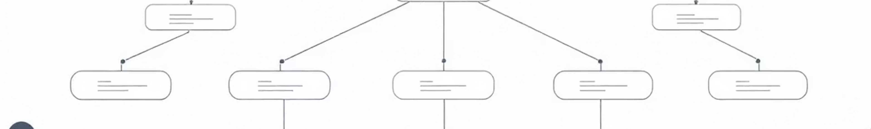
Hybrid Scoring & SLA Assignment
Score Fusion
1
Final Score = (0.6 × Rule Score) + (0.4 × ML High Probability × 100)
2
Priority Classification
Score >70 → HIGH | Score 40-70 → MEDIUM | Score <40 → LOW
SLA Time Allocation
3
HIGH: 2 hours | MEDIUM: 6 hours | LOW: 24 hours
4
Queue Routing
HIGH → Senior Ops | MEDIUM → Standard | LOW → Auto-Reply

Slide 9

Automated Response Generation
The system generates contextualised first-response templates based on priority level and dispute category, ensuring consistent customer communication.
High Priority Template
Medium Priority Template
Low Priority Template
"Dear Customer, Your dispute has been flagged as high priority and is under urgent review. Reference: {case_id}. We will update you within {sla_hours} hours."
"Dear Customer, We have received your dispute (Ref: {case_id}) and assigned it to our resolution team. You can expect an update within {sla_hours} hours."
"Dear Customer, Your request (Ref: {case_id}) is being processed. Standard resolution time is {sla_hours} hours. Track status on our mobile app."

Slide 10

Technology Stack
Backend Framework
ML Engine
Python + FastAPI for high-performance API endpoints and asynchronous processing
Scikit-learn for model training (Logistic Regression / Decision Tree)
Data Storage
Visualisation Layer
SQLite for lightweight case management and historical data persistence
Streamlit for real-time operational dashboards and SLA monitoring

