Slide 1
Bayesian networks

Slide 2
Bayesian networks
Bayesian networks are a type of probabilistic graphical model that represents a set of variables and their probabilistic dependencies in a directed acyclic graph (DAG).
The primary use of Bayesian networks is in modeling and reasoning under uncertainty.

Slide 3
Probabilistic Inference: Bayesian networks allow for efficient probabilistic inference. Given observed evidence (data) about some variables, the network can be used to infer the probabilities of other variables.
Decision Making: Bayesian networks are employed in decision analysis and decision making under uncertainty. They help in making optimal decisions by considering the uncertainties associated with different variables.

Slide 4
Diagnosis and Prediction: In various fields such as medicine and finance, Bayesian networks are used for diagnosis and prediction. For example, in healthcare, Bayesian networks can model the dependencies between symptoms and diseases, helping in diagnosing patients based on observed symptoms.
Risk Assessment: Bayesian networks are valuable in assessing and managing risks. They can model complex dependencies between different risk factors and help in evaluating the overall risk of a system or process.

Slide 5
Anomaly Detection: Bayesian networks can be used for anomaly detection by modeling normal patterns of behavior and identifying deviations from these patterns.
Speech and Natural Language Processing: In language processing tasks, Bayesian networks can be used for tasks such as part-of-speech tagging, syntactic parsing, and semantic analysis.

Slide 6
Data Fusion: When dealing with information from multiple sources, Bayesian networks can be used to combine and fuse the information while accounting for uncertainties.
Causal Reasoning: Bayesian networks are capable of representing causal relationships between variables. This makes them useful for understanding cause-and-effect relationships in complex systems.

Slide 7
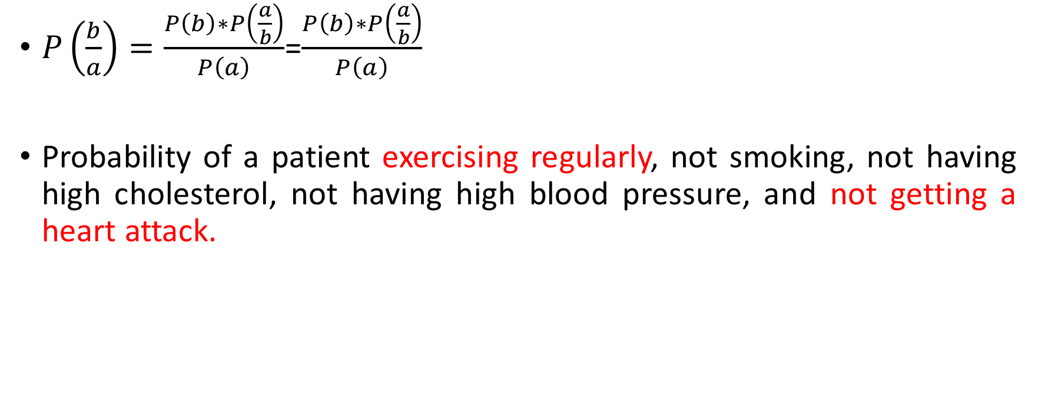
Bays Rule
$P\left(\frac{b}{a}\right)=\frac{P\left(b\right)∗P\left(\frac{a}{b}\right)}{P\left(a\right)}$=$\frac{P\left(b\right)∗P\left(\frac{a}{b}\right)}{P\left(a\right)}$
Probability of a patient exercising regularly, not smoking, not having high cholesterol, not having high blood pressure, and not getting a heart attack.

Slide 8
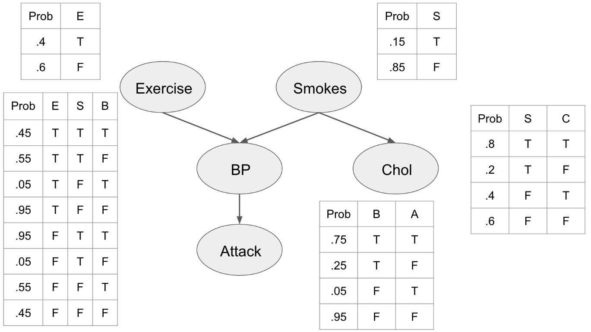
Baysian Network

Slide 9
P(E,S,C,B,A)=P(E)P(S)P(C|S)P(B|E,S)P(A|B)
P(E=T,S=F,C=F,B=F,A=F)=P(E=T)P(S=F)P(C=F|S=F)P(B=F|E=T,S=F) P(A=F|B=F)
=0.4×0.85×0.6×0.95×0.95
=0.184

Slide 10
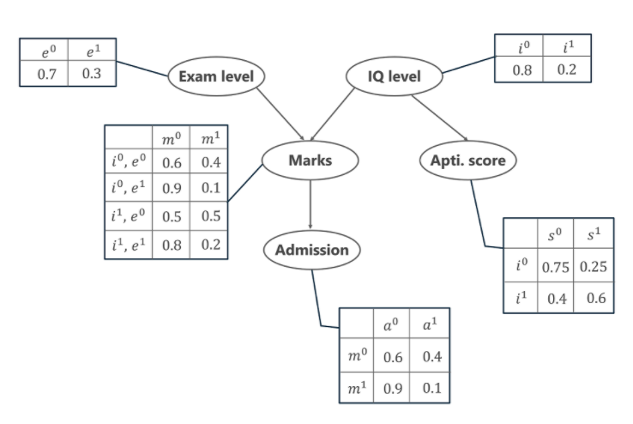
Baysian Network
Calculate the probability that in spite of the exam level being difficult, the student having a low IQ level and a low Aptitude Score, manages to pass the exam and secure admission to the university.

Slide 11
From the above word problem statement, the Joint Probability Distribution can be written as below,
P[a=1, m=1, i=0, e=1, s=0]
From the above Conditional Probability tables, the values for the given conditions are fed to the formula and is calculated as below.
P[a=1, m=1, i=0, e=1, s=0] = P(a=1 | m=1) . P(m=1 | i=0, e=1) . P(i=0) . P(e=1) . P(s=0 | i=0)
= 0.1 * 0.1 * 0.8 * 0.3 * 0.75
= 0.0018

Slide 12
Case 2: In another case, calculate the probability that the student has a High IQ level and Aptitude Score, the exam being easy yet fails to pass and does not secure admission to the university.

Slide 13
= P[a=0, m=0, i=1, e=0, s=1]
=P[a=0, m=0, i=1, e=0, s=1]= P(a=0 | m=0) . P(m=0 | i=1, e=0) . P(i=1) . P(e=0) . P(s=1 | i=1)
= 0.6 * 0.5 * 0.2 * 0.7 * 0.6
= 0.0252

