Slide 1

Cryptography and Network
Security
Chapter 2
Mathematics of Cryptography
Part I: Modular Arithmetic, Congruence,
and Matrices
CRYPTOGRAPHY AND NETWORK SECURITY
3e
1.<number>
Notes:
Copyright © 2015 by McGraw Hill Education (India) Private Limited. All rights reserved.

Slide 2
Objectives
To review integer arithmetic, concentrating on divisibility
and finding the greatest common divisor using the Euclidean
algorithm
To understand how the extended Euclidean algorithm can be
used to solve linear Diophantine equations, to solve linear
congruent equations, and to find the multiplicative inverses
To emphasize the importance of modular arithmetic and
the modulo operator, because they are extensively used in
cryptography
To emphasize and review matrices and operations on residue
matrices that are extensively used in cryptography
To solve a set of congruent equations using residue matrices
2.<number>
Notes:
Copyright © 2015 by McGraw Hill Education (India) Private Limited. All rights reserved.

Slide 3
2-1 INTEGER ARITHMETIC
In integer arithmetic, we use a set and a few operations. You are familiar with this set and the corresponding operations, but they are reviewed here to create a background for modular arithmetic.
Topics discussed in this section:
2.1.1 Set of Integers
2.1.2 Binary Operations
2.1.3 Integer Division
2.1.4 Divisibility
2.1.5 Linear Diophantine Equations
2.<number>
Notes:
Cryptography is based on some specific areas of mathematics, including number theory, linear algebra, and algebraic structures
Copyright © 2015 by McGraw Hill Education (India) Private Limited. All rights reserved.

Slide 4

2.1.1 Set of Integers
The set of integers, denoted by Z, contains all integral numbers (with no fraction) from negative infinity to positive infinity (Figure 2.1).
Figure 2.1 The set of integers
2.<number>
Notes:
Copyright © 2015 by McGraw Hill Education (India) Private Limited. All rights reserved.

Slide 5
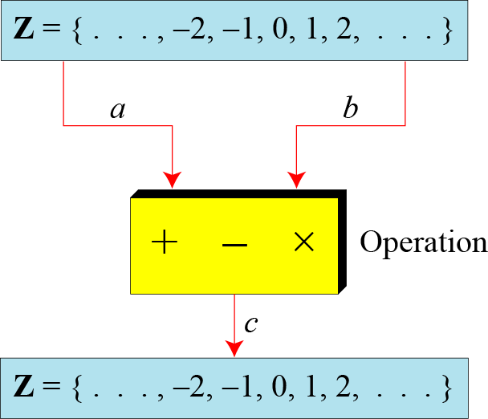
2.1.2 Binary Operations
In cryptography, we are interested in three binary operations applied to the set of integers.
A binary operation takes two inputs and creates one output.
Figure 2.2 Three binary operations for the set of integers
2.<number>
Notes:
Copyright © 2015 by McGraw Hill Education (India) Private Limited. All rights reserved.

Slide 6
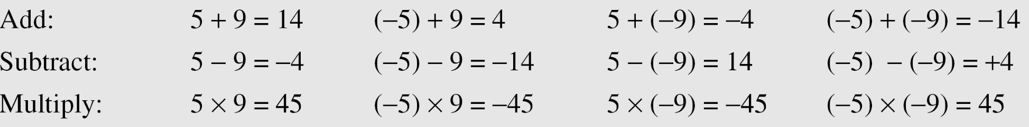
2.1.2 Continued
Example 2.1
The following shows the results of the three binary operations on two integers. Because each input can be either positive or negative, we can have four cases for each operation.
2.<number>
Notes:
Copyright © 2015 by McGraw Hill Education (India) Private Limited. All rights reserved.

Slide 7
2.1.3 Integer Division
In integer arithmetic, if we divide a by n, we can get q
And r . The relationship between these four integers can be shown as
a = q × n + r
a is the dividend;
q is the quotient;
n is the divisor;
r is the remainder.
2.<number>
Notes:
Copyright © 2015 by McGraw Hill Education (India) Private Limited. All rights reserved.

Slide 8
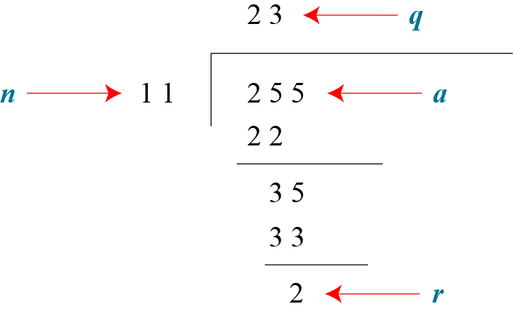
2.1.3 Continued
Example 2.2
Assume that a = 255 and n = 11. We can find q = 23 and R = 2 using the division algorithm.
Figure 2.3 Example 2.2, finding the quotient and the remainder
2.<number>
Notes:
Copyright © 2015 by McGraw Hill Education (India) Private Limited. All rights reserved.

Slide 9
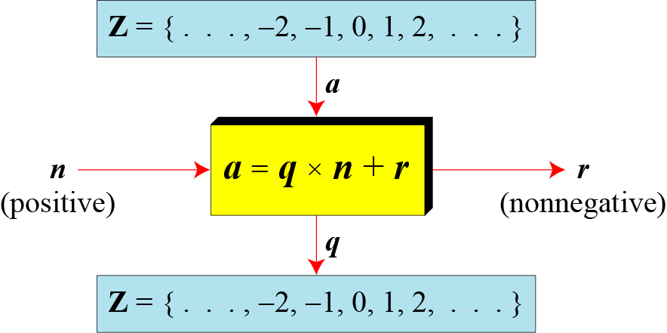
2.1.3 Continued
The division relationship in cryptography, we impose two restrictions.
First, we require that the divisor be a positive integer (n > 0).
Second, we require that the remainder be a nonnegative integer (r ≥ 0).
Figure 2.4 Division algorithm for integers
2.<number>
Notes:
Copyright © 2015 by McGraw Hill Education (India) Private Limited. All rights reserved.

Slide 10
2.1.3 Continued
Example 2.3
When we use a computer or a calculator, r and q are negative when a is negative. How can we apply the restriction that r needs to be positive?
The solution is simple, we decrement the value of q by 1 and we add the value of n to r to make it positive.
2.<number>
Notes:
Copyright © 2015 by McGraw Hill Education (India) Private Limited. All rights reserved.

Slide 11
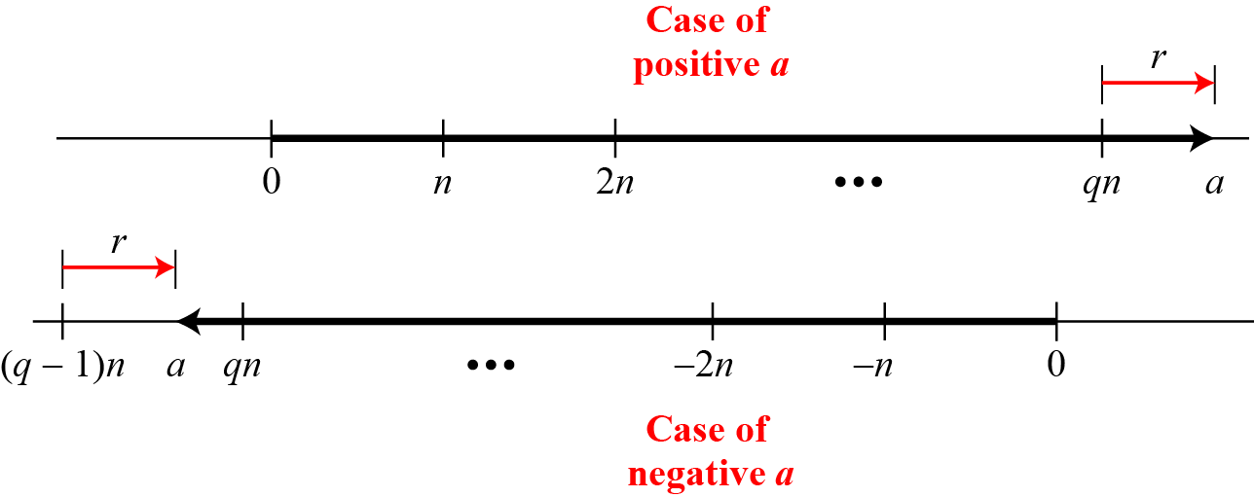
2.1.3 Continued
Figure 2.5 Graph of division alogorithm
2.<number>
Notes:
Copyright © 2015 by McGraw Hill Education (India) Private Limited. All rights reserved.

Slide 12

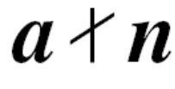
2.1.4 Divisbility
If a is not zero and we let r = 0 in the division relation, we get
a = q × n
If the remainder is zero,
a is divisible by n.
If the remainder is not zero,
n does not divide a
2.<number>
Notes:
Copyright © 2015 by McGraw Hill Education (India) Private Limited. All rights reserved.

Slide 13
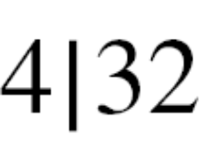
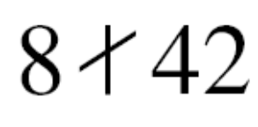
2.1.4 Continued
Example 2.4
The integer 4 divides the integer 32 because 32 = 8 × 4. We show this as
b. The number 8 does not divide the number 42 because
42 = 5 × 8 + 2. There is a remainder, the number 2, in the equation. We show this as
2.<number>
Notes:
Copyright © 2015 by McGraw Hill Education (India) Private Limited. All rights reserved.

Slide 14
2.1.4 Continued
Example 2.5
2.<number>
Notes:
Copyright © 2015 by McGraw Hill Education (India) Private Limited. All rights reserved.

Slide 15
2.1.4 Continued
Properties of divisibility
Property 1: if a|1, then a = ±1.
Property 2: if a|b and b|a, then a = ±b.
Property 3: if a|b and b|c, then a|c.
Property 4: if a|b and a|c, then
a|(m × b + n × c), where m
and n are arbitrary integers
2.<number>
Notes:
Copyright © 2015 by McGraw Hill Education (India) Private Limited. All rights reserved.

Slide 16

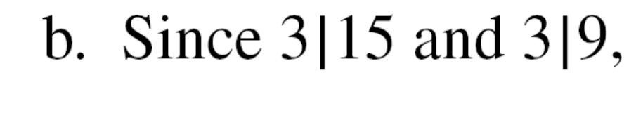
2.1.4 Continued
Example 2.6
2.<number>
Notes:
Copyright © 2015 by McGraw Hill Education (India) Private Limited. All rights reserved.

Slide 17

2.1.4 Continued
A positive integer can have more than one divisor.
For example, the integer 32 has six divisors: 1, 2, 4, 8, 16, and 32.
We can mention two interesting facts about divisors of positive integers
All Divisors
Note
Fact 1: The integer 1 has only one divisor, itself.
Fact 2: Any positive integer has at least
two divisors, 1 and itself (but it
can have more).
2.<number>
Notes:
Copyright © 2015 by McGraw Hill Education (India) Private Limited. All rights reserved.

Slide 18
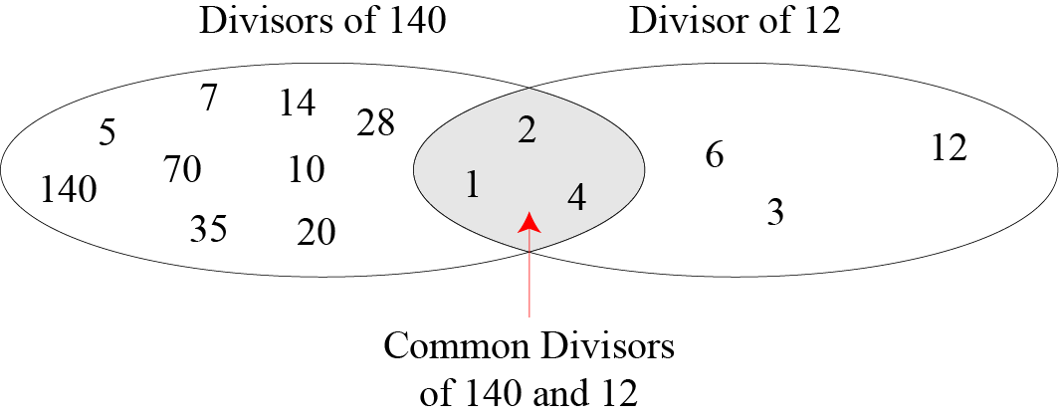
2.1.4 Continued
Figure 2.6 Common divisors of two integers
The greatest common divisor is 4.
2.<number>
Notes:
Copyright © 2015 by McGraw Hill Education (India) Private Limited. All rights reserved.

Slide 19
2.1.4 Continued
Note
Greatest Common Divisor
The greatest common divisor of two positive integers is the largest integer that can divide both integers.
Finding the greatest common divisor (gcd) of two positive integers by listing all common divisors is not practical when the two integers are large.
Note
Euclidean Algorithm
Fact 1: gcd (a, 0) = a
Fact 2: gcd (a, b) = gcd (b, r), where r is
the remainder of dividing a by b
2.<number>
Notes:
Copyright © 2015 by McGraw Hill Education (India) Private Limited. All rights reserved.

Slide 20
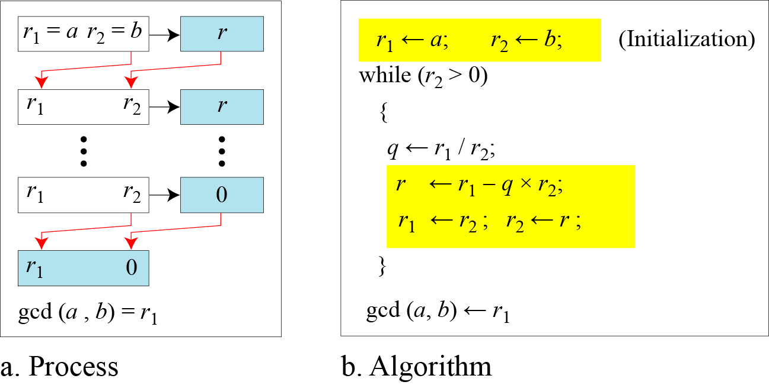
2.1.4 Continued
gcd (36, 10) = gcd (10, 6) = gcd (6, 4) = gcd (4, 2) = gcd (2, 0) = 2
Figure 2.7 Euclidean Algorithm
Note
When gcd (a, b) = 1, we say that a and b are relatively prime.
2.<number>
Notes:
Copyright © 2015 by McGraw Hill Education (India) Private Limited. All rights reserved.

Slide 21
2.1.4 Continued
Note
When gcd (a, b) = 1, we say that a and b are relatively prime.
gcd(2,3)=gcd(1,2)=gcd(1,0)=1
2.<number>
Notes:
Copyright © 2015 by McGraw Hill Education (India) Private Limited. All rights reserved.

Slide 22
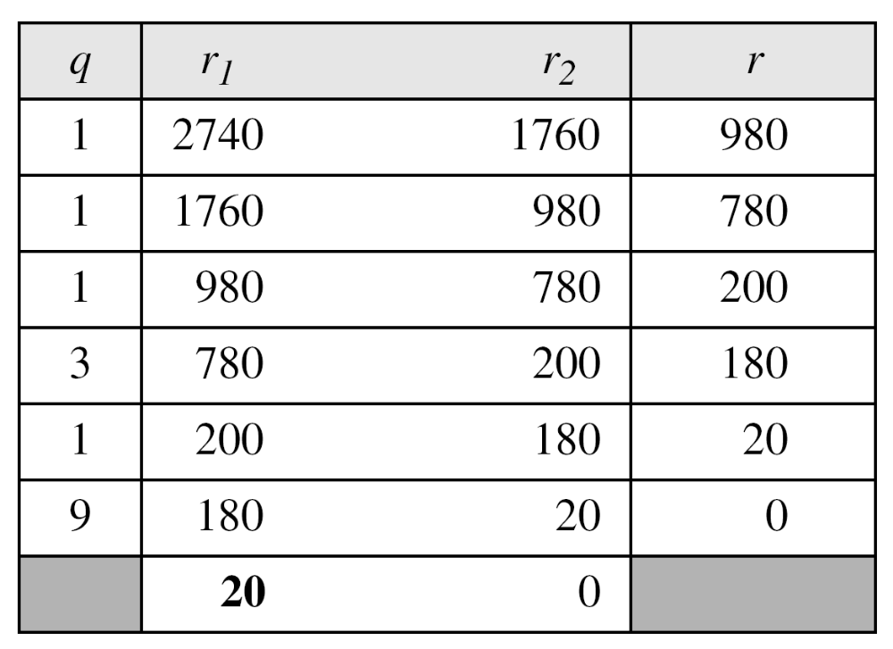
2.1.4 Continued
Example 2.7
Find the greatest common divisor of 2740 and 1760.
Solution
We have gcd (2740, 1760) = 20.
2.<number>
Notes:
Copyright © 2015 by McGraw Hill Education (India) Private Limited. All rights reserved.

Slide 23
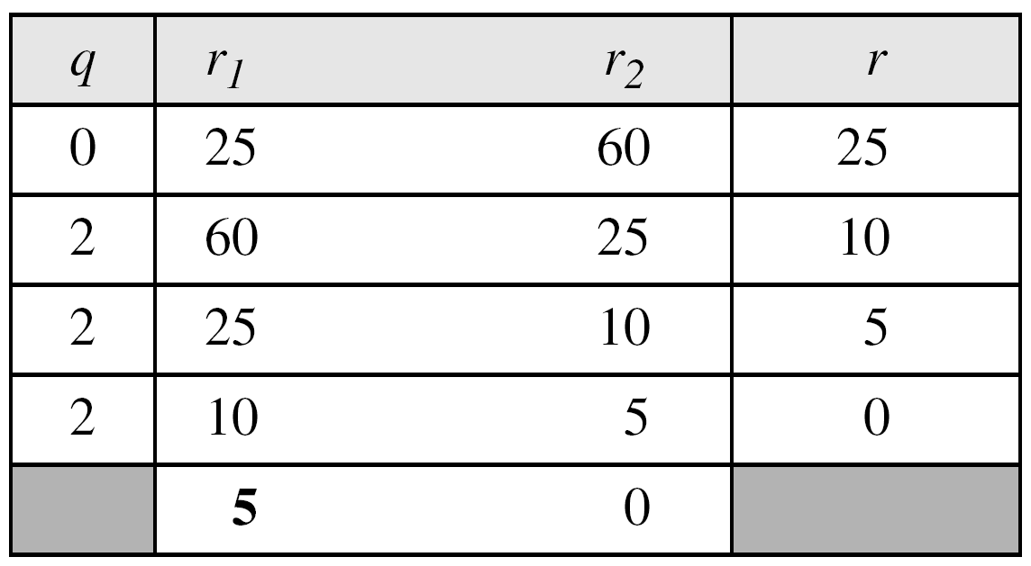
2.1.4 Continued
Example 2.8
Find the greatest common divisor of 25 and 60.
Solution
We have gcd (25, 60) = 5.
2.<number>
Notes:
Copyright © 2015 by McGraw Hill Education (India) Private Limited. All rights reserved.

Slide 24

2.1.4 Continued
Extended Euclidean Algorithm
Given two integers a and b, we often need to find other two integers, s and t, such that
The extended Euclidean algorithm can calculate the gcd (a, b) and at the same time calculate the value of s and t.
2.<number>
Notes:
Copyright © 2015 by McGraw Hill Education (India) Private Limited. All rights reserved.

Slide 25
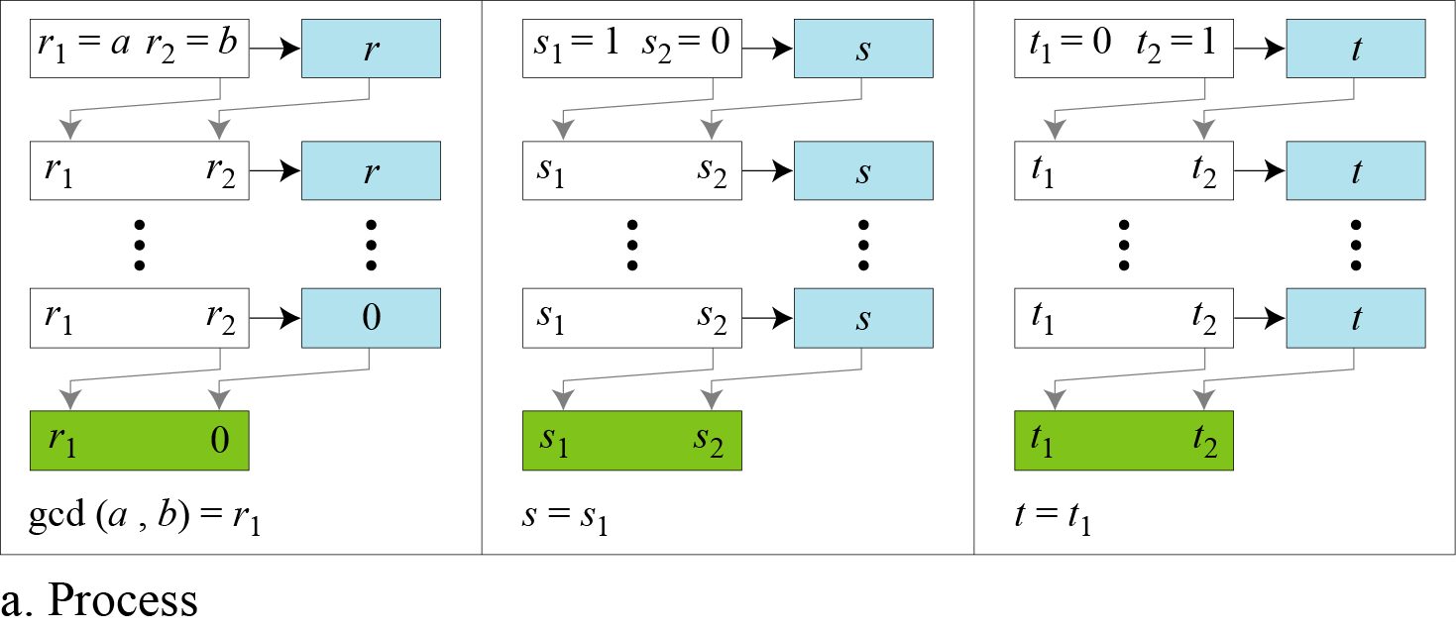
2.1.4 Continued
Figure 2.8.a Extended Euclidean algorithm, part a
2.<number>
Notes:
Copyright © 2015 by McGraw Hill Education (India) Private Limited. All rights reserved.

Slide 26
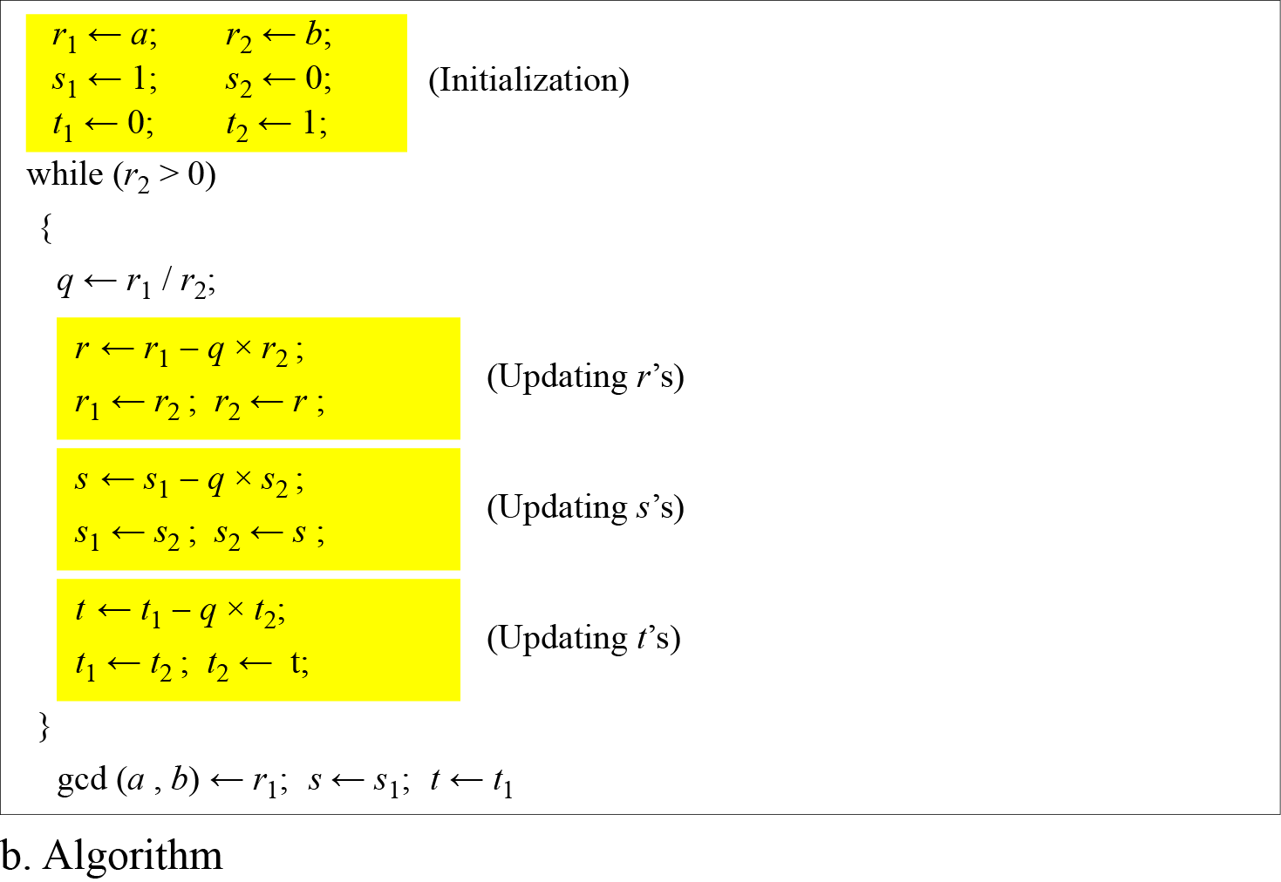
2.1.4 Continued
Figure 2.8.b Extended Euclidean algorithm, part b
2.<number>
Notes:
Copyright © 2015 by McGraw Hill Education (India) Private Limited. All rights reserved.

Slide 27
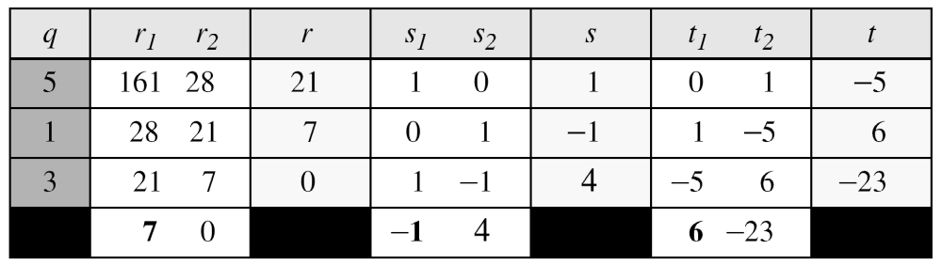
2.1.4 Continued
Example 2.9
Given a = 161 and b = 28, find gcd (a, b) and the values of s and t.
Solution
We get gcd (161, 28) = 7, s = −1 and t = 6.
2.<number>
Notes:
Copyright © 2015 by McGraw Hill Education (India) Private Limited. All rights reserved.

Slide 28
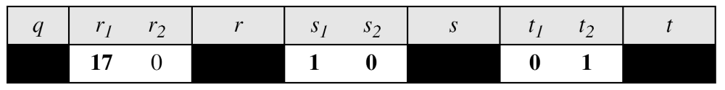
2.1.4 Continued
Example 2.10
Given a = 17 and b = 0, find gcd (a, b) and the values of s
and t.
Solution
We get gcd (17, 0) = 17, s = 1, and t = 0.
2.<number>
Notes:
Copyright © 2015 by McGraw Hill Education (India) Private Limited. All rights reserved.

Slide 29
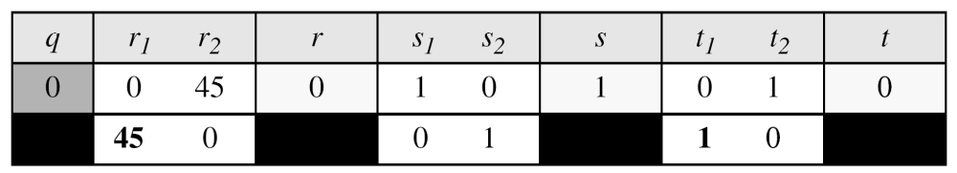
2.1.4 Continued
Example 2.11
Given a = 0 and b = 45, find gcd (a, b) and the values of s
and t.
Solution
We get gcd (0, 45) = 45, s = 0, and t = 1.
2.<number>
Notes:
Copyright © 2015 by McGraw Hill Education (India) Private Limited. All rights reserved.

Slide 30

2.1.4 Continued
Extended Euclidean algorithm application
Linear Diophantine Equation
Note
A linear Diophantine equation of two variables is ax + by = c.
We need to find integer values for x and y that satisfy the equation. This type of equation has either no solution or an infinite number of solutions.
Let d = gcd (a, b). If d c, then the equation has no solution.
If d | c, then we have an infinite number of solutions
2.<number>
Notes:
Copyright © 2015 by McGraw Hill Education (India) Private Limited. All rights reserved.

Slide 31
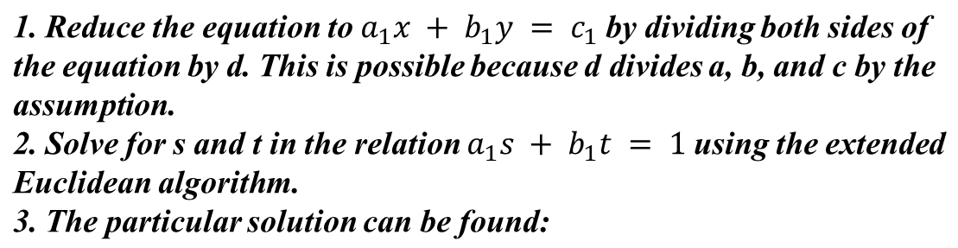
2.1.4 Continued
Note
Particular solution:
x₀ = (c/d)s and y₀ = (c/d)t
Note
General solutions:
x = x₀ + k (b/d) and y = y₀ − k(a/d)
where k is an integer
2.<number>

Slide 32
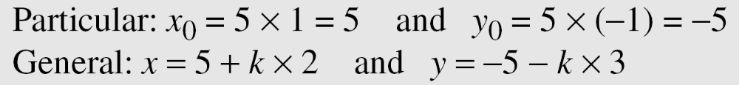
2.1.4 Continued
Example 2.12
Find the particular and general solutions to the equation
21x + 14y = 35.
Solution
Step1 : d = gcd (a,b)=gcd(21,14)=7
Step 2: 7|35 so infinite number of solutions
Step 3: divide both sides by 7
Step 4: x0= (c/d)s= (35/7)*1, y0=(c/d)t=(35/7)(-1)
Step 5: x=x0+k(b/d) and y= y0-k(a/d)
Therefore the solutions are (5,-5) (7-8) (9,-11)……
2.<number>
Notes:
Copyright © 2015 by McGraw Hill Education (India) Private Limited. All rights reserved.

Slide 33
2.1.4 Continued
Example 2.13
For example, imagine we want to cash a $100 check and get
some $20 and some $5 bills. We have many choices, which we can find by solving the corresponding Diophantine equation 20x + 5y = 100. Since d = gcd (20, 5) = 5 and 5 | 100, the equation has an infinite number of solutions, but only a few of them are acceptable in this case.
The general solutions with x and y nonnegative are
s=0, t=1
X0= 20*0=0 y0=20*1=20
X=x0+k(b/d) y=y0-k(a/d)
(0, 20), (1, 16), (2, 12), (3, 8), (4, 4), (5, 0).
2.<number>
Notes:
Copyright © 2015 by McGraw Hill Education (India) Private Limited. All rights reserved.

Slide 34
2-2 MODULAR ARITHMETIC
The division relationship (a = q × n + r) discussed in the previous section has two inputs (a and n) and two outputs (q and r). In modular arithmetic, we are interested in only one of the outputs, the remainder r.
Topics discussed in this section:
2.2.1 Modular Operator
2.2.2 Set of Residues
2.2.3 Congruence
2.2.4 Operations in Z_{n}
2.2.5 Addition and Multiplication Tables
2.2.6 Different Sets
2.<number>
Notes:
Copyright © 2015 by McGraw Hill Education (India) Private Limited. All rights reserved.

Slide 35
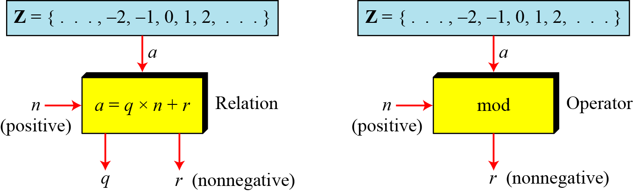
2.2.1 Modulo Operator
The modulo operator is shown as mod. The second input (n) is called the modulus. The output r is called the residue.
Figure 2.9 Division algorithm and modulo operator
2.<number>
Notes:
Copyright © 2015 by McGraw Hill Education (India) Private Limited. All rights reserved.

Slide 36
2.1.4 Continued
Example 2.14
Find the result of the following operations:
a. 27 mod 5 b. 36 mod 12
c. −18 mod 14 d. −7 mod 10
Solution
Dividing 27 by 5 results in r = 2
Dividing 36 by 12 results in r = 0.
c. Dividing −18 by 14 results in r = −4. After adding the modulus r = 10
d. Dividing −7 by 10 results in r = −7. After adding the modulus to −7, r = 3.
2.<number>
Notes:
Copyright © 2015 by McGraw Hill Education (India) Private Limited. All rights reserved.

Slide 37
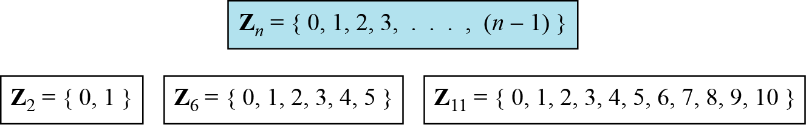
2.2.2 Set of Residues
The modulo operation creates a set, which in modular arithmetic is referred to as the set of least residues modulo n, or Z_{n}.
Figure 2.10 Some Z_{n} sets
2.<number>
Notes:
Copyright © 2015 by McGraw Hill Education (India) Private Limited. All rights reserved.

Slide 38
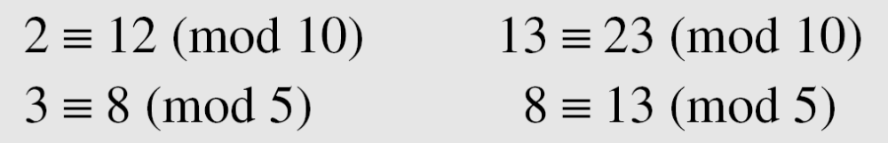

2.2.3 Congruence
In cryptography, we often used the concept of congruence instead of equality.
To show that two integers are congruent, we use the congruence operator ( ≡ ). For example, we write:
Here 12,23,8 and 13 are called congruence.
2.<number>
Notes:
The congruence operator looks like the equality operator, but there are differences.
First, an equality operator maps a member of Z to itself; the congruence operator maps a member from Z to a member of Zn.
Second, the equality operator is one to-one; the congruence operator is many-to-one.
Copyright © 2015 by McGraw Hill Education (India) Private Limited. All rights reserved.

Slide 39
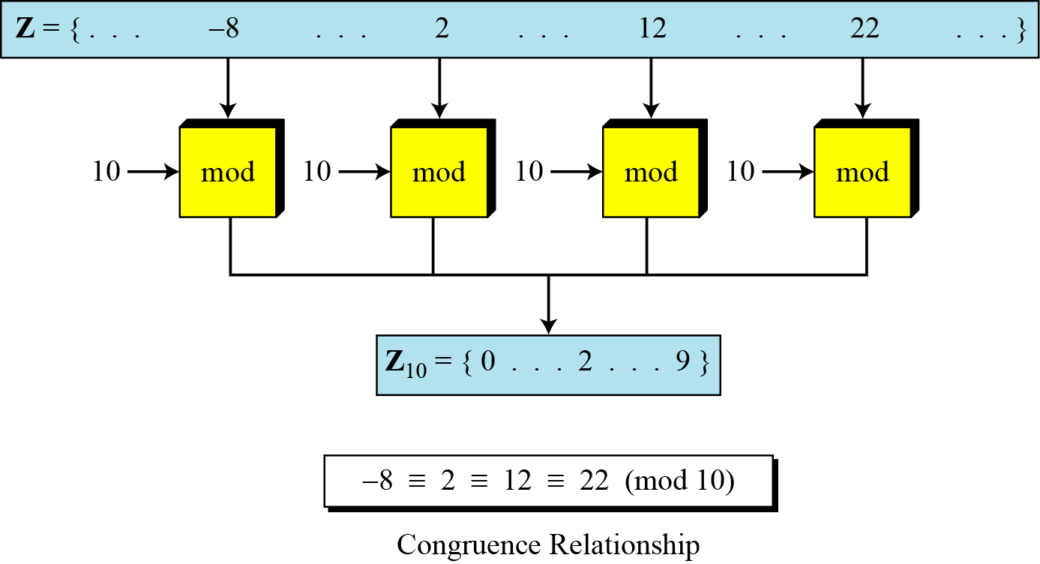
2.2.3 Continued
Figure 2.11 Concept of congruence
2.<number>
Notes:
Copyright © 2015 by McGraw Hill Education (India) Private Limited. All rights reserved.

Slide 40
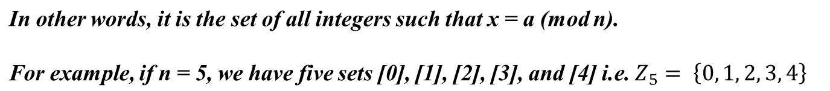
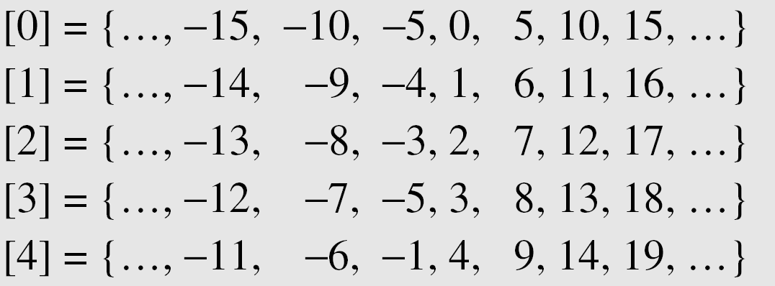
2.2.3 Continued
Residue Classes
A residue class [a] or [a]_{n} is the set of integers congruent modulo n.
2.<number>
Notes:
Copyright © 2015 by McGraw Hill Education (India) Private Limited. All rights reserved.

Slide 41
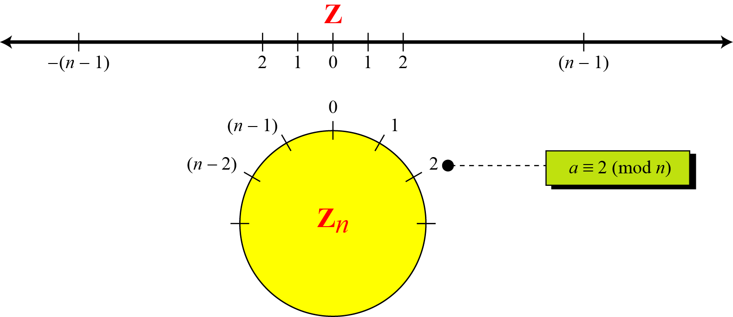
2.2.3 Continued
Figure 2.12 Comparison of Z and Z_{n} using graphs
2.<number>
Notes:
Copyright © 2015 by McGraw Hill Education (India) Private Limited. All rights reserved.

Slide 42
2.2.3 Continued
Example 2.15
We use modular arithmetic in our daily life; for example, we use a clock to measure time. Our clock system uses modulo 12 arithmetic. However, instead of a 0 we use the number 12. So our clock system starts with 0 (or 12) and goes until 11. Because our days last 24 hours, we navigate around the circle two times and denote the first revolution as A.M. and the second as P.M.
2.<number>
Notes:
Copyright © 2015 by McGraw Hill Education (India) Private Limited. All rights reserved.

Slide 43
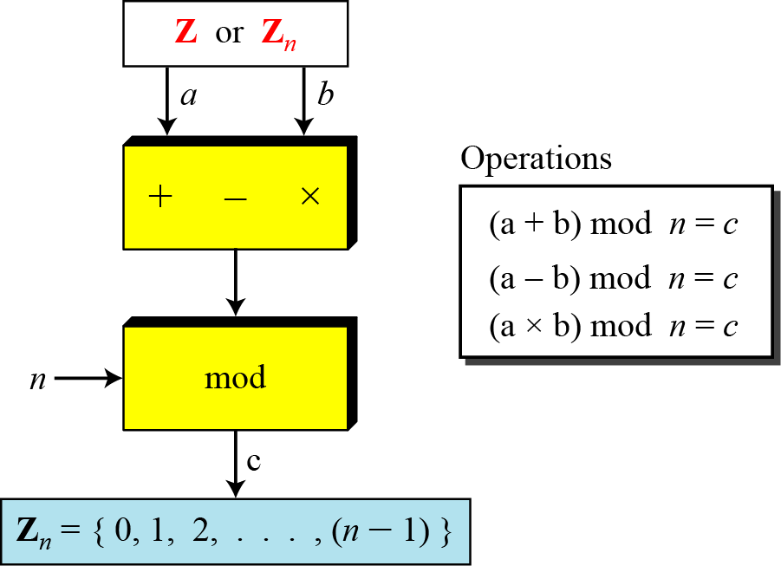
2.2.4 Operation in Z_{n}
The three binary operations that we discussed for the set Z can also be defined for the set Zn. The result may need to be mapped to Zn using the mod operator.
Figure 2.13 Binary operations in Z_{n}
Z15
7 And 14
Add
(7+14) mod 15
6
2.<number>
Notes:
Copyright © 2015 by McGraw Hill Education (India) Private Limited. All rights reserved.

Slide 44
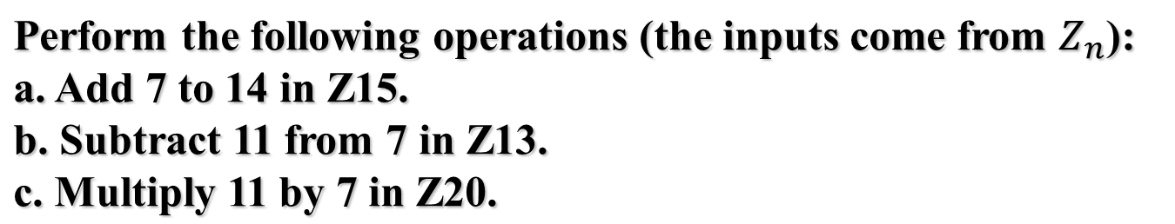
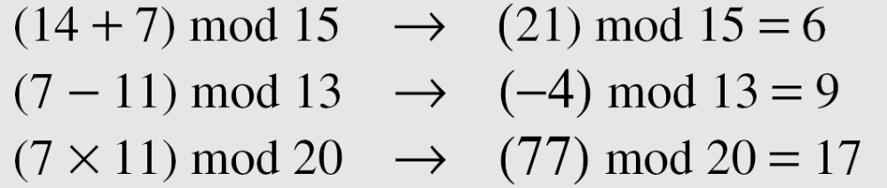
2.2.4 Continued
Example 2.16
Solution
2.<number>
Notes:
Copyright © 2015 by McGraw Hill Education (India) Private Limited. All rights reserved.

Slide 45

2.2.4 Continued
Example 2.17
Perform the following operations (the inputs come from either Z or Z_{n}):
a. Add 17 to 27 in Z₁₄.
b. Subtract 43 from 12 in Z₁₃.
c. Multiply 123 by −10 in Z₁₉.
Solution
2.<number>
Notes:
Copyright © 2015 by McGraw Hill Education (India) Private Limited. All rights reserved.

Slide 46
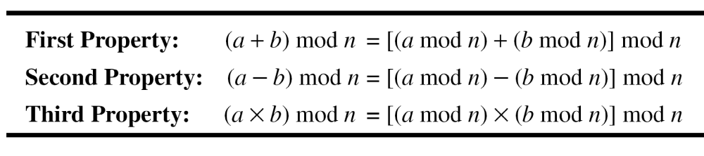
2.2.4 Continued
Properties
2.<number>
Notes:
Copyright © 2015 by McGraw Hill Education (India) Private Limited. All rights reserved.

Slide 47
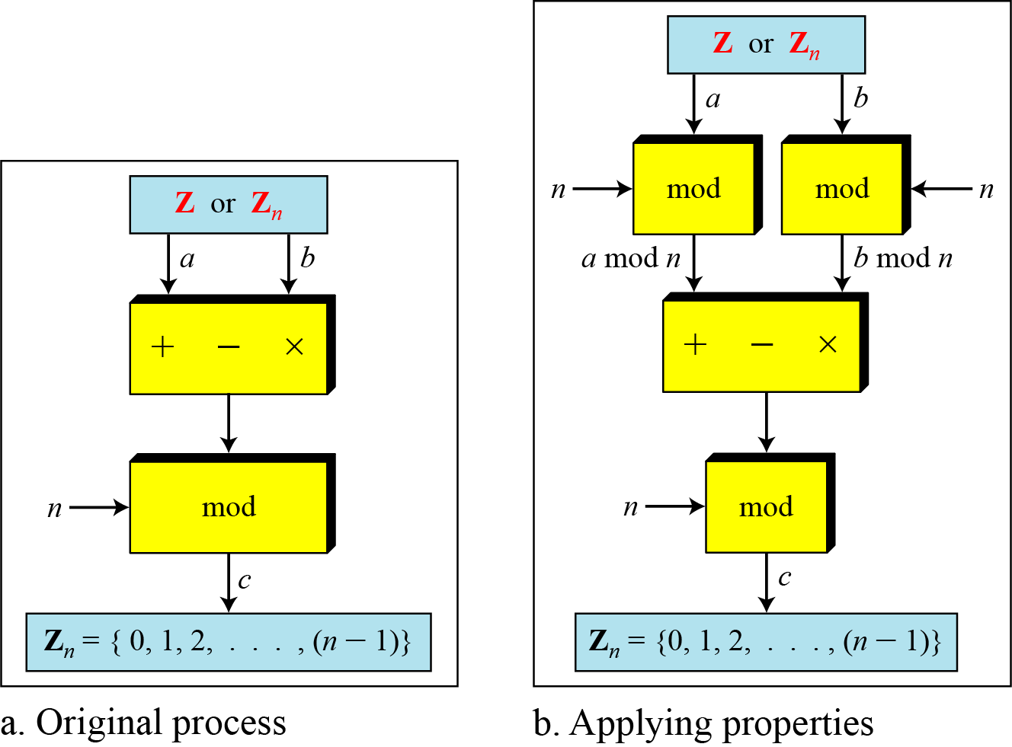
2.2.4 Continued
Figure 2.14 Properties of mode operator
2.<number>
Notes:
Copyright © 2015 by McGraw Hill Education (India) Private Limited. All rights reserved.

Slide 48
2.2.4 Continued
Example 2.18
The following shows the application of the above properties:
1. (1,723,345 + 2,124,945) mod 11 = (8 + 9) mod 11 = 6
2. (1,723,345 − 2,124,945) mod 11 = (8 − 9) mod 11 = 10
3. (1,723,345 × 2,124,945) mod 11 = (8 × 9) mod 11 = 6
2.<number>
Notes:
Copyright © 2015 by McGraw Hill Education (India) Private Limited. All rights reserved.

Slide 49
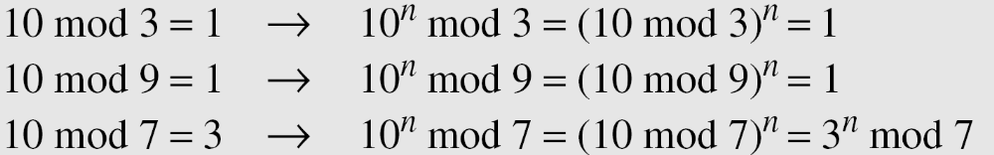
2.2.4 Continued
Example 2.19
In arithmetic, we often need to find the remainder of powers of 10 when divided by an integer.
2.<number>
Notes:
Copyright © 2015 by McGraw Hill Education (India) Private Limited. All rights reserved.

Slide 50
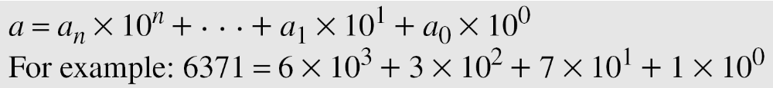
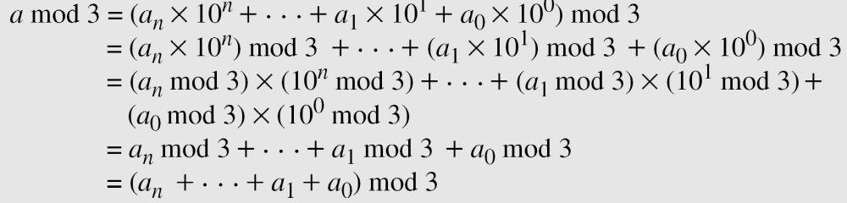
2.2.4 Continued
Example 2.20
We have been told in arithmetic that the remainder of an integer divided by 3 is the same as the remainder of the sum of its decimal digits. We write an integer as the sum of its digits multiplied by the powers of 10.
2.<number>
Notes:
Copyright © 2015 by McGraw Hill Education (India) Private Limited. All rights reserved.

Slide 51
2.2.5 Inverses
When we are working in modular arithmetic, we often need to find the inverse of a number relative to an operation. We are normally looking for an additive inverse (relative to an addition operation) or a multiplicative inverse (relative to a multiplication operation).
2.<number>
Notes:
Copyright © 2015 by McGraw Hill Education (India) Private Limited. All rights reserved.

Slide 52

2.2.5 Continue
Additive Inverse
In Z_{n}, two numbers a and b are additive inverses of each other if
Note
In modular arithmetic, each integer has an additive inverse. The sum of an integer and its additive inverse is congruent to 0 modulo n.
2.<number>
Notes:
Copyright © 2015 by McGraw Hill Education (India) Private Limited. All rights reserved.

Slide 53
2.2.5 Continued
Example 2.21
Find all additive inverse pairs in Z10.
Solution
The six pairs of additive inverses are (0, 0), (1, 9), (2, 8), (3, 7), (4, 6), and (5, 5).
2.<number>
Notes:
Copyright © 2015 by McGraw Hill Education (India) Private Limited. All rights reserved.

Slide 54

2.2.5 Continue
Multiplicative Inverse
In Z_{n}, two numbers a and b are the multiplicative inverse of each other if
For example, if the modulus is 10, then the multiplicative inverse of 3 is 7. In other words, we have (3 × 7) mod 10 = 1.
Note
In modular arithmetic, an integer may or may not have a multiplicative inverse.
When it does, the product of the integer and its multiplicative inverse is congruent to 1 modulo n.
2.<number>
Notes:
Copyright © 2015 by McGraw Hill Education (India) Private Limited. All rights reserved.

Slide 55
2.2.5 Continued
Example 2.22
Find the multiplicative inverse of 8 in Z₁₀.
Solution
There is no multiplicative inverse because gcd (10, 8) = 2 ≠ 1. In other words, we cannot find any number between 0 and 9 such that when multiplied by 8, the result is congruent to 1.
Example 2.23
Find all multiplicative inverses in Z₁₀.
Solution
There are only three pairs: (1, 1), (3, 7) and (9, 9). The numbers 0, 2, 4, 5, 6, and 8 do not have a multiplicative inverse.
2.<number>
Notes:
Copyright © 2015 by McGraw Hill Education (India) Private Limited. All rights reserved.

Slide 56
2.2.5 Continued
Example 2.24
Find all multiplicative inverse pairs in Z₁₁.
Solution
We have six pairs: (1, 1), (2, 6), (3, 4), (5, 9), (7, 8), and (10, 10).
2.<number>
Notes:
Copyright © 2015 by McGraw Hill Education (India) Private Limited. All rights reserved.

Slide 57
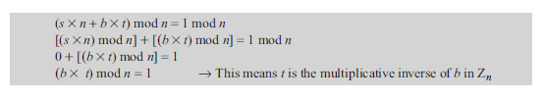
2.2.5 Continued
Note
The extended Euclidean algorithm finds the multiplicative inverses of b in Z_{n} when n and b are given and
gcd (n, b) = 1.
The multiplicative inverse of b is the value of t after being mapped to Z_{n}.
2.<number>
Notes:
Copyright © 2015 by McGraw Hill Education (India) Private Limited. All rights reserved.

Slide 58
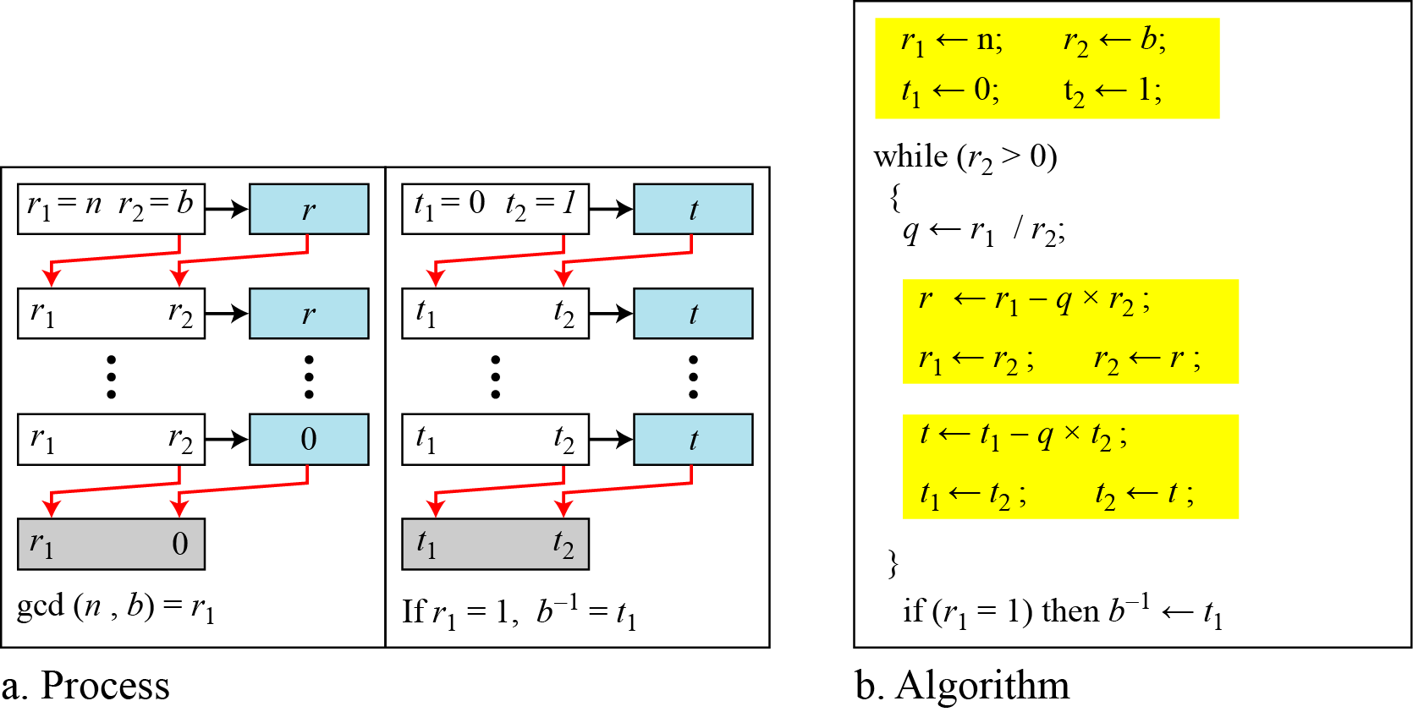
2.2.5 Continued
Figure 2.15 Using extended Euclidean algorithm to
find multiplicative inverse
2.<number>
Notes:
Copyright © 2015 by McGraw Hill Education (India) Private Limited. All rights reserved.

Slide 59
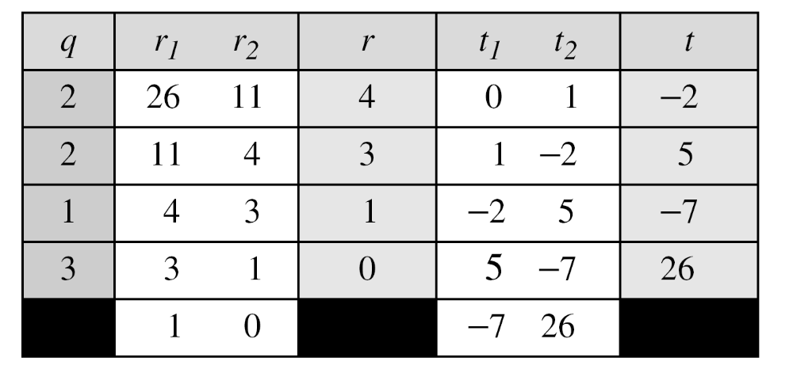
2.2.5 Continued
Example 2.25
Find the multiplicative inverse of 11 in Z₂₆.
Solution
The gcd (26, 11) is 1; the inverse of 11 is −7 or 19.
2.<number>
Notes:
Copyright © 2015 by McGraw Hill Education (India) Private Limited. All rights reserved.

Slide 60
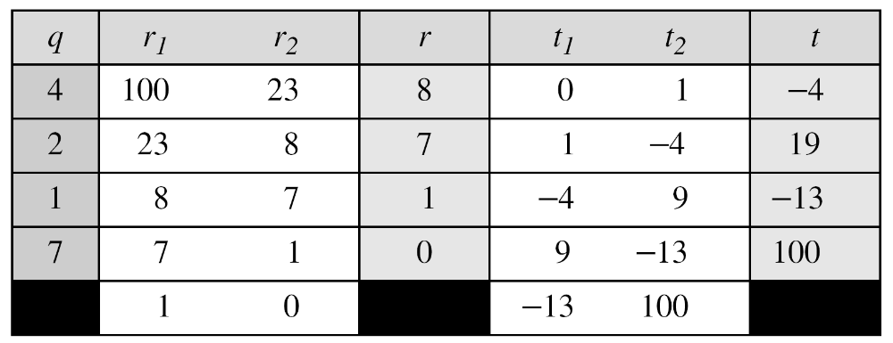
2.2.5 Continued
Example 2.26
Find the multiplicative inverse of 23 in Z₁₀₀.
Solution
The gcd (100, 23) is 1; the inverse of 23 is −13 or 87.
2.<number>
Notes:
Copyright © 2015 by McGraw Hill Education (India) Private Limited. All rights reserved.

Slide 61
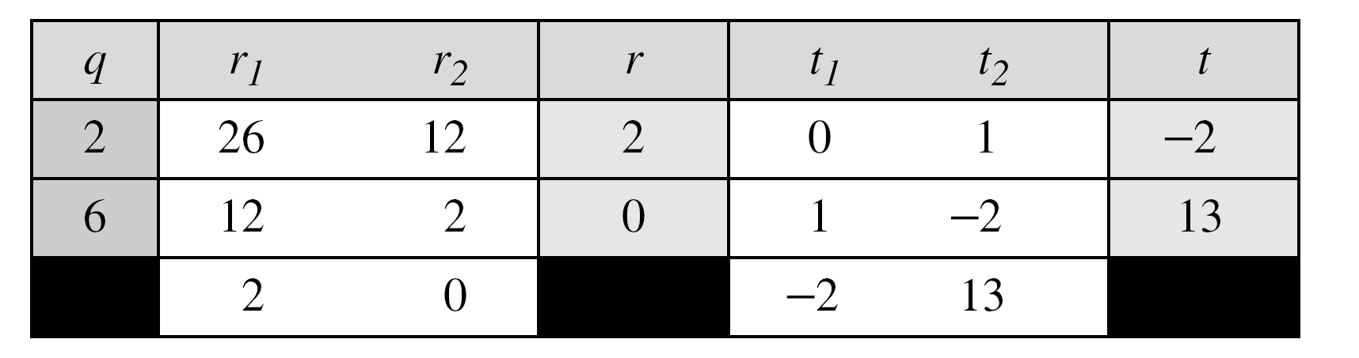
2.2.5 Continued
Example 2.27
Find the inverse of 12 in Z₂₆.
Solution
The gcd (26, 12) is 2;
Therefore no multiplicative inverse exist for 12.
2.<number>
Notes:
Copyright © 2015 by McGraw Hill Education (India) Private Limited. All rights reserved.

Slide 62
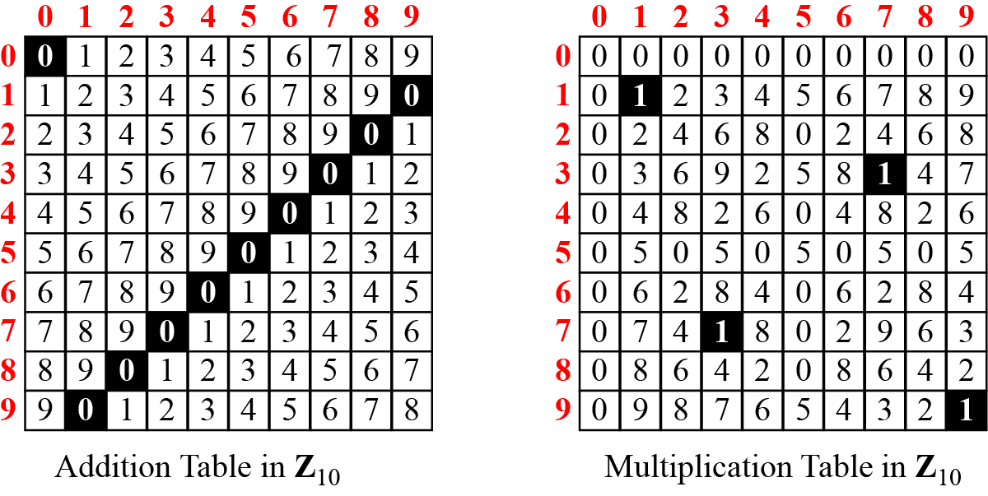
2.2.6 Addition and Multiplication Tables
Figure 2.16 Addition and multiplication table for Z₁₀
2.<number>
Notes:
Copyright © 2015 by McGraw Hill Education (India) Private Limited. All rights reserved.

Slide 63
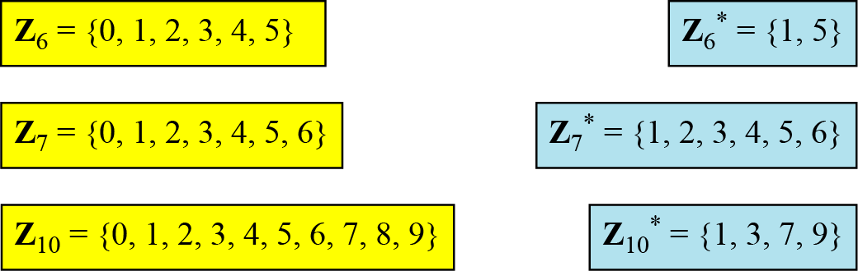
2.2.7 Different Sets
Figure 2.17 Some Z_{n} and Z_{n}* sets
Note
We need to use Zn when additive inverses are needed; we need to use Zn* when multiplicative inverses are needed.
2.<number>
Notes:
Copyright © 2015 by McGraw Hill Education (India) Private Limited. All rights reserved.

Slide 64
2-4 LINEAR CONGRUENCE
Cryptography often involves solving an equation or a set of equations of one or more variables with coefficient in Z_{n}. This section shows how to solve equations when the power of each variable is 1 (linear equation).
Topics discussed in this section:
2.4.1 Single-Variable Linear Equations
2.4.2 Set of Linear Equations
2.<number>
Notes:
Copyright © 2015 by McGraw Hill Education (India) Private Limited. All rights reserved.

Slide 65



2.4.1 Single-Variable Linear Equations
Equations of the form ax ≡ b (mod n ) might have no solution or a limited number of solutions.
2.<number>
Notes:
Copyright © 2015 by McGraw Hill Education (India) Private Limited. All rights reserved.

Slide 66
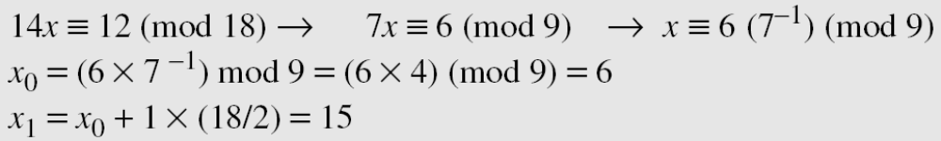
2.4.1 Continued
Example 2.35
Solve the equation 10 x ≡ 2(mod 15).
Solution
First we find the gcd (10 and 15) = 5. Since 5 does not divide 2, we have no solution.
Example 2.36
Solve the equation 14 x ≡ 12 (mod 18).
x = x0 + k (n/ d)
Solution
2.<number>
Notes:
Copyright © 2015 by McGraw Hill Education (India) Private Limited. All rights reserved.

Slide 67
2.4.1 Continued
Example 2.37
Solve the equation 3x + 4 ≡ 6 (mod 13).
Solution
First we change the equation to the form ax ≡ b (mod n). We add −4 (the additive inverse of 4) to both sides, which give
3x ≡ 2 (mod 13). Because gcd (3, 13) = 1, the equation has only one solution, which is x₀ = (2 × 3⁻¹) mod 13 = 18 mod 13 = 5. We can see that the answer satisfies the original equation:
3 × 5 + 4 ≡ 6 (mod 13).
2.<number>
Notes:
Copyright © 2015 by McGraw Hill Education (India) Private Limited. All rights reserved.

Slide 68
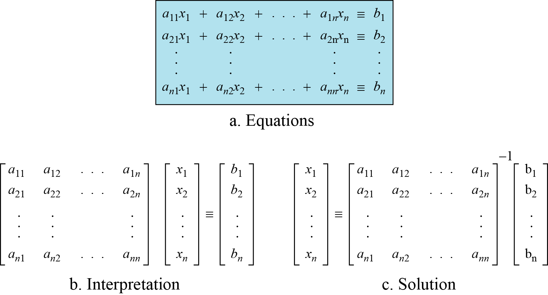
2.4.2 Set of Linear Equations
We can also solve a set of linear equations with the same modulus if the matrix formed from the coefficients of the variables is invertible.
Figure 2.27 Set of linear equations
2.<number>
Notes:
Copyright © 2015 by McGraw Hill Education (India) Private Limited. All rights reserved.

Slide 69
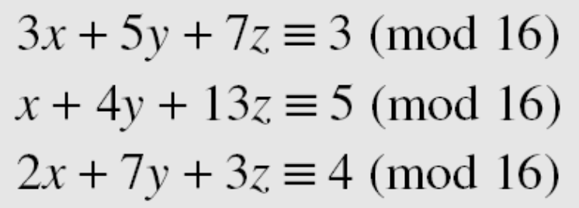
2.4.2 Continued
Example 2.38
Solve the set of following three equations:
Solution
The result is x ≡ 15 (mod 16), y ≡ 4 (mod 16), and z ≡ 14 (mod 16). We can check the answer by inserting these values into the equations.
2.<number>
Notes:
Copyright © 2015 by McGraw Hill Education (India) Private Limited. All rights reserved.

