Slide 1

Github Actions
Automating Workflows Directly in Your GitHub Repository

Slide 2
Github Actions
Automate, customize, and execute your software development workflows right in your repository with GitHub Actions. You can discover, create, and share actions to perform any job you'd like, including CI/CD, and combine actions in a completely customized workflow.

Slide 3
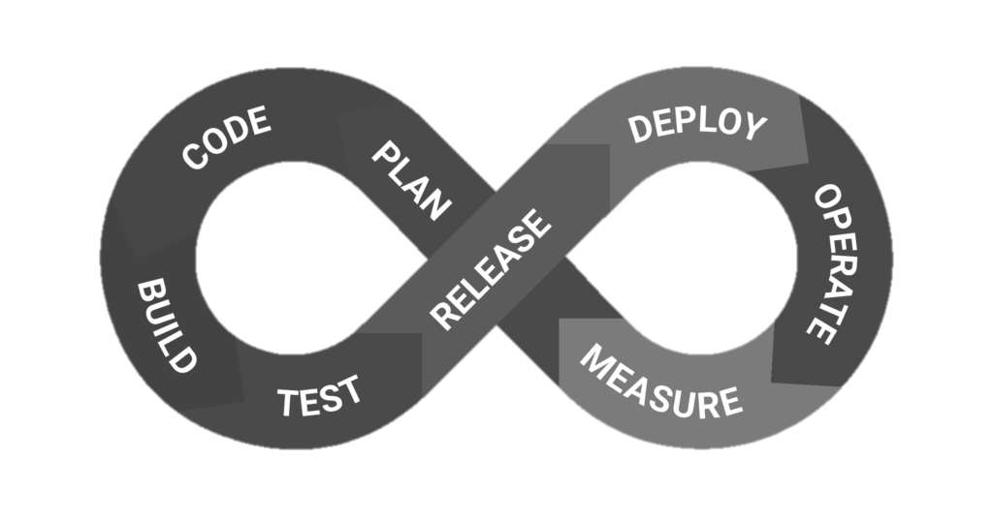




Github Actions
Build
Test
Deploy
Github ecosystem

Slide 4
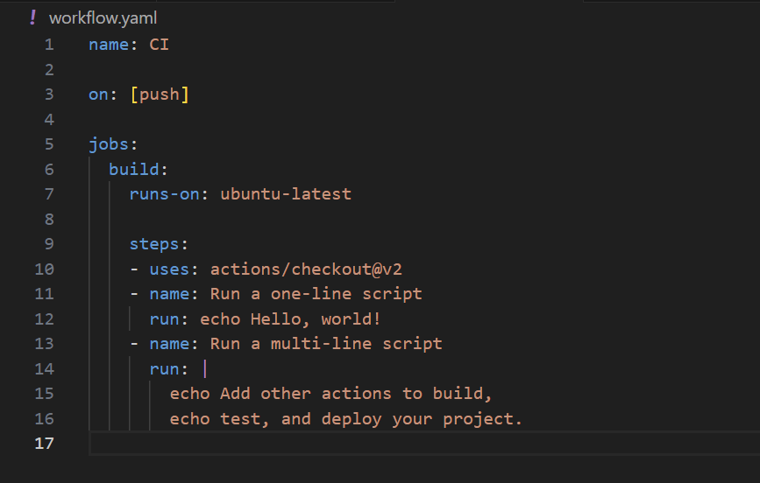

Github Actions
Name of the workflow
Triggers that starts the workflow
(on Push/Pull Request etc.)
Jobs that are set of steps to be executed by the workflow
Step is an individual task within a job
Runner is the server that runs the workflow

Slide 5
Github Actions
Navigate to your repository on GitHub.
Go to the Actions Tab
Click on New workflow or choose a template
Define your workflow in a YAML file.
Commit the YAML file to your repository/.github/workflows DIR

Slide 6
Github Actions
Reusable workflows: Reusable workflows allow you to define and share workflows across multiple repositories.
Benefits:
Consistency: Standardize processes across projects.
Efficiency: Save time by reusing existing workflows.
Maintainability: Centralize updates and modifications.
.github/workflows
main.yml
reusable.yml

