Slide 1
DRDL INTERNSHIP PROJECT REPORT
AI-Driven Aerodynamic Design
Optimization for Aerospace Vehicles
Fusing Differential Evolution and Machine Learning (XGBoost) to design optimal
complete-envelope aerodynamic configurations — Project CARS
NOSE • BODY • WING • TAIL
Baseline missile-like aerospace
configuration (Isometric view)
EVOLUTIONARY ALGORITHMS • MACHINE LEARNING • CFD / DATCOM DATA • SHAPE OPTIMIZATION
01

Slide 2
Problem Statement & Overview
THE PROBLEM
Aerodynamic configuration design today fuses empirical, numerical and experimental data through iterative human experience — a process that often converges on a sub-optimal design rather than the best achievable one across the full flight envelope (Mach, incidence, altitude).
Theory /
Empirical
Experimental /
Testing
Computational /
Simulations
FLUIDS
FLOW DATA
MODEL
OPTIMIZE
CONTROL
REDUCE
THE APPROACH
Outer design loop: Differential Evolution searches the 15-parameter geometry space
Inner fitness function: an XGBoost ML model — trained on Datcom-generated aerodynamic data — predicts CL, CD and XCP for any candidate
Designer sets priority-weights and hard/soft constraints across the flight envelope
Fig. 1 — Data Science: the 4th paradigm of science
15
10,010
Mach 0.2–0.8
geometry variables
training samples
flight envelope
02

Slide 3
Project Objectives
As set out by the DRDL scientist / user team
A
Prediction methodology
Develop a methodology to predict aerodynamic parameters using Machine Learning / Deep Learning.
B
Validation of ML predictions
Validate the ML-based prediction methodology against existing CFD / experimental results for the configuration.
C
Shape optimization
Optimize the aerospace vehicle configuration within the design space at a fixed flight condition.
D
Generalization check
Validate the code and methodology for an unknown vehicle configuration.
E
Documentation
Produce complete documentation covering methodology, tools, techniques and results.
03

Slide 4
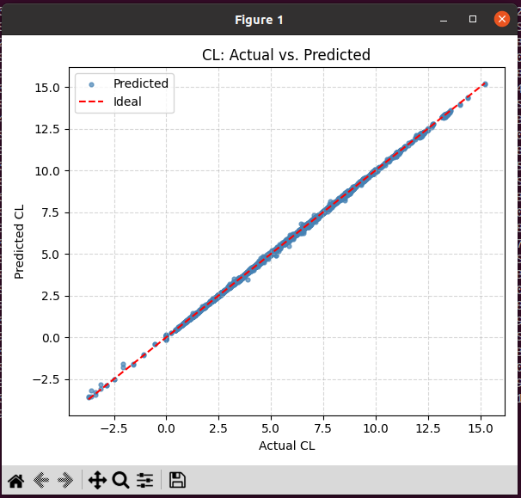
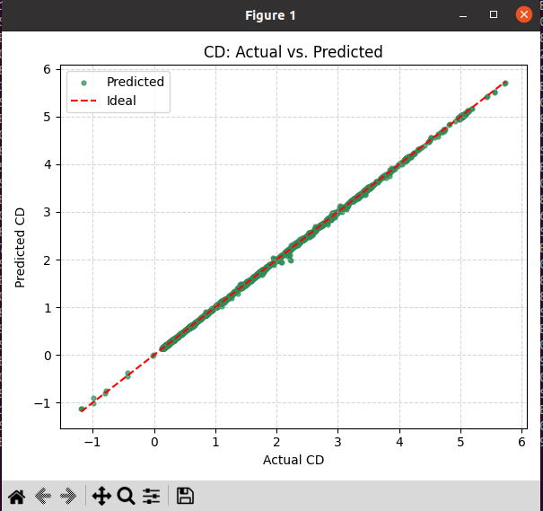
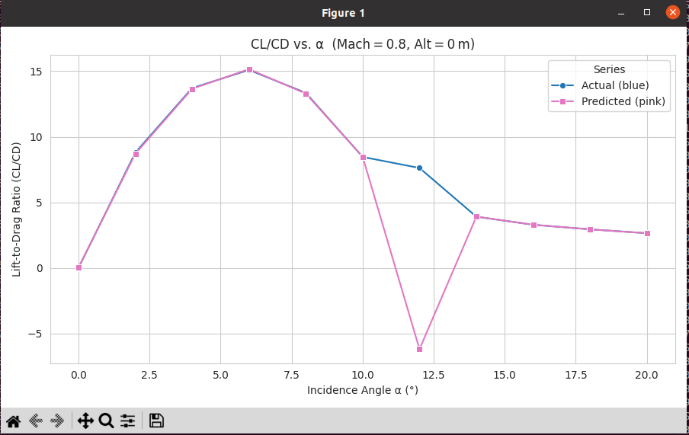
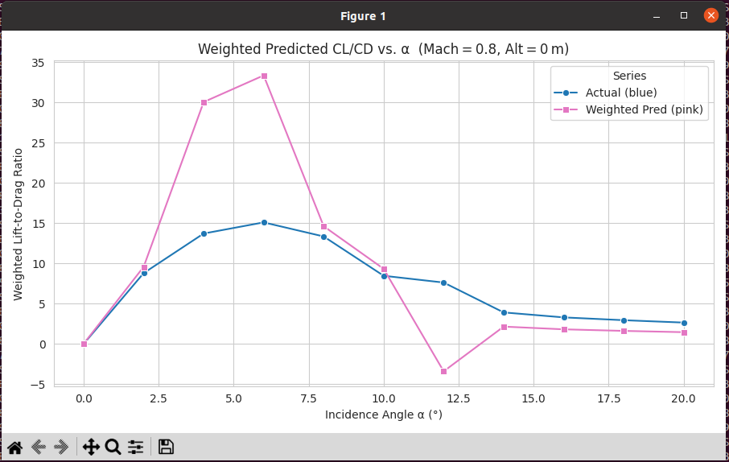
Results & Discussion
XGBoost surrogate accuracy and optimized aerodynamic performance
67%
peak CL/CD improvement across the Mach range (α = 3–8°), for only ~1.7% weight increase
Fig. 5 — Predicted vs Actual CL (R² = 0.9994)
Fig. 6 — Predicted vs Actual CD (R² = 0.9996)
Fig. 9a — CL/CD vs α, Mach 0.8 (Uniform weights)
Fig. 9b — CL/CD vs α, Mach 0.8 (Variable weights)
04

Slide 5
Conclusions & Path Forward
KEY ACHIEVEMENTS
Full-envelope methodology for optimal design of a complete, multi-component aerospace configuration — in one pass
Designer-set priority weights and hard/soft constraints per flight condition and component
Outer Differential Evolution loop paired with an XGBoost fitness function — both physics-blind, entirely data-driven
Loop is agnostic to complexity, flow regime and constraints — limited only by the fidelity of the underlying aerodynamic data
METHODOLOGY AT A GLANCE
1
Datcom aerodynamic data generated across 15 geometry variables & 110 flight conditions
2
XGBoost trained as a fast surrogate for CL, CD, XCP (R² > 0.99)
3
Differential Evolution searches geometry space using XGBoost as the fitness function
WHAT'S NEXT: PHYSICS-INFORMED ML
4
Optimal configuration validated: CL/CD gains up to 67%, weight penalty ~1.7%
Merging the Aerodynamic Data Generation, Fitness Function and Evolutionary Design phases into one unified, physics-informed system — and extending to true multi-objective optimization.
05

