Slide 1
DRDL — CARS PROJECT
Optimal Aerodynamic Configuration
Design of Aerospace Vehicles
A Data-Driven Framework using XGBoost Surrogate Modelling
and Differential Evolution Optimization
Submitted by: Veldi Sai Krishna, B.Tech CSE (AI & ML) Guru Nanak Institutions Technical Campus, Hyderabad Mentor: Kalidasu, Scientist 'E', DRDL Duration: 1 Sept 2025 – 27 Feb 2026

Slide 2
Overview, Problem Statement & Objectives
OVERVIEW
PROJECT OBJECTIVES
DRDL initiated the CARS project to explore Data Science for the design of a complex "missile-like" aerospace vehicle (nose, wing, body, tail). A baseline configuration is refined using a fusion of theory, CFD/experimental data and machine learning to reach an optimal aerodynamic design.
a
Develop a prediction methodology for aerodynamic parameters using Machine Learning / Deep Learning
b
Validate the ML-based prediction methodology against existing CFD / experimental results
PROBLEM STATEMENT
c
Perform shape optimization of the vehicle configuration at a fixed flight condition
Conventional aerodynamic design relies on repeated, computationally expensive CFD simulations and experimental iterations, which are slow and often converge to a sub-optimal configuration. A methodology is needed that can predict aerodynamic performance rapidly and search the full design space — across the entire flight envelope — for a truly optimal, physically valid geometry.
d
Validate the code / methodology for an unknown vehicle configuration
e
Complete documentation of methodology, tools and results
Source: Aero Documentation, Sec. 1–2 | Internship Report — Project Abstract
Optimal Aerodynamic Configuration Design of Aerospace Vehicles
2

Slide 3
Methodology: Surrogate Modelling + Evolutionary Optimization
SYSTEM ARCHITECTURE
OPTIMIZATION FLOWCHART (per Fig. 13)
Aerodynamic Data Generation
(Datcom / CFD / Empirical — 15 geometry vars, Mach 0.2–0.8, α 0–20°, Alt 0 & 6 km)
1
Inputs: baseline geometry, flight conditions, priority weights
2
Generate initial population of candidate geometries
Dataset (~10,000 samples): Geometry + Flight Conditions → CL, CD, XCP
3
For each generation → for each candidate: generate mutant vector
XGBoost Surrogate Models (fitness function)
predict CL, CD, XCP | extensions: MLP (CN, CM), Ensemble-XGBoost
4
Crossover → trial vector (variable Cr + Maximum Crossover)
5
Evaluate fitness: XGBoost predicts CL, CD, XCP over 110 flight points; weighted average → fitness
Differential Evolution Optimizer
(mutation, variable crossover, Maximum Crossover, selection)
6
Selection: keep trial vector only if fitness improves & constraints met
Optimal Aerodynamic Configuration
(validated across full flight envelope)
7
Repeat until all candidates / generations traversed
8
Output: configuration with best fitness (optimal geometry)
Optimal Aerodynamic Configuration Design of Aerospace Vehicles
3

Slide 4
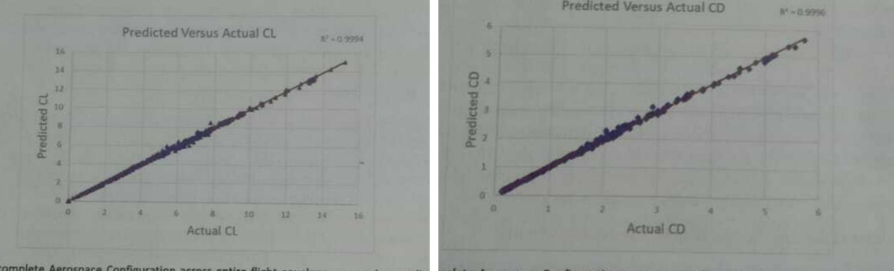
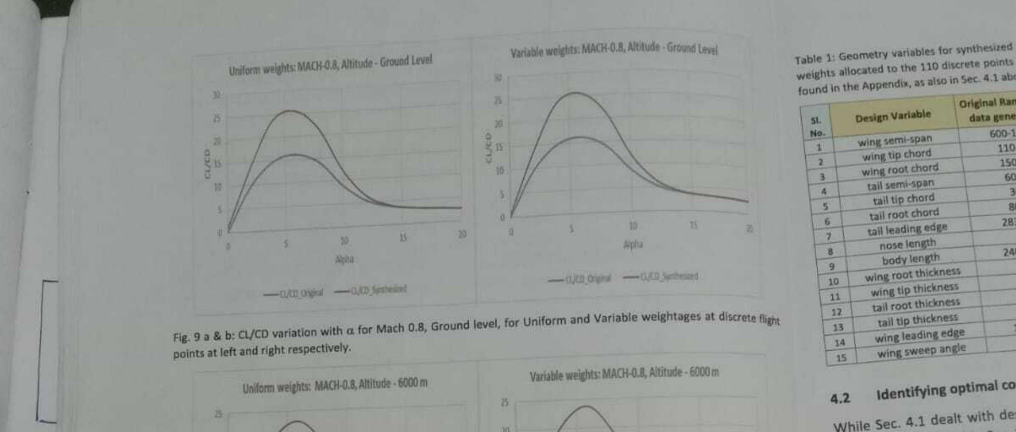
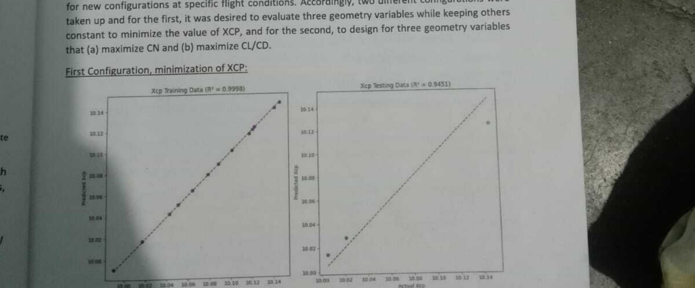
Results & Discussion
Fig. 5 & 6 — XGBoost Predicted vs Actual CL (R² = 0.9994) and CD (R² = 0.9996)
Fig. 9 a & b — CL/CD vs α, Mach 0.8, Ground level (Uniform / Variable weights)
Fig. 11 — XCP Training (R² = 0.9998) vs Testing (R² = 0.9451) Data
Peak CL/CD improvement ≈ 67% (α = 3–8°) • Weight increase only ≈ 1.7% (Steel AISI 304) • CN = 0.54, CM/CD = 7.67 at optimal design points
Discussion: XGBoost reliably captured non-linear CL/CD/XCP behaviour across the flight envelope, replacing repeated CFD/Datcom runs. Differential Evolution, guided by this surrogate, converged to configurations with markedly better lift-to-drag ratio at negligible weight cost — validated by DRDL on Datcom re-runs of the modified geometry.
Optimal Aerodynamic Configuration Design of Aerospace Vehicles
4
Source: exact result figures reproduced from the Aero Documentation (Figs. 5, 6, 9, 11)

Slide 5
Recommendations, Conclusion & Future Scope
RECOMMENDATIONS / SOLUTIONS
CONCLUSION
FUTURE SCOPE
All five project objectives were achieved. A complete methodology now exists for optimal aerodynamic design of a multi-component aerospace vehicle across its full flight envelope, with designer-set priority weights and constraints.
The XGBoost surrogate + Differential Evolution framework delivered configurations with significantly higher CL/CD, reduced drag, and stable behaviour, validated against Datcom re-runs — while cutting computation time versus repeated CFD/experimental analysis.
This confirms ML-driven surrogate modelling combined with evolutionary optimization as a reliable, efficient alternative to conventional simulation-based aerodynamic design.
Multi-objective optimization to jointly maximize CN and CM/CD (currently solved independently)
Use variable (non-uniform) flight-point weighting to prioritize critical Mach/alpha regions of the envelope
Adopt the Maximum Crossover enhancement — improves DE convergence by ~80% over classical DE
Physics-Informed Machine Learning: merge Data Generation, Fitness Function and Evolutionary Design into one unified pipeline
Apply hard/soft geometric and structural constraints (e.g., CD ≥ 0.12, tail/body sizing) during optimization
Extend the framework to more complex, multi-component aerospace vehicle configurations
Validate any optimized geometry's structural weight impact before finalizing (as done for Steel AISI 304)
Broaden constraint handling to structural, stability and other engineering domains
Extend surrogate ensembles (XGBoost + MLP) for additional coefficients such as CN and CM
Optimal Aerodynamic Configuration Design of Aerospace Vehicles
5

