Slide 1
PROJECT REPORT
Optimal Aerodynamic Configuration
Design of Aerospace Vehicles
A Data-Driven Framework using Machine Learning Surrogate Modelling
(XGBoost) and Differential Evolution Optimization
PRESENTED BY
Veldi Sai Krishna — B.Tech CSE (AI & ML)
INSTITUTION
Guru Nanak Institutions Technical Campus, Hyderabad
ORGANIZATION
Research Centre Imarat (RCI), DRDO | Mentor: Kalidasu, Scientist 'E'
DURATION
01 September 2025 – 27 February 2026

Slide 2
Overview, Problem Statement & Objectives
2
OVERVIEW
OBJECTIVES
The project develops a prediction methodology for aerodynamic parameters (CL, CD, XCP) using Machine Learning, validates it against CFD/experimental (Datcom) data, and uses it to shape-optimize an aerospace vehicle configuration — replacing repeated, costly simulation with a fast ML surrogate + optimizer.
Predict — Develop a prediction methodology for aerodynamic parameters using ML / Deep Learning
1
Predict:
Validate — Validate the ML-based methodology against existing CFD / experimental results
2
Validate:
PROBLEM STATEMENT
A typical aerodynamic configuration is arrived at through a fusion of empirical, numerical and experimental methods, plus experience from a baseline design — a process that is often sub-optimal. Data Science offers a way to instead pursue a truly optimal aerodynamic configuration design.
Optimize — Shape-optimize the aerospace vehicle configuration at a fixed flight condition
3
Optimize:
Generalize — Validate the code / methodology for an unknown vehicle configuration
4
Generalize:
Document — Document methodology, tools and results (this deliverable)
5
Document:

Slide 3
Methodology & System Architecture
3
Baseline “missile-like” configuration (Nose-Wing-Body-Tail), 15 geometry variables modulated → Datcom-generated data across 110 flight conditions (Mach 0.2–0.8, incidence 0– 20°, 2 altitudes) → ~10,000 samples used to train an XGBoost surrogate driving a Differential Evolution search.
Inputs
Aerodynamic
Data Generation
Initialize DE
Population
Geometry bounds,
flight conditions,
travel bounds
Datcom: 15 geometry
vars × 110 flight pts
Candidate geometry
vectors (p members)
OUTER LOOP — Differential Evolution (per generation, per candidate)
INNER LOOP — Fitness Function
(XGBoost, per flight condition)
Generate
Mutant Vector
Variable
Crossover
Maximum
Crossover
Selection
Iterate over 110 flight
conditions (Mach, α, Alt)
V = X + K(Xbest−X)
+ F(Xb−Xc)
Trial vector;
Cr scaled by rank
Gene-wise swap
refinement
Trial vs target;
keep the fitter
XGBoost predicts
CL, CD, XCP
Weighted average across
all flight conditions
constraints checked: wing semi-span = 1500 fixed • body length ≥ tail LE + tail root chord • CD ≥ 0.12
Fitness = 0.95·F1(CL/CD)
+ 0.05·F2(XCP target)
Traversed all candidates & generation limit?
Output: Configuration with best fitness (optimal geometry)
Extensions: Ensemble XGBoost (5 seeded models, averaged) & MLP Regressor for CN/CM

Slide 4
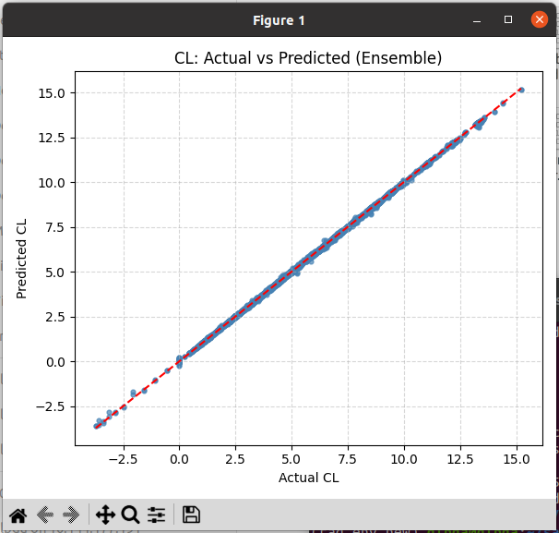
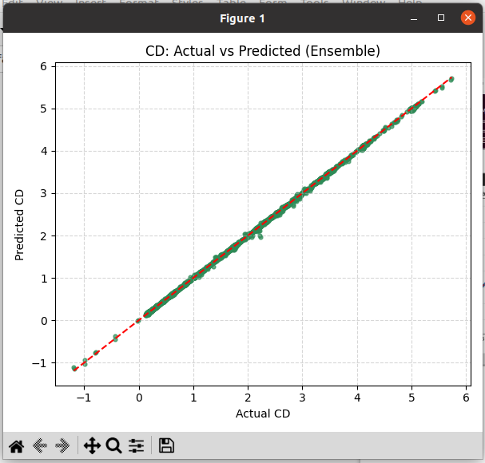
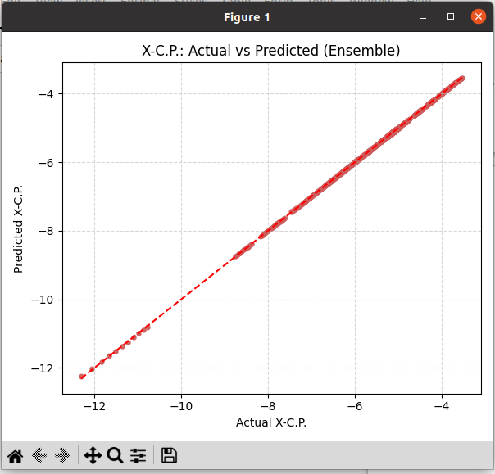
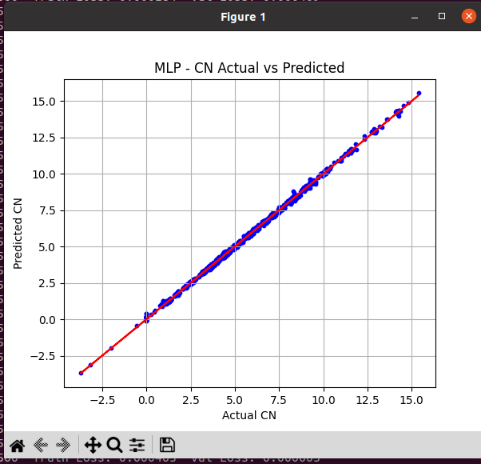
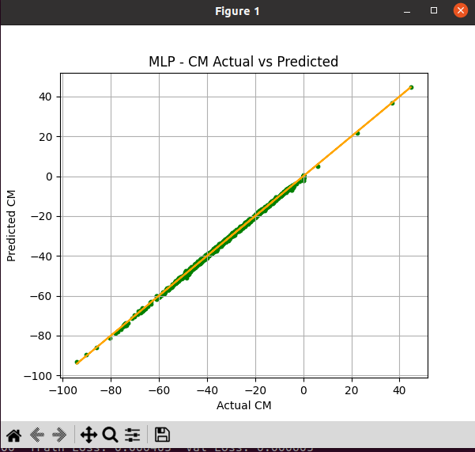
Results & Discussion, Recommendations
4
Exact plots from the internship report (docx) — Ensemble XGBoost (CL, CD, XCP) and MLP Regressor (CN, CM)
KEY FINDINGS
Peak CL/CD improvement ≈ 67% (incidence 3–8°) on the redesigned baseline geometry
Only ~1.7% increase in structural weight (Steel AISI 304) — DRDL-validated against real Datcom runs
Ensemble XGBoost (5 seeded models, averaged) and MLP Regressor (64,64 ReLU) both confirm the primary model's high accuracy
CL — Ensemble XGBoost (R² train 1.0000 / test 0.9998)
CD — Ensemble XGBoost (R² train 1.0000 / test 0.9998)
XCP — Ensemble XGBoost (R² train 1.0000 / test 1.0000)
RECOMMENDATIONS / SOLUTION
Adopt the constrained XGBoost + Differential Evolution pipeline as the standard design tool. It is “physics-blind” — physics lives in the training data — so it extends to any configuration or flight regime, limited only by data accuracy.
R² ≈ 1.00
~67%
+1.7%
Ensemble CL/CD/XCP
CL/CD gain
weight Δ
CN — MLP Regressor (R² train 0.9997 / test 0.9995)
CM — MLP Regressor (R² train 0.9996 / test 0.9995)
Discussion: both the Ensemble XGBoost and MLP models confirm the surrogate captures non-linear CL/CD/XCP/CN/CM relationships with low error, supporting a reliable, low-cost alternative to CFD-based design.

Slide 5
Conclusion & Future Scope
5
CONCLUSION
A methodology for optimal design of a complex aerospace vehicle configuration (multiple components) was developed
The design is comprehensive — it optimizes across the complete flight envelope in one go, with user-settable priority weights per flight condition and hard/soft geometric constraints
Differential Evolution (outer loop) coupled with an XGBoost fitness function (inner loop) reliably drives the search toward high-performance, physically valid configurations
The framework is “physics-blind” by design — the physics lives entirely in the training data — so it generalizes to other configurations and flight regimes
FUTURE SCOPE / PROPOSED PLANS
Multi-objective optimization — jointly maximize CN and CM/CD (noted in the source as future work, outside this project's scope)
Physics-Informed Machine Learning — merge the Aerodynamic Data Generation, Fitness Function and Evolutionary Design phases into one unified system
Extend surrogate coverage with the docx's Ensemble XGBoost and MLP (CN, CM) models for broader coefficient prediction
Bottom line:
ML-driven surrogate modelling combined with evolutionary optimization is a reliable, fast and computationally efficient alternative to conventional simulation-based aerodynamic design.

