Slide 1
DRDO · RESEARCH CENTRE IMARAT — AERODYNAMIC DESIGN INITIATIVE
Optimal Aerodynamic Configuration
Design of Aerospace Vehicles
A data-driven framework combining XGBoost machine-learning surrogate modelling with Differential Evolution optimization for complete-envelope aerodynamic configuration design
OVERVIEW
Aerodynamic design of a complex missile-like vehicle (nose, body, wing, tail) traditionally depends on repeated, costly CFD/experimental (Datcom) runs.
This project builds a surrogate ML model (XGBoost) trained on 10,010 Datcom-generated samples across 15 geometry variables and 110 flight conditions.
The surrogate is coupled with a Differential Evolution optimizer to search the full design space and synthesize an optimal geometry across the entire flight envelope in one pass.
Delivered as a documented, reusable software methodology — validated by the DRDL user team on the baseline missile configuration.
Optimal Aerodynamic Configuration Design of Aerospace Vehicles
1 / 5

Slide 2
Problem Statement & Objectives
THE PROBLEM
OBJECTIVES
Aerodynamic configuration design fuses empirical, numerical and experimental data through experience and repeated iteration — a process that is computationally expensive and slow, and often converges on a sub-optimal baseline configuration relative to the achievable aerodynamic performance (CL, CD, Cm).
a
Prediction methodology
Develop an ML/DL-based prediction methodology for aerodynamic parameters.
b
Validation of predictions
Validate the ML 'prediction' methodology against existing CFD / experimental results.
Data Science offers an opportunity: replace repeated high-fidelity simulation calls with a fast-trained ML surrogate, and let an evolutionary search explore the full 15-parameter geometric design space across the complete flight envelope — not one flight point at a time.
c
Shape optimization
Optimize the aerospace vehicle shape within the design space at a fixed flight condition.
d
Generalization check
Validate the code / methodology on an unknown vehicle configuration.
e
Documentation
Document the methodology, tools and techniques as a reusable software framework.
Optimal Aerodynamic Configuration Design of Aerospace Vehicles
2 / 5

Slide 3
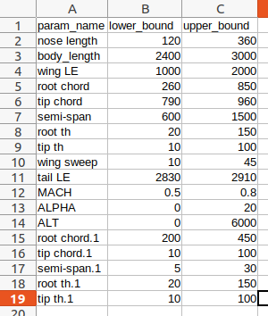
Methodology & System Architecture
Two AI algorithms run in sync: an outer Differential-Evolution design loop, scored at every step by an inner XGBoost surrogate fitness function.
INPUTS
15 geometric variables · 110-point flight envelope · weights & constraints
Mutation
V = X + K(Xbest−X) + F(Xr2−Xr3)
SUPPORTING MODELS
XGBoost (primary)
CL, CD, XCP surrogate; benchmarked against ELM & Random Forest.
Ensemble XGBoost
5-seed bagged models; final prediction = mean, reduces variance.
MLP Regressor
(64,64) ReLU network predicting CN, CM as a secondary study.
OFFLINE: Generate Aerodynamic Data
Datcom runs → 10,010 samples
Crossover (variable Cr)
build trial vector Z
Train XGBoost Surrogate
predicts CL, CD, XCP (R² > 0.99)
Fitness Evaluation
XGBoost across 110 flight pts → weighted CL, CD, XCP
Initialize DE Population
candidate geometries, p = 60
Selection
keep fitter of trial vs target
All generations
complete?
Optimal Configuration
X_best = argmax Fitness
iterate over every candidate, then every generation
Evidence of convergence: best fitness (green) rises and plateaus within ~20 generations while average fitness (orange) tracks upward behind it — confirming the outer DE loop steadily improves candidates generation over generation, as modelled above.
Fig. DE
convergence
Optimal Aerodynamic Configuration Design of Aerospace Vehicles
3 / 5

Slide 4
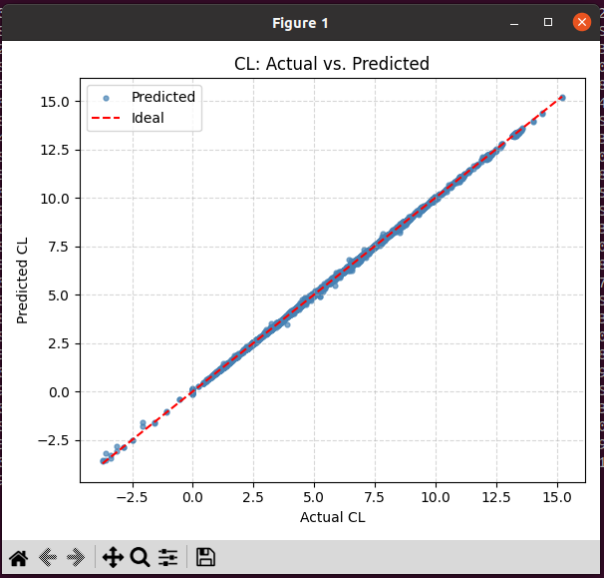
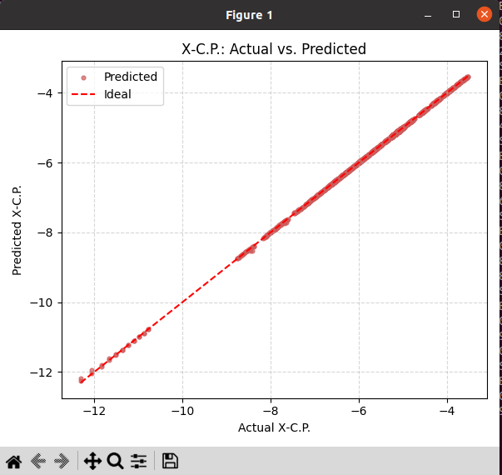
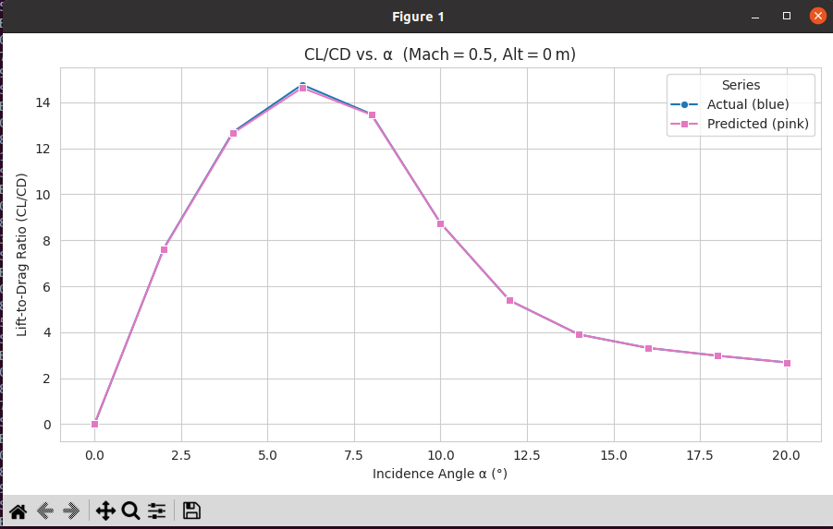
Results & Discussion
0.9994
0.9996
~67%
+1.7%
R² — CL prediction
(test data)
R² — CD prediction
(test data)
Peak CL/CD gain,
α = 3°–8°
Weight increase only,
DRDL-validated
XGBoost surrogate achieves near-perfect correlation with the actual Datcom data on held-out test samples; the DE-optimized geometry visibly lifts CL/CD above the baseline across the flight envelope.
Fig. Predicted vs Actual CL
Fig. Predicted vs Actual CD
XGBoost surrogate generalizes across nonlinear flight regimes, outperforming ELM & Random Forest.
DE + Maximum-Crossover converges steadily to physically feasible, high-performance geometries.
Point-optima also demonstrated: min XCP = 9.99, max CN = 0.54, max CM/CD = 7.67.
Ensemble-XGBoost (5-seed) and an MLP (CN, CM) regressor corroborate these predictions.
Fig. CL/CD vs α — baseline vs DE-optimized geometry (Mach 0.5, uniform & variable flight-point weighting)
Optimal Aerodynamic Configuration Design of Aerospace Vehicles
4 / 5

Slide 5
Conclusion, Recommendations & Future Scope
CONCLUSION
An XGBoost surrogate model, coupled with a Differential-Evolution optimizer, reliably designs an optimal aerospace-vehicle configuration across the complete flight envelope in a single run — meeting all five stated objectives and validated by the DRDL user team on the baseline missile configuration (net weight increase of only ~1.7% for a significant CL/CD gain).
RECOMMENDATIONS / KEY VALUE-ADDS
FUTURE SCOPE
Adopt the DE + XGBoost software as the standard front-end for early-stage configuration design — it evaluates thousands of candidate geometries at a fraction of CFD cost.
Use the priority-weighting feature to bias the design toward mission-critical flight points instead of a single fixed condition.
Apply hard/soft constraint handling (structural, stability, CD floor) so every candidate stays physically feasible.
Retrain the XGBoost surrogate whenever the underlying Datcom/CFD data source or flow regime changes, since fidelity is bounded by the training data.
Multi-Objective Optimization: jointly maximize CN and CM/CD (flagged in the report as unexplored, wide sweep-angle variation observed between the two single-objective optima).
Physics-Informed Machine Learning: merge the Aerodynamic-Data-Generation, Fitness-Function, and Evolutionary-Design phases into one unified pipeline (work actively in progress).
Extend the framework to more complex aerospace vehicle configurations beyond the missile-like baseline.
Broaden constraint handling to structural/stability domains beyond geometry bounds.
Optimal Aerodynamic Configuration Design of Aerospace Vehicles
5 / 5

