Slide 1
Communication in Distributed Systems

Slide 2
DS Communications Terminology
Persistent Communications:
  Once sent, the “sender” can stop executing. The “receiver” need not be operational at this time – the communications system buffers the message as required (until it can be delivered).
Transient Communications:
  The message is only stored as long as the “sender” and “receiver” are executing. If problems occur, the message is simply discarded …

Slide 3
DS Communications Terminology
Asynchronous Communications:
  A sender continues with other work immediately upon sending a message to the receiver.
Synchronous Communications:
  A sender blocks, waiting for a reply from the receiver before doing any other work. (This tends to be the default model for RPC/RMI technologies).

Slide 4
Synchronous Communication:
-Sender blocks until the request is known to be accepted
Asynchronous Communication:
-Sender continues with other work ,Immediately after message sent
Persistent Communication:
-Stores the message until recipient receives it.
Transient Communication:
-Messages are stored as long as sending and receiving applications are executing

Slide 5
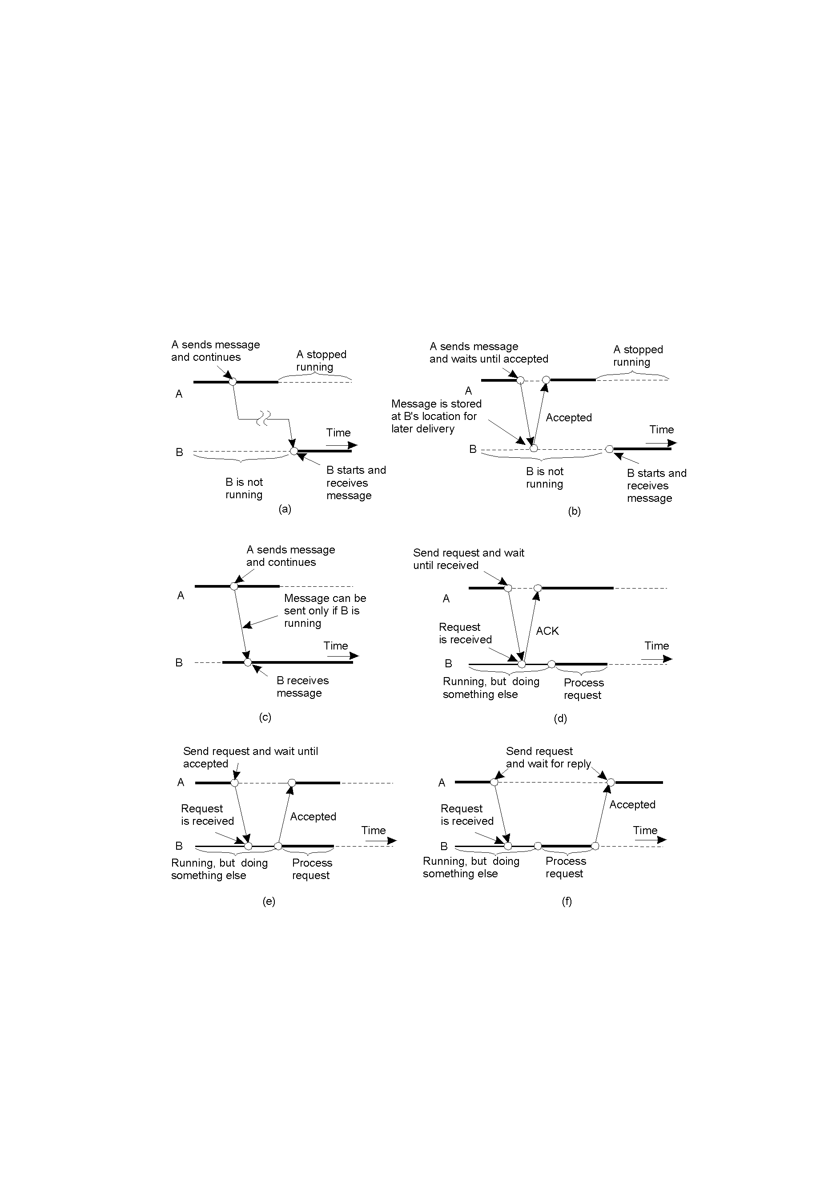
Classifying Distributed Communications (1)
2-22.1
Persistent asynchronous communication.
Persistent synchronous communication.

Slide 6
Classifying Distributed Communications (2)
2-22.2
Transient asynchronous communication.
Receipt-based transient synchronous communication.

Slide 7
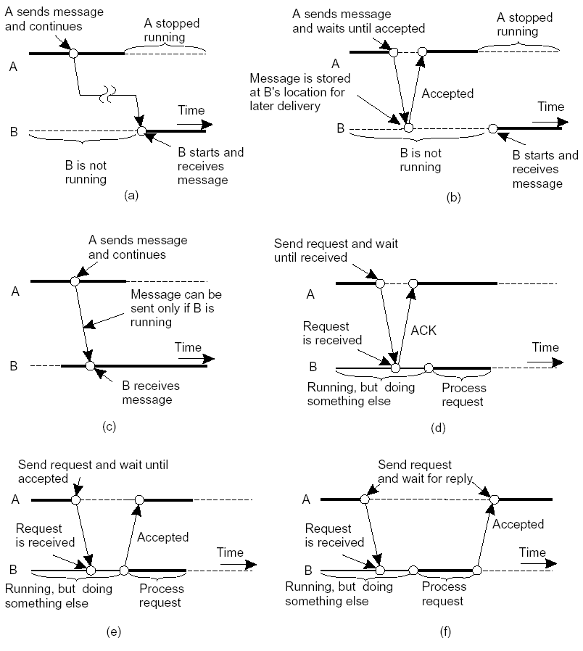
Messaging Combinations
02 – 30 Communication/2.4 Message-Oriented Communication

Slide 8
The single most important difference between a distributed system and a uniprocessor system is the interprocess communication.
In a uniprocessor system, interprocess communication assumes the existence of shared memory.
One process writes to -→ buffer -→ another process reads

Slide 9
In a distributed system, there’s no shared memory.
All communication in distributed system is based on message passing.
Proc. A wants to communicate with Proc. B
It first builds a message in its own address space & sends it through network to B.

Slide 10
Message Passing (MP) Systems
All communications primitives are defined in terms of passing “messages”.
Initially, MP systems were “transient”, but these did not scale well geographically.
Recent emphasis has been on “persistent” solutions.

Slide 11
Interprocess Communication
Four IPC models are popular:
  RPC/ RMI
  Message oriented communication
  Group communication
  Streams oriented communication

Slide 12
Message Oriented Communication
Message Oriented Transient Communication
-Socket
- MPI
Message Oriented Persistent Communication
-Message Oriented Middleware(MOM)
-Message Broker
JMS API

Slide 13
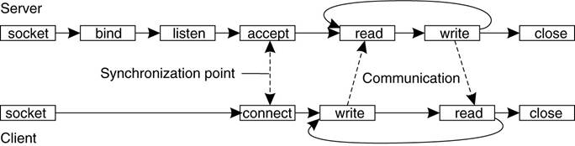
Message Oriented Transient Communication
Socket
Socket is an end point of an inter process communication
Socket address is the combination of IP address + port number

Slide 14
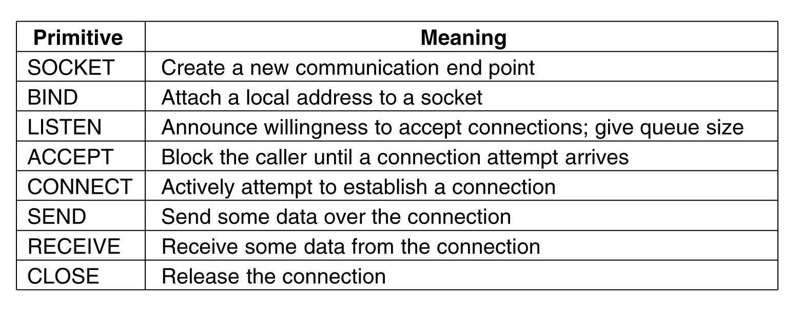
Socket Primitives

Slide 15
Limitations Of Sockets
Sockets Designed for network communication
- Simple send and receive primitives
- Use general purpose protocol stacks
Large number of incompatible proprietary libraries and protocols
- Need for a standard interface
vendors looked to provide a higher-level of abstraction.
this lead to portability problems, as no two vendors product interfaces were the same.
The solution?
  The “Message-Passing Interface” (MPI).
  Message Passing Interface (MPI) is a standardized and portable message-passing system developed for distributed Computing.

Slide 16
Message Passing Interface(MPI)
MPI
- Hardware Independent
- Designed for parallel applications
Communication between group of processes
Support most of the forms of transient communication

Slide 17
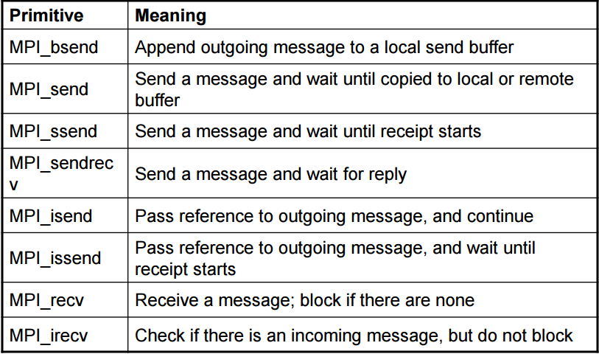
MPI Primitives

Slide 18
Message Oriented Persistent Communication
Message Queuing systems or Message Oriented Middleware(MOM)
- Supports Asynchronous Persistent Communication
-Intermediate Storage for messages while sender/receiver are inactive
Typically, transport can take minutes (hours?) as opposed to seconds/milliseconds.
The basic idea: applications communicate by putting messages into and taking messages out of “message queues”.
Communicate by inserting messages in queues
Sender is only guaranteed that message will be eventually inserted in recipients queue
This leads to “loosely-coupled” communications.

Slide 19
Messages are “put into” a source queue.
They are then “taken from” a destination queue.
Obviously, a mechanism has to exist to move a message from a source queue to a destination queue.
This is the role of the Queue Manager.

Slide 20
For example, if you have something like:
System A – produces messages periodically in huge bursts
System B – consumes messages constantly, at a slower pace
With this architecture, a queue would allow System A to produce messages as fast as it can, and System B to slowly digest the messages at it’s own pace.

Slide 21
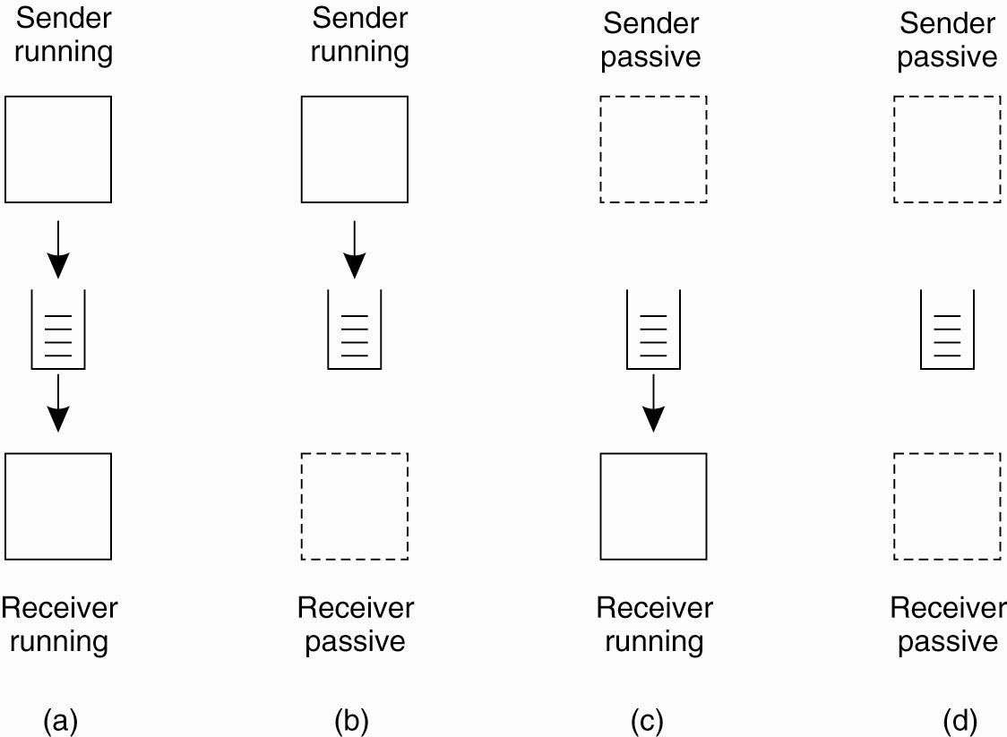
Message-Queuing Model
Four combinations for loosely-coupled
communications using queues

Slide 22
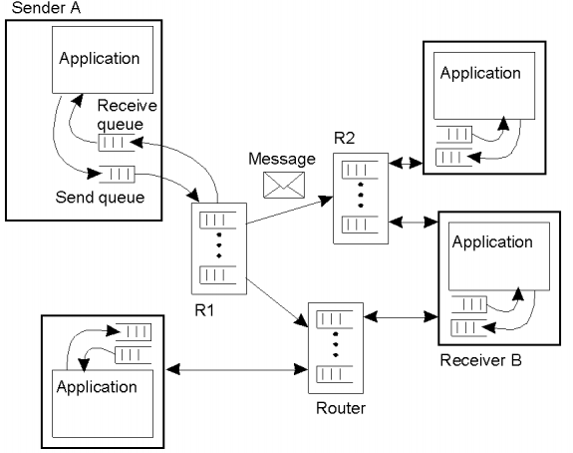
Message Queuing System

Slide 23
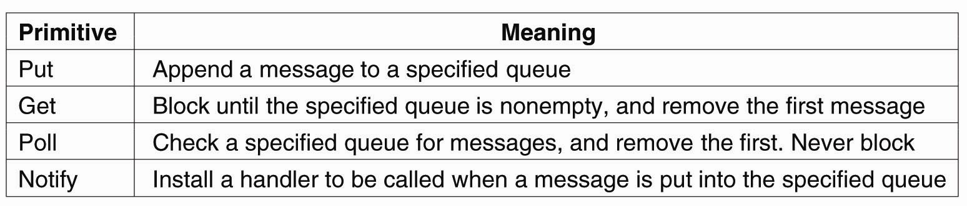
Message-Queuing
Basic interface to a queue in a
message-queuing system

Slide 24
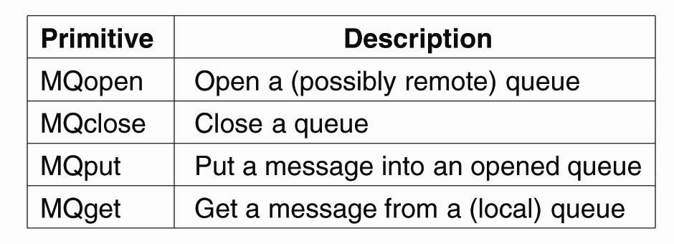
Message-Queuing
Primitives available in the message-queuing interface

Slide 25
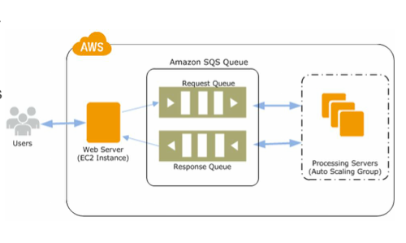
amazon simple queue service (SQS) in cloud computing
Using SQS, you can send, store, and receive messages between software components at any volume, without losing messages or requiring other services to be available.

Slide 26
Message Brokers
Message Brokers are building blocks of Message Oriented Middleware
Often, there’s a need to integrate new/existing apps into a “single, coherent Distributed Information System (DIS)”.
Problem: different message formats exist in legacy systems. It may not be convenient to “force” legacy systems to adhere to a single, global message format.
It is often necessary to live with diversity (no choice).
How? “Message Broker”.
  Transforms incoming messages to target format, possibly using intermediate representation

Slide 27
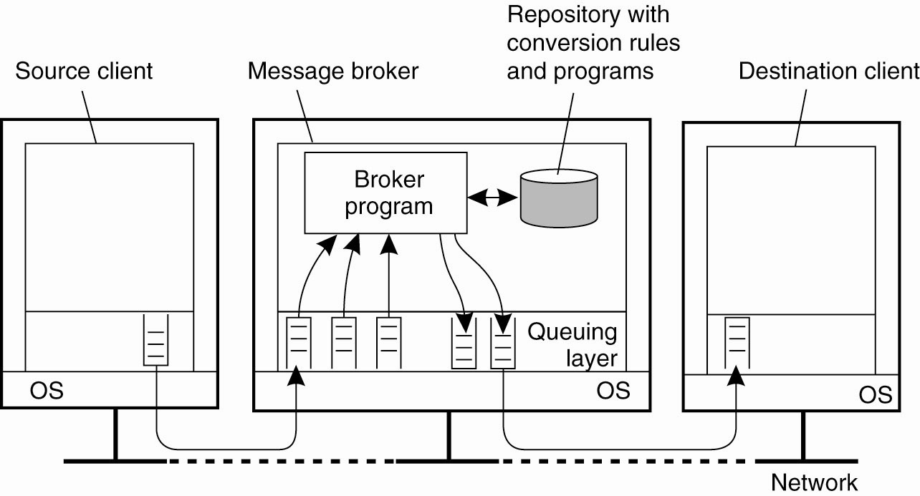
Message Brokers
The general organization of a message broker in a message-queuing system

Slide 28
Message-Queuing (MQ) Applications
General-purpose MQ systems support a wide range of applications, including:
  Electronic mail
  Workflow
  Groupware
  Batch Processing
Most important MQ application area:
  The integration of a widely dispersed collection of database applications (which is all but impossible to do with traditional RPC/RMI techniques).

Slide 29
Java Message Service(JMS)
JMS API is a Java Message Oriented Middleware API for sending messages between two or more clients
JMS Elements
- JMS Provider
- JMS Client
- JMS Provider/Publisher
- JMS Consumer/Subscriber
- JMS Message
- JMS Queue

Slide 30
JMS API Models
Point to point model
-Messaging Type is built on the concept of message queues, senders and receivers
-Producers send messages to the queues, each message is guaranteed to be delivered
-If no consumer is registered to consume the message, the queue will hold the until a consumer registers to consume them

Slide 31
JMS API Models
Publish/subscribe Model
-Publisher publishes the particular message topic.
Subscriber may subscribe interest in receiving
message.
-Zero or more consumers will receive the message.
Example: Bulletin board

Slide 32
Upcoming Advancements in MOM
Wireless Networks
Cloud Computing
Sensor Networks
Internet Of Technologies

Slide 33
Unicast, Broadcast versus Multicast
Unicast
  One-to-one
  Destination – unique receiver host address
Broadcast
  One-to-all
  Destination – address of network
Multicast
  One-to-many
  Multicast group must be identified
  Destination – address of group

Slide 34
Group communication
  Broadcast
    one-to-all relationship
  Multicast
    one-to-many relationship
    A variation of broadcast where an object can target its messages to a specified subset of objects
Multicast means the use of a single communication primitive to send a message to a specific set of processes rather than using a collection of individual point to point message primitives.
Each machine receives a message. If the message is not for this machine, then discard.

Slide 35
Multicast application examples
Financial services
  Delivery of news, stock quotes, financial indices, etc
Remote conferencing/e-learning
  Streaming audio and video to many participants (clients, students)
  Interactive communication between participants
Data distribution
  e.g., distribute experimental data from Large Hadron Collider (LHC) at CERN lab to interested physicists around the world

Slide 36
Closed groups: only the member of the group can send messages to the group. Outsiders cannot.
Open groups: any process in the system can send messages to the group.
Peer group: all the group members are equal.
Advantage: symmetric and has no single point of failure.
Disadvantage: decision making is difficult. A vote has to be taken.
Hierarchical group: coordinator
Advantage and disadvantage: opposite to the above

Slide 37




Peer Group
All the members are equal.
All the members send messages to the group.
All the members receive all the messages.

Slide 38


Client-Server Group
Replicated servers.
Clients do not care which server answers.

Slide 39
Overlapping Groups
Overlapping groups can lead to a new kind of inconsistency.
Group 1
Group 2
1
B
2
A
D
4
C
3

Slide 40
Group Membership Management
Centralized way: group server maintains a complete data base of all the groups and their exact membership.
Advantage: straightforward, efficient, and easy to implement.
Disadvantage: single point of failure.
Distributed way: an outsider sends to message to all group members to join and sends a goodbye message to everyone to leave.

Slide 41
Core Based Trees
  Multicast tree constructed dynamically, grows on demand.
  Each group has a core node(s)
  A node wishing to join the tree as a receiver sends a unicast join message to the core node.
  The join marks the edges as it travels; it either reaches the core node, or some node already part of the tree. The path followed by the join till the core/multicast tree is grafted/inserted to the multicast tree.
  A node on the tree multicasts a message by using flooding on the core tree.

Slide 42
Multicast
Basic Multicast: Does not consider failures
    Liveness: Each process must receive every message
    Integrity : No spurious message received
    No duplicates: Accepts exactly one copy of a message
  Reliable multicast: tolerates (certain kinds of) failures.
  Atomic Multicast:
    A multicast is atomic, when the message is delivered to every correct member, or to no member at all.
    In general, processes may crash, yet the atomicity of the multicast is to be guaranteed.

Slide 43
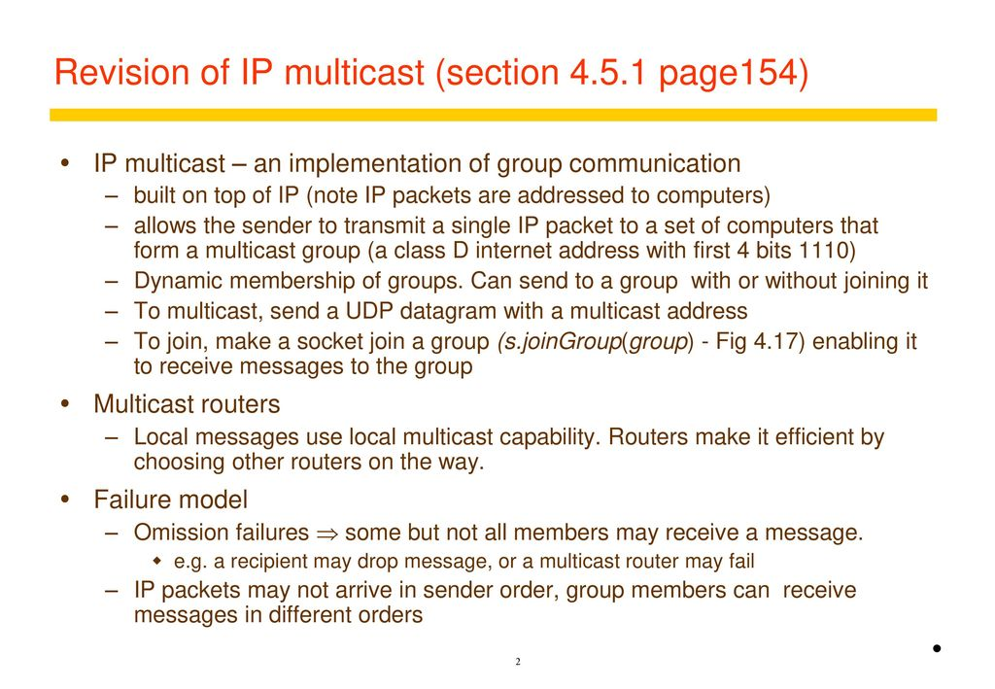


Slide 44
IP multicast
Gatech
Stanford
CMU
Berkeley
Routers with multicast support
Highly efficient bandwidth usage
Key Architectural Decision: Add support for multicast in IP layer

Slide 45
Group Communication Issues
Ordering
Delivery Guarantees
Membership
Failure

Slide 46
Ordering Service
Unordered
Single-Source FIFO (SSF)
  For all messages m₁, m₂ and all objects a_{i}, a_{j}, if a_{i} sends m₁ before it sends m₂, then m₂ is not received at a_{j} before m₁ is
Totally Ordered
  For all messages m₁, m₂ and all objects a_{i}, a_{j}, if m₁ is received at a_{i} before m₂ is, the m₂ is not received at a_{j} before m₁ is
Causally Ordered
  For all messages m₁, m₂ and all objects a_{i}, a_{j}, if m₁ happens before m₂, then m₂ is not received at a_{i} before m₁ is

Slide 47
Delivery guarantees
  Agreed Delivery
      guarantees total order of message delivery and allows a message to be delivered as soon as all of its predecessors in the total order have been delivered.
  Safe Delivery
      requires in addition, that if a message is delivered by the GC to any of the processes in a configuration, this message has been received and will be delivered to each of the processes in the configuration unless it crashes.

Slide 48
Membership
Messages addressed to the group are received by all group members
If processes are added to a group or deleted from it (due to process crash, changes in the network or the user's preference), need to report the change to all active group members, while keeping consistency among them

Slide 49
Failure Model
Failures types
  Message omission and delay
    Discover message omission and (usually) recovers lost messages
  Processor crashes and recoveries
  Network partitions and re-merges
Assume that faults do not corrupt messages or that message corruption can be detected
Faults are detected using an unreliable fault detector, based on a timeout mechanism

Slide 50
Some GC Properties
  Atomic Multicast
    Message is delivered to all processes or to none at all. May also require that messages are delivered in the same order to all processes.
  Failure Atomicity
    Failures do not result in incomplete delivery of multicast messages
  Uniformity
    A view change reported to a member is reported to all other members
  Liveness
    A machine that does not respond to messages sent to it is removed from the local view of the sender within a finite amount of time.

Slide 51
Reliability
Correct processes: those that never fail.
Validity
  A message from a correct process will be delivered eventually.
Agreement
  A message delivered by a correct process will be delivered by all other correct processes in the group.
⇒ Validity + Agreement = Liveness
Notes:
deliver ~ accept ( but #receive)

Slide 52
How to guarantee atomic broadcast and fault tolerance?
The sender starts out by sending a message to all members of the group.
Timers are set and retransmissions sent where necessary.
When a process receives a message, if it has not yet seen this particular message, it, too, sends the message to all members of the group (again with times and retransmissions if necessary).
If it has already seen the message, this step is not necessary and the message is discarded.
No matter how many machines crash or how many packets are lost, eventually all the surviving processes will get the message.

Slide 53
Group Addressing
A process just sends a message to a group address and it is delivered to all the members. The sender is not aware of the size of the group or whether communication is implemented by multicasting, broadcasting, or unicasting.

Slide 54
Send and Receive Primitives
to send a message, one of the parameters of send indicates the destination.
If it is a process address, a single message is sent to that one process.
If it is a group address, a message is sent to all members of the group.

Slide 55
Stream-Oriented Communication
Support for continuous media
Streams in distributed systems
Stream management

Slide 56
Continuous Media
Continuous media: Characterized by the fact that values are time dependent:
  Audio
  Video
  Animations
  Sensor data (temperature, pressure, etc.)
Transmission modes: Different timing guarantees with respect to data transfer:
  Asynchronous: no restrictions with respect to when data is to be delivered
  Synchronous: define a maximum end-to-end delay for individual data packets
  Isochronous: define a maximum and minimum end-to-end delay

Slide 57
Definition: A (continuous) data stream is a connection-oriented communication facility that supports isochronous data transmission
Some common stream characteristics:
  Streams are unidirectional. There is generally a single source, and one or more sinks
  sink and/or source may be camera, CD device, TV monitor, dedicated storage.
Stream types:
  Simple: consists of a single flow of data (e.g., audio or video)
  Complex: multiple data flows (e.g., stereo audio or combination audio/video)

Slide 58
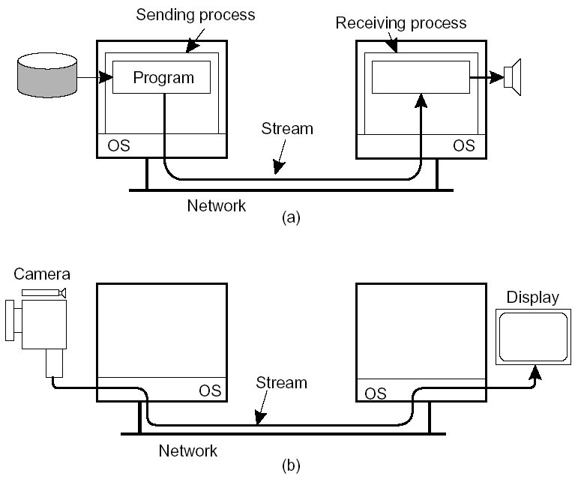
Stream
Issue: Streams can be set up between two processes at different machines, or directly between two different devices. Combinations are possible as well.

Slide 59
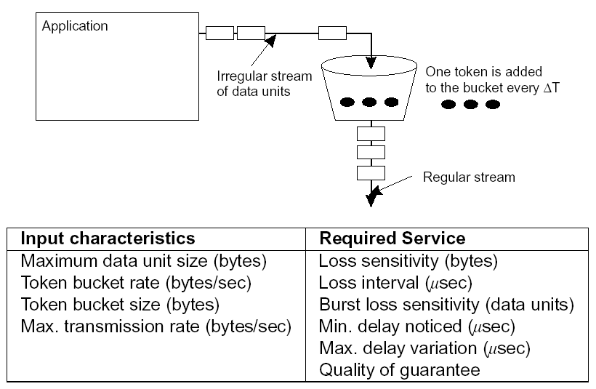
Streams and QoS
Essence: Streams are all about timely delivery of data. How do you specify this Quality of Service (QoS)?
Make distinction between specification and implementation of QoS.
Flow specification: Use a token-bucket model and express QoS in that model. Tokens are generated at a constant rate.Token is fixed number of bytes that an application is allowed to pass to the network

Slide 60
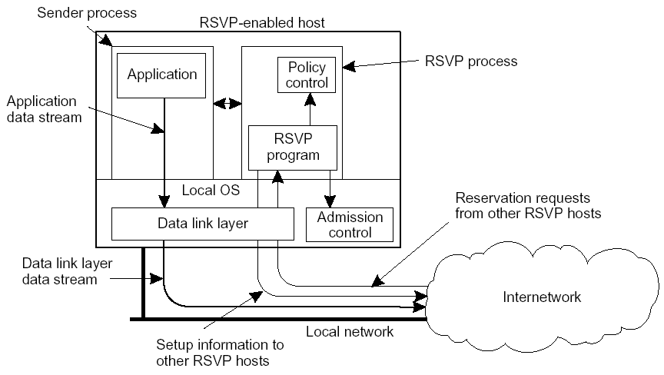
Implementing QoS
QoS specifications translate to resource reservations in underlying communication system.
Approach: Use Resource Reservation Protocol (RSVP) as first attempt, is a transport layer protocol designed to reserve resources across a network using the integrated services model

Slide 61
Streams and Quality of Service(3)
Setting up a stream
  Resource reSerVation Protocol(RSVP)
    Transport-level control protocol for enabling resource reservation in network router
    Used to provide QoS for continuous data streams by reserving resources (bandwidth, delay, jitter and so on)
    Issue: How to translate QoS parameters to resource usage?
      Two ways to translate
      1. RSVP translates QoS parameters into data link layer parameters
      2. Data link layer provides its own set of parameters (as in ATM)

Slide 62
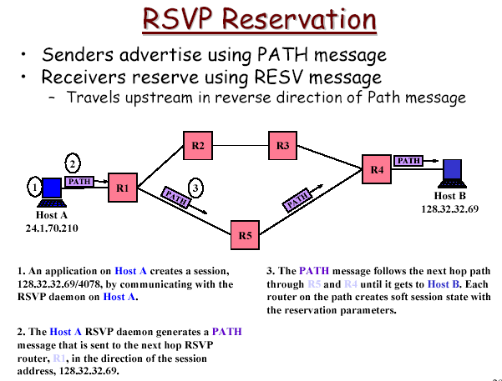
Streams and Quality of Service

Slide 63
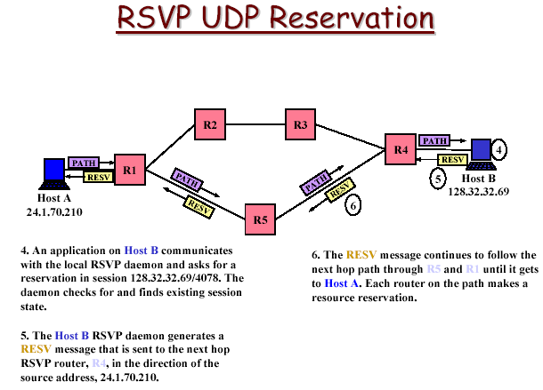
Streams and Quality of Service

Slide 64
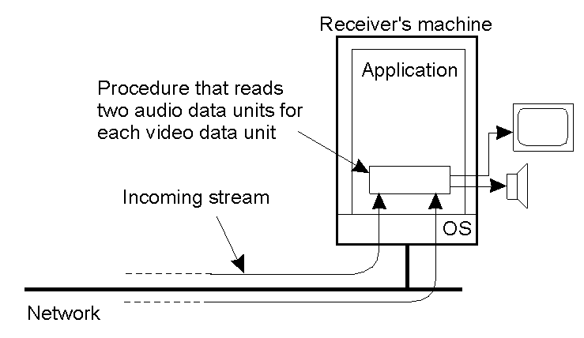
Stream Synchronization
The principle of explicit synchronization on the level data units

Slide 65
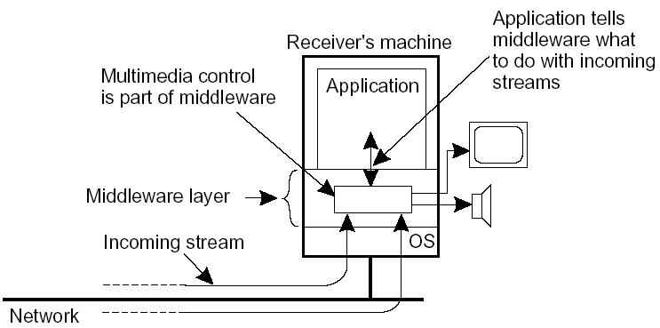
Stream Synchronization
Problem: Given a complex stream, how do you keep the different substreams in synch?
Example: Think of playing out two channels, that together form stereo sound.
The principle of synchronization as supported by high-level interfaces
Alternative: multiplex all substreams into a single stream, and demultiplex at the receiver. Synchronization is handled at multiplexing/demultiplexing point (MPEG).

