Slide 1
Distributed Systems:
Distributed Process Management –
Process Migration

Slide 2
Process Migration
What
  The movement of an active process from one machine to another
How
  Transfer of sufficient amount of the state of a process from one machine to another
  The process continues execution on the target machine
Notes:
  Process migration assumes preemption, i.e., transferring a partially executed process
  A simpler function is a non-preemptive process transfer, i.e., transferring a process that has not begun execution

Slide 3
Motivation
Load sharing
  Move processes from heavily loaded to lightly loaded systems
  Load can be balanced to improve overall performance
Communications performance
  Processes that interact intensively can be moved to the same node to reduce communications cost
  Processes that require large amount of remote data can be moved to the location of data
Availability
  Long-running process can move
  In the case of scheduled downtime
  When faults develop on the node they are running
Utilizing special capabilities
  Process can take advantage of unique hardware or software capabilities on a remote node

Slide 4
Process migration mechanisms
Initiation of migration: who initiates migration
  When goal is load balancing
    monitor component of OS
      Decides when migration takes place
      Communicates with peer modules in other systems to determine the distribution of loads and agree on migration decision
      Preempts migration candidate and starts migration
    Migration is transparent to the migrating process
  When goal is to reach a particular resource
    Process itself initiates migration
    Process is aware of distributed system and location of resources

Slide 5
Implementation of process migration
Must destroy the process on the source system and create it on the target system
Process image and process control block and any links between this process and other processes migrated

Slide 6
Implementation of process migration
What is migrated
  Process image
    Process control block
    Process address space
  Links between this process and other processes
    Links for passing messages
    Links for passing signals
  Open files

Slide 7
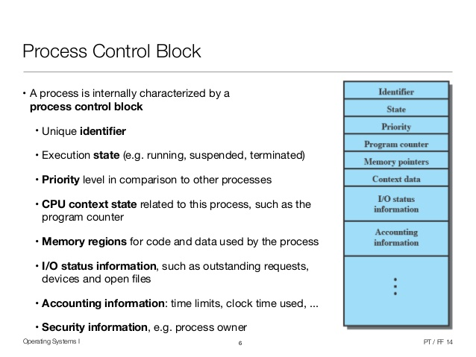

A process control block (PCB) is a data structure used by computer operating systems to store all the information about a process

Slide 8
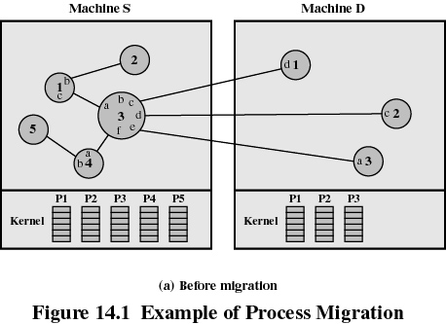
Implementation of process migration (cont.)

Slide 9
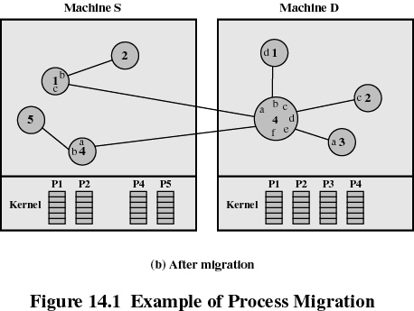
Implementation of process migration (cont.)

Slide 10
Implementation of process migration (cont.)
Strategies for the migration of process address space
  Eager (all)
    Transfer entire address space at time of migration
    No trace of process is left behind
    Potential drawback:
      If address space is large and if the process does not need most of it, then this approach may be unnecessarily expensive
  Pre-copy
    Process continues to execute on the source node while the address space is copied
    Reduces the time that a process is frozen and cannot execute during migration

Slide 11
Implementation of process migration (cont.)
Strategies for the migration of process address space (cont.)
  Eager (dirty)
    Transfer only the pages that are in main memory and have been modified
    Any additional blocks of the virtual address space are transferred on demand (remote paging support)
    Advantage
      Minimizes the amount of transferred data
    Disadvantage
      The source machine is involved throughout the life of the process

Slide 12
Implementation of process migration (cont.)
Strategies for the migration of process address space (cont.)
  Copy-on-reference
    Pages are brought over only on referenced
    has the lowest initial costs, ranging from a few tens to a few hundred microseconds. However, it increases the run-time costs
    demand paging: pages are transferred only upon reference.
    Advantage
      Minimizes the amount of transferred data
    Disadvantage
      The source machine is involved throughout the life of the process

Slide 13
  Flushing
    Pages are cleared from main memory by flushing dirty pages to disk
    Pages are then accessed as needed from disk
    Advantage
      Relieves the source of holding any pages of the migrated process in main memory
      Minimizes the amount of transferred data
    Disadvantage
      The source machine is involved throughout the life of the process

Slide 14
Implementation of process migration (cont.)
Selecting a strategy for the migration of process address space
  If the process is expected to be only temporarily on the target machine, then only a minimum of pages should be transferred, e.g., eager (dirty), copy-on-reference, or flushing
  If the process is expected to be for a long time on the target machine and use much of its address space, then the entire address space should be transferred at once, e.g., eager (all) or pre-copy
  If the unit of migration is the thread and the remaining threads of the process remain on the original machine, then remote paging works best

Slide 15
Implementation of process migration (cont.)
Strategies for the migration of files
  If the file is locked by the migrating process and resides on the same system, then transfer file with the process
  If the process is moved temporarily, transfer the file only after an access request was made by the migrated process
  If the file is shared by several distributed processes, do not transfer file
Strategies for migration of links between the migrating process and other processes (messages and signals)
  Provide a mechanism for temporarily storing outstanding messages and signals during the migration and then forward them to the target system

Slide 16
A migration scenario
Example:
  Sequence of events for self-migration
    Process (A)
      Decides to migrate itself
      Selects target machine
      Sends remote tasking message with part of process image and open file info.
    Kernel server process at the target system
      Forks a child (B) with the received information
    Newly created process (B)
      Starts execution copying pages if dirty or demand paging clean pages
    Original process (A)
      Receives signal on completion of migration
      Sends final message to process (B) and destroys itself

Slide 17
Negotiation of Migration
On some systems, the migration decision is negotiated between the source and the target systems
Example: Charlotte
  Starter utility is a process responsible for
    Migration policy (when to migrate, which process, to what target)
    Long-term scheduling
    Memory allocation
  The migration decision is reached jointly by the Starter processes at the source and destination

Slide 18
Negotiation of Migration
  Negotiation for migration on Charlotte
    1. Starter on (S)
      Decides to migrate process P to system (D)
      Sends message to Starter on (D), requesting transfer
    2. Starter on (D)
      Sends back positive acknowledgment, if it agrees
    3. Starter on (S)
      Communicates decision to kernel on (S) via KenJob (KJ) on (S)
    4. Kernel on (S) sends offer for P to (D), including statistics about P
    5. Kernel on (D)
      If in agreement (resources available) forwards offer to its Starter process
    6. Starter for (D) agrees with MigrateIn call
    7. (D) reserves resources and sends acceptance to (S)
  Process migration
    (S) sends P’s context in a message to (D)
    (S) sends link update messages to machines 0 and 2 with new address of P

Slide 19
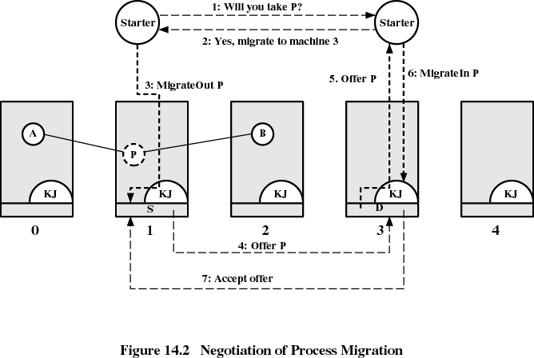
Example: Negotiation of process migration on Charlotte

Slide 20
Eviction
A destination system may have the right to evict a process after it has been migrated there.
Example: Sprite system
  Strategy
    Each process has a home node
    If process is migrated, it becomes a foreign process on the destination node
    The destination machine may decide to evict a foreign process and force it to migrate back to the home node

Slide 21
Eviction (cont.)
Example (cont.): Sprite eviction mechanism
  Monitor process on each node
    Measures current load to determine if foreign processes should be allowed
    If it detects activity at the workstation’s console, it starts eviction for current foreign processes
  All foreign processes identified are suspended
  The entire address space for each evicted process is transferred to the respective home node

Slide 22
Multithreading - The ability of an OS to support multiple, concurrent paths of execution within a single process
Concurrency is based on the number of cores available and the thread capacity of the system

Slide 23
Resource Management in Distributed Systems
Task assignment,
Load-balancing and Load-sharing

Slide 24
Introduction
Distributed systems contain a set of resources interconnected by a network
Processes are migrated to fulfill their resource requirements
Resource manager are to control the assignment of resources to processes
Resources can be logical (shared file) or physical (CPU)
One of the functions of a distributed operating system is to assign processes to the nodes (resources) of the distributed system such that the resource usage, response time, network congestion, and scheduling overhead are optimized.

Slide 25
Types of process scheduling techniques
Task assignment approach
  User processes are collections of related tasks
  Tasks are scheduled to improve performance
Load-balancing approach
  Tasks are distributed among nodes so as to equalize the workload of nodes of the system
Load-sharing approach
  Simply attempts to avoid idle nodes while processes wait for being processed
  The task assignment approach has limited applicability to practical situations because it works on the assumption that the characteristics (e.g. execution time, IPC costs etc) of all the processes to be scheduled are known in advance.

Slide 26
Desirable features of a good global scheduling algorithm I.
No A Priori Knowledge about Processes
Scheduling algorithms that operate based on the information about the characteristics and resource requirements of the processes pose an extra burden on the users who must provide this information while submitting their processes for execution.
Dynamic in nature
  Decision should be based on the changing load of nodes and not on fixed static policy
  It is recommended that the scheduling algorithm possess the flexibility to migrate a process more than once because the initial decision of placing a process on a particular node may have to be changed after some time to adapt to the new system load.
Quick decision-making capability
  Algorithm must make quick decision about the assignment of task to nodes of system

Slide 27
Desirable features of a scheduling algorithm II.
Balanced system performance and scheduling overhead
  Algorithms that provide near-optimal system performance with a minimum of global state information (such as CPU load) gathering overhead are desirable
  Great amount of information gives more intelligent decision, but increases overhead
  This is because the usefulness of that information is decreased due to both the aging of the information being gathered and the low scheduling frequency as a result of the cost of gathering and processing the extra information.
Stability
  Unstable when all processes are migrating without accomplishing any useful work. It occurs when the nodes turn from lightly-loaded to heavily-loaded state and vice versa. Fruitless migration of processes, known as processor thrashing, must be prevented.
  E.g. if nodes n1 and n2 observe that node n3 is idle and then offload a portion of their work to n3 without being aware of the offloading decision made by the other node. Now if n3 becomes overloaded due to this it may again start transferring its processes to other nodes. This is caused by scheduling decisions being made at each node independently of decisions made by other nodes.

Slide 28
Desirable features of a scheduling algorithm III.
Scalability
  A scheduling algorithm should be capable of handling small as well as large networks
  An algorithm that makes scheduling decisions by first inquiring the workload from all the nodes and then selecting the most lightly loaded node has poor scalability. This will work fine only when there are few nodes in the system. This is because the inquirer receives a flood of replies almost simultaneously, and the time required to process the reply messages for making a node selection is too long as the number of nodes (N) increase. Also the network traffic quickly consumes network bandwidth. A simple approach is to probe only m of N nodes for selecting a node.

Slide 29
Fault tolerance
  Should be capable of working after the crash of one or more nodes of the system
  A good scheduling algorithm should not be disabled by the crash of one or more nodes of the system.
  Also, if the nodes are partitioned into two or more groups due to link failures, the algorithm should be capable of functioning properly for the nodes within a group. Algorithms that have decentralized decision making capability and consider only available nodes in their decision making have better fault tolerance capability.

Slide 30
Fairness of Service
  More users initiating equivalent processes expect to receive the same quality of service
  Global scheduling policies that blindly attempt to balance the load on all the nodes of the system are not good from the point of view of fairness of service.
  This is because in any load-balancing scheme, heavily loaded nodes will obtain all the benefits while lightly loaded nodes will suffer poorer response time than in a stand-alone configuration.
  A fair strategy that improves response time of the former without unduly affecting the latter is desirable. Hence load-balancing has to be replaced by the concept of load sharing, that is, a node will share some of its resources as long as its users are not significantly affected.

Slide 31
Task assignment approach
Main assumptions
  Processes have been split into tasks
  Computation requirement of tasks and speed of processors are known
  Cost of processing tasks on nodes are known
  Communication cost between every pair of tasks are known
  Resource requirements and available resources on node are known
  Reassignment of tasks are not possible

Slide 32
Task assignment approach
Basic idea: Finding an optimal assignment to achieve goals such as the following:
  Minimization of IPC costs
  Quick turnaround time of process
  High degree of parallelism
  Efficient utilization of resources

Slide 33
Task assignment approach
  These goals often conflict. E.g., while minimizing IPC costs tends to assign all tasks of a process to a single node, efficient utilization of system resources tries to distribute the tasks evenly among the nodes. So also, quick turnaround time and a high degree of parallelism encourage parallel execution of the tasks, the precedence relationship among the tasks limits their parallel execution.
  Also note that in case of m tasks and q nodes, there are m^{q} possible assignments of tasks to nodes . In practice, however, the actual number of possible assignments of tasks to nodes may be less than m^{q} due to the restriction that certain tasks cannot be assigned to certain nodes due to their specific requirements (e.g. need a certain amount of memory or a certain data file).

Slide 34
Task assignment example
There are two nodes, {n1, n2} and six tasks {t1, t2, t3, t4, t5, t6}. There are two task assignment parameters – the task execution cost (x_{ab} the cost of executing task a on node b) and the inter-task communication cost (c_{ij} the inter-task communication cost between tasks i and j).
Inter-task communication cost Execution costs
t1 t2 t3 t4 t5 t6 Nodes
t1 0 6 4 0 0 12 n1 n2
t2 6 0 8 12 3 0 t1 5 10
t3 4 8 0 0 11 0 t2 2 ∞
t4 0 12 0 0 5 0 t3 4 4
t5 0 3 11 5 0 0 t4 6 3
t6 12 0 0 0 0 0 t5 5 2
t6 ∞ 4
Task t6 cannot be executed on node n1 and task t2 cannot be executed on node n2 since the resources they need are not available on these nodes.

Slide 35
Task assignment example
1) Serial assignment, where tasks t1, t2, t3 are assigned to node n1 and tasks t4, t5, t6 are assigned to node n2:
Execution cost, x = x₁₁ + x₂₁ + x₃₁ + x₄₂ + x₅₂ + x₆₂ = 5 + 2 + 4 + 3 + 2 + 4 = 20
Communication cost, c = c₁₄ + c₁₅ + c₁₆ + c₂₄ + c₂₅ + c₂₆ + c₃₄ + c₃₅ + c₃₆ = 0 + 0 + 12 + 12 + 3 + 0 + 0 + 11 + 0 = 38. Hence total cost = 58.
2) Optimal assignment, where tasks t1, t2, t3, t4, t5 are assigned to node n1 and task t6 is assigned to node n2.
Execution cost, x = x₁₁ + x₂₁ + x₃₁ + x₄₁ + x₅₁ + x₆₂
= 5 + 2 + 4 + 6 + 5 + 4 = 26
Communication cost, c = c₁₆ + c₂₆ + c₃₆ + c₄₆ + c₅₆
= 12 + 0 + 0 + 0 + 0 = 12
Total cost = 38
Optimal assignments are found by first creating a static assignment graph. In this graph, the weights of the edges joining pairs of task nodes represent inter-task communication costs. The weight on the edge joining a task node to node n1 represents the execution cost of that task on node n2 and vice-versa. Then we determine a minimum cutset in this graph.
A cutset is defined to be a set of edges such that when these edges are removed, the nodes of the graph are partitioned into two disjoint subsets such that nodes in one subset are reachable from n1 and the nodes in the other are reachable from n2. Each task node is reachable from either n1 or n2. The weight of a cutset is the sum of the weights of the edges in the cutset. This sums up the execution and communication costs for that assignment. An optimal assignment is found by finding a minimum cutset.

Slide 36
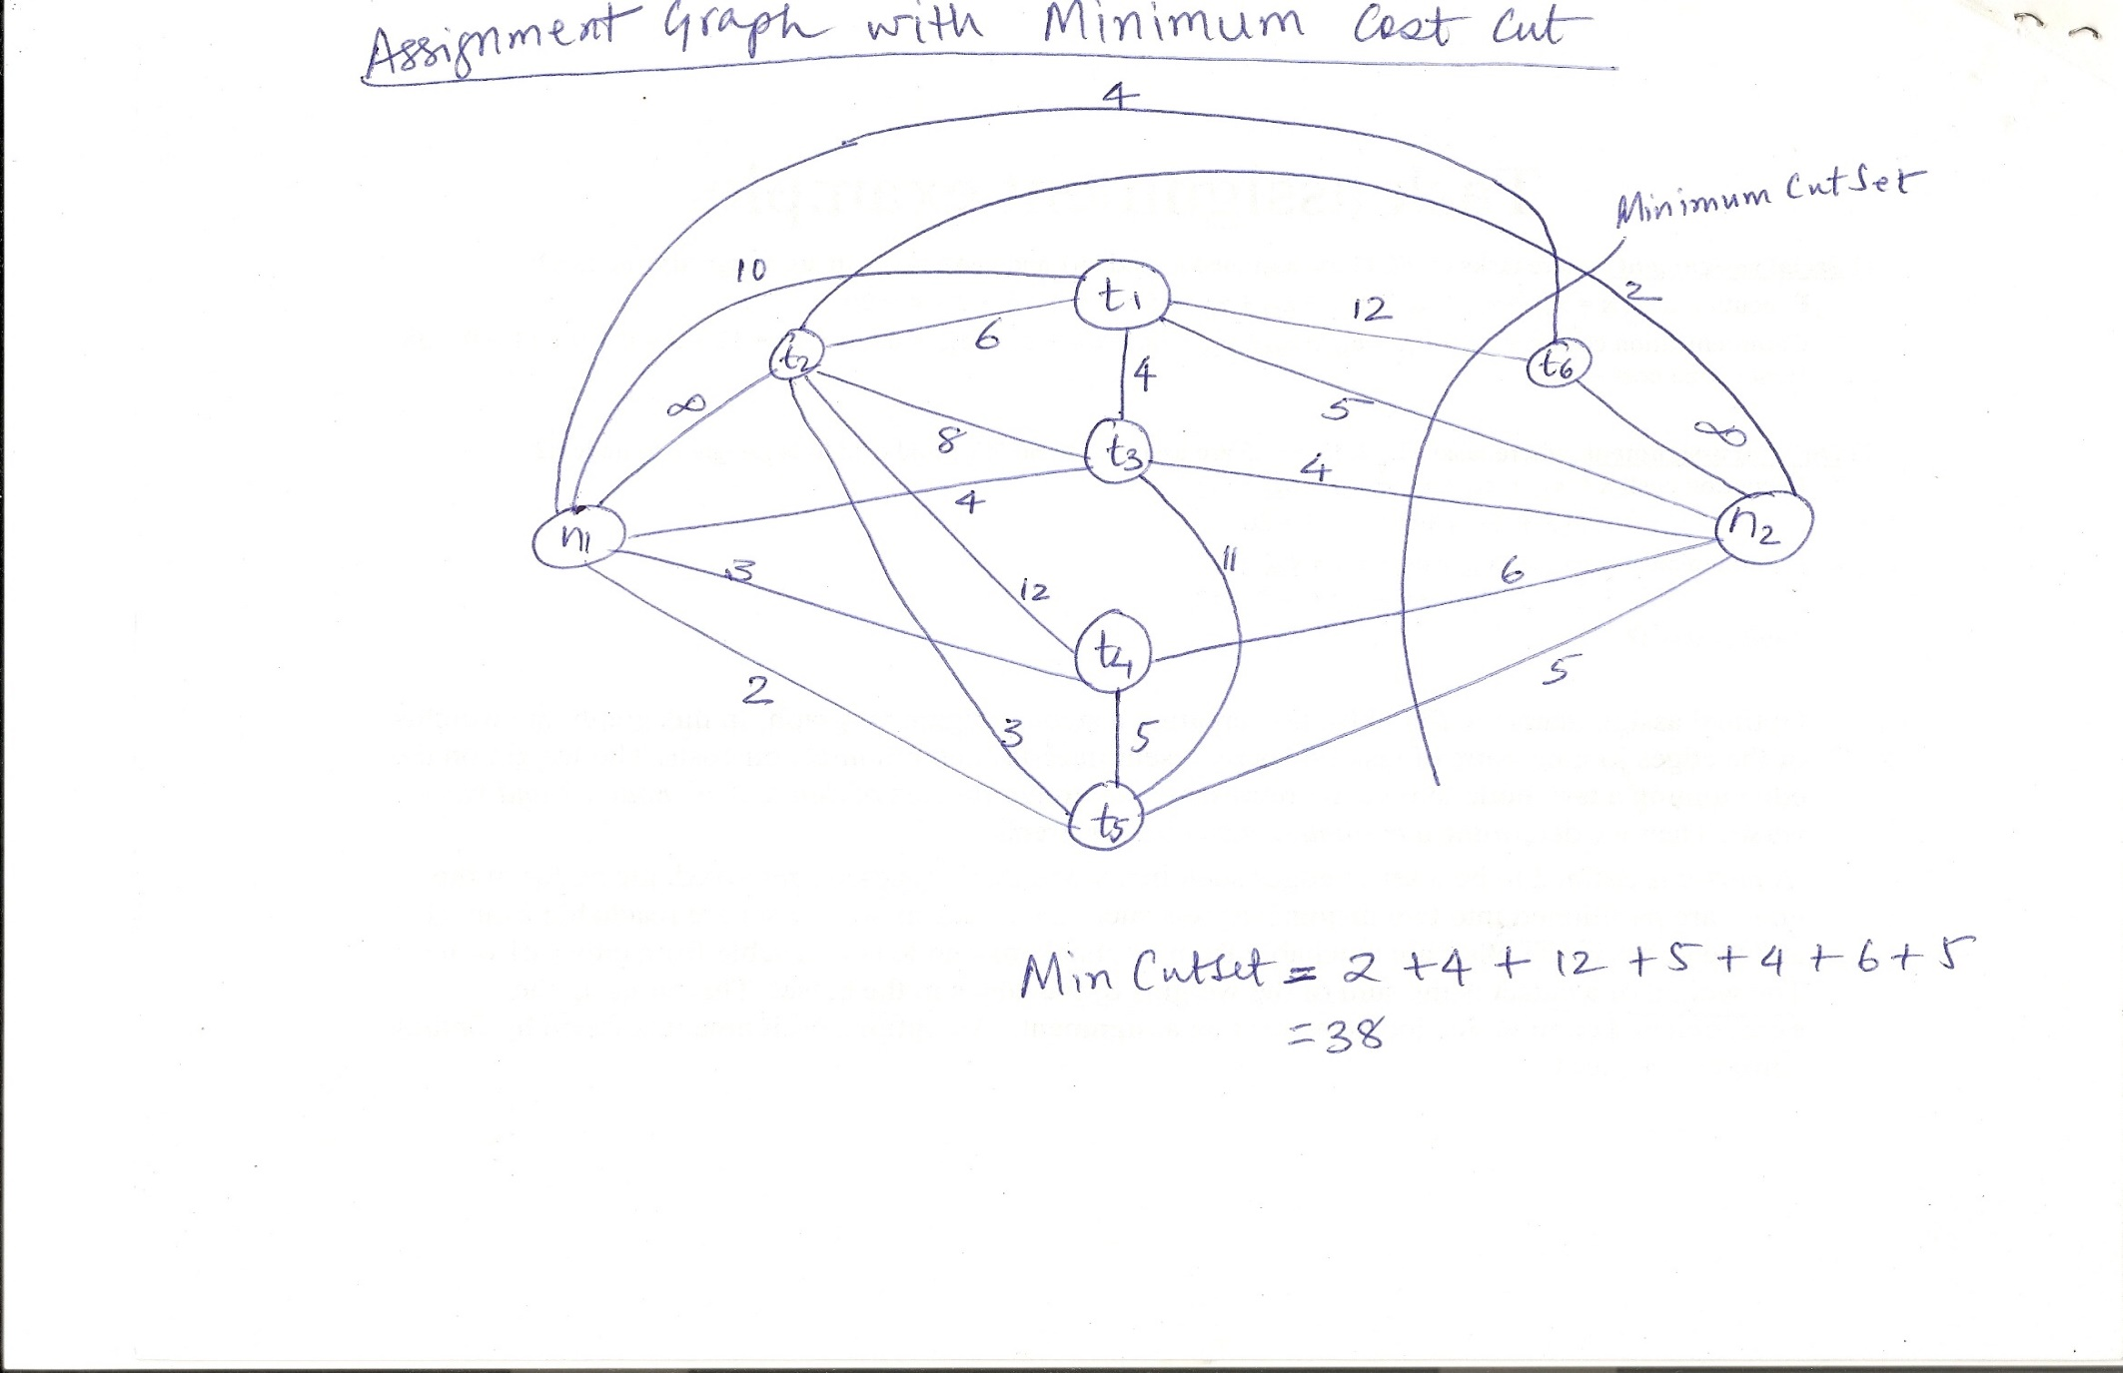
Assignment Graph

Slide 37
Load-balancing approach
A Taxonomy of Load-Balancing Algorithms
Load-balancing algorithms
Static
Dynamic
Deterministic
Probabilistic
Centralized
Distributed
Cooperative
Noncooperative

Slide 38
Load-balancing approach
Type of load-balancing algorithms
Static versus Dynamic
  Static algorithms use only information about the average behavior of the system
  Static algorithms ignore the current state or load of the nodes in the system
  Dynamic algorithms collect state information and react to system state if it changed
  Static algorithms are much more simpler
  Dynamic algorithms are able to give significantly better performance

Slide 39
Load-balancing approach
Type of static load-balancing algorithms
Deterministic versus Probabilistic
  Deterministic algorithms use the information about the properties of the nodes and the characteristic of processes to be scheduled
  Probabilistic algorithms use information of static attributes of the system (e.g. number of nodes, processing capability, topology) to formulate simple process placement rules
  Deterministic approach is difficult to optimize
  Probabilistic approach has poor performance

Slide 40
Load-balancing approach
Type of dynamic load-balancing algorithms
Centralized versus Distributed
  Centralized approach collects information to server node and makes assignment decision
  Distributed approach contains entities to make decisions on a predefined set of nodes
  Centralized algorithms can make efficient decisions, have lower fault-tolerance
  Distributed algorithms avoid the bottleneck of collecting state information and react faster

Slide 41
Load-balancing approach
Type of distributed load-balancing algorithms
Cooperative versus Noncooperative
  In Noncooperative algorithms entities act as autonomous ones and make scheduling decisions independently from other entities
  In Cooperative algorithms distributed entities cooperatewith each other
  Cooperative algorithms are more complex and involve larger overhead
  Stability of Cooperative algorithms are better

Slide 42
Issues in designing Load-balancing algorithms
Load estimation policy
  determines how to estimate the workload of a node
Process transfer policy
  determines whether to execute a process locally or remote
State information exchange policy
  determines how to exchange load information among nodes
Location policy
  determines to which node the transferable process should be sent
Priority assignment policy
  determines the priority of execution of local and remote processes
Migration limiting policy
  determines the total number of times a process can migrate

Slide 43
Load estimation policy I. for Load-balancing algorithms
To balance the workload on all the nodes of the system, it is necessary to decide how to measure the workload of a particular node
Some measurable parameters (with time and node dependent factor) can be the following:
  Total number of processes on the node
  Resource demands of these processes
  Instruction mixes of these processes
  Architecture and speed of the node’s processor
Several load-balancing algorithms use the total number of processes to achieve big efficiency

Slide 44
Load estimation policy II. for Load-balancing algorithms
In some cases the true load could vary widely depending on the remaining service time, which can be measured in several way:
  Memoryless method assumes that all processes have the same expected remaining service time, independent of the time used so far
  Pastrepeats assumes that the remaining service time is equal to the time used so far
  Distribution method states that if the distribution service times is known, the associated process’s remaining service time is the expected remaining time conditioned by the time already used

Slide 45
Load estimation policy III. for Load-balancing algorithms
None of the previous methods can be used in modern systems because of periodically running processes and daemons
An acceptable method for use as the load estimation policy in these systems would be to measure the CPU utilization of the nodes
Central Processing Unit utilization is defined as the number of CPU cycles actually executed per unit of real time
It can be measured by setting up a timer to periodically check the CPU state (idle/busy)

Slide 46
Process transfer policy I. for Load-balancing algorithms
Most of the algorithms use the threshold policy to decide on whether the node is lightly-loaded or heavily-loaded
Threshold value is a limiting value of the workload of node which can be determined by
  Static policy: predefined threshold value for each node depending on processing capability
  Dynamic policy: threshold value is calculated from average workload and a predefined constant
Below threshold value node accepts processes to execute, above threshold value node tries to transfer processes to a lightly-loaded node

Slide 47
Process transfer policy II. for Load-balancing algorithms
Single-threshold policy may lead to unstable algorithm because underloaded node could turn to be overloaded right after a process migration
To reduce instability double-threshold policy has been proposed which is also known as high-low policy
Overloaded
Overloaded
High mark
Threshold
Normal
Low mark
Underloaded
Underloaded
Single-threshold policy
Double-threshold policy

Slide 48
Process transfer policy III. for Load-balancing algorithms
Double threshold policy
  When node is in overloaded region new local processes are sent to run remotely, requests to accept remote processes are rejected
  When node is in normal region new local processes run locally, requests to accept remote processes are rejected
  When node is in underloaded region new local processes run locally, requests to accept remote processes are accepted

Slide 49
Location policy I. for Load-balancing algorithms
Threshold method
  Policy selects a random node, checks whether the node is able to receive the process, then transfers the process. If node rejects, another node is selected randomly. This continues until probe limit is reached.
Shortest method
  L distinct nodes are chosen at random, each is polled to determine its load. The process is transferred to the node having the minimum value unless its workload value prohibits to accept the process.
  Simple improvement is to discontinue probing whenever a node with zero load is encountered.

Slide 50
Location policy II. for Load-balancing algorithms
Bidding method
  Nodes contain managers (to send processes) and contractors (to receive processes)
  Managers broadcast a request for bid, contractors respond with bids (prices based on capacity of the contractor node) and manager selects the best offer
  Winning contractor is notified and asked whether it accepts the process for execution or not
  Full autonomy for the nodes regarding scheduling
  Big communication overhead
  Difficult to decide a good pricing policy

Slide 51
Location policy III. for Load-balancing algorithms
Pairing
  Contrary to the former methods the pairing policy is to reduce the variance of load only between pairs
  Each node asks some randomly chosen node to form a pair with it
  If it receives a rejection it randomly selects another node and tries to pair again
  Two nodes that differ greatly in load are temporarily paired with each other and migration starts
  The pair is broken as soon as the migration is over
  A node only tries to find a partner if it has at least two processes

Slide 52
State information exchange policy I. for Load-balancing algorithms
Dynamic policies require frequent exchange of state information, but these extra messages arise two opposite impacts:
  Increasing the number of messages gives more accurate scheduling decision
  Increasing the number of messages raises the queuing time of messages
State information policies can be the following:
  Periodic broadcast
  Broadcast when state changes
  On-demand exchange
  Exchange by polling

Slide 53
State information exchange policy II. for Load-balancing algorithms
Periodic broadcast
  Each node broadcasts its state information after the elapse of every T units of time
  Problem: heavy traffic, fruitless messages, poor scalability since information exchange is too large for networks having many nodes
Broadcast when state changes
  Avoids fruitless messages by broadcasting the state only when a process arrives or departures
  Further improvement is to broadcast only when state switches to another region (double-threshold policy)

Slide 54
State information exchange policy III. for Load-balancing algorithms
On-demand exchange
  In this method a node broadcast a State-Information-Request message when its state switches from normal to either underloaded or overloaded region.
  On receiving this message other nodes reply with their own state information to the requesting node
  Further improvement can be that only those nodes reply which are useful to the requesting node
Exchange by polling
  To avoid poor scalability (coming from broadcast messages) the partner node is searched by polling the other nodes on by one, until poll limit is reached

Slide 55
Priority assignment policy for Load-balancing algorithms
Selfish
  Local processes are given higher priority than remote processes. Worst response time performance of the three policies.
Altruistic
  Remote processes are given higher priority than local processes. Best response time performance of the three policies.
Intermediate
  When the number of local processes is greater or equal to the number of remote processes, local processes are given higher priority than remote processes. Otherwise, remote processes are given higher priority than local processes.

Slide 56
Migration limiting policy for Load-balancing algorithms
This policy determines the total number of times a process can migrate
  Uncontrolled
    A remote process arriving at a node is treated just as a process originating at a node, so a process may be migrated any number of times
  Controlled
    Avoids the instability of the uncontrolled policy
    Use a migration count parameter to fix a limit on the number of time a process can migrate
    Irrevocable migration policy: migration count is fixed to 1
    For long execution processes migration count must be greater than 1 to adapt for dynamically changing states

Slide 57
Load-sharing approach
Drawbacks of Load-balancing approach
  Load balancing technique with attempting equalizing the workload on all the nodes is not an appropriate object since big overhead is generated by gathering exact state information
  Load balancing is not achievable since number of processes in a node is always fluctuating and temporal unbalance among the nodes exists every moment
Basic ideas for Load-sharing approach
  It is necessary and sufficient to prevent nodes from being idle while some other nodes have more than two processes
  Load-sharing is much simpler than load-balancing since it only attempts to ensure that no node is idle when heavily node exists
  Priority assignment policy and migration limiting policy are the same as that for the load-balancing algorithms

Slide 58
Load estimation policies for Load-sharing algorithms
Since load-sharing algorithms simply attempt to avoid idle nodes, it is sufficient to know whether a node is busy or idle
Thus these algorithms normally employ the simplest load estimation policy of counting the total number of processes
In modern systems where permanent existence of several processes on an idle node is possible, algorithms measure CPU utilization to estimate the load of a node

Slide 59
Process transfer policies for Load-sharing algorithms
Algorithms normally use all-or-nothing strategy
This strategy uses the threshold value of all the nodes fixed to 1
Nodes become receiver node when it has no process, and become sender node when it has more than 1 process
To avoid processing power on nodes having zero process load-sharing algorithms use a threshold value of 2 instead of 1
When CPU utilization is used as the load estimation policy, the double-threshold policy should be used as the process transfer policy

Slide 60
Location policies I. for Load-sharing algorithms
Location policy decides whether the sender node or the receiver node of the process takes the initiative to search for suitable node in the system, and this policy can be the following:
  Sender-initiated location policy
    Sender node decides where to send the process
    Heavily loaded nodes search for lightly loaded nodes
  Receiver-initiated location policy
    Receiver node decides from where to get the process
    Lightly loaded nodes search for heavily loaded nodes

Slide 61
Location policies II. for Load-sharing algorithms
Sender-initiated location policy
  Node becomes overloaded, it either broadcasts or randomly probes the other nodes one by one to find a node that is able to receive remote processes
  When broadcasting, suitable node is known as soon as reply arrives
Receiver-initiated location policy
  Nodes becomes underloaded, it either broadcast or randomly probes the other nodes one by one to indicate its willingness to receive remote processes
Receiver-initiated policy require preemptive process migration facility since scheduling decisions are usually made at process departure epochs

Slide 62
Location policies III. for Load-sharing algorithms
Experiences with location policies
  Both policies gives substantial performance advantages over the situation in which no load-sharing is attempted
  Sender-initiated policy is preferable at light to moderate system loads
  Receiver-initiated policy is preferable at high system loads
  Sender-initiated policy provide better performance for the case when process transfer cost significantly more at receiver-initiated than at sender-initiated policy due to the preemptive transfer of processes

Slide 63
State information exchange policies for Load-sharing algorithms
In load-sharing algorithms it is not necessary for the nodes to periodically exchange state information, but needs to know the state of other nodes when it is either underloaded or overloaded
Broadcast when state changes
  In sender-initiated/receiver-initiated location policy a node broadcasts State Information Request when it becomes overloaded/underloaded
  It is called broadcast-when-idle policy when receiver-initiated policy is used with fixed threshold value value of 1
Poll when state changes
  In large networks polling mechanism is used
  Polling mechanism randomly asks different nodes for state information until find an appropriate one or probe limit is reached
  It is called poll-when-idle policy when receiver-initiated policy is used with fixed threshold value value of 1

Slide 64
SUMMARY
Resource manager of a distributed system schedules the processes to optimize combination of resources usage, response time, network congestion, scheduling overhead
Three different approaches has been discussed
  Task assignment approach deals with the assignment of task in order to minimize inter process communication costs and improve turnaround time for the complete process, by taking some constraints into account
  In load-balancing approach the process assignment decisions attempt to equalize the avarage workload on all the nodes of the system
  In load-sharing approach the process assignment decisions attempt to keep all the nodes busy if there are sufficient processes in the system for all the nodes

Slide 65

Multithreaded Server Architecture

Slide 66
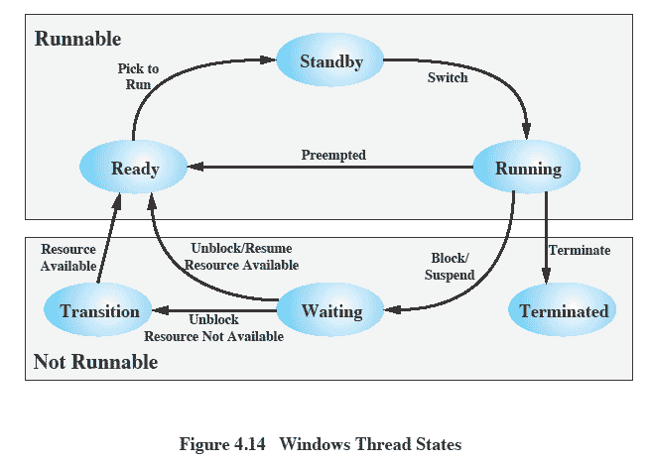
Thread States
Figure 4.12 Windows Thread States
Notes:
An existing Windows thread is in one of six states ( Figure 4.12 ):
• Ready: A ready thread may be scheduled for execution. The Kernel dispatcher
keeps track of all ready threads and schedules them in priority order.
• Standby: A standby thread has been selected to run next on a particular processor.
The thread waits in this state until that processor is made available. If the standby thread’s priority is high enough, the running thread on that processor may be preempted in favor of the standby thread. Otherwise, the standby thread waits until the running thread blocks or exhausts its time slice.
• Running: Once the Kernel dispatcher performs a thread switch, the standby
thread enters the Running state and begins execution and continues execution until it is preempted by a higher-priority thread, exhausts its time slice, blocks, or terminates. In the first two cases, it goes back to the Ready state.
• Waiting: A thread enters the Waiting state when (1) it is blocked on an event
(e.g., I/O), (2) it voluntarily waits for synchronization purposes, or (3) an environment subsystem directs the thread to suspend itself. When the waiting
condition is satisfied, the thread moves to the Ready state if all of its resources are available.
• Transition: A thread enters this state after waiting if it is ready to run but the
resources are not available. For example, the thread’s stack may be paged out of memory. When the resources are available, the thread goes to the Ready state.
• Terminated: A thread can be terminated by itself, by another thread, or when
its parent process terminates. Once housekeeping chores are completed, the thread is removed from the system, or it may be retained by the Executive 6 for future re-initialization.

Slide 67
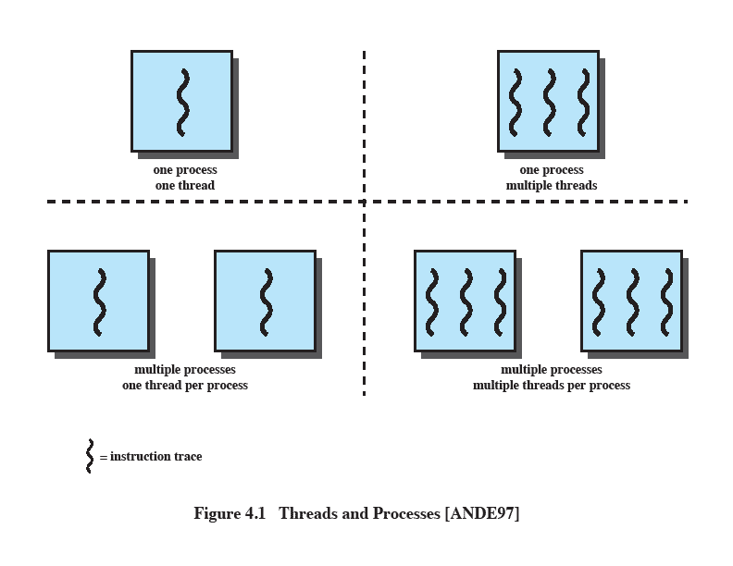
Single Threaded Approaches
A single execution path per process, in which the concept of a thread is not recognized, is referred to as a single-threaded approach
MS-DOS, some versions of UNIX supported only this type of process.
Notes:
The traditional approach of a single thread of execution per process, in which the concept of a thread is not recognized, is referred to as a single-threaded approach. The two arrangements shown in the left half of Figure 4.1 are single-threaded approaches. MS-DOS is an example of an OS that supports a single user process and a single thread.

Slide 68
Multithreaded Approaches
The right half of Figure 4.1 depicts multithreaded approaches
A Java run-time environment is a system of one process with multiple threads; Windows, some UNIXes, support multiple multithreaded processes.
Notes:
The right half of Figure 4.1 depicts multithreaded approaches. A Java run-time environment is an example of a system of one process with multiple threads. Of interest in this section is the use of multiple processes, each of which supports multiple threads. This approach is taken in Windows, Solaris, and many modern versions of UNIX, among others. In this section we give a general description of multithreading; the details of the Windows, Solaris, and Linux approaches are discussed later in this chapter.

Slide 69
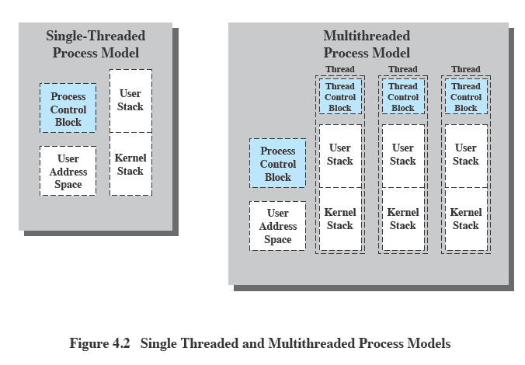
Threads vs. Processes
Notes:
Figure 4.2 illustrates the distinction between threads and processes from the point of view of process management. In a single-threaded process model (i.e., there is no distinct concept of thread), the representation of a process includes its process control block and user address space, as well as user and kernel stacks to manage the call/return behavior of the execution of the process. While the process is running, it controls the processor registers. The contents of these registers are saved when the process is not running. In a multithreaded environment, there is still a single process control block and user address space associated with the process, but now there are separate stacks for each thread, as well as a separate control block for each thread containing register values, priority, and other thread-related state information.

Slide 70
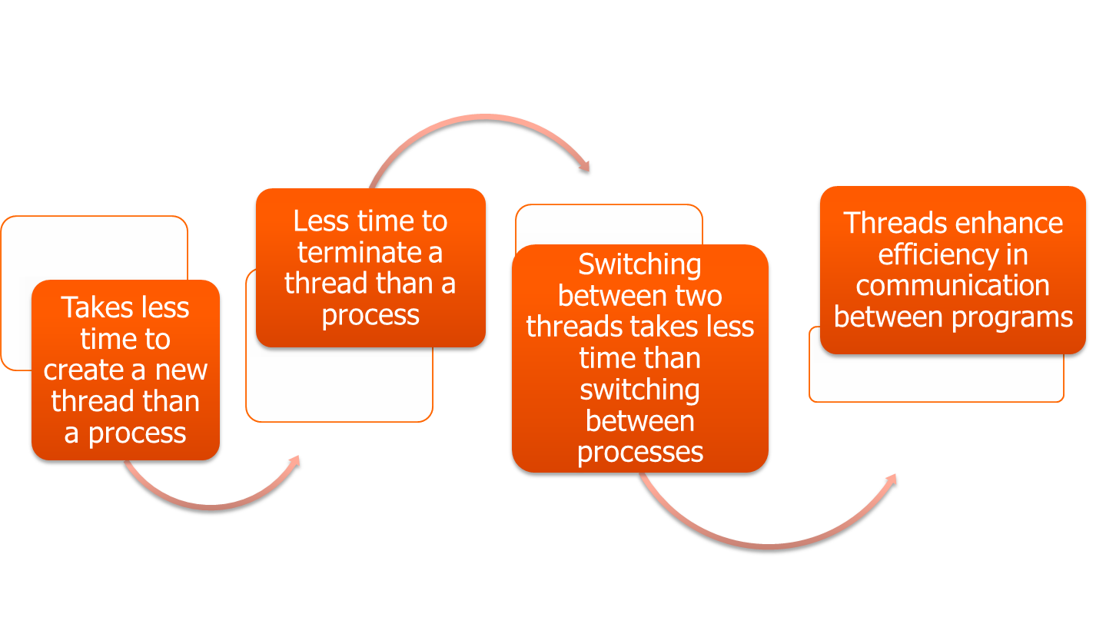
Benefits of Threads
Notes:
Thus, all of the threads of a process share the state and resources of that process. They reside in the same address space and have access to the same data. When one thread alters an item of data in memory, other threads see the results if and when they access that item. If one thread opens a file with read privileges, other threads in the same process can also read from that file.
The key benefits of threads derive from the performance implications:
1. It takes far less time to create a new thread in an existing process than to
create a brand-new process. Studies done by the Mach developers show that
thread creation is ten times faster than process creation in UNIX [TEVA87].
2. It takes less time to terminate a thread than a process.
3. It takes less time to switch between two threads within the same process than to switch between processes.
4. Threads enhance efficiency in communication between different executing programs. In most operating systems, communication between independent processes requires the intervention of the kernel to provide protection and the mechanisms needed for communication. However, because threads within the same process share memory and files, they can communicate with each other without invoking the kernel.
Thus, if there is an application or function that should be implemented as a set of related units of execution, it is far more efficient to do so as a collection of threads rather than a collection of separate processes.

Slide 71
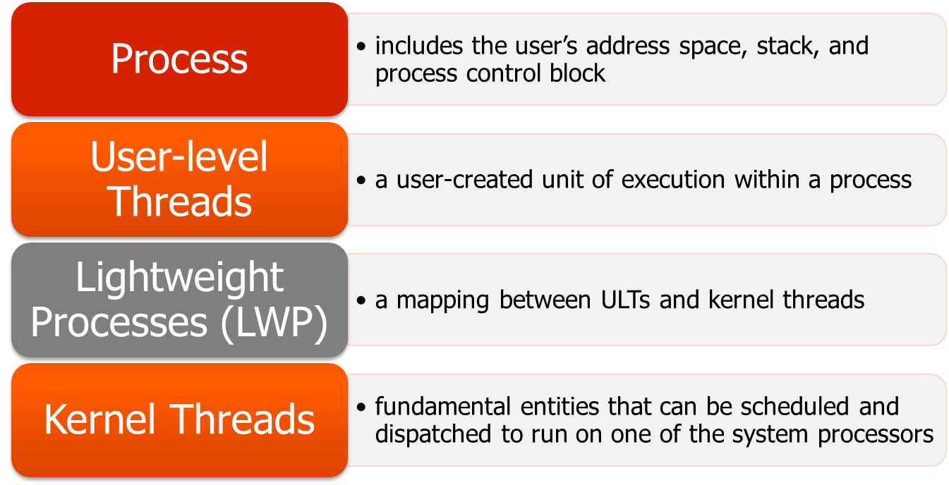
Solaris Process
- makes use of four thread-related concepts:
Notes:
Solaris makes use of four separate thread-related concepts:
• Process: This is the normal UNIX process and includes the user’s address
space, stack, and process control block.
• User-level threads: Implemented through a threads library in the address
space of a process, these are invisible to the OS. A user-level thread (ULT) 7 is a user-created unit of execution within a process.
• Lightweight processes: A lightweight process (LWP) can be viewed as a mapping
between ULTs and kernel threads. Each LWP supports ULT and maps to one kernel thread. LWPs are scheduled by the kernel independently and may execute in parallel on multiprocessors.
• Kernel threads: These are the fundamental entities that can be scheduled and
dispatched to run on one of the system processors.

Slide 72

Summary
User-level threads
  created and managed by a threads library that runs in the user space of a process
  a mode switch is not required to switch from one thread to another
  only a single user-level thread within a process can execute at a time
  if one thread blocks, the entire process is blocked
Kernel-level threads
  threads within a process that are maintained by the kernel
  a mode switch is required to switch from one thread to another
  multiple threads within the same process can execute in parallel on a multiprocessor
  blocking of a thread does not block the entire process
Process/related to resource ownership
Thread/related to program execution
Notes:
Some operating systems distinguish the concepts of process and thread, the former related to resource ownership and the latter related to program execution. This approach may lead to improved efficiency and coding convenience. In a multithreaded system, multiple concurrent threads may be defined within a single process. This may be done using either user-level threads or kernel-level threads. User-level threads are unknown to the OS and are created and managed by a threads library that runs in the user space of a process. User-level threads are very efficient because a mode switch is not required to switch from one thread to another. However, only a single user-level thread within a process can execute at a time, and if one thread blocks, the entire process is blocked. Kernel-level threads are threads within a process that are maintained by the kernel. Because they are recognized by the kernel, multiple threads within the same process can execute in parallel on a multiprocessor and the blocking of a thread does not block the entire process. However, a mode switch is required to switch from one thread to another.

Slide 73
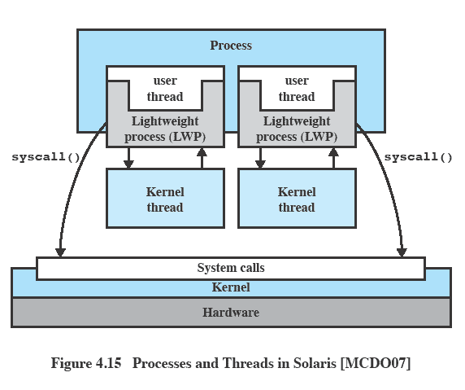
Processes and Threads in Solaris
Figure 4.13 Processes and Threads in Solaris [MCDO07]
Notes:
Figure 4.13 illustrates the relationship among these four entities. Note that there is always exactly one kernel thread for each LWP. An LWP is visible within a process to the application. Thus, LWP data structures exist within their respective process address space. At the same time, each LWP is bound to a single dispatchable kernel thread, and the data structure for that kernel thread is maintained within the kernel’s address space.
A process may consist of a single ULT bound to a single LWP. In this case, there is a single thread of execution, corresponding to a traditional UNIX process. When concurrency is not required within a single process, an application uses this process structure. If an application requires concurrency, its process contains multiple threads, each bound to a single LWP, which in turn are each bound to a single kernel thread.
In addition, there are kernel threads that are not associated with LWPs. The kernel creates, runs, and destroys these kernel threads to execute specific system functions. The use of kernel threads rather than kernel processes to implement system functions reduces the overhead of switching within the kernel (from a process switch to a thread switch).

Slide 74
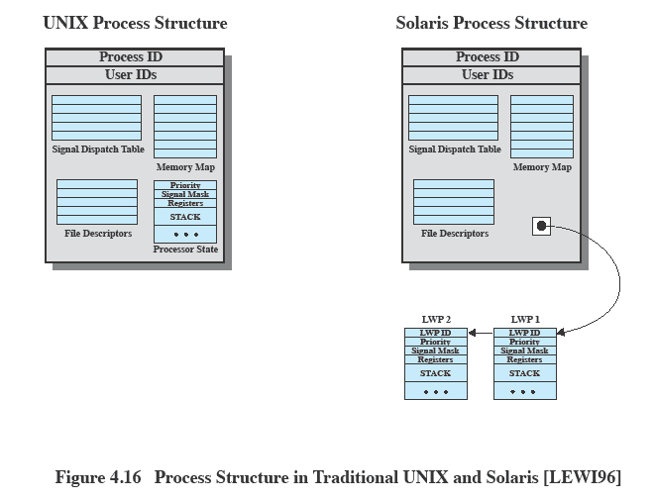

Traditional Unix vs Solaris
Figure 4.14 Process Structure in Traditional UNIX and Solaris [LEWI96]
Notes:
Figure 4.14 compares, in general terms, the process structure of a traditional UNIX system with that of Solaris. On a typical UNIX implementation, the process structure includes the process ID; the user IDs; a signal dispatch table, which the kernel uses to decide what to do when sending a signal to a process; file descriptors, which describe the state of files in use by this process; a memory map, which defines the address space for this process; and a processor state structure, which includes the kernel stack for this process. Solaris retains this basic structure but replaces the processor state block with a list of structures containing one data block for each LWP.

Slide 75
Introduction to Threads
Basic idea: we build virtual processors in software,on top of physical processors:
Processor: Provides a set of instructions along with the capability of automatically executing a series of those instructions.
Thread: A minimal software processor in whose context a series of instructions can be executed. Saving a thread context implies stopping the current execution and saving all the data needed to continue the execution at a later stage.
Process: A software processor in whose context one or more threads may be executed. Executing a thread means executing a series of instructions in the context of that thread.
03 – 2 Processes/3.1 Threads

Slide 76
Context Switching (1/2)
Processor context: The minimal collection of values stored in the registers of a processor used for the execution of a series of instructions (e.g., stack pointer, addressing registers, program counter).
Process context: The minimal collection of values stored in registers and memory of a process used for the execution of a series of instructions (i.e., processor context, state).
Thread context: The minimal collection of values stored in registers and memory, used for the execution of a thread (i.e., thread context).
03 – 3 Processes/3.1 Threads

Slide 77
Context Switching (2/2)
Observation 1: Threads share the same address space. Thread context switching can be done entirely independent of the operating system.
Observation 2: Process context switching is generally more expensive as it involves getting the OS in the loop, i.e., trapping to the kernel.
Observation 3: Creating and destroying threads is much cheaper than doing so for processes.
03 – 4 Processes/3.1 Threads

Slide 78
Threads and Operating Systems (1/2)
Main issue: Should an OS kernel provide threads, or should they be implemented as user-level packages?
User-space solution:
Have nothing to do with the kernel, so all operations can be completely handled within a single process.
All services provided by the kernel are done on behalf of the process in which a thread resides => if the kernel decides to block a thread, the entire process will be blocked. Requires messy solutions.
In practice, we want to use threads when there are lots of external events: threads block on a per-event basis => if the kernel cannot distinguish threads, how can it support signaling events to them?
03 – 5 Processes/3.1 Threads

Slide 79
Threads and Operating Systems (2/2)
Kernel solution: The whole idea is to have the kernel contain the implementation of a thread package. This does mean that all operations return as system calls
Operations that block a thread are no longer a problem: the kernel schedules another available thread within the same process.
Handling external events is simple: the kernel (which catches all events) schedules the thread associated with the event.
The big problem is the loss of efficiency due to the fact that each thread operation requires a trap to the kernel.
Conclusion: Try to mix user-level and kernel-level threads into a single concept.
03 – 6 Processes/3.1 Threads

Slide 80
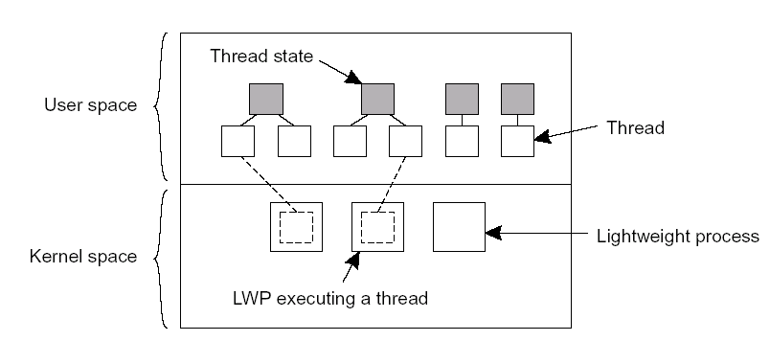
Solaris Threads (1/2)
Basic idea: Introduce a two-level threading approach:
Lightweight processes (LWP) that can execute user-level threads.
03 – 7 Processes/3.1 Threads

Slide 81
Solaris Threads (2/2)
When a user-level thread does a system call, the LWP that is executing that thread, blocks. The thread remains bound to the LWP
The kernel can simply schedule another LWP having a runnable thread bound to it. Note that this thread can switch to any other runnable thread currently in user space.
. When a thread calls a blocking user-level operation, we can simply do a context switch to a runnable thread, which is then bound to the same LWP.
When there are no threads to schedule, an LWP may remain idle, and may even be removed (destroyed) by the kernel.
03 – 8 Processes/3.1 Threads

Slide 82
Threads and Distributed Systems (1/2)
Multi-threaded clients: Main issue is hiding network latency
Multi-threaded Web client:
  Web browser scans an incoming HTML page, and finds that more files need to be fetched
  Each file is fetched by a separate thread, each doing a (blocking) HTTP request
  As files come in, the browser displays them
Multiple RPCs:
  A client does several RPCs at the same time, each one by a different thread
  It then waits until all results have been returned
  Note: if RPCs are to different servers, we may have a linear speed-up compared to doing RPCs one after the other
03 – 9 Processes/3.1 Threads

Slide 83
Threads and Distributed Systems (2/2)
Multi-threaded servers: Main issue is improved performance and better structure
Improve performance:
  Starting a thread to handle an incoming request is much cheaper than starting a new process
  Having a single-threaded server prohibits simply scaling the server to a multiprocessor system
  As with clients: hide network latency by reacting to next request while previous one is being replied
Better structure:
  Most servers have high I/O demands. Using simple, well-understood blocking calls simplifies the overall structure
  Multi-threaded programs tend to be smaller and easier to understand due to simplified flow of control
03 – 10 Processes/3.1 Threads

