Slide 1

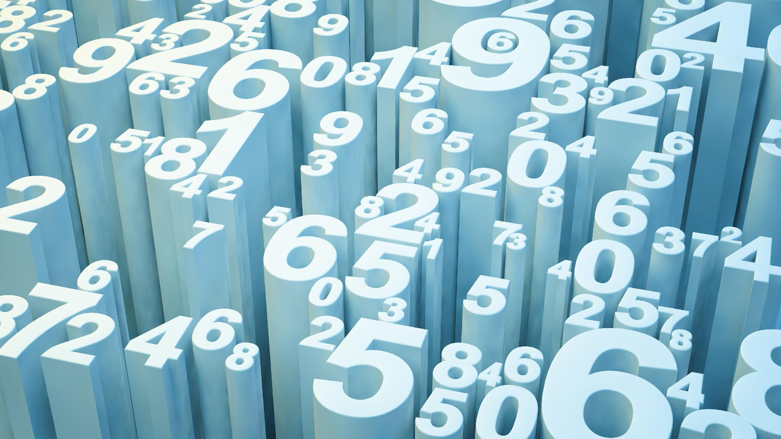
Detect Money Laundering
By Machine Learning Methods

Slide 2
S.NO. | TOPICS
1. | Definition of Money Laundering.
2. | Overview of Money Laundering.
3. | Why combat money laundering?
4. | Detection of Unusual Transaction.
5. | Money Laundering Indicators.
6. | Solution

Slide 3
Money Laundering
DEFINATION:
The FATF has defined “money laundering” as the processing of criminal proceeds to disguise their illegal origin in order to legitimise the ill-gotten gains of crime.
NOTE: The Financial Action Task Force (FATF) is an inter-governmental body whose purpose is the development and promotion of policies to combat money laundering and terrorist financing.

Slide 4
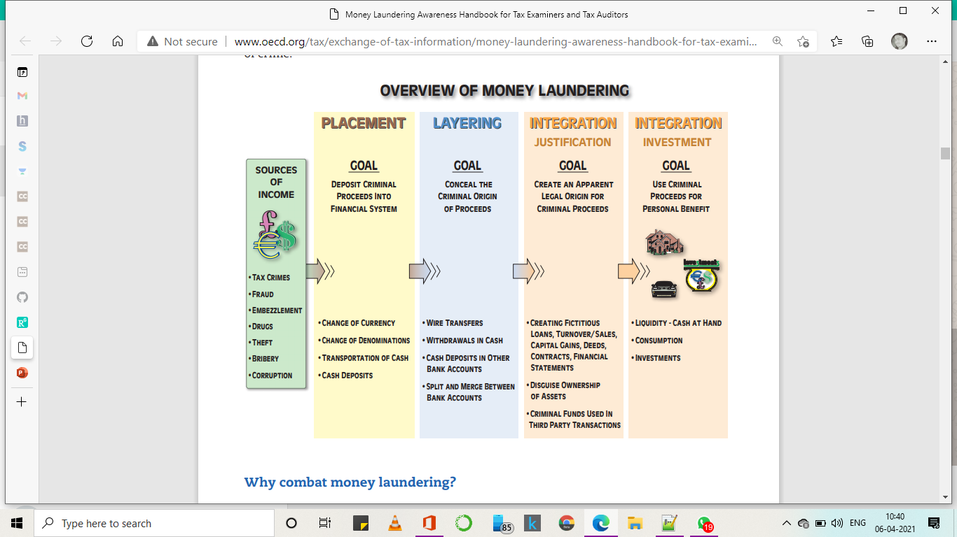

Slide 5
Why combat money laundering?
Criminals accumulate significant sums of money by committing crimes such as drug trafficking, human trafficking, theft, investment fraud, extortion, corruption, embezzlement and tax fraud.
Money laundering is a serious threat to the legal economy and affects the integrity of financial institutions. It also changes the economic power in certain sectors. If left unchecked, it will corrupt society as a whole.
Fighting money laundering serves several purposes as follows:
i. The social importance
ii. To identify tax crimes
Iii. To identify other crimes and criminals
Iv. To locate and confiscate criminal assets

Slide 6
Detection of unusual Transaction
In general, unusual transactions have certain characteristics like:
The fact that the origin of the funds is not clear.
The fact that the identities of the parties are not clear.
The transaction does not fit the person’s background or legal income.
The fact that there is no economical or logical explanation for the transaction.

Slide 7
Money laundering Indicators
These Indicators are:
Money laundering indicators for individuals
Tax return examination and pre-audit indicators
Audit indicators
Specific indicators on real estate
Specific indicators on cash
Specific indicators on international trade
Specific indicators on loans
Specific indicators on professional service providers.

Slide 8
Solution
Prediction:
Suspicious Transaction or not
Testing Data set
Large
Transaction Data
Algorithm
Evaluation
Model
Training Data Set
New Transactional Data

Slide 9
Short Notes On Solution of detecting Money laundering:
We Take out All Money Transaction Data takes place Online Mode from banks to other financial institutions.
From these Past Data we label them which are case of Fraud like money laundering and some which are fair transactions.
We will create a Machine Learning Model based on these Data and make them Capable to identify themselves when any new Transaction is happened.
The model can classify each transaction into Two category:
(i). Suspicious Transaction.
(ii). Non-Suspicious Transaction.
Evaluation: High Precision will be our priority in creating this kind of model.

Slide 10




THANK YOU
MADE BY:
NAME
JYOTISH RANJAN MALLIK
SWARUPA DAS
SUBHASHREE DUTTA
SOMESH KANT

