Slide 1
Clustering Toronto Neighborhood based on restaurant categories
Finding the most and least number of restaurant available in Toronto neighborhood
Prepared by
Swarup Barua
October 2019

Slide 2
Business Problem
The objective of this capstone project is to determine which places in Toronto has which type of restaurant more.
By using machine learning algorithm such as clustering this project aims to find which cuisine restaurants dominate in which part of Toronto.

Slide 3
Data source & extraction
Fetch list of neighborhoods in Toronto, Canada using web scrapping tool.
Latitude and longitude of Toronto neighborhoods through geocode package.
Venues related to food category around different neighborhoods using Foursquare API call.

Slide 4
Data Cleaning
Records have Borough as ‘Not assigned’ are removed first.
Neighborhoods having the same borough are merged and location of the borough are added to dataframe.
Filter dataframe related to Toronto Borough.

Slide 5
Methodology
Use category Id ‘4d4b7105d754a06374d81259’ to explore the neighborhoods for restaurants.
Filter data for the selected restaurant categories (Chinese Restaurant, Italian Restaurant, Mexican Restaurant, New American Restaurant, Fast Food Restaurant, Sushi Restaurant, Japanese Restaurant, Thai Restaurant, Seafood Restaurant, Indian Restaurant, French Restaurant, Asian Restaurant and Greek Restaurant).
Use onehot encoding to determine the different restaurant category count for each neighborhood.

Slide 6
Data Visualization
Determine the top 5 restaurants among all neighborhood.
Find top 20 neighborhoods for the above restaurant categories.
Use bar plot to plot the restaurant counts in these neighborhood for top 5 restaurant categories.

Slide 7
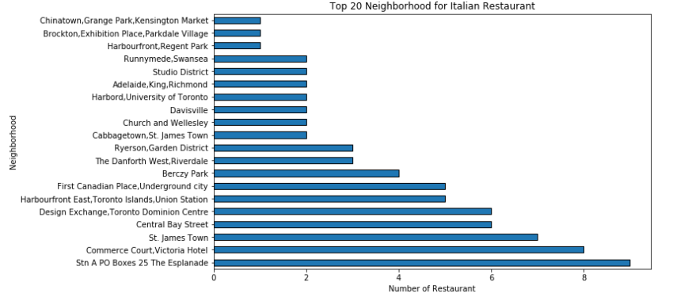
Top 20 Neighborhood for Italian Restaurant

Slide 8
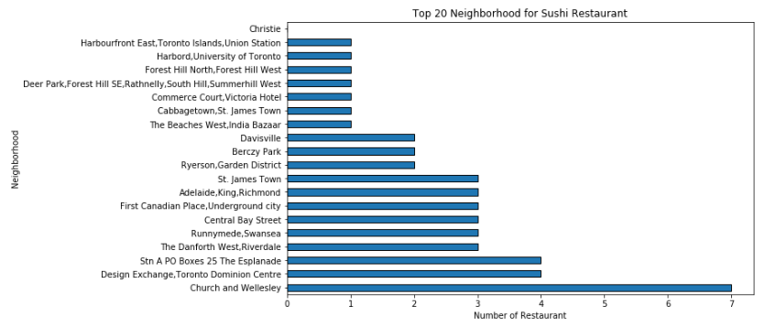
Top 20 Neighborhood for Sushi Restaurant

Slide 9
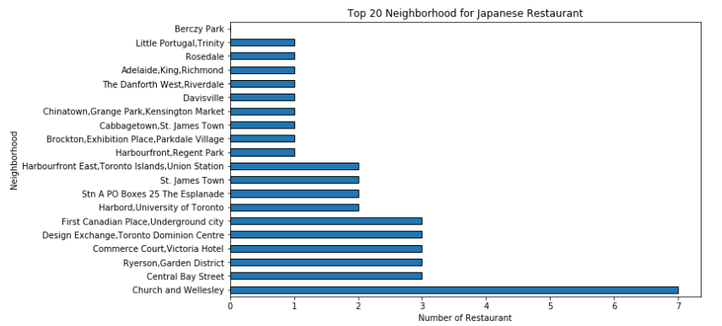
Top 20 Neighborhood for Japanese Restaurant

Slide 10
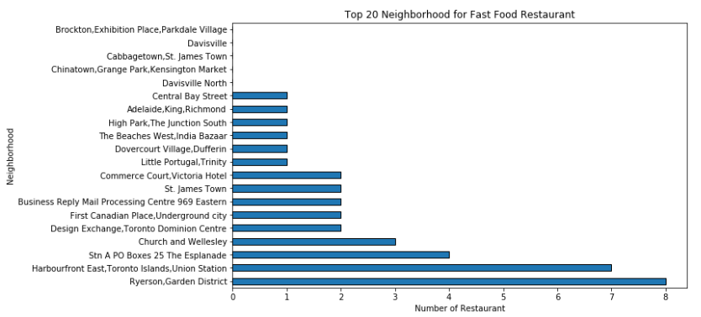
Top 20 Neighborhood for Fast Food Restaurant

Slide 11
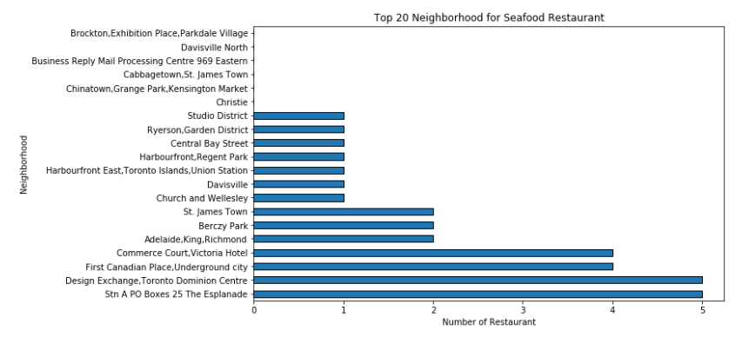
Top 20 Neighborhood for SeaFood Restaurant

Slide 12
Results
Top most five restaurant available in each neighborhood in Toronto.
Top least five restaurant available in each neighborhood in Toronto.

Slide 13
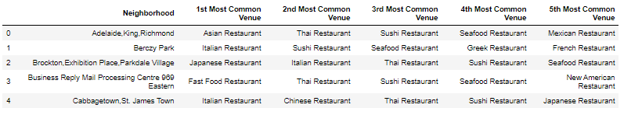
Top 5 most available restaurant in each neighborhood

Slide 14
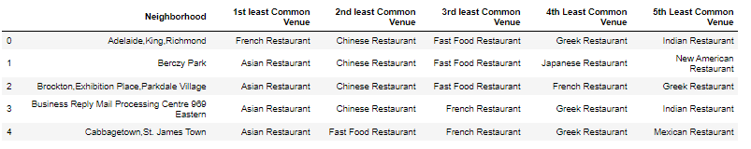
Top 5 least available restaurant in each neighborhood

Slide 15
Clustering
Use K means clustering algorithm to find the food culture in different neighborhoods in Toronto.
5 clusters are used in the clustering method and assigned to each neighborhood.

Slide 16
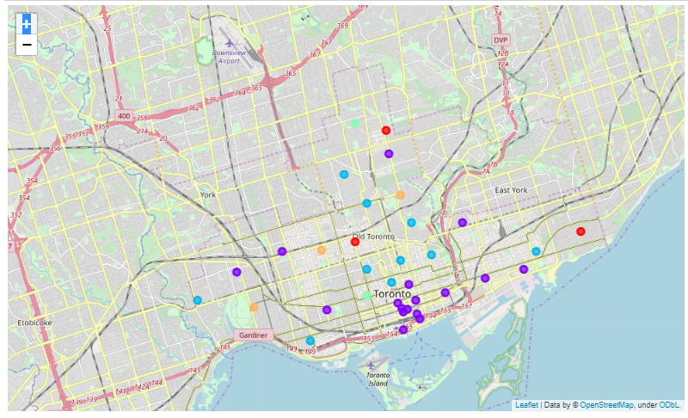
Cluster visualization using folium
Neighborhoods are clustered and plotted in Toronto Map.

Slide 17
Conclusion and future direction
From the above analysis people can find their food restaurant of interest.
Stakeholders interested in opening new restaurant can get an knowledge of most and least available restaurants in neighborhoods in Toronto.
In future this analysis can be extended to find out an exact location for opening a restaurant using more input parameters.

