Slide 1
Cloud Computing mini project
Swasthika
Swathi M

Slide 2
Implementation
Components
NodeMCU with ESP8266 WIFI module
DHT11 temperature and humidity sensor
Components are connected to form a circuit and NodeMCU is connected to the system.
Using Arduino IDE, hardware is programmed. The program is then uploaded to the hardware memory.
Program consists of reading the sensor data and storing it in ThingSpeak channel by using ESP8266 module, ThingSpeak and DHT sensor libraries.
ThingSpeak channel has unique channel ID, read and write API keys using which hardware can be connected to ThingSpeak.

Slide 3
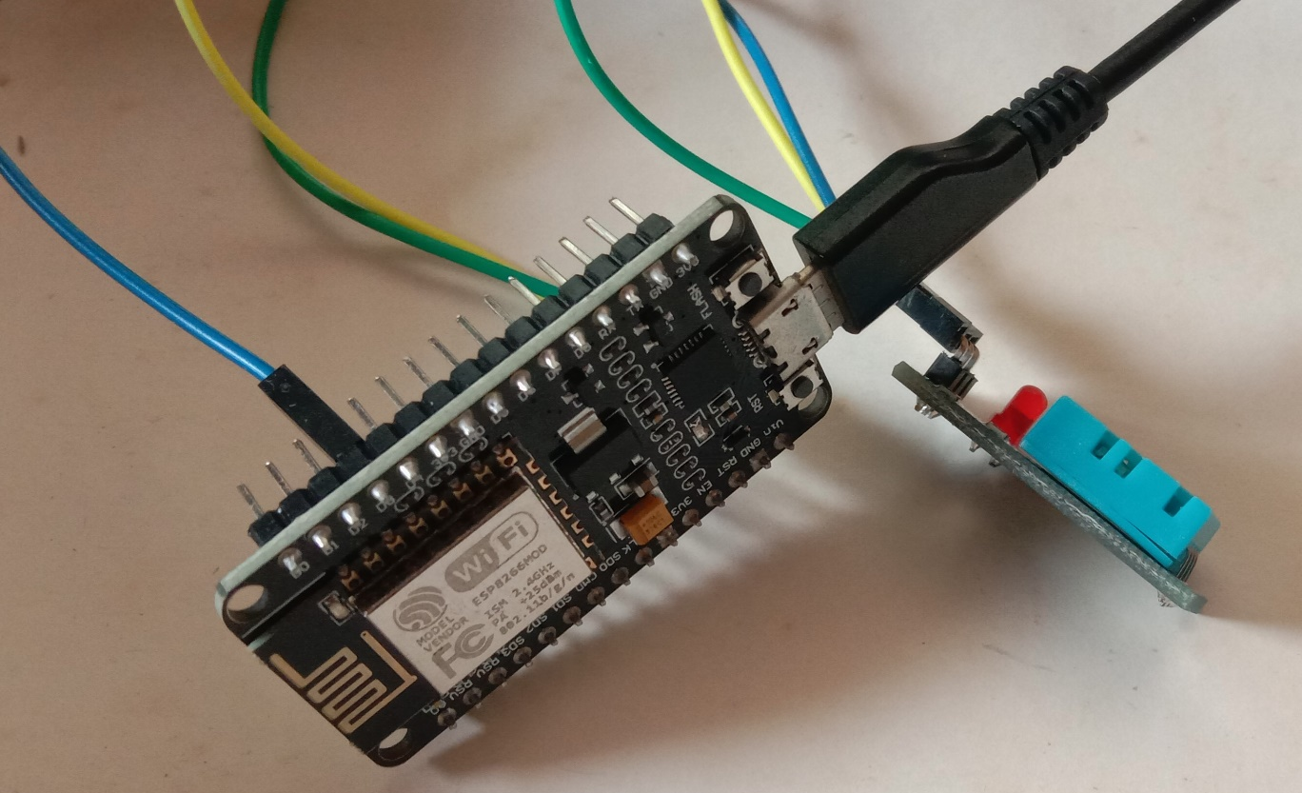
Hardware

Slide 4
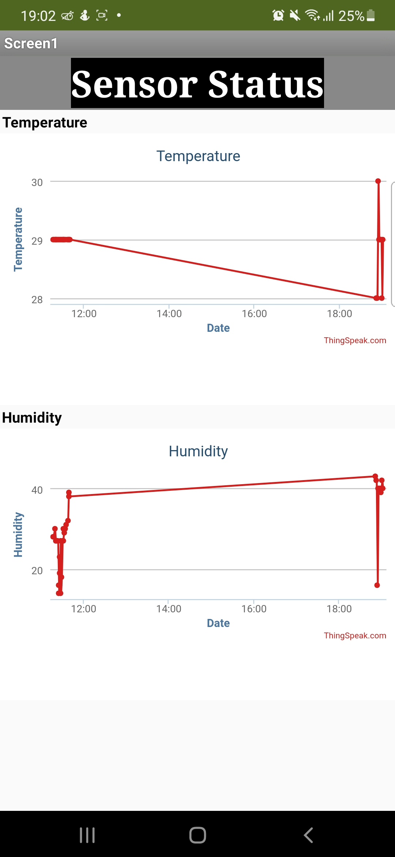
Mobile App Development

Slide 5
Thank You

