Slide 1

XENSERVER
Swasthika

Slide 2
WHAT IS XEN?
Xen is a type-1 hypervisor, providing services that allow multiple computer operating systems to execute on the same computer hardware concurrently. It was originally developed by the University of Cambridge Computer Laboratory and is now being developed by the Linux Foundation with support from Intel.
Types of virtualization it supports?

Slide 3

DOM0
DOMU
DOMU
DOMU
DOMU

Slide 4
WHAT IS XENSERVER?
The Citrix Xenserver is a pre-package installable OS which you can easily install on any compatible hardware.
Xenserver and the Covid-19.

Slide 5
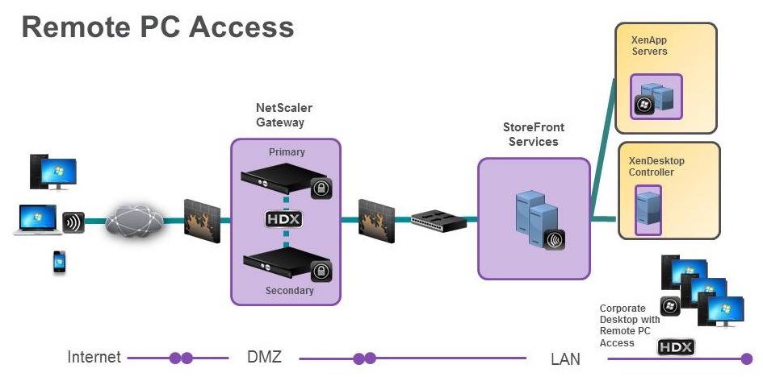

Slide 6

Thank You

