Slide 1
KEYLOGGER
CAPSTONE PROJECT
Presented By:
1. R.SWASTHIKA LAKSHMI PRIYA-College Of Engineering Guindy-B.Tech IT

Slide 2
OUTLINE
Problem Statement
Proposed System/Solution
System Development Approach
Algorithm & Deployment
Result (Output Image)
Conclusion
Future Scope
References

Slide 3
Problem Statement
The provided Python code presents a keylogger application integrated with a Tkinter-based graphical user interface (GUI). This application records various key events, including press, hold, and release actions, and archives them in both text and JSON file formats. Users can initiate and terminate the keylogging process through intuitive GUI buttons, with real-time status updates displayed on the interface. The primary objective is to develop an accessible and efficient keylogger solution that offers seamless control and clear feedback to users, ensuring accurate logging of keystrokes for potential analysis or monitoring purposes.

Slide 4
Proposed Solution
The provided Python code offers a basis for addressing the challenge of developing a keylogger application with a Tkinter-based graphical user interface (GUI). To enhance its functionality and usability, the following steps can be implemented:
Data Collection:
The code collects data on key press, hold, and release events using the pynput library.
Machine Learning Algorithm:
The application relies on event listener functions provided by the pynput library to capture and log key press, hold, and release events in real-time. These events are then processed and stored accordingly, without the need for training or prediction typically associated with machine learning algorithms. Therefore, the keylogger application operates primarily based on event detection and logging rather than machine learning techniques.
Data Preprocessing:
As the data collection process is straightforward, no specific preprocessing steps are required in this context.
Deployment:
Develop a user-friendly interface or application using Tkinter to provide a seamless user experience for starting and stopping the keylogging process.
Enhance the GUI design to improve usability and aesthetics.
Evaluation:
Assess the application's performance by testing its functionality on different operating systems and environments.
Gather user feedback to identify areas for improvement, such as additional features or enhancements to the GUI.
Result:Upon successful implementation and deployment, the keylogger application will provide users with a convenient way to monitor and log keystrokes, with clear feedback on the GUI indicating the current status of the keylogging process. Continuous refinement based on user feedback will ensure the application meets the needs of its users effectively.

Slide 5
System Approach
Highlight key libraries such as tkinter for GUI development and pynput for capturing keyboard events.
System requirements:
Define the hardware and software prerequisites necessary for running the keylogger application effectively.
Specify the supported operating systems and system configurations for seamless compatibility.
Library required to build the model
Identify the external libraries and dependencies utilized in constructing the keylogger application.
Highlight key libraries such as tkinter for GUI development and pynput for capturing keyboard events.

Slide 6
Algorithm & Deployment
Algorithm Selection:
The chosen algorithm for the keylogger application is based on utilizing event listener functions provided by the pynput library. These functions enable the detection and capture of key press, hold, and release events in real-time.
Data Input:
The input features utilized by the keylogger algorithm include various attributes of key events, such as timestamps, key identifiers (e.g., 'a', 'b', 'Enter'), and event types (press, hold, release).
Additionally, the keylogger may consider contextual information, such as the active application window or system-wide keyboard events, to provide comprehensive logging capabilities.
Training Process:
The keylogger algorithm does not undergo a traditional training process, as it primarily functions as a real-time event listener and logger.
Initialization of the keylogger involves setting up event listeners to detect key events and configuring event buffers to handle incoming events efficiently.
Prediction Process:
The keylogger captures and processes key events in real-time, logging each event along with its associated timestamp and event type.
Different types of key events, including key press, hold, and release actions, are handled and stored sequentially in log files for later analysis or monitoring purposes.

Slide 7
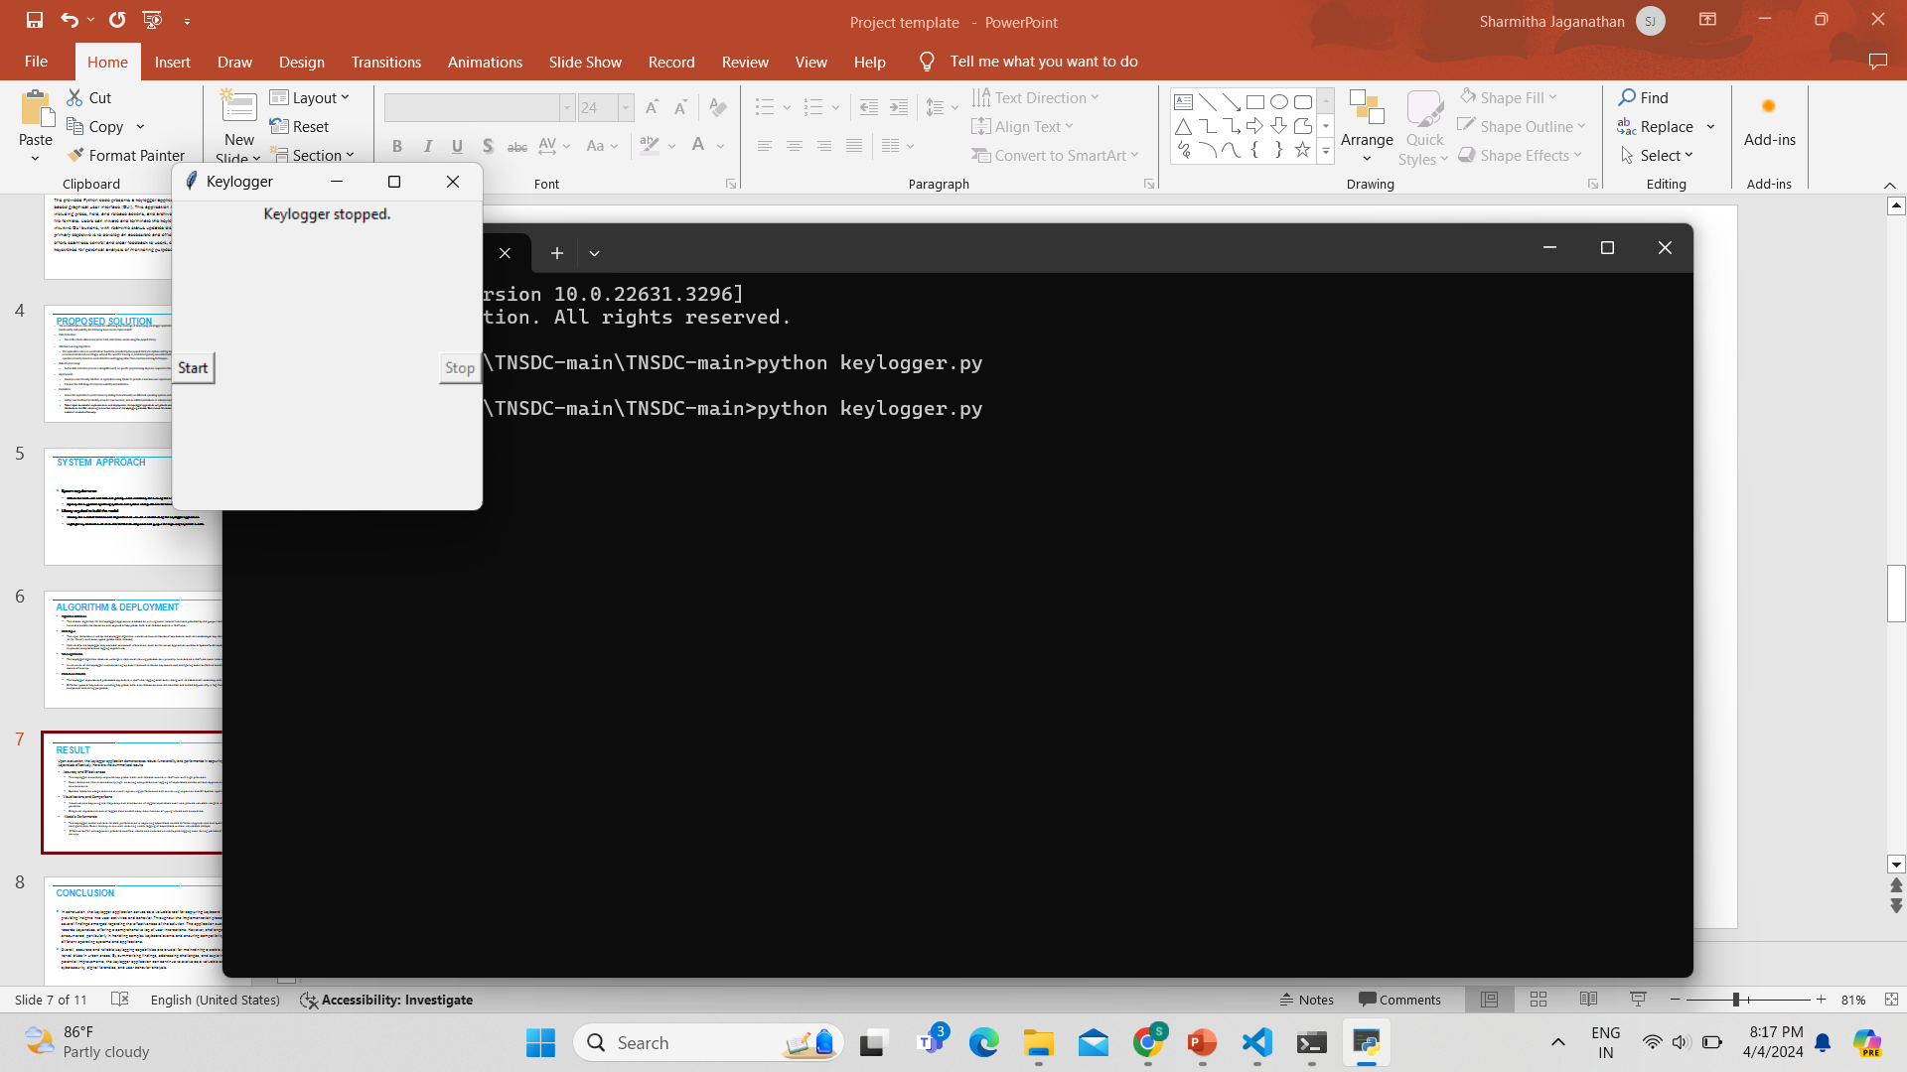
Result
Upon evaluation, the keylogger application demonstrates robust functionality and performance in capturing and logging keystrokes effectively. Here are the summarized results:
Accuracy and Effectiveness:
The keylogger accurately captures key press, hold, and release events in
real-time with high precision.
Event detection rate is consistently high, ensuring comprehensive logging
of keystrokes across various applications and system environments.
Visualizations and Comparisons:
Visualizations depicting the frequency and distribution of logged keystrokes
over time provide valuable insights into user activity patterns.
Model's Performance:
The keylogger model exhibits reliable performance in capturing keystrokes across different applications and system configurations. Event latency is minimal, ensuring timely logging of keystrokes without noticeable delays.
Effective buffer management prevents overflow issues and ensures uninterrupted logging even during periods of high typing activity.

Slide 8
Conclusion
In conclusion, the keylogger application serves as a valuable tool for capturing keyboard input, providing insights into user activities and behavior. Throughout the implementation process, several findings emerged regarding the effectiveness of the solution. The application successfully records keystrokes, offering a comprehensive log of user interactions. However, challenges were encountered, particularly in handling complex keyboard events and ensuring compatibility across different operating systems and applications.
Overall, accurate and reliable keylogging capabilities are crucial for maintaining a stable supply of rental bikes in urban areas. By summarizing findings, addressing challenges, and exploring potential improvements, the keylogger application can continue to evolve as a valuable asset in cybersecurity, digital forensics, and user behavior analysis.

Slide 9
Future scope
For further developments, the keylogger application could benefit from various enhancements and expansions. Integrating additional data sources, such as system events or application usage statistics, would offer a more comprehensive understanding of user behavior.
Optimizing the algorithm for efficiency and accuracy, particularly in handling uncommon keyboard events, could improve overall performance. Expanding the system's coverage to include multiple devices or platforms would enable centralized monitoring across various endpoints.
Additionally, integrating emerging technologies like edge computing or advanced machine learning techniques could enhance scalability, responsiveness, and intelligent logging capabilities. These developments would position the keylogger application as a more robust and adaptable tool, capable of meeting the evolving needs of users and applications.

Slide 10
References
https://www.grafiati.com/en/literature-selections/keylogger/
https://iopscience.iop.org/article/10.1088/1742-6596/954/1/012008/pdf
https://www.researchgate.net/publication/228797653_Keystroke_logging_keylogging

Slide 11
THANK YOU

