Slide 1
Unix Programming with Standard Input and Output

Slide 2
Introduction to Standard Streams
In Unix systems, communication between applications is achieved using standard streams:
• stdin – Standard Input Stream
• stdout – Standard Output Stream
• stderr – Standard Error Stream
These streams act as communication channels between programs and the terminal.

Slide 3
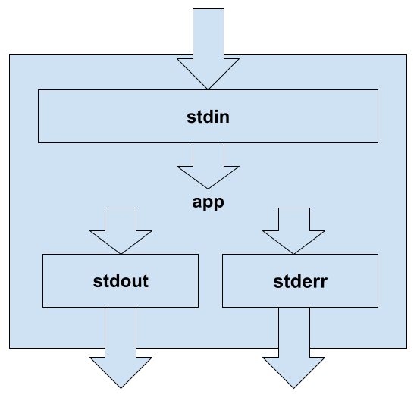

Slide 4
Input/Output Streams Example
Example: Using grep with input redirection
#!/usr/bin/env bash
echo pattern | grep pattern
• 'echo pattern' sends output to grep via stdin.
• grep outputs matching results to stdout.

Slide 5
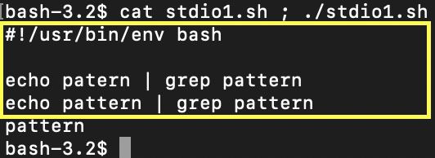
The script running at the console:

Slide 6
Error Stream Example
stderr is used for reporting errors independently from stdout.
Example:
ls > /tmp/log
ls /not/existed_path > /tmp/log
• Errors are displayed on console because they use stderr.

Slide 7
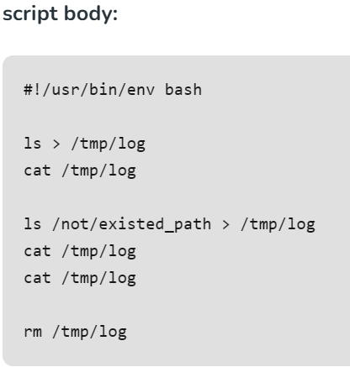

Slide 8
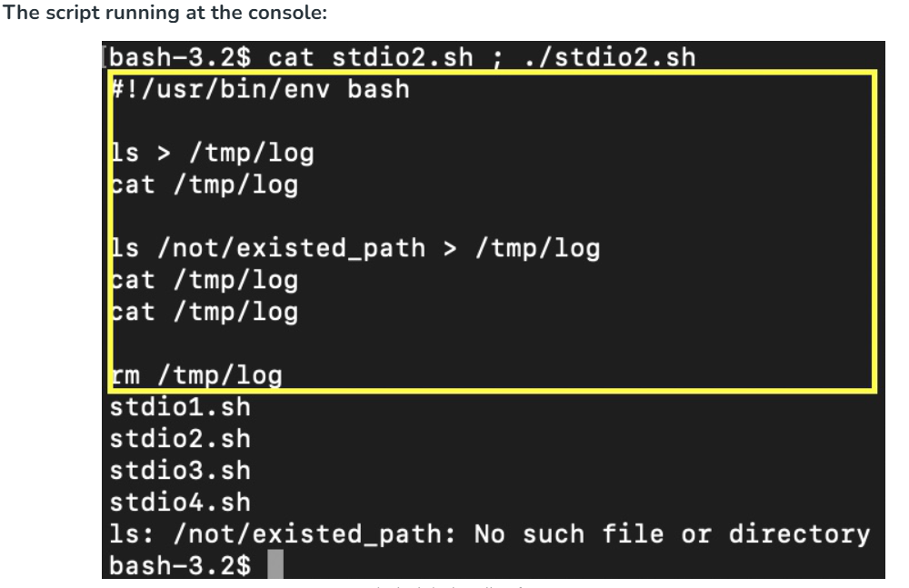

Slide 9
Redirecting Streams
It is possible to manipulate the standard streams: redirect them or use pipes to process them.
Streams can be redirected or piped:
'>' redirects stdout to a file.
'2>' redirects stderr.
'/dev/null' discards unwanted output.
Example:
ls /not/existed_path 2> /dev/null

Slide 10
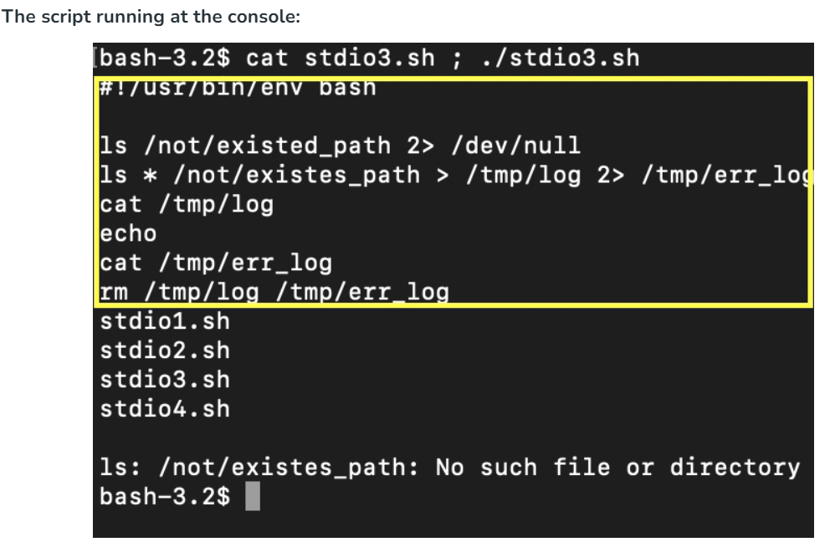
Redirecting Streams

Slide 11
Discarding Output
In some cases, it is useful to drop all of the application output (to save storage space or remove the unimportant sources of data to analyze). We should remember that we should mute not just the standard output stream but the standard error stream also. Let's look at an example of how does it work.

Slide 12
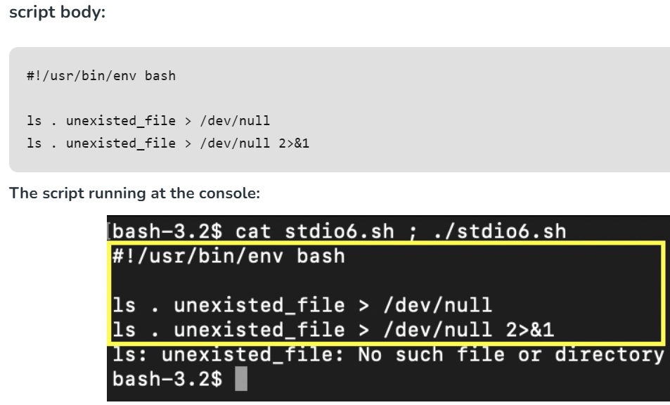
Discarding Output

Slide 13
In both lines of script standard output stream redirected to file /dev/null. This file is not a file itself: but a special Linux device with a file interface. It has a write function available from shell (that does nothing). So all of the input is just dropped. But the second string of the script has a difference from the first one: "2>&1" at the end of the command. These symbols tell that the second standard stream ( standard error stream ) needs to be directed at the first standard stream (standard output stream) permanently for this command. That is why we see only one error message displayed in the console - at the second command string of the script standard error stream redirected to terminating file device /dev/null in the end.

Slide 14
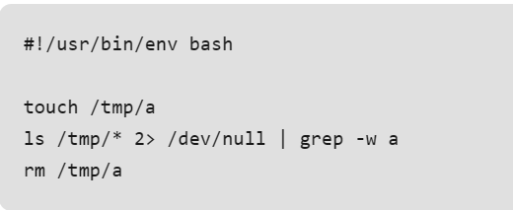
Pipelined Streams
It also can be useful to modify the stream. is able to run several applications connected by the streams.

Slide 15
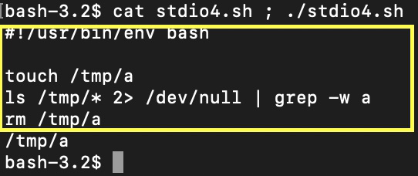
The script running at the console:
Here we collect the listing and set “ls” standard output stream as grep standard input stream by using “|”. On “2>” standard errors stream is redirected to the termination file. The output stream of grep contains the "/tmp/a" filename from listing that matches by grep pattern.

Slide 16
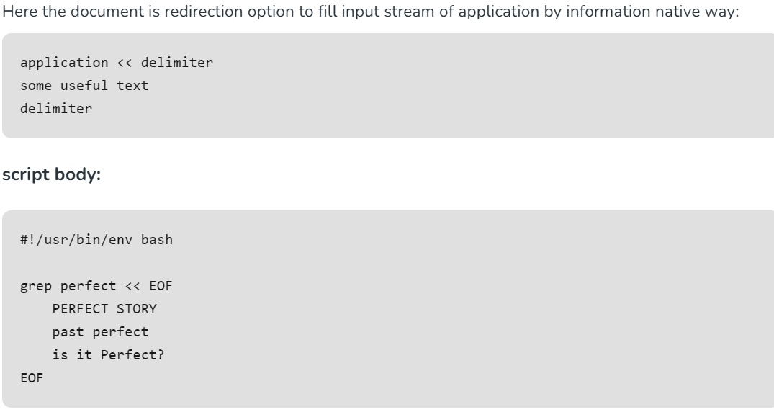
Here Document

Slide 17
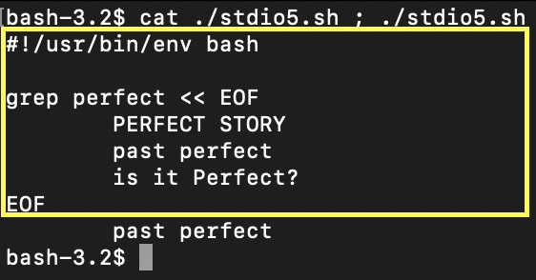
The script running at console.
As we can see only the second string from 3 of the strings of text for the grep standard input stream delimited by "EOF" match the grep pattern: that is why it passed to grep standard output stream and be displayed in the console next.

Slide 18
Conclusion
• Unix uses three main data streams for process communication.
• Streams can be redirected, piped, or discarded as needed.
• Mastering stdin, stdout, and stderr is essential for shell scripting.

