Slide 1
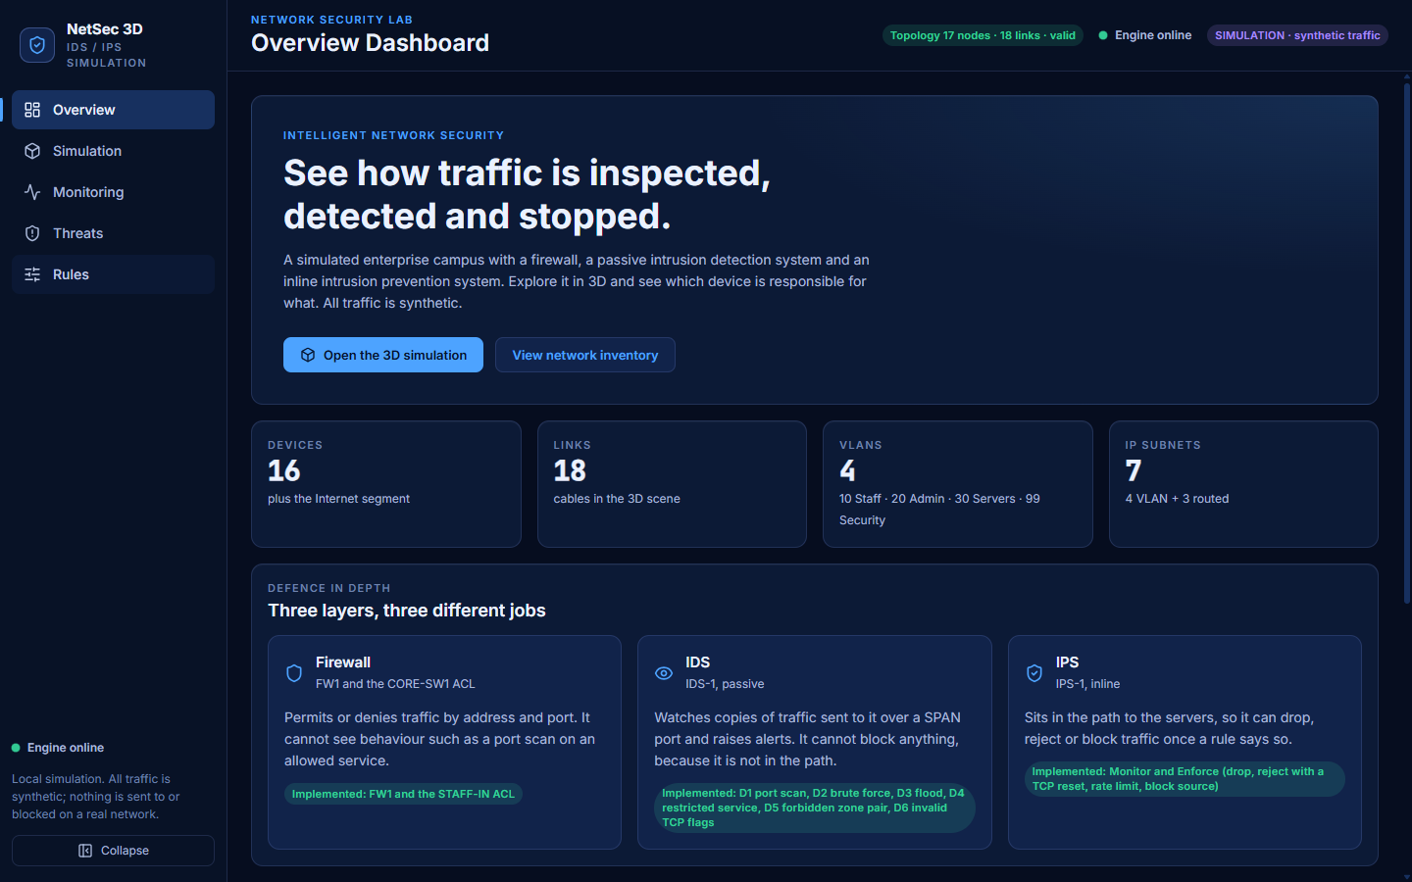
COMPUTER NETWORKS PROJECT | FINAL PRESENTATION
Intelligent Network Security Using Intrusion Detection and Automated Threat Prevention
The problem
A firewall decides by address and port. It cannot see a port scan on a service it allows.
An IDS watches copies of traffic and alerts, but it is not in the path, so it cannot stop anything.
An IPS is in the path and can stop traffic, but a wrong rule blocks real users.
Our answer
A 3D simulation of one campus network that shows who detects, who prevents, and why. Synthetic traffic only: nothing real is captured or blocked.
Notes:
Say: Firewalls, IDS and IPS are often confused. A firewall filters by address and port. An IDS watches a copy of the traffic and raises alerts, but it is not in the path, so it cannot stop anything. An IPS sits in the path, so it can drop or block, at the risk of blocking real users. Our project simulates all three on one small campus so the difference can be seen packet by packet. Say clearly: everything is a simulation with synthetic traffic.

Slide 2
OBJECTIVES
Five objectives, one clear boundary
1
Model a campus network
2
Detect with a passive IDS
3
Prevent with an inline IPS
4 VLANs, 7 subnets, static routing, a stateful firewall and an access list.
IDS-1 reads SPAN copies and raises alerts. Six detectors, D1 to D6.
IPS-1 can drop, reject, rate-limit or block, in Monitor or Enforce mode.
4
Make it visible and repeatable
5
Prove it works
Boundary
Not real traffic, not a real product. Our own model of the concepts.
A deterministic trace replayed in 3D. Same seed, same result.
93 scenario checks and automated tests, not just a good-looking demo.
Notes:
The first five cards are what we set out to do. The last card is what we did not: this is not Snort, Suricata or Cisco IOS and it never touches a real network. It is our own model of the concepts, built so the behaviour can be shown and tested.

Slide 3
SYSTEM ARCHITECTURE
The engine decides, the browser replays
Configuration
Python engine
Trace
React player
3D scene and pages
topology, rules, scenarios (JSON)
discrete-event; decides every packet
time-stamped events plus a hash
play, pause, seek, step
counters, tables, inspectors
One source of truth
Deterministic
The 3D scene, counters and tables all read the same trace, so they cannot disagree.
Integer-microsecond clock. Same seed and rules give the same trace hash.
Changes at the playhead
Local only
Switching IPS mode or sending traffic re-simulates; everything before the playhead stays identical.
Binds to 127.0.0.1, REST only. After install it needs no internet.
Notes:
The Python engine runs a discrete-event simulation and returns a trace: a list of time-stamped events. The browser never decides what happens to a packet; it only replays the trace. Because everything comes from one trace, the 3D scene and the numbers cannot disagree. Same seed and same rules give the same trace hash, which is why our expected demo numbers are exact.

Slide 4
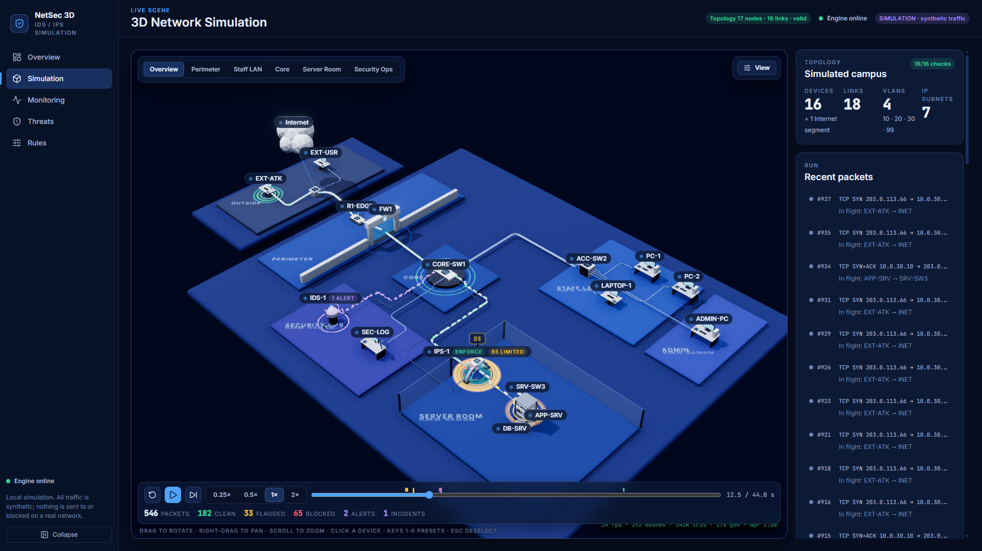
NETWORK TOPOLOGY
Four VLANs, seven subnets, one campus
VLAN | Name | Subnet
10 | Staff | 10.0.10.0/24
20 | Admin | 10.0.20.0/24
30 | Servers | 10.0.30.0/24
99 | Security | 10.0.99.0/24
- | Routed | 203.0.113.0/24, two /30 links
17 nodes (16 devices + Internet), 18 links, 7 zones
Static routes; TTL 64 becomes 63 at CORE-SW1
SPAN: CORE-SW1 ingress is copied to IDS-1, before the ACL.
IPS-1: transparent bridge in front of the servers (VLAN 30).
Notes:
Path inward: outside hosts, the Internet segment, R1-EDGE, FW1, then CORE-SW1, a layer-3 switch that routes between VLAN 10 Staff, 20 Admin, 30 Servers and 99 Security. The trunk to the access switch carries VLANs 10 and 20. Three more routed subnets sit outside any VLAN, making seven subnets. CORE-SW1 copies every packet entering it to IDS-1 over a SPAN port, before the ACL. IPS-1 is a transparent bridge in VLAN 30: no IP on its data ports, so routing and TTL are unchanged but all server traffic passes through it. The picture is a real screenshot of our app.

Slide 5
TECHNOLOGIES
Plain, testable technologies
Backend: the engine
Frontend: the replay
Tooling
Python 3.13
FastAPI 0.162 + Uvicorn 0.54
Pydantic 2.14 (validation)
Scapy 2.8 (packet codec in tests)
pytest 9.2 + httpx
React 19 + Vite 8
Three.js 0.187 with react-three-fiber
Zustand (one shared store)
Vitest 5 (277 tests)
Fonts bundled: works offline
Windows .cmd scripts: setup, run, verify
Chrome DevTools scripts for the rehearsal
Git: tracks per area, tagged milestones
Not used: WebSocket, database, machine learning
Notes:
Python and FastAPI for the engine because it is easy to read and test. React, Vite and Three.js for the browser. One Zustand store feeds both the 3D scene and the pages. Fonts and libraries are bundled, so after installation the app needs no internet. We deliberately did not use a database, WebSocket or machine learning.

Slide 6
IDS AND IPS WORKFLOW
IDS watches a copy; IPS stands in the path
Sender
FW1 / ACL
CORE-SW1
IPS-1
Server
host on the campus or outside
static policy; drops by address and port
routes; copies each packet to IDS-1
inline; the only sensor that enforces
APP-SRV or DB-SRV
IPS-1, for every packet
IDS-1 (SPAN copy)
Actions (Enforce mode)
1 Source in the block table? Drop.
2 Detectors look at the packet.
3 Look up the action for the finding.
4 Enforce, or in Monitor only record.
5 Forward unless dropped.
passive: alerts only, never blocks
Drop: D5, D6
Reject with a TCP reset: D4
Rate limit, 10 per second: D3
Block the source 20 to 30 s: D1, D2, D3
Notes:
Follow one packet. FW1 and the core ACL enforce static policy no matter what. CORE-SW1 copies each packet entering it to IDS-1; IDS-1 can only raise alerts, because it is looking at a copy. The original packet continues to IPS-1, which sits in the path. IPS-1 first checks the block table, then runs the detectors on every packet, then looks up the action, then either enforces it (Enforce mode) or only records what it would have done (Monitor mode). Detection runs before enforcement so a rate limiter can never hide a flood from the detector. D1 port scan, D2 brute force, D3 flood, D4 restricted service, D5 forbidden zone pair, D6 invalid TCP flags.

Slide 7
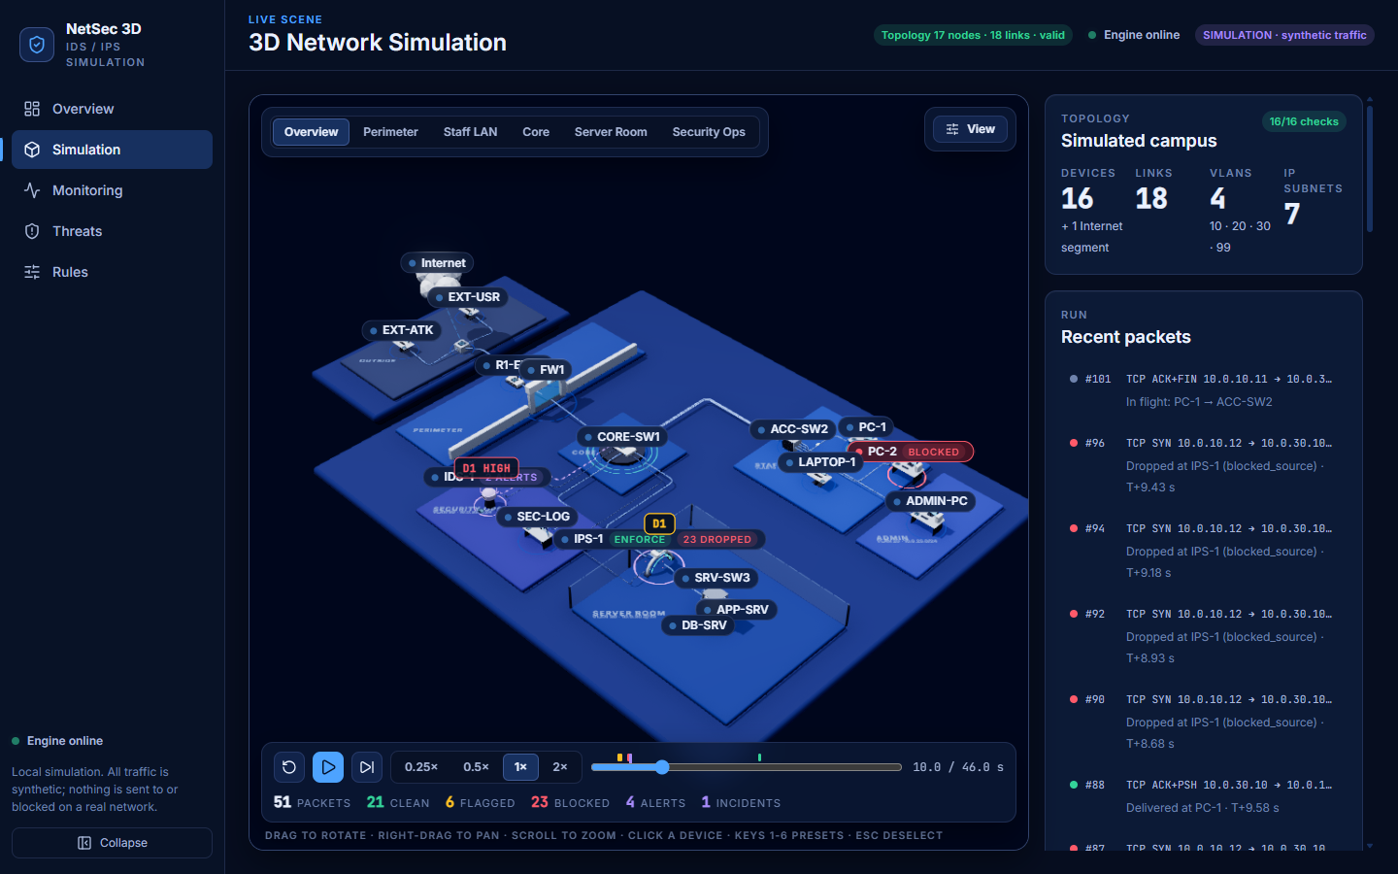
SIMULATION SCENARIOS
Seven scenarios, exact expected results
Scenario | What happens | Result (shipped rules)
S1 Normal | HTTPS, ping, admin SSH, app to database | 30 packets, 0 alerts
S2 Port scan | PC-2 probes ports; D1 at 6 and 12 ports | Monitor: 0 blocked. Enforce: 24 blocked
S3 Access control | Four forbidden attempts: ACL, firewall, IPS reject | 4 blocked, 4 alerts
S4 Flood | Outside host floods port 443 | Rate limit, then block; real user unaffected
S5, S6 | S2 traffic pinned to Monitor / Enforce | Same until the HIGH alert
S7 Brute force | Repeated SSH attempts (D2) | Alerts at 6 and 12; block 30 s
S2, Enforce: PC-2 blocked at IPS-1, 23 dropped so far.
Custom traffic
Inject your own packet at the playhead; the engine re-simulates.
Notes:
These are the exact outcomes with the shipped rules; the demo checks them. S2 shows Monitor against Enforce with identical traffic: the traces are the same until the HIGH alert, then in Enforce 24 packets are dropped and PC-2 is blocked for 20 seconds. S3 shows defence in depth: two ACL denials, one firewall drop that no sensor sees, and an IPS reject for the admin PC. S4 shows the token-bucket rate limit and then a block, while the legitimate outside user keeps getting through. Custom traffic lets the audience try their own packet.

Slide 8
RESULTS AND TESTING
Tested by machines and in a real browser
937
277
93/93
34/34
8/8
backend tests
frontend tests
scenario checks
demo rehearsal
offline recovery
What we did not measure
The 55 fps target on the RTX 4050 is not verified. Chrome used the Intel GPU.
Clean install: 9.4 min on one laptop. The second laptop was not tested.
No real network, no real IDS/IPS product.
Notes:
Everything here was executed, not assumed. Backend and frontend test suites, the 93 scenario checks across 12 runs, a 34-check rehearsal of the whole demo in a real Chrome window, and an 8-check test that kills the backend while the page is open and checks it recovers. Frame rates were measured on the laptop Intel integrated GPU at the heaviest moment of S4; the Low preset reaches the 30 fps target at all three window sizes. Be explicit about what was not measured: the 55 fps RTX 4050 target is not verified, because Chrome rendered on the Intel GPU; the second laptop was not available; and nothing was tested on a real network.

Slide 9
CONCLUSION AND FUTURE SCOPE
What we built, and what comes next
Delivered
Future scope
A deterministic simulation of firewall, ACL, passive IDS and inline IPS
Six detectors and four IPS actions, Monitor and Enforce
A 3D replay with packet and device inspectors, rules editor and 93 self-checks
Offline demo mode with a tested recovery path
Packet Tracer lab to compare with real Cisco configuration (not built)
Anomaly or machine-learning detection beside the rules
PCAP export, host-sweep detector, saved run history
Simulated, not real
Blocking changes simulation state only. Nothing is captured, sent or blocked on a real network.
Notes:
Summary: a deterministic engine decides every packet and writes a trace; the browser replays it. The IDS detects without being in the path; the IPS enforces because it is. Limits to state plainly: the traffic is synthetic; the Packet Tracer lab in the original plan was not built; detection is rule-based with no machine learning; D3 has no half-open condition; and the high-end GPU target is unverified. Future scope: a Packet Tracer comparison, anomaly detection, PCAP export and persistent run history. Thank the audience and invite questions. The viva question bank is docs/VIVA_QA.md.

