Slide 1
From Diurnal to Bimodal: Measuring the Nocturnal Shift in Delhi’s Peak Electricity Demand from Daily Peak-Timing Records
4th IEEE International Conference on Industrial Electronics: Developments & Applications
Swastik Verma, Pummy Dhiman
Swastik Verma, Chitkara University Institute of Engineering and Technology Chitkara University, Punjab, India onamverma8@gmail.com
Pummy Dhiman Chitkara University Institute of Engineering and Technology Chitkara University, Punjab, India pummy.dhiman@chitkara.edu.in
42 – Swastik Verma & Pummy Dhiman
4th IEEE International Conference on Industrial Electronics: Developments & Applications

Slide 2
Problem Statement
Delhi’s daily peak demand no longer falls only in the afternoon. It now often falls late at night, and the two peaks are almost equal in height, so the hour of the peak is hard to predict.
Why it happens :
Warm nights keep demand high: Concrete buildings and roads in the urban heat island soak up sunlight during the day and radiate the energy slowly at night. This keeps the nights from cooling off and results in strong electricity demand in the region.
Humidity changes which hour carries the peak: High humidity combined with the urban heat island creates a compounded effect. Humidity pushes the AC compressors to work harder through the whole night to fight the heat and humidity together.
What is missing :
Peak timing is not measured: Most studies give the size of the peak but not its clock time. A peak of 8,000 MW looks the same whether it happened at 3 pm or at 11 pm.
The late-night window is not estimated: Reports quote 22:00 to 01:00, but its centre and spread have not been measured.
The heat threshold is not known: We do not know the night temperature above which cooling demand starts rising faster.
Storage is not sized: Solar cannot supply a midnight peak, and the battery size needed to flatten it has not been worked out.
From Diurnal to Bimodal: Measuring the Nocturnal Shift in Delhi’s Peak Electricity Demand from Daily Peak-Timing Records – Swastik Verma

Slide 3
Research Objective
Build a Daily Peak-Timing Record: Collect Delhi’s daily peak demand from 2010 to 2026, with its size and clock time.
Measure the Shift: Compare early and recent years to see whether the peak is moving from the afternoon to late night.
Locate the Late-Night Window: Estimate the centre and spread of the time window where the late-night peak falls.
Find What Drives the Peak: Use weather and calendar data to explain when the peak happens and how large it is.
Find the Heat Threshold: Estimate the night temperature above which demand rises faster, and how humidity changes it.
Size the Battery Storage: Use observed 5-minute load curves to estimate the storage needed to flatten the late-night peak.
From Diurnal to Bimodal: Measuring the Nocturnal Shift in Delhi’s Peak Electricity Demand from Daily Peak-Timing Records – Swastik Verma

Slide 4
Dataset
What we built: A daily record of Delhi’s peak demand: 5,618 days, from 29 March 2010 to 12 January 2026. Each day has the size of the peak (MW) and the clock time it happened (IST).
Three sources
15-minute data (March 2010 to early 2013): 1,078 days from a public Columbia University archive of Delhi load data.
Monthly operating reports (2013 to 2022): 3,526 days of daily peak size and reported peak time, copied from Delhi SLDC reports, the pdf’s has been extracted manually from the website.
5-minute data (2023 to 2026): 1,014 days of system load data at 5 mins of interval from kaggel.
Where sources overlap, the finer one is used. Only sources 1 and 3 are instrument-measured (2,092 days). Source 2 gives the time stated in the report.
Weather data: daily minimum temperature and humidity for Delhi from Open-Meteo (ERA5), matched to each day’s peak (5,608 of 5,618 days). It is city-wide reanalysis data, not station readings.
Checks: It reproduces 17 official maxima exactly and differs from CEA monthly figures by 0.52% on average over 33 months.
From Diurnal to Bimodal: Measuring the Nocturnal Shift in Delhi’s Peak Electricity Demand from Daily Peak-Timing Records – Swastik Verma

Slide 5
Feature Engineering
Nighttime Cooling Degree Days (CDD)
Formula: CDD = max(0, Tmin − 18 °C). We use the night minimum, not the daytime maximum. If the night stays above 18 °C, natural cooling stops and ACs run all night.
Heat and Humidity Interaction
Formula: latent = CDD × (RH − average RH). Hot, humid nights make ACs work harder. We subtract the average humidity first so this term is not just a copy of CDD.
Nocturnal Thermal Mass
Formula: Tmin². Squaring makes very hot nights count more than warm ones. It stands in for heat stored in buildings and released after sunset.
Long-Term Trend
Formula: Trend = days since the first record. It stands in for growing AC use, but it also picks up population and floor space growth.
Calendar Variables
Weekend flag: marks weekend days. Peaks fall at night more often on weekends.
Month indicators: one flag for each month, to capture the season.
From Diurnal to Bimodal: Measuring the Nocturnal Shift in Delhi’s Peak Electricity Demand from Daily Peak-Timing Records – Swastik Verma

Slide 6
Magnitude Model: Specification
Target P: monthly peak demand of Delhi (MW). Data: 128 months, 2013 to 2025, with 2020 and 2021 excluded.
Model Equation (Ridge Regression)
P̂ = β₀ + β₁·CDD + β₂·T_{min}² + β₃·H̃ + β₄·(CDD × H̃) + β₅·t + β₆·W + Σ γ_{k}·M_{k}
Variables
CDD: cooling degree days, max(0, T_{min} − 18 °C), from the monthly mean nighttime minimum
T_{min}²: squared monthly mean T_{min}, the nocturnal thermal mass
H̃: monthly mean humidity, centred on its overall mean
CDD × H̃: latent heat interaction between heat and humidity
t: days since the first month, the trend for growing demand
W: weekend share of the month
M_{k}: month indicators for February to December, with January as the baseline
Regularizer: L2 (Ridge) Penalty
Minimizes Σ(P − P̂)² + α Σ β_{j}², which handles correlated weather predictors. α is chosen by RidgeCV (30 values from 0.001 to 100; selected 0.005 to 0.85 across folds).
From Diurnal to Bimodal: Measuring the Nocturnal Shift in Delhi’s Peak Electricity Demand from Daily Peak-Timing Records – Swastik Verma

Slide 7
Magnitude Model: Performance
The model explains about 88% of the variation in monthly peak demand on data it has not seen (rolling origin cross-validation).
Model Performance
Cross-Validation (5 Folds): R² = 0.8835 (SD ±0.0119) with a Root Mean Square Error (RMSE) of 383 MW.
Held-Out Test (Full Year 2025): trained on data through 2024 and tested on all 12 observed months of 2025 without refitting: R² = 0.8747 | RMSE = 464 MW | MAPE = 6.48%.
Prediction Band: the ±RMSE band covers 69.5% of out of fold months. The empirical 95% interval runs from −698 to +783 MW.
Benchmark Models Evaluated
Unpenalized OLS: R² = 0.8785.
LassoCV (L1 Regularization): R² = 0.8572.
Random Forest Regressor: R² = 0.7550.
Seasonal-Naive Baseline: R² = 0.8159.
So this model is helpful to predict the coming peak in the months, but its not a fully peak predictive model because of interval runs from −698 to +783 MW. It does well as a baseline model for the upcoming peaks. Furthermore, we found out the weather variables are averaged out here so they don’t contribute much (only 0.0095). Weather variables are much stronger predictors when observing daily data.
From Diurnal to Bimodal: Measuring the Nocturnal Shift in Delhi’s Peak Electricity Demand from Daily Peak-Timing Records – Swastik Verma

Slide 8
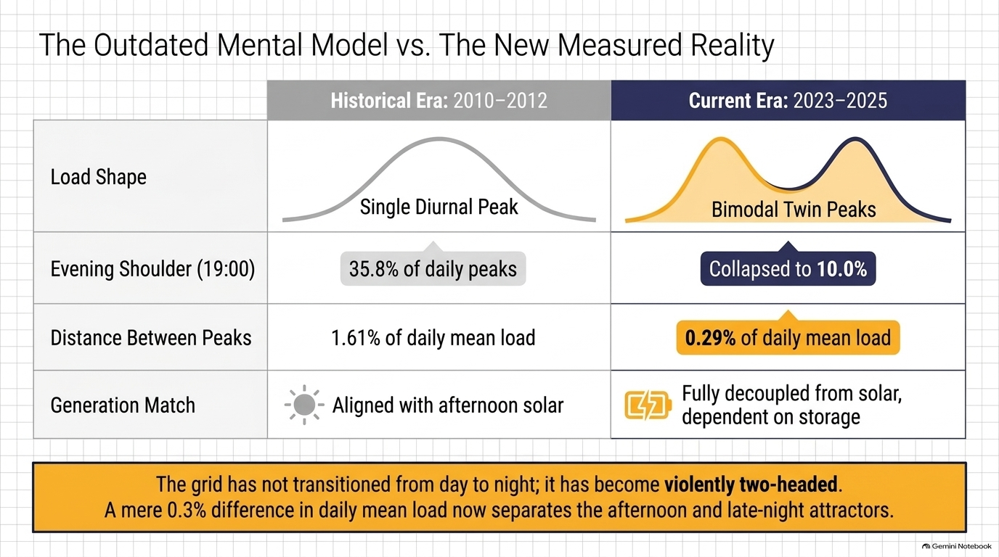
The Shift to Bimodal Demand
Two Eras Compared
After comparing the data from two eras, 2010–2012 and 2023–2025, we found:
The nocturnal share of the peak demand rose from 25.4% to 39.7%, compared across 642 days in each era.
The evening share dropped from 35.8% to 10.0% and dissolved into two main attractors at 3 pm and 11 pm.
Not a Single Shift, but a Bimodal Transformation
Delhi’s daily peak did not simply move from afternoon to night. The afternoon mode (15:00 IST) actually expanded from 36.6% to 43.3% of cooling-season days. The shift was caused by the dissolution of the traditional 19:00 IST evening peak (dropping from 24.1% of days to just 1.6%).
From Diurnal to Bimodal: Measuring the Nocturnal Shift in Delhi’s Peak Electricity Demand from Daily Peak-Timing Records – Swastik Verma

Slide 9
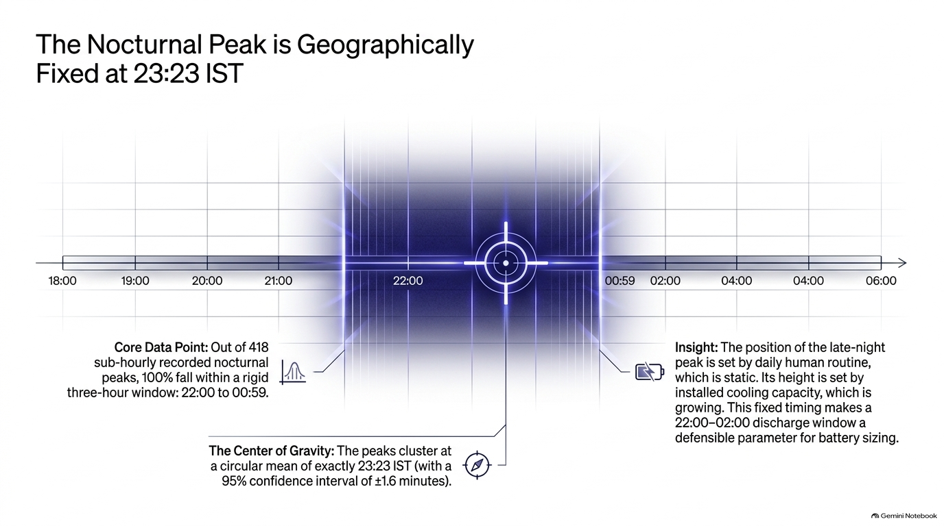
The Late-Night Peak Window
Mathematical Precision via Circular Statistics
Converting timestamps into angular vectors (θ = 2πt / 24) avoids midnight boundary errors.
Results:
Late-night peaks are centred on 23:23 IST, based on 1,448 nocturnal days.
The centre is known to ±1.6 minutes (95% confidence interval).
Individual peaks spread more: the typical spread is about 30 minutes either side of the centre.
Narrowing the Operational Window
Grid operators historically cited a loose window of 22:00 to 01:00 IST. Sub-hourly meter data narrows the upper bound: all 418 instrument-measured nocturnal peaks occur between 22:00 and 00:59 IST (narrowing the window by 1 hour).
From Diurnal to Bimodal: Measuring the Nocturnal Shift in Delhi’s Peak Electricity Demand from Daily Peak-Timing Records – Swastik Verma

Slide 10
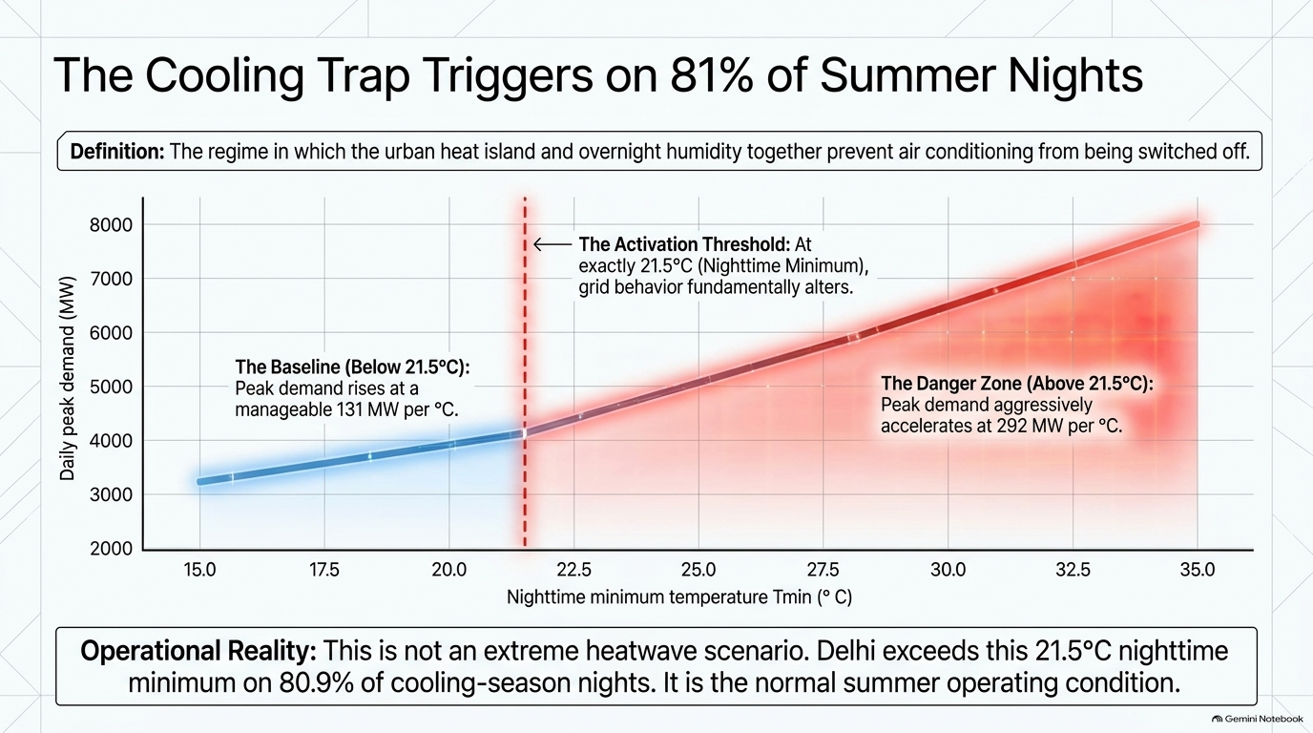
The “Cooling Trap” (21.5 °C Threshold)
The Cooling Trap Threshold.
We fitted a two-slope line to 2,743 cooling-season days. The slope changes at a night minimum of about 21.5 °C (95% interval 21.25 to 22.5 °C).
Below 21.5 °C, each extra degree adds about 131 MW.
Above 21.5 °C, each extra degree adds about 292 MW, 2.2 times more.
Possible explanation: nights stay too warm for fans, so air conditioners run all night.
Why It Matters for the Grid
The threshold is exceeded on 81% of cooling-season nights, so it is the normal summer condition, not a heatwave.
Above it, 55% of daily peaks fall at night, against 10% below it.
Sensitivity is growing: the slope above 21.5 °C rose from 140 MW per °C (2010 to 2012) to 353 (2023 to 2025).
From Diurnal to Bimodal: Measuring the Nocturnal Shift in Delhi’s Peak Electricity Demand from Daily Peak-Timing Records – Swastik Verma

Slide 11
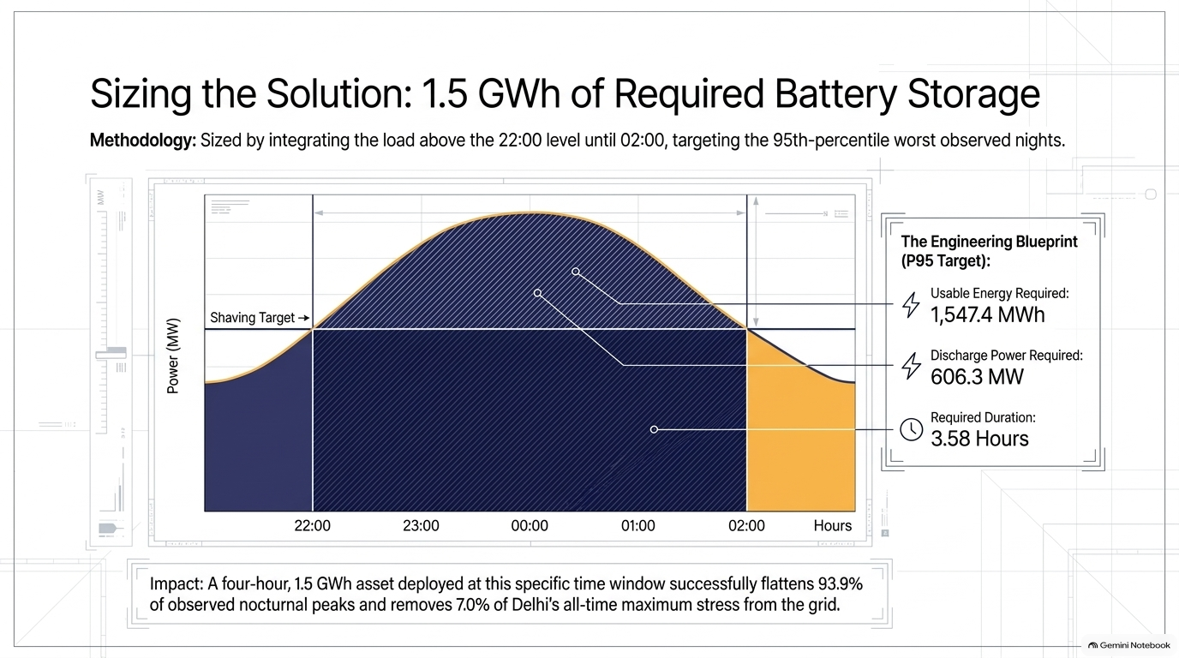
Battery Energy Storage (BESS) Sizing
Why Storage.
Solar can serve afternoon demand but not demand after sunset. The late-night peak falls between 22:00 and 00:59, when solar output is zero.
How We Sized It
We took the 229 cooling-season nights (2023 to 2025) whose peak fell at night.
For each night we measured the load above its 22:00 level until 02:00. That area is the energy to store, and the highest point is the power needed.
We designed for the 95th-percentile night, then added for battery losses (efficiency 0.88, depth of discharge 0.90).
Result
Usable energy: 1,225.5 MWh. Installed: 1,547.4 MWh.
Power: 606.3 MW, which is 7.0% of the all-time peak demand.
It fully flattens 93.9% of the 229 nights.
Treat as a minimum. Reserve margin, battery ageing and charging are not included.
From Diurnal to Bimodal: Measuring the Nocturnal Shift in Delhi’s Peak Electricity Demand from Daily Peak-Timing Records – Swastik Verma

Slide 12
Limitations
Monthly peak model
It under-predicts the highest peaks: all 10 held-out annual maxima, by 143 to 981 MW.
The error band is wide: the empirical 95% interval is −698 to +783 MW.
Weather adds little at monthly level (R² +0.0095). It is a baseline, not a peak finder.
Data
Weather is daily and city-wide. Most of 2013 to 2022 has only daily peaks.
Past peaks reflect demand met, which load shedding capped.
Cooling Trap and battery
The 21.5 °C threshold partly reflects the season. Within May to September it moves to about 27.5 °C. The fan to air conditioning cause is not tested.
The battery size uses 229 nights (2023 to 2025) and one target level. It leaves out reserve margin, ageing and charging, so it is a minimum.
Only April to October is modelled. Winter is not.
From Diurnal to Bimodal: Measuring the Nocturnal Shift in Delhi’s Peak Electricity Demand from Daily Peak-Timing Records – Swastik Verma

Slide 13
Future Scope
Goal: predict the peak’s month, day and clock time, with a probability for each, using neural networks on long, fine-grained data.
Build the dataset
Collect 5 to 15 minute Delhi load for 2010 to 2025.
Collect hourly weather for the same years, from several stations across Delhi NCR.
Add meaningful variables
Weather: hourly temperature, dew point, wet-bulb temperature and heat index at 22:00 to 00:00, cloud cover, solar radiation, wind and rain.
Heat memory: number of consecutive hot days and nights, and heat over the last 3 to 5 days.
Calendar: holidays, festivals, school vacations, wedding season, elections and big events.
Load history: yesterday’s load at the same time, and last week’s. In our test, yesterday’s peak alone raised daily R² from 0.85 to 0.95.
Demand drivers: air conditioner stock, population and economic activity, rooftop solar, EV charging.
Grid data: load shedding and outages (to know the real demand), solar output, and electricity prices.
From Diurnal to Bimodal: Measuring the Nocturnal Shift in Delhi’s Peak Electricity Demand from Daily Peak-Timing Records – Swastik Verma

Slide 14
Future Scope (continued)
Build the model
A sequence network (LSTM, GRU or Transformer) reads the last 7 days of load and weather. It predicts the next 24 hours of load every 15 minutes.
The peak size and time come from that predicted curve.
Quantile outputs give an upper bound, to fix the under-prediction of peaks.
Test it honestly
Test year by year, always predicting later years from earlier ones.
Beat our Ridge and gradient boosting baselines.
Report peak error in MW, how often the peak time is within 30 minutes, and the afternoon-or-night call.
Use it
Use the forecasts to schedule battery charging and discharging, and update the battery size with reserve and ageing.
From Diurnal to Bimodal: Measuring the Nocturnal Shift in Delhi’s Peak Electricity Demand from Daily Peak-Timing Records – Swastik Verma

Slide 15
Thank You
Swastik verma
onamverma8@gmail.com

