Slide 1
Tables observed
tbl_ab_subsmaster (accnt-scheme wise data)
tbl_customeroneview (demographic-behavioural data)
ab_subsmaster_history_daily (daily transaction data)

Slide 2
Prepared DataSet Fields
NewMark (Mark of repetition)
Accode (acct code)
Schemerefno (scheme ref. no.)
Monthly (Month and Year)
Ab_consumed (Monthly ab consumed)
no_of_transaction
monthly_per_ab_del (%age of ab_del)
monthly_ab_del (amt of ab_del)
monthly_per_ab_id (%age of ab_id
monthly_ab_id (amt of ab_id)
monthly_per_ab_fut (%age of ab_fut)
monthly_ab_fut (amt of ab_fut)
monthly_per_ab_opt (%age of ab_opt)
monthly_ab_opt (amt of ab_opt)
Mark10 (weather 10% completed)
Mark25 (weather 25% completed)
Mark50 (weather 50% completed)
Mark75 (weather 75% completed)
Mark100 (weather 100% completed)
Mark10t (number of transaction for 10%)
Mark25t (number of transaction for 25%)
Mark50t (number of transaction for 50%)
Mark100t (number of transaction for 100%)
no_of_schemes (No. Of schemes taken)
Tenure (duration between acct creation & month)
Behaviour
Free Period
Ab_excess (Excess of ab consumed)

Slide 3
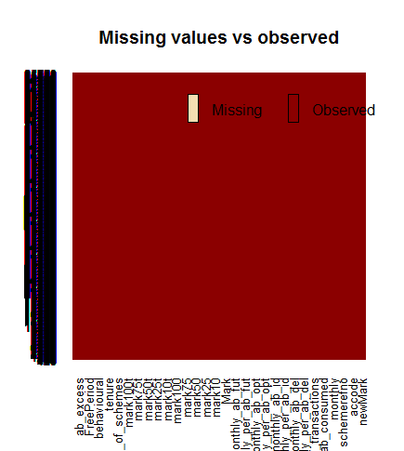
Summary of DataSet
Total 1,14,433 rows with 30 columns
No NA/NULL values
Total 0's in NewMark -> 80436
Total 1's in NewMark -> 33997
If some value is never reached, negative value is assigned

Slide 4
Model
Dependent Variable – NewMark
Independent Variables – Ab_consumed, no_of_transaction, monthly_per_ab_del, monthly_per_ab_id, monthly_per_ab_opt, monthly_per_ab_fut, Mark10, Mark50, Mark75, Mark100, Mark10t, Mark50t, Mark75t, Mark100t, no_of_schemes, Tenure, Behaviour, Free Period, Ab_excess
After feature extraction Important Variables Found. (LR P sq value & Anova)
Important Variables – no_of_transactions, monthly_per_ab_del, monthly_per_ab_id, monthly_per_ab_opt, monthly_per_ab_fut,mark25, mark50, mark75, mark100, mark100t, ab_excess
It is a case of binary classification

Slide 5
Steps Performed
Feature Extraction
Subsetting Important Variables
Normalization/Scaling of every Variable except NewMark (dependent variable)
Divide data in 70-30% for train and test data respectively
The train data contains 50-50% of both 0's and 1's case
Trained different models with this train data (Logistic Reg, KNN, Decision Tree, Random Forest)
Tested with test data and accuracy noted

Slide 6
Results
Random Forest performed with the best accuracy in this case.
Number of trees = 500
Accuracy -> 75~%
Predicted 0 1
0 26333 3594
1 8852 11221

