Slide 1


SECOND REVIEW
PneumoCare : Pneumonia Classification Using Chest X-Ray Images
Healthcare Analytics
Student Name & Registration Number & Section :
Swastika Chowdhury (RA2312704010019) – AP2
Abhijeet Pandey (RA2312704010020) – AP2
Notes:
Problem: pneumonia diagnosis relies partly on chest X-ray interpretation. Aim: build a binary classifier with transfer learning and report its results honestly. Users: this is for learning and demonstration by students and faculty, not clinicians. Objectives: (1) train and evaluate the classifier with a clean train/validation/test protocol; (2) explain predictions with Grad-CAM while being clear about its limits; (3) implement all fifteen tutorials as working modules; (4) keep the data domains separate and label synthetic data; (5) verify every tutorial workflow end to end through the API.

Slide 2


Project overview
PROJECT OBJECTIVES
Problem
1
Train and evaluate a ResNet-18 transfer-learning classifier, with the test set used only once
Pneumonia is a common respiratory infection that is diagnosed partly from chest X-rays, which need expert reading.
2
Explain predictions with Grad-CAM and state openly what it does and does not show
Aim
Classify paediatric chest X-rays as NORMAL or PNEUMONIA with transfer learning, and report honest, audited metrics.
3
Implement Tutorials T1–T15 as working, tested modules in one application
4
Keep imaging, EHR, text and survey data separate, and label synthetic data clearly
Intended users
Healthcare Analytics students and faculty exploring methods. It is an educational prototype, not for clinical use.
5
Verify every tutorial workflow through the live API with real datasets
Notes:
Problem: pneumonia diagnosis relies partly on chest X-ray interpretation. Aim: build a binary classifier with transfer learning and report its results honestly. Users: this is for learning and demonstration by students and faculty, not clinicians. Objectives: (1) train and evaluate the classifier with a clean train/validation/test protocol; (2) explain predictions with Grad-CAM while being clear about its limits; (3) implement all fifteen tutorials as working modules; (4) keep the data domains separate and label synthetic data; (5) verify every tutorial workflow end to end through the API.

Slide 3
Progress since Review 1
REVIEW 1 · DATA PIPELINE
REVIEW 2 · NOW
Problem definition and objectives
Data pipeline: loading, splits, 224×224 resize, augmentation, weighted sampling, sanity checks
Class-imbalance observation
Tutorials T1–T6 as separate exercises
No trained model or results yet
Model
ResNet-18 trained (6 epochs, ~39 min CPU); test ROC-AUC 0.994; audit 9/9
App
React + FastAPI + SQLite: 12 pages, 8 API routers, analysis history, CSV/JSON/PDF reports
Tutorials
All 15 implemented in the app; 15/15 verified through the live API (64/64 checks)
Quality
85 backend + 15 frontend tests, lint and type check clean
Audit
Run counts, dataset switching and Grad-CAM claims corrected; segmentation rebuilt; model inventory
Notes:
Review 1 established the data pipeline and covered T1–T6 as separate exercises, with no trained model. Since then we built the complete application. Important correction: the Review 1 slides mentioned a private hospital dataset and Apple M3 hardware. The current, verified project trains on the public PneumoniaMNIST dataset (the same Kermany et al. images as the Kaggle set, resized to 224×224) on a CPU-only laptop. Kaggle data was not used because it needs credentials. Review 1 also reported Kaggle class counts (1,341 normal / 3,875 pneumonia); our current training split is 1,214 / 3,494. Now: the model is trained and independently audited; the application has 12 pages and 8 API routers; all 15 tutorials are verified through the live API with 64 of 64 checks passing; 85 backend and 15 frontend tests pass. An audit corrected misleading run counts, removed an unsupported Grad-CAM claim, replaced a k-means 'segmentation' with a classical lung-field method, and produced a full model inventory.

Slide 4
System architecture
Browser UI
Vite proxy → FastAPI
API routes (8)
Reports
React 18 · TypeScript · Vite · Tailwind · Recharts. 12 pages, URL-addressable tabs
/api/* JSON and multipart uploads; one error envelope {error: {code, message}}
system · screening · ehr · imaging · text · operations · analytics · reports
CSV · JSON · PDF export of stored results
SQLite (metadata only)
Services (analytics)
ML pipeline (PyTorch)
analysis_runs · predictions · uploaded_datasets. Drives dashboard progress and history
pandas · scikit-learn · SciPy · spaCy · OpenCV. One module per tutorial group; used by API, tests and scripts
data · model · train · evaluate · Grad-CAM · inference. Scripts train; the API only loads the checkpoint
Files on disk
data/raw (5 required datasets with SHA-256 manifests) · data/sample (8 demo test X-rays) · models/ (checkpoints, metrics JSON, plots) · reports/ (verification evidence)
Notes:
The browser app talks only to /api; the Vite dev server proxies it to FastAPI, so there is one origin and no CORS setup. Routes are thin: they validate input, call a service, record the run in SQLite, and return JSON. All analysis lives in services (pandas, scikit-learn, SciPy, spaCy, OpenCV) and in the PyTorch ML pipeline. The pipeline is independent of the API: scripts train and evaluate; the API only loads the finished checkpoint and returns HTTP 409 if a model or dataset is missing. SQLite stores metadata only (analysis runs, predictions, uploads); images, datasets and checkpoints stay on disk. Availability is computed from files, never hard-coded.

Slide 5
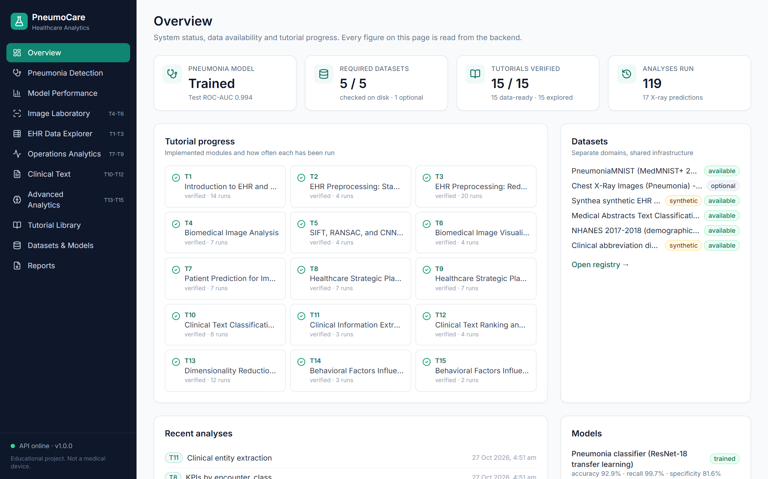
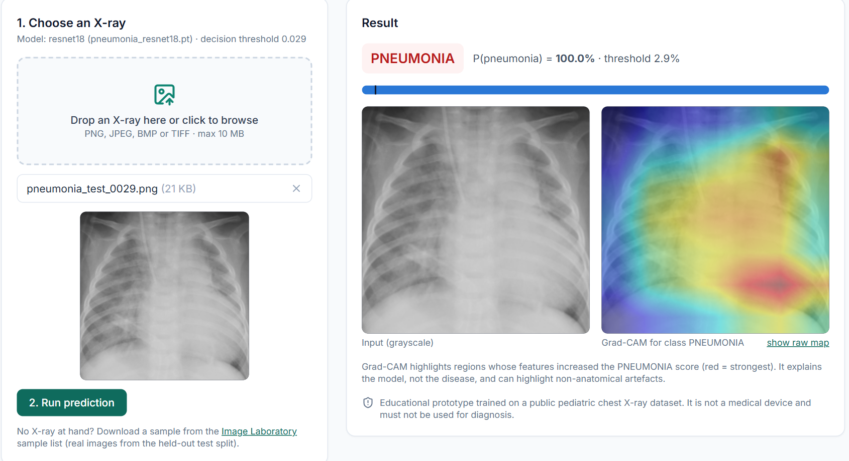
Application walkthrough
Pneumonia Detection: real test X-ray → P(pneumonia), threshold, Grad-CAM overlay. Grad-CAM shows where the model looked, not where disease is
Overview: system status, 5/5 required datasets, 15/15 tutorials verified, recent analyses
Notes:
Left: the Overview dashboard. Every number is read from the backend: model status with test ROC-AUC, required datasets available, tutorials verified, and recent analyses. Right: the Pneumonia Detection page after uploading a real test-split X-ray. It shows the label, P(pneumonia) against the decision threshold, and the Grad-CAM overlay, plus a prediction history. Emphasise the disclaimer banner on the page and that Grad-CAM explains the model's decision, not the location of disease. Other pages: Model Performance, Image Laboratory (T4–T6), EHR Data Explorer (T1–T3), Operations Analytics (T7–T9), Clinical Text (T10–T12), Advanced Analytics (T13–T15), Tutorial Library, Datasets & Models, Reports.

Slide 6
Dataset and preprocessing
PREPROCESSING (TRAIN | VAL / TEST / INFERENCE)
Grayscale → 3 channels
all splits
Resize 224×224
all splits
Random affine ±10°, ±5% shift, 0.9–1.1 scale
train only
Brightness / contrast jitter ±15%
train only
ImageNet mean/std normalisation
all splits
No horizontal flip (heart side must not change)
excluded
Real, de-identified paediatric X-rays (Kermany et al., 2018) via MedMNIST+, CC BY 4.0. Pneumonia share: 74.2% train/val, 62.5% test.
LEAKAGE CHECK (AVERAGE HASH + PIXEL CONFIRMATION)
8 exact train–validation duplicates removed from validation (val 524 → 516). 0 duplicates involving the test set, so test metrics are not inflated by leakage. MedMNIST has no patient IDs, so patient-level overlap cannot be checked.
Notes:
We use PneumoniaMNIST at 224×224 from MedMNIST+. These are the same paediatric images as the Kaggle 'Chest X-Ray Images (Pneumonia)' dataset (Kermany et al., 2018), resized and centre-cropped. Kaggle itself needs a login and was not installed; it is optional and only for an external check. Official splits: train 4,708 (1,214 normal / 3,494 pneumonia), validation 524, test 624 (234 / 390). Preprocessing: grayscale replicated to 3 channels to match ImageNet weights, resize, light affine and brightness/contrast augmentation for training only, ImageNet normalisation. Horizontal flips are deliberately not used because they would move the heart to the wrong side. Leakage: an average-hash check, confirmed pixel by pixel, found 8 exact train–validation duplicates, which are removed from validation, and none involving the test set.

Slide 7
Model methodology: ResNet-18 transfer learning
Chest X-ray (224×224)
ImageNet ResNet-18 backbone, all layers fine-tuned
Dropout 0.3 → Linear 512→2
Softmax: P(pneumonia)
Compare with threshold → label
Grad-CAM on layer4
Setting | Value
Loss | Cross-entropy, class weights (NORMAL 1.94, PNEUMONIA 0.67)
Optimiser | AdamW, lr 1e-4, weight decay 1e-4, cosine schedule
Batch / epochs | 32 / 6 (early stopping, patience 3 on validation ROC-AUC)
Model selection | Best validation ROC-AUC (epoch 6: 0.9983)
Threshold | Youden J on validation = 0.029 (chosen before testing)
Seed / hardware | 42 / CPU, 2,347 s (~39 min)
Validation ROC-AUC was already 0.996 after epoch 1; training loss keeps falling while validation loss stays flat.
Notes:
We use transfer learning: a ResNet-18 pretrained on ImageNet, with the final layer replaced by dropout 0.3 and a 512-to-2 linear layer, and all layers fine-tuned. ResNet-18 is small enough (11 million parameters) to train on a laptop CPU in under an hour. Training: cross-entropy with inverse-frequency class weights to handle the 74% pneumonia imbalance; AdamW with learning rate 1e-4 and cosine annealing; batch 32; 6 epochs with early stopping on validation ROC-AUC. The best epoch was 6 (validation AUC 0.9983). The decision threshold was chosen on the validation split with Youden's J statistic: 0.029. It was fixed before the test set was ever used. At inference, an uploaded image goes through exactly the test-time transform, the model outputs P(pneumonia), and Grad-CAM is computed from layer4.

Slide 8
Model evaluation on the official test set (624 images)
0.994
0.930
0.997
0.816
ROC-AUC: ranking quality across all thresholds
Accuracy at the validation threshold 0.029
Sensitivity at 0.029 (1 missed case)
Specificity at 0.029 (43 false alarms)
Metric | At 0.029 (validation) | At 0.5 (comparison)
Accuracy | 0.930 | 0.968
Precision (PPV) | 0.900 | 0.970
Recall / sensitivity | 0.997 | 0.979
Specificity | 0.816 | 0.949
F1-score | 0.947 | 0.974
ROC-AUC (threshold-free) | 0.994 | 0.994
At 0.029
At 0.5
191
43
222
12
TN
FP
TN
FP
1
389
8
382
FN
TP
FN
TP
Rows: actual NORMAL / PNEUMONIA · columns: predicted NORMAL / PNEUMONIA
Reading the results. ROC-AUC measures how well the model ranks pneumonia above normal, independent of any threshold; accuracy depends on the chosen threshold. The validation-chosen threshold transfers poorly to the test set, so specificity is low. We report 0.5 for comparison but did not switch to it: choosing a threshold on test data would leak test information.
Notes:
The official test set has 624 images: 390 pneumonia and 234 normal. It was used once, after training and threshold selection. ROC-AUC is 0.994. It measures ranking quality across all thresholds and does not depend on the operating point. Accuracy, precision, recall, specificity and F1 do depend on the threshold. At the validation-chosen threshold of 0.029: accuracy 0.930, sensitivity 0.997 (only 1 missed pneumonia), specificity 0.816 (43 false positives), F1 0.947. For comparison at 0.5: accuracy 0.968, specificity 0.949, sensitivity 0.979. The very low validation threshold does not transfer to the test folder, which was collected separately. We did not switch thresholds after seeing the test results, because that would be tuning on the test set. The proper fix is probability calibration or choosing the threshold on deployment-like validation data. An independent audit script recomputed every metric and both confusion matrices with plain NumPy and scikit-learn: 9 of 9 checks passed.

Slide 9
How the tutorials fit into PneumoCare
EHR Data Explorer
Biomedical Image Lab
Pneumonia Detection
T1 · T2 · T3
T4 · T5 · T6
Main project · T6 Grad-CAM
Synthea (synthetic EHR)
PneumoniaMNIST + trained model
PneumoniaMNIST
Operations Analytics
Clinical Text
Advanced Analytics
T7 · T8 · T9
T10 · T11 · T12
T13 · T14 · T15
Synthea encounters (synthetic)
Medical Abstracts (real) + synthetic notes
NHANES 2017–2018 (real survey)
SHARED BY EVERY TUTORIAL
One FastAPI backend · SQLite analysis history (dashboard progress) · Reports (CSV/JSON/PDF) · Tutorial Library with evidence-based “verified” status · common UI and chart components. Data domains are never merged.
Notes:
The fifteen tutorials are grouped into five workspaces plus the main pneumonia module. T1–T3 run in the EHR Data Explorer on synthetic Synthea records; T4–T6 in the Biomedical Image Lab on PneumoniaMNIST; T7–T9 in Operations Analytics; T10–T12 in Clinical Text; T13–T15 in Advanced Analytics. Note that in Review 1 the T1–T6 exercises used other datasets (for example UCI Cleveland and Pima); in the application they are re-implemented on the project's datasets. The modules share one backend, one analysis history that drives the dashboard, the reports service and the Tutorial Library. A tutorial is shown as 'verified' only when scripts/verify_tutorials.py has run its full workflow through the API and all checks passed. The data domains stay separate; they are not forced into one model.

Slide 10
T7 · Patient Prediction for Improved Healthcare Staffing
Forecast patient volume and translate it into a staffing (FTE) estimate
SYNTHETIC DATA
DATASET
Synthea encounters from 2016: 3,935 encounters, 101 patients, 129 monthly periods
WORKFLOW
INPUT
PROCESSING
OUTPUT
Monthly encounter counts
Lag + season features, time-ordered split, Ridge & random forest vs baselines
6-month forecast, workload hours, FTE
METHODS IMPLEMENTED
Lags 1–3, rolling mean, seasonal sin/cos, trend
Latest 20% of periods held out (no future leakage)
FTE = workload h ÷ (160 h × 85% utilisation)
ACTUAL RESULT
KEY LEARNING
IN PNEUMOCARE
Random forest MAE 5.71 vs naive 6.62 (MAPE 19%). Next month ≈ 39.5 encounters ≈ 0.15 FTE
No staffing labels exist, so forecast demand and convert it to workload instead
Operations Analytics → Volume & staffing
Notes:
Objective: forecast patient volume and turn it into a staffing estimate. Synthea has no staff rosters, so staff numbers cannot be predicted directly. Instead we predict patient volume, which has real labels, and convert it to workload hours using the median observed encounter duration (31 minutes) and then to full-time equivalents. Data: 3,935 synthetic encounters from 2016, aggregated to 129 months. Features: lags, rolling mean, seasonal sine/cosine and trend. The split is time-ordered: the latest periods are held out, because a random split would leak the future. Models: Ridge regression and a 300-tree random forest, compared with naive and moving-average baselines. Result on 26 held-out months: random forest MAE 5.71, Ridge 5.74, moving average 6.46, naive 6.62. The next-month forecast is about 39.5 encounters, which is only 0.15 FTE because the synthetic clinic is tiny. Limitation: 111 synthetic patients make the errors noisy; FTE is a planning estimate, not a roster.

Slide 11
T8 · Healthcare Strategic Planning Part 1
Compute healthcare KPIs, compare groups statistically and follow trends
SYNTHETIC DATA
3,935
$3,301
71.1%
5.0 d
DATASET
Synthea encounters joined with patients, payers and organisations (2016–2026)
encounters
avg claim cost
payer coverage
avg length of stay
WORKFLOW
INPUT
PROCESSING
OUTPUT
Encounters filtered by start year
KPIs, group-by, rank-based significance test
KPI cards, group charts, trend lines
METHODS IMPLEMENTED
Volume, cost, payer coverage, LOS, 30-day readmission, ED visits / 1,000
Group by class, year, gender, age, payer or organisation
Kruskal–Wallis H (Mann–Whitney U for 2 groups): costs are skewed
ACTUAL RESULT
KEY LEARNING
IN PNEUMOCARE
Cost differs strongly by class: Kruskal–Wallis H = 307.8, p = 8.9×10⁻⁶²; SNF and inpatient cost most
Skewed cost data need rank-based tests; significance is not practical importance
Operations Analytics → KPIs & comparisons
Notes:
Objective: compute healthcare KPIs, compare groups and follow trends. From 2016 the synthetic data contain 3,935 encounters for 101 patients, average claim cost $3,301, payer coverage 71.1%, 4.9% uninsured encounters, 39 inpatient admissions with an average length of stay of 5.0 days. The 30-day readmission rate is 0%, which is unstable with only 39 admissions. Claim costs are heavily right-skewed, so we use the rank-based Kruskal–Wallis test rather than ANOVA. Cost differs very strongly by encounter class (H = 307.8, p = 8.9 × 10^-62). The chart shows average cost per class with its encounter count; skilled nursing and inpatient stays are the most expensive, but hospice and virtual have only 2 and 6 encounters, so their averages are unreliable. Key learning: choose tests that match the data distribution, and remember that with large samples statistical significance does not imply practical importance.

Slide 12
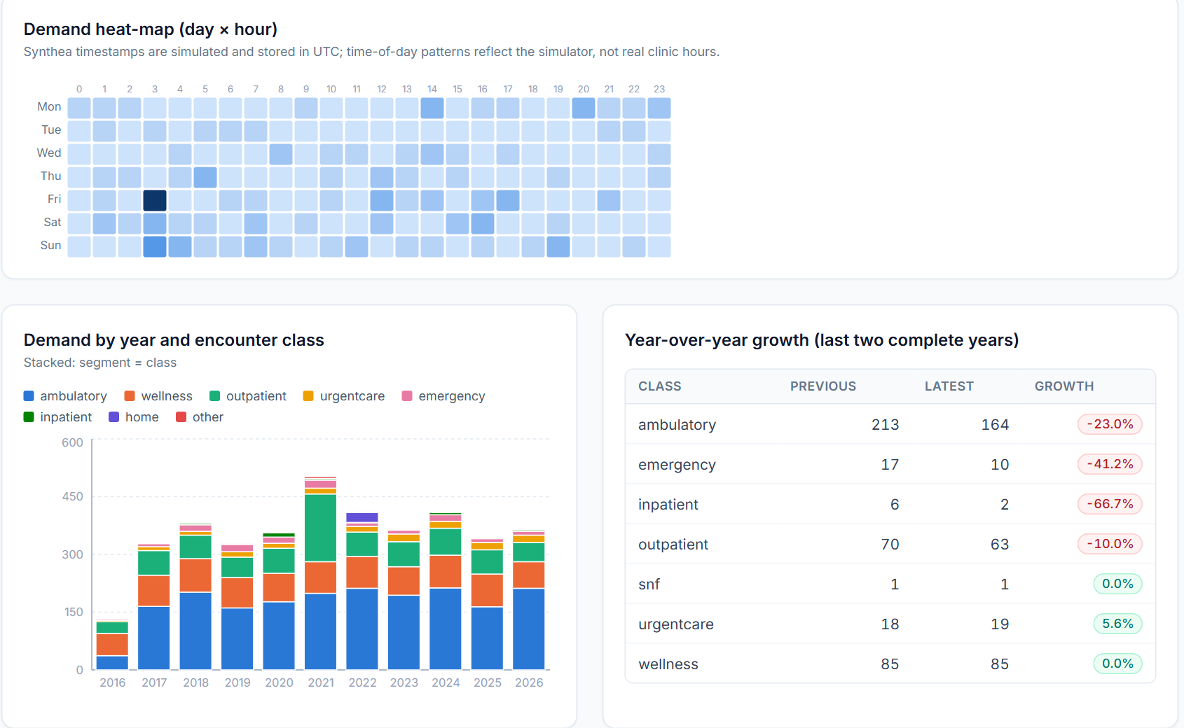
T9 · Healthcare Strategic Planning Part 2
Analyse demand patterns and resource utilisation, and compare what-if scenarios
SYNTHETIC DATA
DATASET
Synthea encounters (2016+); bed capacity is a user assumption (default 5 beds)
WORKFLOW
INPUT
PROCESSING
OUTPUT
Encounter timestamps and long stays
Day×hour crosstab, provider workload, bed occupancy, scenario formulas
Heat-map, utilisation charts, scenario table
METHODS IMPLEMENTED
Demand heat-map and demand by year and class
Bed utilisation = occupied bed-days ÷ (beds × days)
Scenarios: demand %, staff FTE → utilisation, unmet hours, FTE needed
ACTUAL RESULT
KEY LEARNING
IN PNEUMOCARE
Top 10 of 215 providers handle 25% of work. Demand +30% lifts utilisation 63.6% → 82.7%
Utilisation turns demand into capacity decisions; linear what-ifs ignore queues and variability
Operations Analytics → Utilisation & scenarios
Notes:
Objective: analyse demand patterns and resource use, and compare scenarios. The screenshot shows the day-by-hour demand heat-map and stacked demand by year and encounter class. Note that Synthea timestamps are simulated and stored in UTC, so the time-of-day pattern does not reflect real opening hours. Provider workload: 215 providers averaging 2.4 encounters per provider-year, with the busiest 10 handling 25% of the work. Ambulatory visits fell 23% between the last two complete years. Bed utilisation uses a user-set capacity. Scenario analysis: with current staffing of 0.2 FTE, utilisation is 63.6%; a 30% demand increase raises it to 82.7%, and adding staff (0.3 FTE) brings it back to 55.1%. The verification checks that doubling demand exactly doubles utilisation. Limitation: the scenarios are linear and deterministic, with no queueing or variability.

Slide 13
T10 · Clinical Text Classification and Clustering
Preprocess clinical text, classify it with supervised models, and find structure by clustering
REAL DATA
DATASET
Medical Abstracts TC Corpus: 11,550 train / 2,888 test abstracts, 5 disease classes
WORKFLOW
INPUT
PROCESSING
OUTPUT
Abstract text
spaCy tokenise + lemmatise → TF-IDF → classifiers; SVD + k-means
Predictions, metrics, clusters
METHODS IMPLEMENTED
TF-IDF: unigrams + bigrams, sublinear TF, min_df 2
Logistic regression, linear SVM, Complement Naive Bayes
Truncated SVD (100-d) → k-means; silhouette, ARI, NMI, purity
ACTUAL RESULT
KEY LEARNING
IN PNEUMOCARE
Best: Complement NB accuracy 0.586, macro-F1 0.578 (chance ≈ 0.23). k = 5 clusters: NMI 0.108
Macro-F1 weights every class equally; overlapping classes cap accuracy
Clinical Text → Classification / Clustering
Notes:
Objective: preprocess clinical text, classify it, and explore it with clustering. Data: the Medical Abstracts corpus, real published abstracts in five classes. These are research abstracts, not clinical notes. Preprocessing uses spaCy tokenisation, stop-word removal and lemmatisation, then TF-IDF features. Three linear classifiers were trained on the official training split and evaluated once on the test split. Complement Naive Bayes is best with accuracy 0.586 and macro-F1 0.578; linear SVM 0.511; logistic regression 0.499. Chance is about 0.23. The 'general pathological conditions' class overlaps all others, and published baselines for this corpus are also around 0.6. Hyperparameters are defaults and not tuned; tuning must use cross-validation on training data. Clustering with k = 5 gives silhouette 0.031 and NMI 0.108: clusters capture themes like oncology or cardiology rather than the official labels.

Slide 14
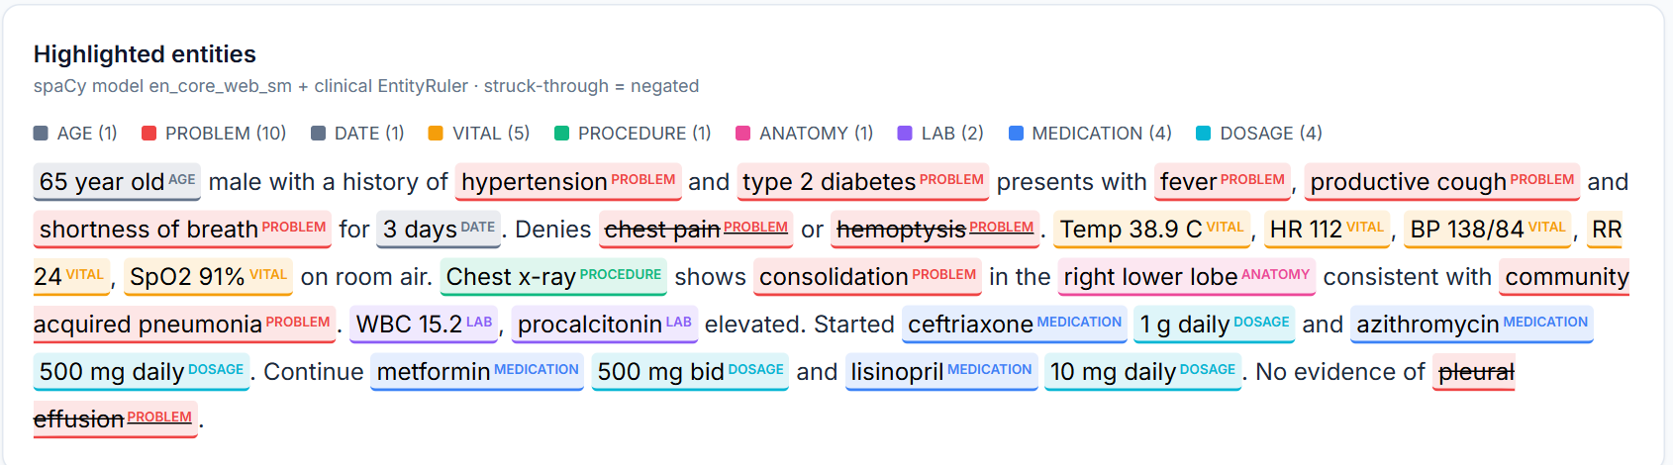
T11 · Clinical Information Extraction and Entity Recognition
Extract problems, medications with doses, vitals, labs and procedures from free text, including negation
REAL + SYNTHETIC
DATASET
3 synthetic notes written for the project; 200 Medical Abstracts for corpus statistics
WORKFLOW
INPUT
PROCESSING
OUTPUT
Clinical note
spaCy en_core_web_sm + clinical EntityRuler + negation rules
Highlighted entities + structured JSON
Negated | chest pain, hemoptysis, pleural effusion
Medications | ceftriaxone 1 g daily · azithromycin 500 mg daily · metformin 500 mg bid · lisinopril 10 mg daily
Vitals | Temp 38.9 C · HR 112 · BP 138/84 · RR 24 · SpO2 91%
METHODS IMPLEMENTED
Statistical NER plus a rule lexicon (~80 problems, 44 medications)
Token patterns for dosage, vitals, lab values, age
NegEx-style negation (6-token window); history and family flags
ACTUAL RESULT
KEY LEARNING
IN PNEUMOCARE
ED note: 29 entities; 3 negations correct; all 4 medications linked to doses; 5 vitals extracted
General NER misses clinical concepts; rules + negation context turn notes into structured data
Clinical Text → Entity extraction
Notes:
Objective: turn free-text notes into structured data. The pipeline runs spaCy's general English model en_core_web_sm and adds our clinical EntityRuler: a hand-made lexicon of about 80 problems, 44 medications, 23 labs and 20 procedures, plus token patterns for doses, vitals, lab values and age. Negation is NegEx-style: a trigger such as 'denies' or 'no' within six preceding tokens of the same sentence negates a problem unless a terminator like 'but' intervenes. We also flag historical and family-history mentions. On the synthetic emergency-department note: 29 entities; chest pain, hemoptysis and pleural effusion are correctly negated; hypertension and diabetes are flagged as history; all four medications are linked to their doses; five vitals are extracted. Limitations: the lexicon is small, the negation rules miss complex cases, and the specialised scispaCy clinical model is not installed.

Slide 15
T12 · Clinical Text Ranking and Word Disambiguation
Rank documents by relevance to a query, and resolve ambiguous clinical abbreviations from context
REAL + SYNTHETIC
DATASET
Ranking: 11,550 Medical Abstracts (real). WSD: 43 hand-written labelled sentences, 6 abbreviations
WORKFLOW
INPUT
PROCESSING
OUTPUT
Query, or a sentence with an abbreviation
TF-IDF cosine & BM25; simplified Lesk overlap
Ranked list, P@10 / MAP; chosen sense
METHODS IMPLEMENTED
Vector space model (cosine) and BM25 (k1 1.5, b 0.75)
200 test titles as queries; same label = relevant (proxy)
Simplified Lesk: gloss, gloss + corpus, corpus-only signatures
ACTUAL RESULT
KEY LEARNING
IN PNEUMOCARE
BM25 P@10 0.457 vs random 0.232. Corpus-only Lesk 0.58 vs 0.42 (*gloss 1.00 is optimistic)
Retrieval needs an evaluation protocol; disambiguation depends on context words
Clinical Text → Ranking & disambiguation
Notes:
Two demonstrations. Ranking: documents and queries become TF-IDF vectors scored by cosine similarity, or are scored with BM25, which saturates term frequency and normalises for document length. Evaluation: 200 held-out abstract titles are used as queries, and a retrieved training abstract counts as relevant if it has the same disease label, which is a proxy for real relevance. BM25 reaches precision@10 0.457 and TF-IDF 0.438, versus 0.232 for random. Disambiguation: abbreviations such as MS, RA and PE have several senses. Simplified Lesk picks the sense whose signature overlaps most with the sentence context. On 43 hand-written labelled sentences, the corpus-only signatures reach 0.58 against a first-sense baseline of 0.42. The gloss-based variants score 1.00, but that is optimistic because the same person wrote the glosses and the test sentences. Be explicit about this.

Slide 16
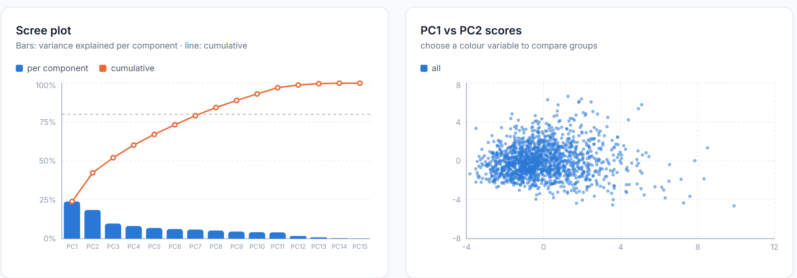
T13 · Dimensionality Reduction for EDA
Reduce many correlated variables to a few components and use them for exploratory analysis
REAL DATA
DATASET
NHANES 2017–2018 adults: 15 numeric variables, n = 5,120 (also the Synthea patient profile)
WORKFLOW
INPUT
PROCESSING
OUTPUT
Numeric features
Median impute → z-score → PCA
Scree, loadings, 2-D/3-D scores, correlation map
PC1 · diet quantity
PC2 · body size
PC3 · activity vs age
METHODS IMPLEMENTED
energy +0.49, fat +0.45, protein +0.42
waist, BMI, weight ≈ +0.54
activity +0.56, age −0.47, sedentary −0.34
Scaling compared: z-score, min-max, centring only
Explained variance and cumulative curve (80% line)
Loadings interpret components; scores coloured by group
ACTUAL RESULT
KEY LEARNING
IN PNEUMOCARE
8 of 15 components explain 80%. PC1 holds 76% of variance unscaled vs 24% scaled
Scale before PCA; components summarise correlation and are not causes
Advanced Analytics → PCA & EDA
Notes:
Objective: reduce many correlated variables to a few components for exploration. Data: real NHANES 2017–2018 adults, 15 numeric variables, 5,120 people. PCA maximises variance, so unscaled variables with large units such as kilocalories dominate. Without scaling, PC1 explains 76% of the variance; with z-scores it explains 24%, which is why scaling matters. After standardisation, 8 of 15 components are needed for 80% of the variance. The loadings give meaning: PC1 is overall diet quantity (energy, fat, protein), PC2 is body size (waist, BMI, weight), PC3 contrasts physical activity with age and sedentary time. The app also shows 2-D and rotatable 3-D score plots and a correlation heat-map, and runs on the Synthea patient profile as a second dataset. Limitations: PCA is linear and sensitive to outliers; median imputation shrinks variance; components are not causal factors.

Slide 17
T14 · Behavioral Factors Influencing Adult Weight Part 1
Describe adult BMI and lifestyle factors and how they relate
REAL DATA
42.5%
41.8%
DATASET
NHANES 2017–2018: 7 files merged on SEQN; adults ≥ 20, not pregnant, BMI measured (n = 5,120)
obesity, survey-weighted (CDC ≈ 42%)
obesity, unweighted sample
WORKFLOW
INPUT
PROCESSING
OUTPUT
7 NHANES survey files
Merge, recode survey codes, derive activity, alcohol, smoking
BMI categories, weighted prevalence, correlations, tests
METHODS IMPLEMENTED
Codes 7/9/77/99/… recoded as missing; vigorous minutes ×2
WHO BMI categories; survey weight WTMEC2YR
Spearman correlation; Kruskal–Wallis across groups
ACTUAL RESULT
KEY LEARNING
IN PNEUMOCARE
Weighted obesity 42.5% (CDC ≈ 42%). Top correlate: sedentary time ρ = +0.10; inactive BMI 30.3 vs 29.6
Survey data need recoding and weights; correlations here are weak and not causal
Advanced Analytics → Adult weight: exploration
Notes:
Objective: describe adult BMI and lifestyle factors. Data: seven real NHANES 2017–2018 files merged on the participant ID, restricted to non-pregnant adults aged 20 or over with measured BMI: 5,120 people. NHANES uses codes like 7, 9, 77 and 99 for refused or don't know; these become missing. Activity is converted to moderate-equivalent minutes per week with vigorous minutes counted double; alcohol to drinks per week; smoking to never, former or current. Using the exam weight WTMEC2YR, the population obesity prevalence is 42.5%, which matches the CDC's published estimate of about 42% for 2017–2018, a useful check that the recoding is right. Correlations with BMI are all weak: sedentary time +0.10, alcohol −0.09, fibre −0.07, sleep −0.06. Mean BMI is 30.3 for inactive adults and 29.6 for those meeting the activity guideline (Kruskal–Wallis p = 0.008). Limitations: cross-sectional, self-reported, single-day diet recall, and no design-based standard errors.

Slide 18
T15 · Behavioral Factors Influencing Adult Weight Part 2
Model BMI (regression) and obesity (classification) from behavioural and demographic factors
REAL DATA
DATASET
NHANES adults from T14 (n = 5,120): 11 numeric + 4 categorical predictors; 80/20 split
WORKFLOW
INPUT
PROCESSING
OUTPUT
Lifestyle and demographic predictors
Impute, scale, one-hot; 4 models; 5-fold CV
Metrics, importance, coefficients, odds ratios
METHODS IMPLEMENTED
Weight, height, waist excluded (BMI leakage)
Linear regression & random forest (BMI); logistic & RF (obese)
Permutation importance, coefficients, odds ratios
ACTUAL RESULT
KEY LEARNING
IN PNEUMOCARE
RF R² 0.115 (CV 0.100); obesity AUC 0.699, accuracy 0.650 vs majority 0.582
Lifestyle factors explain ~10% of BMI variation: associated, but weak individual predictors
Advanced Analytics → Adult weight: models
Notes:
Objective: model BMI and obesity from behaviour and demographics, evaluate the models honestly and interpret them. Weight, height and waist are excluded because BMI is computed from weight and height and waist is almost a proxy: including them would leak the target. The pipeline imputes, standardises numeric and one-hot encodes categorical features; an 80/20 stratified split with 5-fold cross-validation on the training part. Regression: random forest R² 0.115 (cross-validated 0.100 ± 0.013), linear 0.091, mean baseline about 0. Classification of obesity (BMI ≥ 30): random forest ROC-AUC 0.699 and accuracy 0.650 against a majority baseline of 0.582; logistic regression AUC 0.670. Permutation importance ranks race/ethnicity, age, sedentary time, alcohol and sex highest. Race/ethnicity reflects social and structural factors, not biology. Conclusion: these lifestyle factors explain only about 10% of BMI variation; they are associated with weight but weak individual predictors. Survey weights are not used in fitting, so results describe the sample.

Slide 19

Testing and verification
85
15
15/15
backend tests passed (pytest)
frontend tests passed (Vitest + RTL)
tutorials verified via live API (64/64 checks)
9/9
46/46
0
independent model-audit checks
live API contract checks: errors, uploads, 24 exports
lint (ruff) and type-check (tsc) errors; build OK
WHAT THE VERIFICATION ACTUALLY CHECKS
Each tutorial's workflow runs on its intended dataset through the API, and outputs are checked (e.g. best model = lowest MAE, variance sums to 1)
Model metrics recomputed with plain NumPy/scikit-learn, independent of the project's metric code
Every page and button was clicked through in a scripted browser walkthrough (28 Oct); there is no automated browser test suite, and no load or security testing
Notes:
Latest counts: 85 backend tests pass (82 before the 28 October segmentation change, which added 3), 15 frontend tests pass, ruff and the TypeScript type check report no errors, and the production build succeeds. Tutorial verification runs every tutorial workflow through the live API on its real dataset and checks the outputs, not just that a page loads: 15 of 15 tutorials, 64 of 64 checks. The model audit recomputes all test metrics independently: 9 of 9. The live API contract check (error envelope, upload validation, all 24 exports) passed 46 of 46, re-run on 28 October. A browser walkthrough of every page, tab, action button and export showed no console errors or failed requests. Be honest about gaps: there are no browser-driven end-to-end tests of button-triggered workflows, and no load or security testing.

Slide 20





Limitations and critical observations
Grad-CAM does not localise to the lungs
Threshold does not transfer
On 156 test images, Grad-CAM mass inside the lung fields (0.304) ≈ their area share (0.316). The model may use non-lung cues.
Validation threshold 0.029 gives specificity 0.816 on test (0.949 at 0.5). Needs calibration, never test-set tuning.
Dataset scope
Small or synthetic data
Paediatric images only, down-sampled; no external validation; no patient-level leakage check for MedMNIST.
Synthea operations data have 111 patients; WSD and NER notes are hand-written and synthetic.
Classical segmentation
Text and survey models
T4 lung-field segmentation has no ground truth and misses consolidated lung; checked only for plausibility.
Abstracts are not clinical notes; scispaCy not installed; T10 untuned; T14–T15 lack survey-design errors.
Notes:
The two most important limitations concern the main model. First, Grad-CAM: on 156 test images with plausible lung masks, the share of Grad-CAM mass inside the lungs (0.304) is about the same as the lungs' share of the image (0.316), so the heat-maps do not concentrate on the lungs. The model may be using cues outside the lungs, which is a known risk with this dataset. We therefore do not present Grad-CAM as proof of correct reasoning. Second, the validation-chosen threshold transfers poorly to the test set. Other limitations: paediatric, down-sampled images with no external validation; small or synthetic data for operations and some text tasks; the T4 lung segmentation is classical with no ground truth and misses consolidated lung; research abstracts are not clinical notes; the clinical NER model scispaCy is not installed; T10 hyperparameters are untuned; and the NHANES analyses lack design-based standard errors.

Slide 21
Future improvements (prioritised)
1
Calibrate probabilities
Temperature scaling or threshold selection on deployment-like validation data; report calibration curves
2
Test where the model looks
Validated lung masks (a pretrained anatomical model checked against ground truth) and lung-cropped training
3
External validation
An independent dataset from a different population; the Kaggle copy is the same patients at higher resolution
4
Browser end-to-end tests
Playwright tests for upload, training and Image Lab workflows
5
Stronger text models
Install scispaCy clinical NER; tune T10 with cross-validation on training data only
6
Survey-correct statistics
Design-based standard errors and weighted models for T14–T15
Notes:
Priorities follow from the limitations. One: calibrate the classifier's probabilities, for example with temperature scaling, or select the threshold on validation data that resembles deployment, and report calibration curves. Two: test where the model looks, using validated lung masks, and consider training on lung-cropped images. Three: external validation on an independent population; the Kaggle copy contains the same patients at higher resolution, so it is not independent. Four: browser-driven end-to-end tests with Playwright. Five: install the scispaCy clinical NER model and tune the text classifiers with cross-validation on the training set only. Six: survey-correct standard errors and weighted models for the NHANES tutorials.

