Slide 1
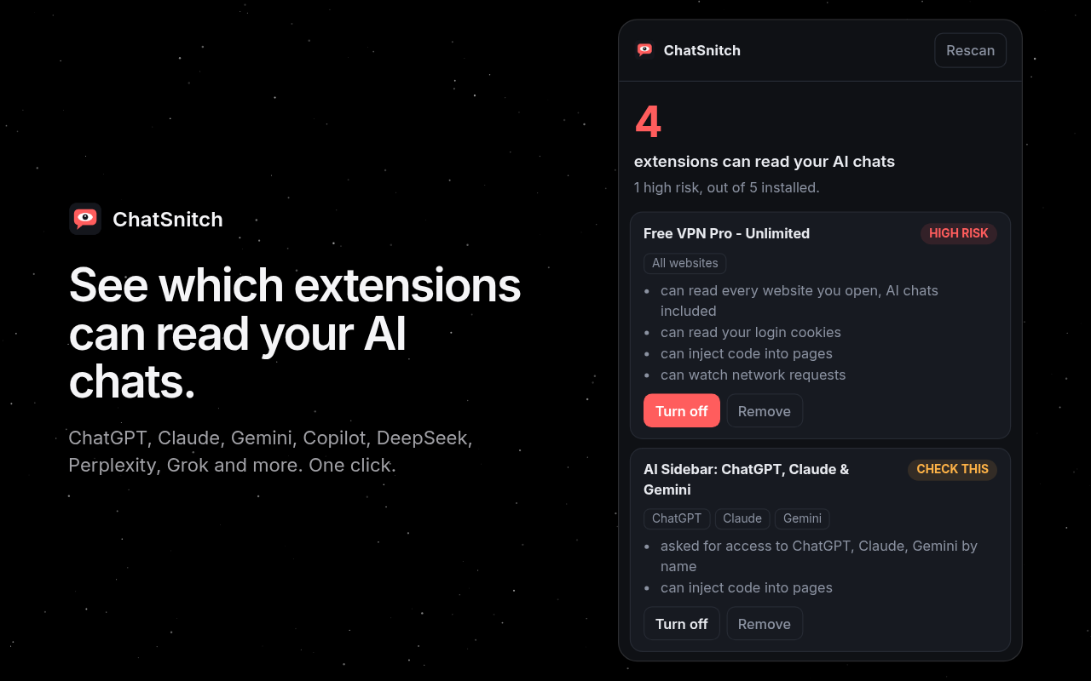
SHORT PITCH
ChatSnitch
See which Chrome extensions can read your AI chats
Free
Open source
1 permission
Swastik · github.com/Swastikkkkk/chatsnitch
Notes:
ChatSnitch tells you, in one click, which of your Chrome extensions can read your AI chats.

Slide 2
Extensions caught reading chats
900K
8M+
470K+
users hit by two fake AI extensions, one with Google's Featured badge
installs of Urban VPN and 7 sister extensions that auto-updated into chat capture
users of extensions caught spying on eight AI chat sites
Dec 2025
Dec 2025
Jun 2026
The advice is "check your permissions". That is minutes per extension, and most people have twenty.
ChatSnitch · 2/6
Notes:
Every report ends with 'review your extension permissions'. Nobody does, because it takes minutes per extension and most people have twenty.

Slide 3
One click. Plain answers.
1
A count
of extensions that can see your AI chats right now
2
A risk level
High risk, check this, or low, for each one
3
Reasons in plain words
reads every site, reads your cookies, injects code, watches traffic
4
Turn off or Remove
right in the popup, and turn back on if you change your mind
Covers ChatGPT, Claude, Gemini, Copilot, DeepSeek, Perplexity, Grok, Meta AI, Mistral and Poe.
ChatSnitch · 3/6
Notes:
One click. A count, a risk level per extension, plain-word reasons, and a Turn off button right there.

Slide 4
How it decides
1
2
3
Collect access
Match AI sites
Score
Reads host permissions from chrome.management, plus content-script access parsed from Chrome's own permission warnings, in any UI language.
Checks Chrome match patterns against each AI chat domain. Errs toward flagging.
Named AI domains outrank "all sites". Cookies, webRequest, scripting, debugger, clipboard and sideloading each add risk.
High risk
Check this
Low
ChatSnitch · 4/6
Notes:
The scoring is about 160 lines in extension/analyze.js. Named AI domains score higher than all sites, because a sidebar asking for chatgpt.com by name is the stealer pattern.

Slide 5
The most boring extension
1
Only management: lists extensions and can turn them off.
0
It can't read any page, your chats included.
permission
site access
0
connect-src 'none'. It can't phone home.
<300
Plain JavaScript, no build step. Read it first.
network
lines of JS
ChatSnitch · 5/6
Notes:
An extension that inspects your extensions should be the most boring one you install. Verified in a real Chromium with five decoy extensions.

Slide 6
Next
Chrome Web Store listing
in progress
Try it now
Every Chrome UI language
done, v0.2.0
chatsnitch.vercel.app
Firefox build
planned
github.com/Swastikkkkk/chatsnitch
Alert when an update adds AI-site access
planned
You clicked Allow. Now see what it reads.
Shareable report for IT teams
planned
ChatSnitch · 6/6
Notes:
Ask: install it, star the repo, help with Firefox or the update alert.

