Slide 1
PROJECT TITLE
CAPSTONE PROJECT
Presented By:
SWATHI S-SASTRA DEEMED TO BE UNIVERSITY-COMPUTER APPLICATION

Slide 2
OUTLINE
Problem Statement (Should not include solution)
System Development Approach (Technology Used)
Algorithm & Deployment (Step by Step Procedure)
Result
Conclusion
Future Scope(Optonal)
References

Slide 3
Problem Statement
Accurately predicting employee salaries is difficult due to multiple influencing factors like experience, location, and job title.
HR teams often rely on manual, inconsistent methods that may lead to biased or inaccurate salary decisions.
The lack of a data-driven approach affects transparency and fairness in compensation structures.
Organizations need a reliable system to estimate salaries based on historical employee data.
This project aims to use machine learning to build a predictive model that helps automate and improve salary prediction accuracy.

Slide 4
System Approach
Language: Python
IDE: Jupyter Notebook / VS Code
Libraries Used:
pandas for data manipulation
matplotlib and seaborn for data visualization
scikit-learn for building and evaluating ML models
Machine Learning Models:
Linear Regression
Decision Tree Regressor
Random Forest Regressor

Slide 5
Algorithm & Deployment
Import Libraries Load all required Python libraries for data handling, visualization, and modeling.
Data Loading Load the dataset using pandas.read_csv() and preview its structure using .head() and .info().
Data Preprocessing
Check for null values and handle them.
Convert categorical variables to numerical using Label Encoding or One-Hot Encoding.
Normalize or scale data if required.
Exploratory Data Analysis (EDA)
Use plots like histograms, pairplots, heatmaps to understand relationships and distributions.

Slide 6
Feature Selection
Identify important features for prediction.
Use correlation matrix or feature importance from models.
Model Building
Split the dataset into training and testing sets (e.g., 80/20).
Fit the data to different regression models.
Predict on the test data.
Model Evaluation
Use metrics like Mean Absolute Error (MAE), Mean Squared Error (MSE), and R² Score.
Result Visualization
Plot predicted vs actual salaries.
Display error metrics and graphs.

Slide 7
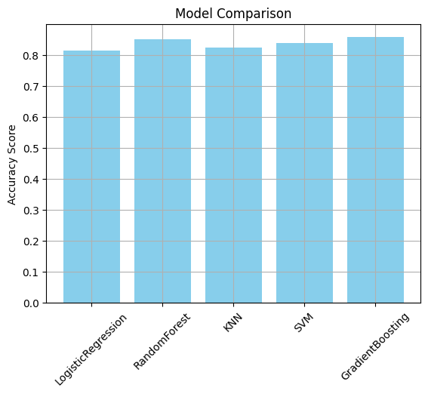
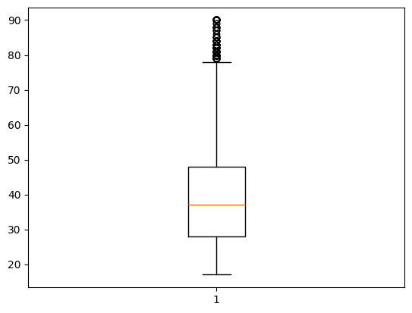
Result
Boxplot for age

Slide 8
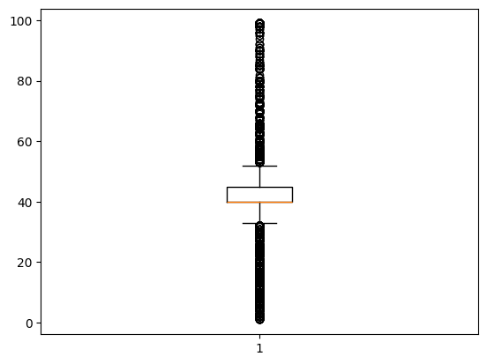
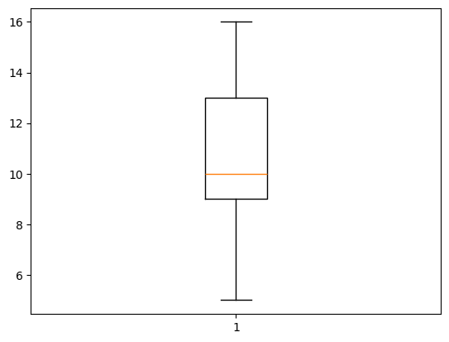

Slide 9
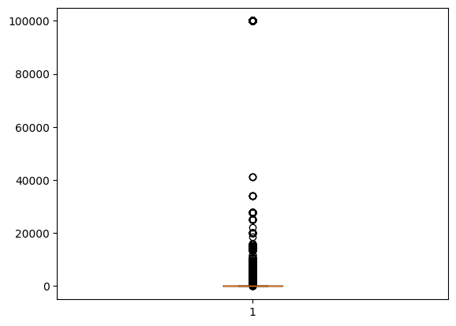
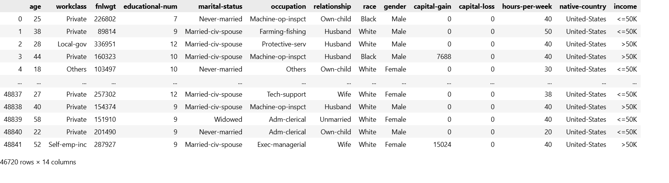

Slide 10
GITHUB LINK:
https://github.com/Swathi-2003/Employee-salary-prediction

Slide 11
Conclusion
This project successfully demonstrates how machine learning can be applied to predict employee salaries based on historical data. The developed models, particularly ensemble methods, proved to be effective in capturing nonlinear relationships and minimizing prediction errors. It can be a valuable tool for HR analytics and strategic workforce planning.

Slide 12
Future scope(Optional)
Include more features like department, performance rating, and education level to improve accuracy.
Deploy the model as a web application using Flask or Streamlit.
Enable real-time prediction with input forms for new employees.
Train models on large-scale company datasets with anonymized records.

Slide 13
References
Python Machine Learning by Sebastian Raschka
Hands-On Machine Learning with Scikit-Learn, Keras, and TensorFlow by Aurélien Géron
Introduction to Machine Learning with Python by Andreas C. Müller & Sarah Guido
Krish Naik – Machine Learning, Data Science tutorials
Simplilearn – AI & ML Concepts

Slide 14
THANK YOU

