Slide 1
SECURE DATA HIDING IN IMAGES USING STEGANOGRAPHY
CAPSTONE PROJECT
Presented By:
Student Name : SWATHI SETHURAMAN
College Name & Department : SASTRA UNIVERSITY
COMPUTER SCIENCE

Slide 2
OUTLINE
Problem Statement
Technology used
Wow factor
End users
Result
Conclusion
Git-hub Link
Future scope

Slide 3
Problem Statement
This project explores image-based steganography, where a secret message is embedded into an image at the pixel level.
The encrypted message remains visually undetectable, making it a covert way of transmitting sensitive information.
The recipient can retrieve the message only with the correct passcode, ensuring an additional layer of security.

Slide 4
Technology used
Programming Language:
Python
Platform:
Windows (but can be adapted for Linux/macOS)
Libraries Used:
OpenCV (cv2): Handles image reading, modification, and saving.
OS Module: Enables automatic file handling and image display.

Slide 5
Wow factors
Stealthy Message Hiding:
The message is embedded within an image, making it invisible to the human eye.
Passcode Protection:
Only users with the correct passcode can decrypt and retrieve the message.
No External Storage Needed:
The message is stored directly in the image pixels, eliminating the need for additional storage.
Minimal Image Distortion:
The encoding process does not significantly alter the visual appearance of the image.

Slide 6
End users
Cybersecurity Professionals:
Can utilize this for covert communication.
Whistleblowers & Journalists:
Enables secure message transmission without raising suspicion.
Digital Forensics Experts:
Can extract and analyze hidden data from images.
General Users:
Those looking for a fun and creative way to send secret messages.

Slide 7
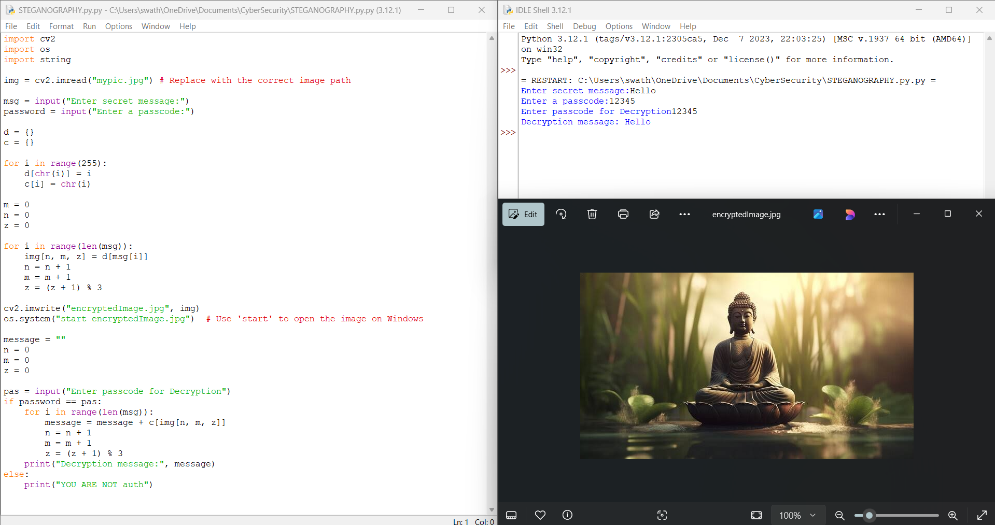
Results

Slide 8
Conclusion
This project showcases a simple yet effective approach to steganography, allowing users to embed messages in images without altering their visual integrity. While it serves as a basic prototype, it demonstrates the potential of using digital images as a medium for secure communication.

Slide 9
GitHub Link
https://github.com/Swathi-2003/STEGANOGRAPHY.git

Slide 10
Future scope(optional)
Advanced Encryption:
Integrate encryption algorithms (AES, RSA) to enhance security.
Multi-layer Encoding:
Use different image channels (RGB, Alpha) for deeper message embedding.
Support for Various Formats:
Expand compatibility to multiple image file types (PNG, BMP, TIFF).
Mobile & Web Integration:
Develop a mobile or web-based version for broader accessibility.
Machine Learning Integration:
Detect and prevent steganalysis attacks that attempt to reveal hidden messages.

Slide 11
THANK YOU

