Slide 1
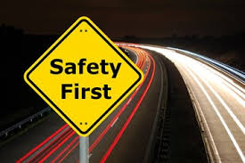
SIGN BOARD RECOGNITION USING DEEP LEARNING
By
Swathi M Huttada : 201046019
K Madhuri : 201046022
Shaik Fareen Akhtar : 201046038

Slide 2
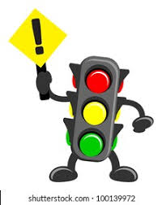
CONTENTS
Introduction
Libraries
Dataset
Data Augmentation
Data Preprocessing and Training
Conclusion
References

Slide 3
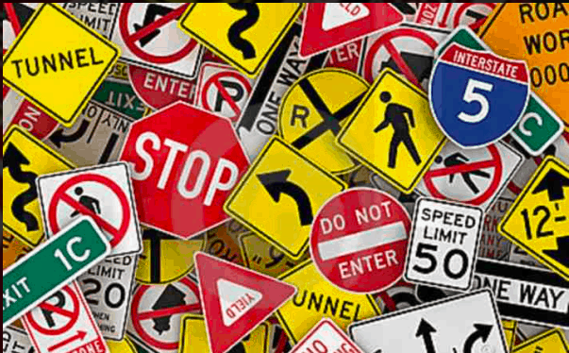
INTRODUCTION
Traffic sign are very helpful for the driver.
Traffic sign recognition has significant job in the autonomous driving.
Deep learning methods helps to get accuracy.
Traffic sign recognition is an interesting part of computer vision.

Slide 4

LIBRARIES
NUMPY
PICKLE
CV2
TENSORFLOW
PANDAS
MATPLOTLIB

Slide 5
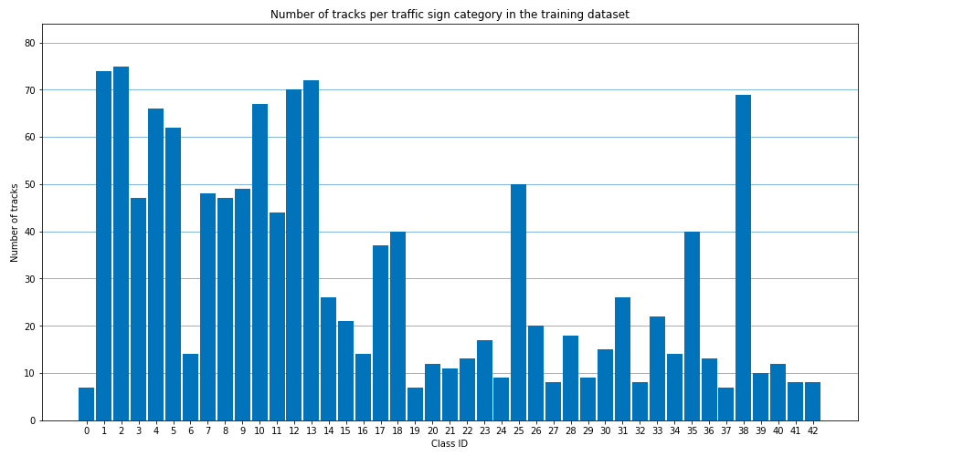
DATASET
Dataset is a pickle file.
The pickle file consists of various types of sign board images.
The dataset was divided into training and test data.
The dataset consists of 43 features and 39209 images.
4

Slide 6
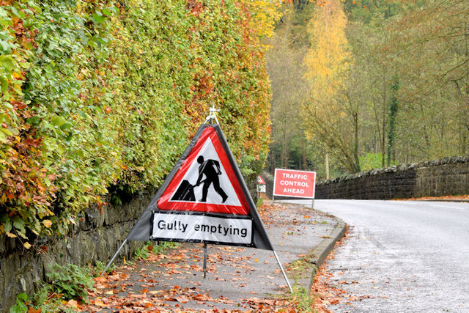
DATA AUGMENTATION
Transform 1: Scale -> Translate -> Perspective Transformation
Transform 2: Brightness -> Translate -> Rotate
Transform 3: Brightness -> Scale -> Translate

Slide 7
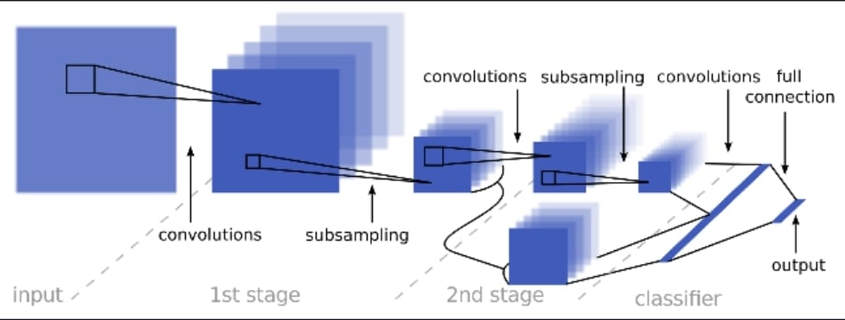
DATA PREPROCESSING AND TRAINING
Converting the RGB images into
grayscale images.

Slide 8
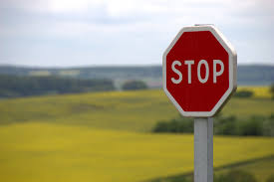
CONCLUSION
Convolution neural network can be used in image recognition.
Accuracy of validation set is 95.9%.
Accuracy of test set is 97.1%.
Flexible way of evaluating multiple architecture.
Can be implemented in self driving car for traffic sign recognition.

Slide 9
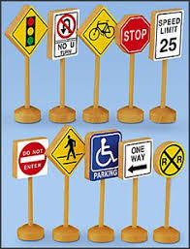
REFERENCES
https://github.com/pierluigiferrari/traffic_sign_classifier
https://www.kaggle.com/meowmeowmeowmeowmeow/gtsrb-german-traffic-sign/code
https://towardsdatascience.com/recognizing-traffic-signs-with-over-98-accuracy-using-deep-learning-86737aedc2ab
https://towardsdatascience.com/traffic-sign-recognition-using-deep-neural-networks-6abdb51d8b70
https://arxiv.org/abs/2003.03256
Dataset -https://drive.google.com/drive/folders/1q1ylYdBg3JQZ3AH18RY-liSnkAQt56qD?usp=sharing

Slide 10

THANK YOU

