Slide 1


CAPSTONE PROJECT
Gold Price Trend and market analysis
Presented By
Student Name: SWATHI R
College Name: Sapthagiri nps university
Department: Computer science and engineering
Email ID: swathirshettigar2006@gmail.com

Slide 2
OUTLINE:
Problem Statement
Proposed System/Solution
System Development Approach (Technology Used)
Algorithm & Deployment
Result
Conclusion
Future Scope
References

Slide 3
Problem Statement:
Gold prices fluctuate continuously due to changing economic conditions, inflation, global market trends, and investor behavior. These frequent variations make it difficult for investors and analysts to clearly understand long term trends, volatility patterns, and trading activity using raw data alone. Without structured analysis, identifying price movements, peak and low periods, and overall market behavior becomes challenging, highlighting the need to systematically examine historical gold price data to better understand market dynamics.

Slide 4
Proposed Solution:
To address this problem, an interactive data analytics dashboard is developed using Power BI to systematically analyze historical gold price data. The solution organizes and visualizes key indicators such as open, high, low, close prices, and trading volume to identify trends, volatility patterns, and market behavior over time. Advanced features like time series forecasting and scenario analysis are incorporated to estimate future price movements and evaluate potential market changes. This structured analytical approach enables clearer interpretation of gold price trends and supports more informed financial analysis.

Slide 5
System Approach:
Data Collection Gather historical gold price data containing date, open, high, low, close, and trading volume.
Data Cleaning and Preparation Perform data preprocessing in Power BI by correcting data types, handling missing values, removing duplicates, and structuring the dataset for analysis.
Data Modeling Create appropriate data relationships and calculated measures to support trend analysis and performance evaluation.
KPI Development Define key performance indicators such as average price, highest price, lowest price, price change, and total trading volume.
Visualization Design Develop interactive dashboards using line charts, bar charts, donut charts, and matrix visuals to analyze trends and market behavior.
Trend and Volatility Analysis Examine historical patterns to identify upward trends, downward trends, and price fluctuations over different time periods.
Forecasting Implementation Apply time series forecasting techniques within Power BI to estimate future price movements.
Scenario Simulation Use What If parameters to analyze the impact of hypothetical price changes.
Insight Generation Interpret visual findings to understand market dynamics and support analytical conclusions.

Slide 6
Algorithm & Deployment:
Algorithm:
Import and preprocess historical gold price data.
Validate data types and remove inconsistencies.
Create necessary calculated measures and date table for time based analysis.
Develop interactive visualizations to analyze price trends and market volatility.
Apply forecasting techniques to estimate future gold price movements.
Perform scenario analysis using What If parameters.
Generate insights based on visual analysis.
Deployment:
Publish the completed report to Power BI Service.
Configure automatic data refresh for updated analysis.
Share dashboard access with authorized users.
Maintain security, access control, and performance monitoring.

Slide 7
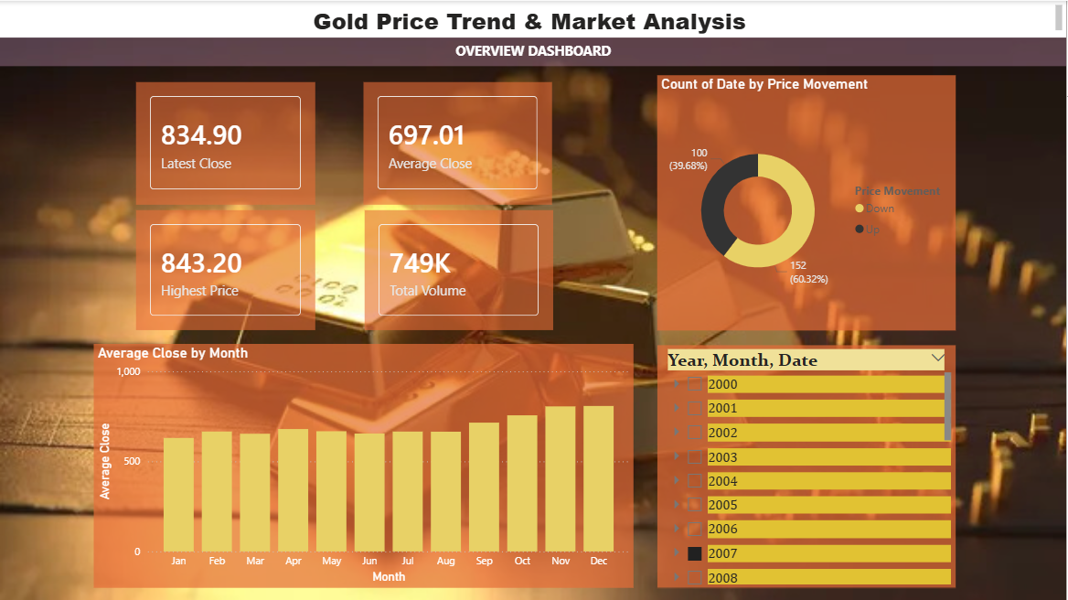
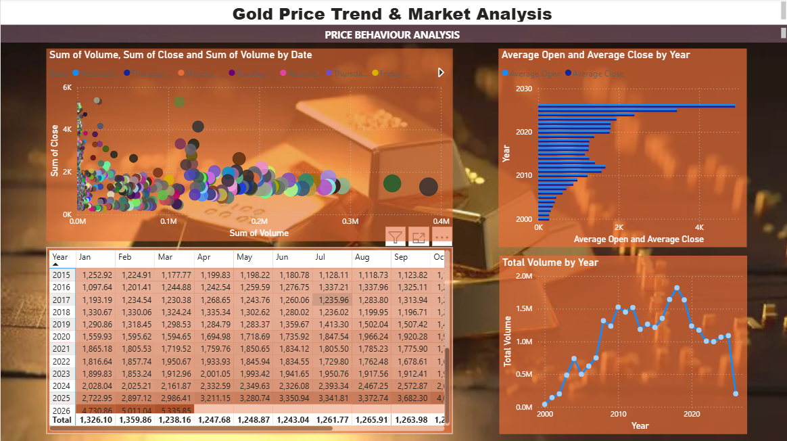
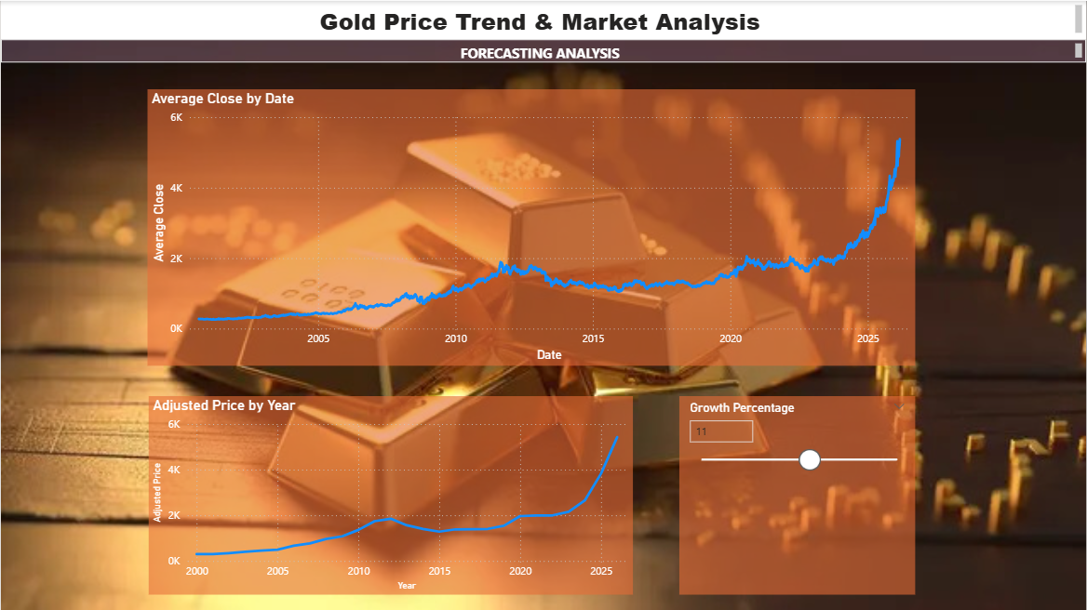
Result:
The analysis of historical gold price data revealed clear trend patterns, fluctuations, and variations in market activity over time. The dashboard effectively highlighted periods of price growth and decline, as well as the highest and lowest price levels within the dataset. Trading volume analysis provided insights into market volatility and investor participation. The forecasting model generated short term future price estimates with defined confidence levels, while scenario analysis demonstrated the potential impact of price changes. Overall, the results enabled a comprehensive understanding of gold market behavior through structured and interactive data visualization.

Slide 8
Conclusion:
This project successfully analyzed historical gold price data to understand market trends, price fluctuations, and trading behavior. Through structured data modeling and interactive visualizations, meaningful insights into volatility, peak periods, and overall market patterns were identified. The integration of forecasting and scenario analysis further enhanced the analytical depth of the study. Overall, the dashboard provides a comprehensive and data driven view of gold price dynamics, supporting better interpretation of market behavior.

Slide 9
Future scope:
Integrate real time gold price data using live data sources or APIs.
Enhance forecasting accuracy using advanced machine learning models.
Compare gold prices with other financial assets such as stocks or cryptocurrencies for broader market analysis.
Incorporate macroeconomic indicators like inflation rate and currency exchange rates to study their impact on gold prices.
Develop automated alerts for significant price changes or trend reversals.
Deploy the dashboard for enterprise level decision making with advanced security and scalability features.

Slide 10
References:
Historical Gold Price Dataset source from Kaggle.
Microsoft Power BI Documentation.
Financial market analysis resources and online research articles.
GitHub Link: Link

Slide 11
Thank You

