Slide 1




Slide 2
ClearCare
TEAM NAME
Cassandra
TRACK
Health and Wellbeing
LEADER
Adishree Gupta
MEMBER 1
Swathi S
MEMBER 2
Jawwaad Sheriff
TEAM SIZE
3 people
COLLEGE
PES UNIVERSITY
WHAT WE BUILT
Turns discharge instructions into a source-linked, multilingual care plan with review flags and calendar-ready follow-up.
HOW AGENTIC AI IS USED
Retrieves relevant care evidence, calls AMD only on user action, verifies the response, and routes uncertainty to human review.
Health and Wellbeing · Synthetic demo · Prototype, not for clinical use

Slide 3
The problem we chose
THE CHOSEN PROBLEM
Patients and caregivers leave hospital with dense instructions and must turn them into safe next steps at home.
PEOPLE AFFECTED
Patients recovering at home and the family members helping manage their care.
WHY IT MATTERS
Missing dose units, conflicting directions, or vague follow-up details can leave people unsure what to ask next.
PROBLEM STATEMENT
How might we help patients and caregivers understand discharge instructions and organize next steps without guessing when details are unclear?

Slide 4
Problem and existing workarounds
WHO HAS THIS PROBLEM
Patients and family caregivers managing the move from hospital to home.
WHAT EXISTS TODAY
Paper discharge packet
Medication list
Phone call to clinic or pharmacist
Personal notes and calendar
HOW OFTEN IT HAPPENS
At each discharge, across pages of instructions and several follow-up tasks.
WHERE THEY FALL SHORT
Information is spread across documents and tools.
Unclear or conflicting instructions still need a person to resolve them.
WHAT IT COSTS THEM TODAY
Time spent searching and cross-checking. Uncertainty can delay a question or routine next step.

Slide 5
How ClearCare works
WHAT OUR AGENT DOES
Reads text PDFs locally and extracts instructions with source evidence.
Explains the original wording in plain language.
Keeps unclear or high-risk items in review.
HOW THE AGENT DECIDES
Deterministic rules organize and validate document facts. A user click triggers a bounded Care Agent to retrieve relevant evidence and make one AMD request.
HOW IT HANDLES FAILURE
Missing units, conflicts, unreadable text, or failed checks remain incomplete or need review. Nothing is silently repaired or auto-retried.
WHY AGENTIC AND NOT A SIMPLE APP
A question may need evidence from more than one place. The Care Agent selects document or calendar evidence, then returns a grounded answer with sources. Parsing and calendar rules stay deterministic.

Slide 6
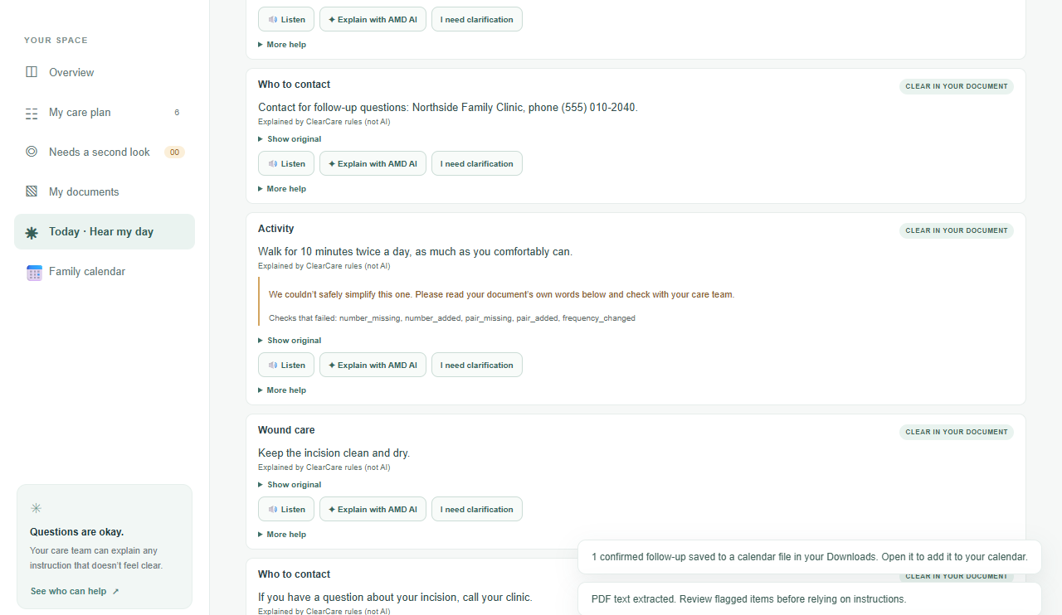
Product screen and technology
CLEARCARE IN USE
Original wording stays beside its review status.
TECH STACK
PDF reading: pdf.js and local deterministic extraction
App: JavaScript and Node.js
AMD: Developer Cloud API, DeepSeek-V4-Flash for user-requested explanations, translation, and Care Agent answers
Voice and calendar: browser speech APIs and .ics export
PDF extraction does not use AI. No ROCm claim.

Slide 7
How ClearCare handles data
DATA FLOW DIAGRAM
1 Choose PDF; extract embedded text in the browser.
2 Parse fields with exact source evidence.
3 Flag ambiguity, conflicts, missing units, and high-risk medicines.
4 A user click sends selected evidence to AMD.
5 Verify the answer; withhold unsafe output.
6 Keep review items unscheduled; export eligible visits to .ics.

Slide 8
Feasibility and next steps
CAN THIS BE BUILT FOR REAL?
Runs locally for text PDFs. AMD explanations and Care Agent answers need a backend key and network. Scanned PDFs need optional local OCR.
WHO USES IT, WHAT CHANGES
Patients and family caregivers get one source-linked checklist and clearer questions to take to their care team.
WHAT DIDN'T WORK
Broad OCR and automatic whole-site translation remain outside this MVP. No caregiver comprehension study has been run.
NEXT 30 DAYS
Run caregiver comprehension sessions.
Ask clinicians to review safety language.
Improve scan support and evaluate more held-out documents.

Slide 9
What the prototype has demonstrated
SYNTHETIC EVALUATION
110/110 extraction checks passed across 11 synthetic documents, with 0 clinically significant errors recorded. The held-out set passed 32/32 checks. Calendar checks placed 7/7 dated visits correctly, kept 4/4 undated visits off calendar, and created 0 invented visits. These small, hand-written tests do not establish clinical safety or patient comprehension.

Slide 10
Thank you | ClearCare
REFERENCES
PROJECT REPOSITORY
https://github.com/1stsimplifycode/ClearCare-Understand-My-Care-Instructions
AMD API
https://developer.amd.com.cn/radeon/api/v1 · DeepSeek-V4-Flash
EVALUATION
Synthetic fixtures and measured results: docs/evidence/extraction-eval.json
DEMO VIDEO
CLEARCARE_AMD_ACT_III_SUBMISSION/videos/CLEARCARE_AMD_ACT_III_DEMO.mp4
Synthetic data only · Prototype, not for clinical use

