Slide 1
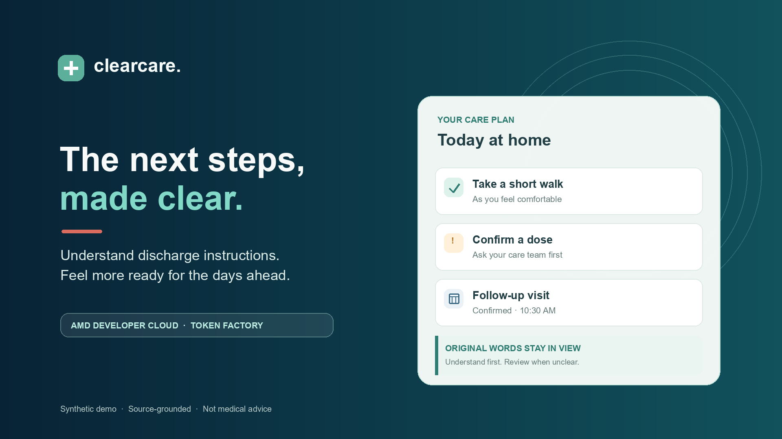
Notes:
After a hospital stay, patients and family caregivers may be sent home with pages of instructions. ClearCare helps make those next steps easier to understand and organize, while keeping the care team’s original words in view.

Slide 2
01 · READ
Start with the document.
SYNTHETIC DISCHARGE SUMMARY
Select a text-based discharge PDF. The demo reads it in the browser and keeps the selected file in the current session.
DISCHARGE INSTRUCTIONS
Medication
Acetaminophen 500 mg every 6 hours as needed for pain.
Follow-up
Primary care · Oct 20 · 10:30 AM
READ IN BROWSER
ClearCare · Synthetic demo · Not medical advice
01 / 08
Notes:
The workflow starts with a discharge PDF. ClearCare reads text-based documents in the browser. The demonstration uses synthetic patient details, and uploaded files are not saved to an account.

Slide 3
02 · SHOW THE SOURCE
Keep each instruction grounded.
MEDICATION INSTRUCTION
Medication directions and care steps stay paired with the exact words found in the document, so families can compare the summary with its source.
Acetaminophen · 500 mg
Every 6 hours as needed for pain
ORIGINAL WORDS
“Take acetaminophen 500 mg every 6 hours as needed for pain.”
AI · Explain simply
ClearCare · Synthetic demo · Not medical advice
02 / 08
Notes:
Each extracted instruction stays connected to its source wording. Families can see the original line alongside the organized plan, instead of having to trust a summary on its own.

Slide 4
03 · AMD TOKEN FACTORY
Explain simply, when you ask.
ONE CLICK · ONE SELECTED INSTRUCTION
A person chooses Explain simply on one instruction. ClearCare sends that selected text to the backend AMD service for a short plain-language explanation.
Care text
→
AMD API
Selected text only
DeepSeek-V4-Flash
Plain words · source stays visible
ClearCare · Synthetic demo · Not medical advice
Backend key · no request on page load
03 / 08
Notes:
The core AI action is explicit. Nothing is sent just because the page opened. When a person chooses Explain simply, ClearCare sends only the selected instruction to the backend, which calls AMD Developer Cloud Token Factory using DeepSeek V4 Flash.

Slide 5
04 · SAFETY BY DESIGN
Unclear stays unclear.
SAFETY REVIEW
Missing units, ambiguous doses, conflicting directions, and high-risk medicines are marked for review. ClearCare does not guess or mark them confirmed.
Needs a second look
!
Dose unit missing
Ask the care team to confirm
!
Directions conflict
Both source lines stay visible
!
High-risk medicine
Never auto-confirm or schedule
ClearCare · Synthetic demo · Not medical advice
04 / 08
Notes:
When an instruction is ambiguous, missing a unit, conflicting, or involves a high-risk medicine, ClearCare routes it for review. It does not silently choose a direction, confirm an item, or schedule an incomplete appointment.

Slide 6
05 · CHECKLIST & CALENDAR
A plan that fits real life.
A SIMPLE CHECKLIST
Every task has its own checkbox. Confirmed appointments can be shown on the calendar and exported as an .ics file; items needing review stay out.
1
Buy medication: A
A separate reminder
2
Buy medication: B
Its own checkbox
OCTOBER 2026
M
T
W
T
F
S
S
19
20
21
22
23
24
25
ClearCare · Synthetic demo · Not medical advice
Only complete, confirmed visits export
05 / 08
Notes:
The care plan uses a straightforward checklist, with separate checkboxes for separate tasks. Confirmed follow-ups can appear on the calendar and be exported as an ICS file. Items that still need review are not eligible for scheduling.

Slide 7
06 · LANGUAGE & VOICE
Make the plan easier to use.
BUILT-IN CARE PLAN LANGUAGES
English, Spanish, and Hindi are available in Settings. Today · Hear my day adds a readable transcript, browser voice controls, and document questions.
EN
English
ES
Español
हि
हिन्दी
Read the transcript.
Play, pause, or stop.
ClearCare · Synthetic demo · Not medical advice
Voice availability depends on the device.
06 / 08
Notes:
ClearCare includes English, Spanish, and Hindi settings, plus a Today view with a readable transcript and browser-based voice controls. People can type or speak a question and edit the text before sending it.

Slide 8
07 · HOW AMD FITS
AI that knows its limits.
THE REQUEST PATH
AMD Token Factory is a hosted API integration. The API key stays on the backend. ClearCare does not use ROCm or run the model on the patient’s device.
01
Patient chooses
one explanation
02
ClearCare backend
holds the secret key
03
AMD Token Factory
DeepSeek-V4-Flash
04
Verified result
shown with source
ClearCare · Synthetic demo · Not medical advice
Not ROCm · no local model runtime
07 / 08
Notes:
The AI runs through AMD Developer Cloud Token Factory, not locally through ROCm. The key remains on the backend. ClearCare is a prototype organizer and explainer, not a clinician, and the care team remains the source of medical direction.

Slide 9
CLEARCARE · SYNTHETIC PROTOTYPE
Notes:
ClearCare makes the next steps after discharge easier to see, understand, and organize. This is a synthetic-data prototype for the AMD Developer Hackathon. It does not diagnose or prescribe, and it never replaces guidance from the care team.

