Slide 1
Capstone Project
TEDtalk Views Prediction Team Members Charishma Suddala Swathi V Hebbar

Slide 2
CONTENTS
Introduction
Problem Statement
Methodology
(1) Loading the data
(2) Exploratory Data Analysis
(3) Treating missing values and outliers
(4) Feature engineering
(5) Train test split
(6) Data Modeling
(7) Model interpretation
(8) Train and test interpretation
Conclusion

Slide 3
INTRODUCTION
TED(Technology, Entertainment, Design) is a non profit devoted to spreading
ideas, usually in the form of short, powerful talks. It is an American media
organization that posts talks online for free distribution under the slogan “ideas
worth spreading:”. These talks address a wide range of topics within the
research and practice of science and culture, often through story telling.
The notable programs and initiatives of TED include TED include TED talks,
TED Conferences, TED Translators, TED-Ed.

Slide 4
PROBLEM STATEMENT
Our objective is to predict the views of a TED talk that’s been uploaded in the
TEDx website. For this we are provided with a data set “data_ted_talks”.
This data set contains information about:
talk id and title of the TED talks
Speakers and their occupations who had given TED talks
Recorded and published date of TED talks
Event on which TED talks were held
Native and available languages for the respective TED talks
Topics, duration and comments of the TED talks
URL, description and transcript of the TED talks

Slide 5
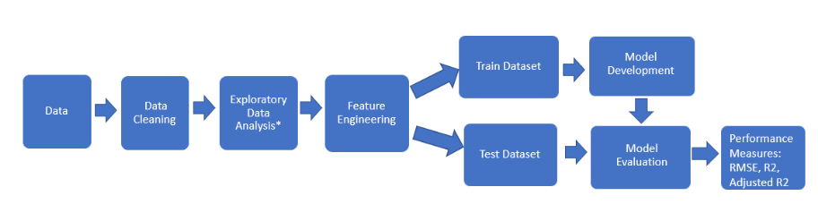
METHODOLOGY

Slide 6
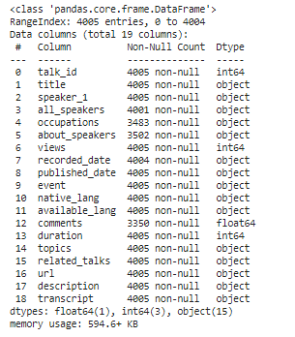
LOADING THE DATA AND DATA CLEANING
After loading the data, we can observe that the data frame contains
4005 rows with 19 variables. And we are trying to have an insight on missing values

Slide 7
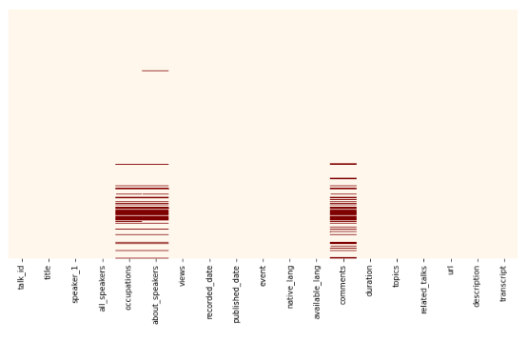
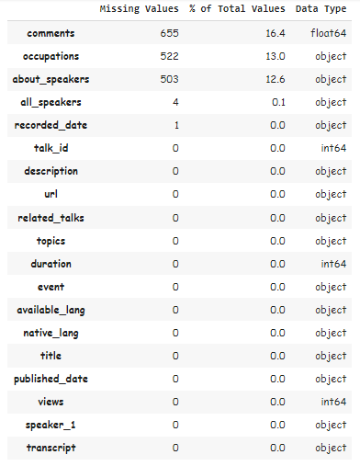
SPREAD OF MISSING VALUES

Slide 8
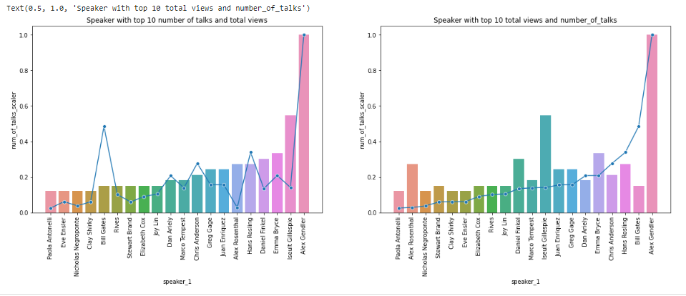
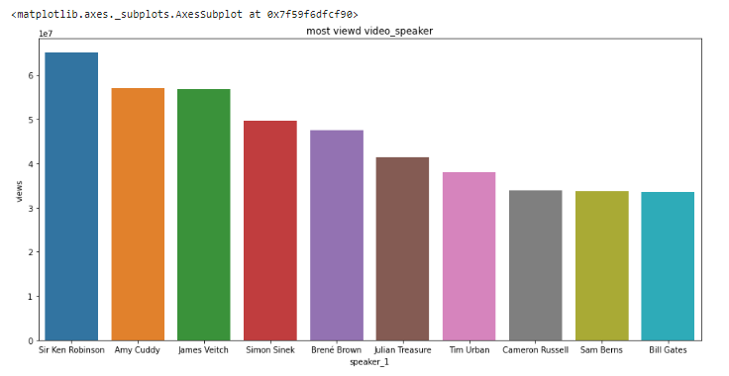
EDA
Speakers with top 20 total views with respect to number of talks
Speakers with max number of views for a single TED talk

Slide 9
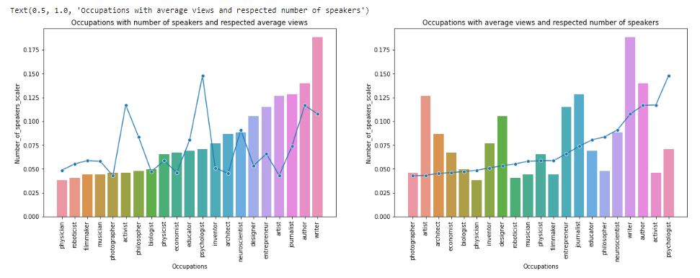
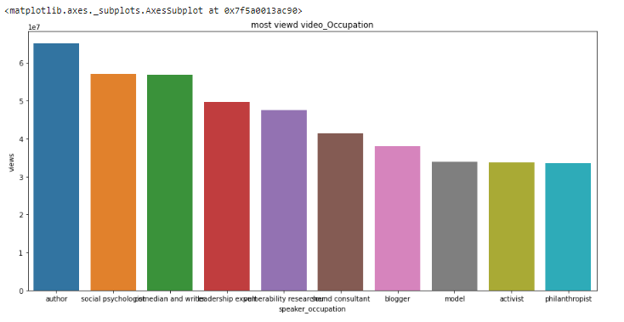
EDA (continued)
Top occupations of the speakers with respect to number of talks and views
Occupations of speakers which got maximum number of views for a single TED talk

Slide 10
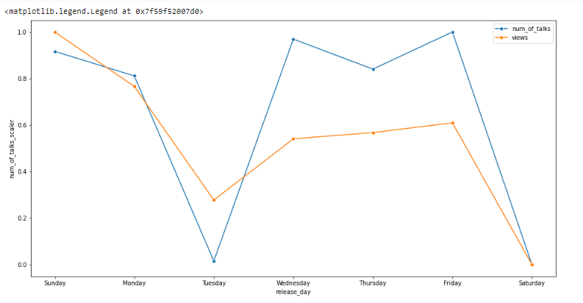
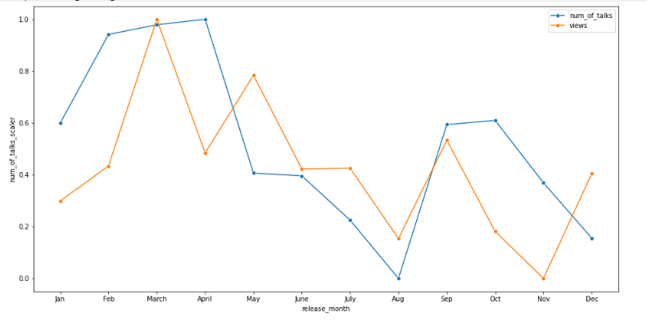
EDA (continued)
Number f talks and average views received with respect to weekdays
Number of talks and average views with respect to Month

Slide 11
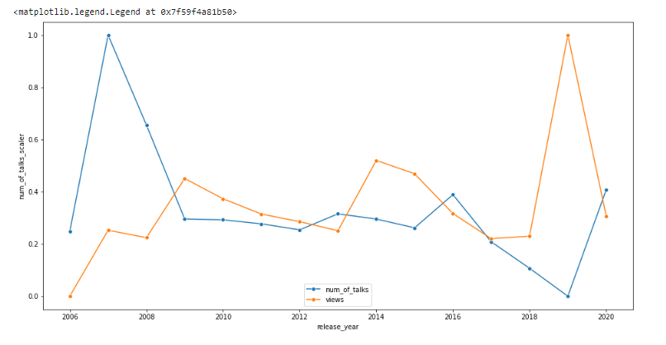
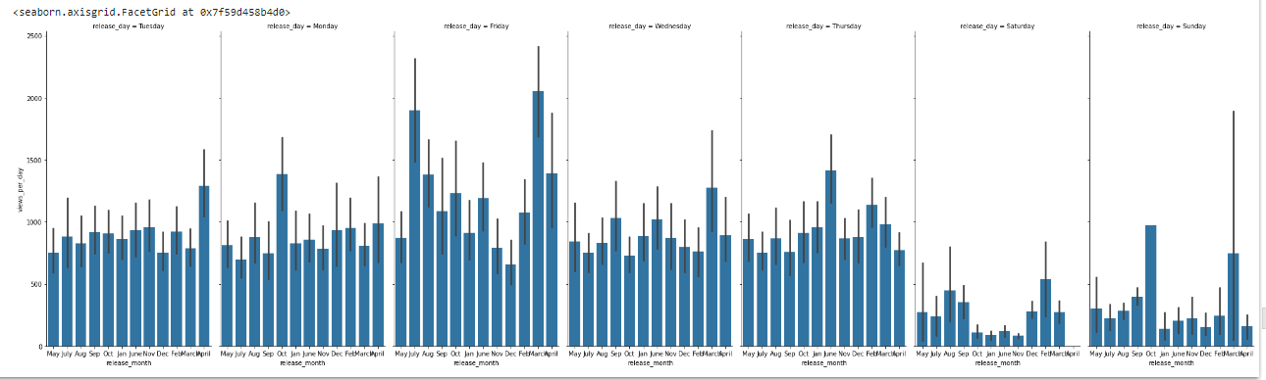
EDA (continued)
Number of talks and average views with respect to Year
Views per day with respect to every day on monthly basis

Slide 12
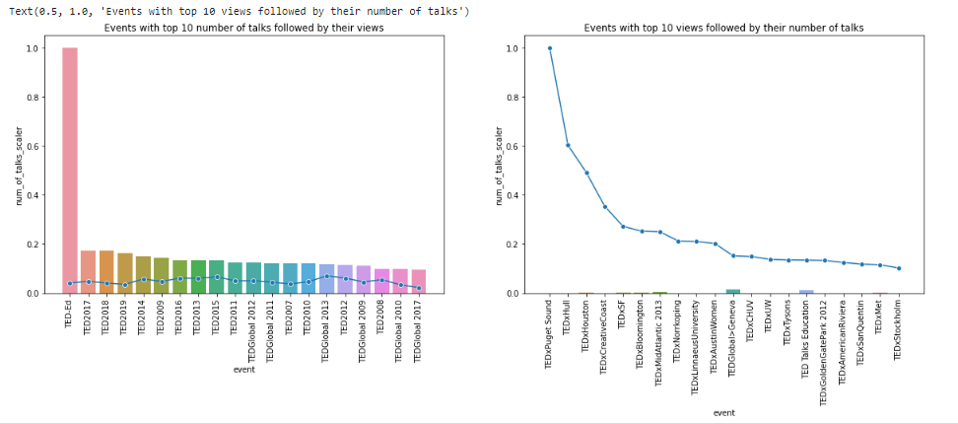
EDA (continued)
Events with top 10 number of talks with respect to views

Slide 13
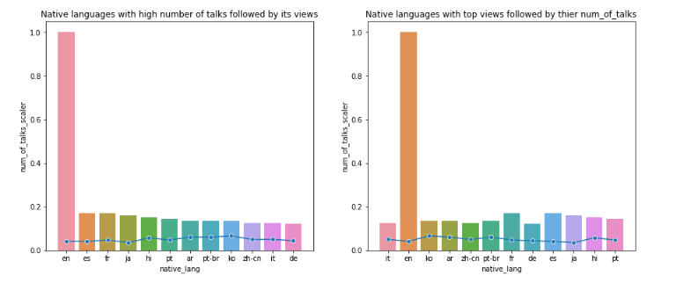
EDA (continued)
Native languages with views and number of talks
Native languages with views and number of talks

Slide 14
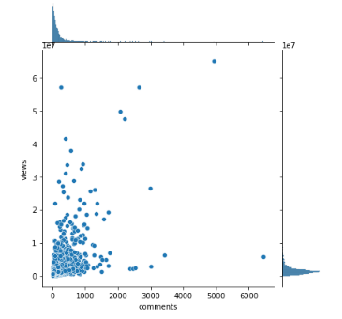
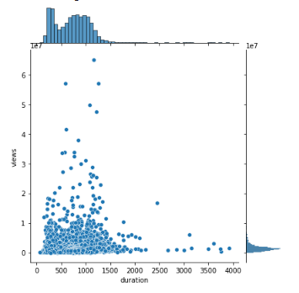
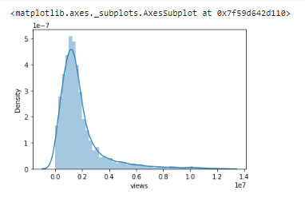
EDA (continued)
Duration and views
Comments and views
Distribution of views

Slide 15


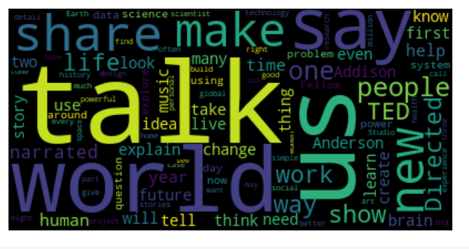
EDA (continued)
Word cloud for Topics , Description and Title columns

Slide 16
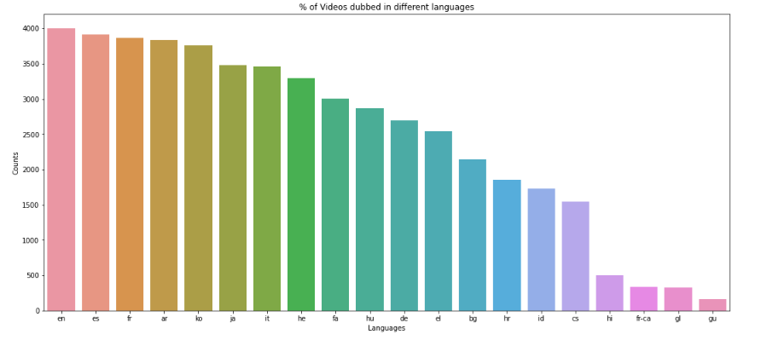
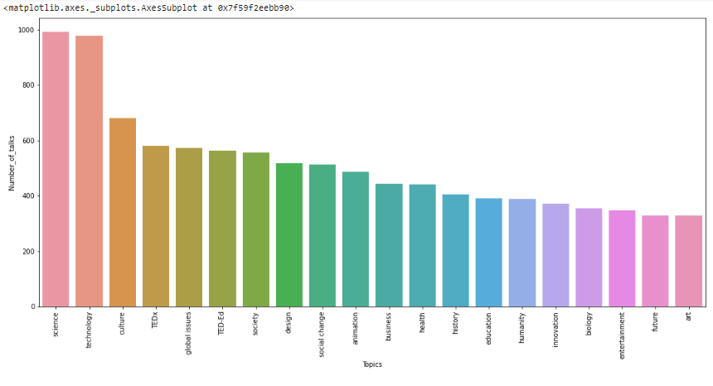
EDA (Continued)
Count of available languages
Topics with respect to number of talks

Slide 17
EDA CONCLUSIONS:
The number of views depends on many points. But the more number of talks does not give the more number of videos.
Speaker and occupation of the speaker alters the number of views. Some speakers who are influencers will contribute a lot for the maximum number of views and thus the occupation.
People tend to look at the video which was delivered by Psychiatrist , Activist and Authors.
On weekend and on the month of March there will be surge on number of views.
We can see that most of the videos are on the topic ‘Science’ and ‘Technology’
English is the language which is available as main language and as well as the subtitles for many of the videos.
Portuguese is the language which received maximum average views

Slide 18
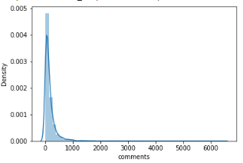
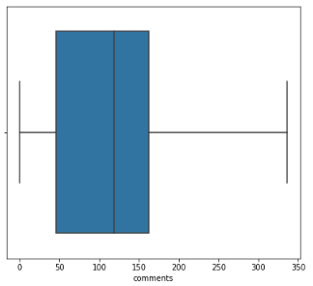
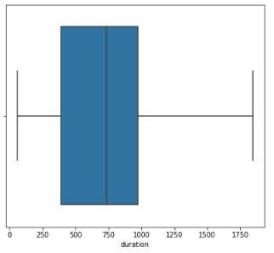
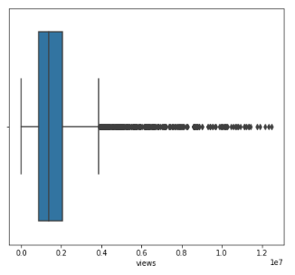
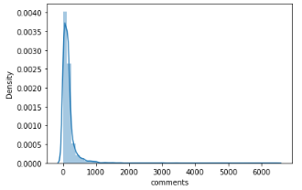
TREATING MISSING VALUES AND OUTLIERS
While dealing with the missing values, we observed that there exists a column ‘comments’. It has more than 16% of missing values and has skewed data, so we tried predicting the missing values by KNN Imputer.
Later Outliers in the independent numerical columns were treated by IQR and dependent numerical columns outliers were treated by Z score.
Before treating missing values
Box plots after applying Outlier treatment for the numerical variables
Comments
Duration
Views
After treating missing values

Slide 19
FEATURE ENGINEERING
Feature engineering is the process of selecting, manipulating, and transforming raw data into features that can be used in supervised learning.
Feature Engineering consists of various process :
(1) Feature Creation (2) Transformation (3) Feature Extraction
Feature Extraction: Feature extraction is the process of extracting features from a data set to identify useful information.
Feature Creation: Creating features involves creating new variables which will be most helpful for our model.
Transformations: Feature transformation is simply a function that transforms features from one representation to another.

Slide 20
FEATURE ENGINEERING (Continued)
When feature engineering activities are done correctly, the resulting dataset is optimal and contains all of the important factors that affect the business problem. As a result of these datasets, the most accurate predictive models and the most useful insights are produced.
Once we were done with creating/altering existing/new variables, we try the conditions which are necessary for Linear regression models.
Those are –
(1) Linearity: The relationship between the independent and dependent variables must be linear..
(2)There should be no or little multi-collinearity: Multi-collinearity is the phenomenon when a number of the explanatory variables are strongly correlated.
(3)Normality: All residuals should follow a normal distribution in Linear Regression

Slide 21
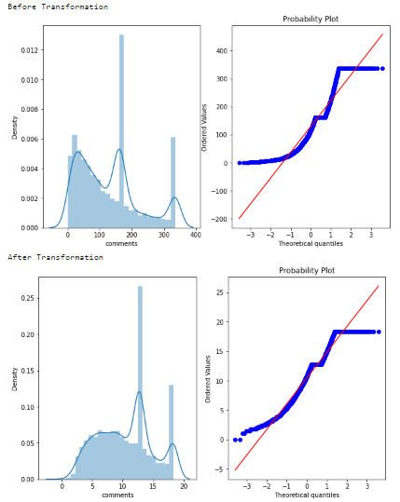
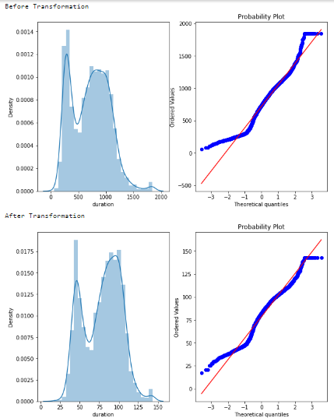
FEATURE ENGINEERING (continued)
Applying Transformations for the featured columns to convert it into normal distribution.
Duration
Comments

Slide 22
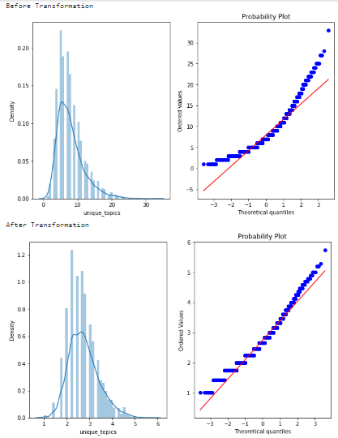
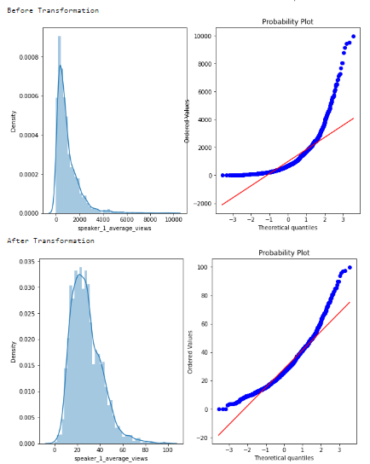
Feature Engineering (Continued)
Unique topics
Speaker average Views

Slide 23
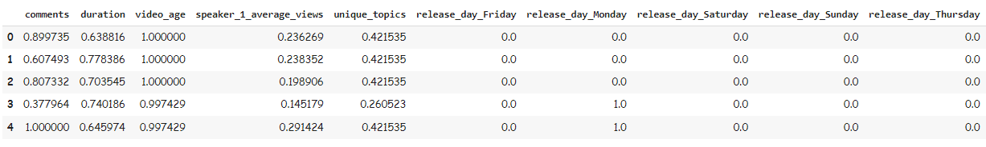
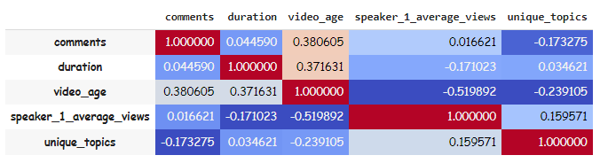
Before Building a model…
After finished with Feature engineering, this is the data frame that we have.
Correlation matrix for the featured numerical variables
Now that we have finished EDA, Feature Engineering, we have only the variables which are important.
These variables are transformed into normal distribution and been scaled. We can observe that even One hot encoding is done for the categorical variable.
We are all set to build models.
So lets just start with the train test split.

Slide 24
TRAIN – TEST SPLIT
After cleaning the data, the dataset is split into Train – Test datasets. This is done to
ensure that our test dataset is completely isolated and there is no information leakage
during the training process of machine learning models
DATA MODELING
In Machine Learning, we use various kinds of algorithms to allow machines to learn the relationships within the data provided and make predictions based on patterns or rules identified from the dataset.
So, regression analysis is a machine learning technique where the model predicts the output as a continuous numerical value.
Many models were trained, from simple parametric models like Linear Regression to tree based models.

Slide 25
DATA MODELING (continued)
Few of the important Regression models which we have used in here are,
Linear regression – This technique finds out a linear relationship between a dependent variable and the other given independent variables.
Random Forest Regressor – Random Forests are an ensemble(combination) of decision trees. It executes by constructing a different number of decision trees at training time and mean prediction (for regression) of the individual trees.
Catboost Regressor – It provides Machine Learning algorithms under gradient boost framework. It supports both numerical and categorical features.

Slide 26
DATA MODELING (continued)
4) LGBM Regressor – It is a boosting technique that uses tree based learning algorithm. It grows tree leaf wise rather than level wise.
5) XGBoost Regressor – It is also a boosting technique that uses gradient descent algorithm to minimize the loss when adding new tree models.
6) Extra Trees (Extremely Randomized Trees) - The ensemble learning algorithms. It constructs the set of decision trees. During tree construction the decision rule is randomly selected. This algorithm is very similar to Random Forest except random selection of split values.

Slide 27
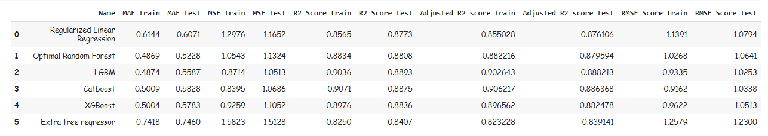
EVALUATION OF MODELS
R-squared (R2) is a statistical measure that represents the proportion of the variance for a dependent variable that’s explained by an independent variable or variables in a regression model.
Mean absolute error (MAE) is the average of the absolute difference between the actual and predicted values in the dataset. It measures the average of the residuals in the dataset.
Mean Squared Error (MSE) or Mean Squared Deviation (MSD) represents the average of the squared difference between the original and predicted values in the data set. It measures the variance of the residuals. It is always non-negative, and values closer to zero are better.
Root Mean Squared Error (RMSE) is a common way of measuring the quality of the fit of the model. A value of zero would indicate a perfect fit to the data.

Slide 28
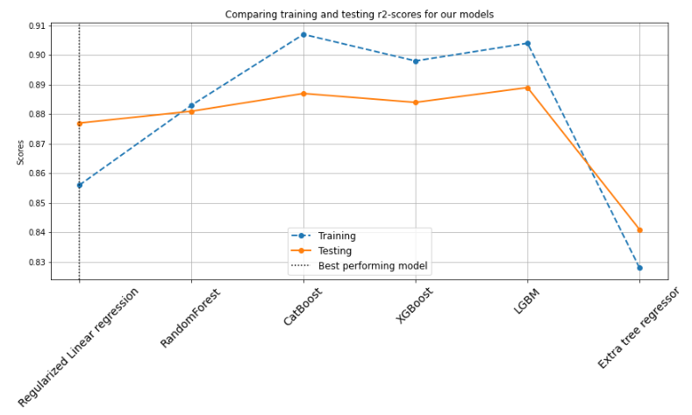
TRAIN AND TEST EVALUATION

Slide 29
CONCLUSION
If we try comparing the prediction accuracy among different linear regression (LR) models then RMSE is a better option as it is simple to calculate and differentiable. And the number of predictor variables in a linear regression model is determined by adjusted R squared.
As we are more concerned about evaluating prediction accuracy among different LR models we can choose RMSE over adjusted R squared.
If we compare RMSE, Optimal Random Forest and as well as Extra Tree is performing well. But if we consider RMSE along with the adjusted R squared, Optimal Random Forest is best performer.

Slide 30
Thank You

