Slide 1
PRODUCT DEMAND PREDICTION WITH MACHINE LEARNING

Slide 2
PRODUCT DEMAND PREDICTION
Demand forecasting
Demand forecasting is the process of predicting what customers’ appetite will be for existing products or services, determining what adjustment you should make and what new offerings will spark interest. But predicting what people will want, in what quantities and when is no small feat.

Slide 3
Design thinking
Data collection
Data preparation
Feature engineering
Model selection
Model training
Evaluation

Slide 4
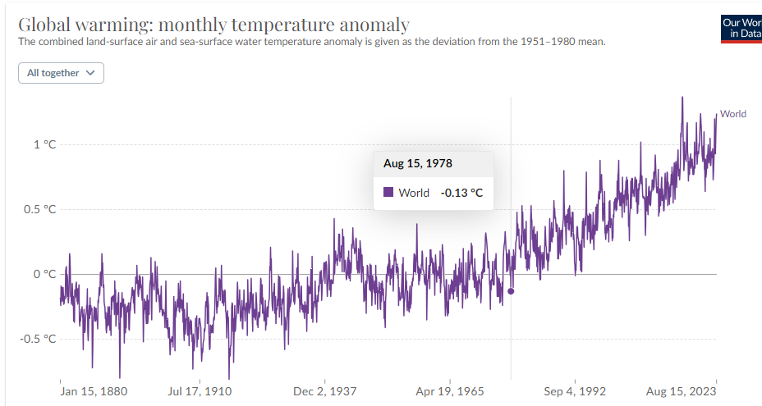
Data about climate change

Slide 5
Data preprocessing
Data preprocessing can refer to manipulation or dropping of data before it is used in order to ensure or enhance performance,^{[1]} and is an important step in the data mining process. The phrase "garbage in, garbage out" is particularly applicable to data mining and machine learning projects. Data collection methods are often loosely controlled, resulting in out-of-range values, impossible data combinations, and missing values, amongst other issues.

Slide 6
Data preprocessing
Clean and preprocess the data
Handle missing values
Convert categorical features into numerical representation
methods

Slide 7
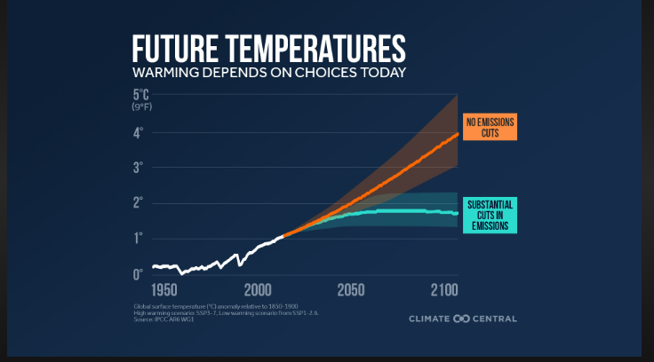
Feature engineering

Slide 8
Model selection
LINEAR REGRESSION
RANDOM FOREST
XG BOOST for demand forecasting

Slide 9
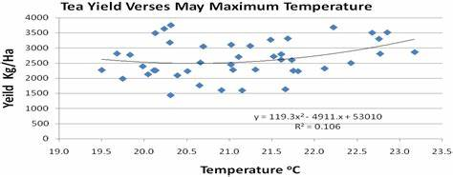
Linear regression

Slide 10
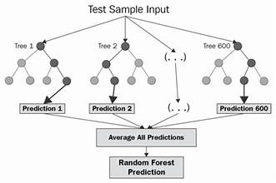
Random forest

Slide 11

XG boost

Slide 12
Evaluation
Mean absolute error
Root mean squared error

Slide 13
Evaluation
Mean absolute error
Root mean squared error
In statistics, mean absolute error (MAE) is a measure of errors between paired observations expressing the same phenomenon. Examples of Y versus X include comparisons of predicted versus observed, subsequent time versus initial time, and one technique of measurement versus an alternative technique of measurement. MAE is calculated as the sum of absolute errors divided by the sample size:^{[1]}
MAE=∑�=1�|��−��|�=∑�=1�|��|�.
Root Mean Square Error (RMSE) is the standard deviation of the residuals (prediction errors). Residuals are a measure of how far from the regression line data points are; RMSE is a measure of how spread out these residuals are. In other words, it tells you how concentrated the data is around the line of best fit. Root mean square error is commonly used in climatology, forecasting, and regression analysis to verify experimental results.

Slide 14
Thank You

