Slide 1

Exploratory data Analysis of AMCAT data(EDA)

Slide 2
About me
Back ground: B Tech in Electronics and Communication Engineering from G Pulla Reddy Engineering College , Kurnool
work experience: Fresher (2024 passed out). Interested in python and Machine learning
Linkedin profile: https://www.linkedin.com/in/swathi-mada
Github profile: https://github.com/Swathi0963
Why Data Science:
I want to learn Data Science because it combines three key aspects that I am passionate about: problem-solving, data analysis, and technology. Data Science offers the tools to extract meaningful insights from data, helping to solve real-world challenges across industries. The field is dynamic and growing, with opportunities to work on projects that can significantly impact business decisions, improve efficiency, and even make breakthroughs in fields like healthcare, finance, and AI.
Moreover, Data Science requires a blend of technical skills (like programming, statistics, and machine learning) and critical thinking, which I enjoy. The prospect of being able to use data to make informed decisions, predict trends, and create models that can improve outcomes excites me, and I believe this skillset is crucial in today’s data-driven world.

Slide 3
Business Problem and Use case Domain understanding
This is a problem based on study of data based on job opportunities of freshers and their salaries depending on their degree and specialization. Everyone can understand the Job competiton in todays’ scenario and factors effecting in todays competition .
Objective of the Problem:
This exploratory data analysis of “AMCAT DATA” focuses on students who are graduated in different fields across different states. By analysing we have to extract the relationship between various things like salary and type of college studied and field of study. This analysis include the way how different factors effect the students carrers. By analysing different factors

Slide 4
Summary of the Data
The dataset was released by Aspiring Minds from the Aspiring Minds Employment Outcome 2015 (AMEO). The study is primarily limited only to students with engineering backgrounds. The dataset contains employment outcomes of engineering graduates like salary, job location, Designation etc. The dataset also shows the scores of students in personality skills ,cognitive skills and technical skills.

Slide 5
Exploratory Data analysis involves several steps :
Data cleaning
Uni variate analysis
Bi variate analysis
Data Cleaning steps:
1. Load dataset and displaying dataset info.
2. Fixing column names and data types of each column
3. Removing Duplicates
4. Checking for Missing values and outliers
Uni Variate Analysis:
This analysis perform on single column of dataset to analyse the required column of dataset. This is done by using different plots depending on different type of data. For numerical data type, histogram plot, box plot is used to visualise data. For categorical, bar plot is used

Slide 6
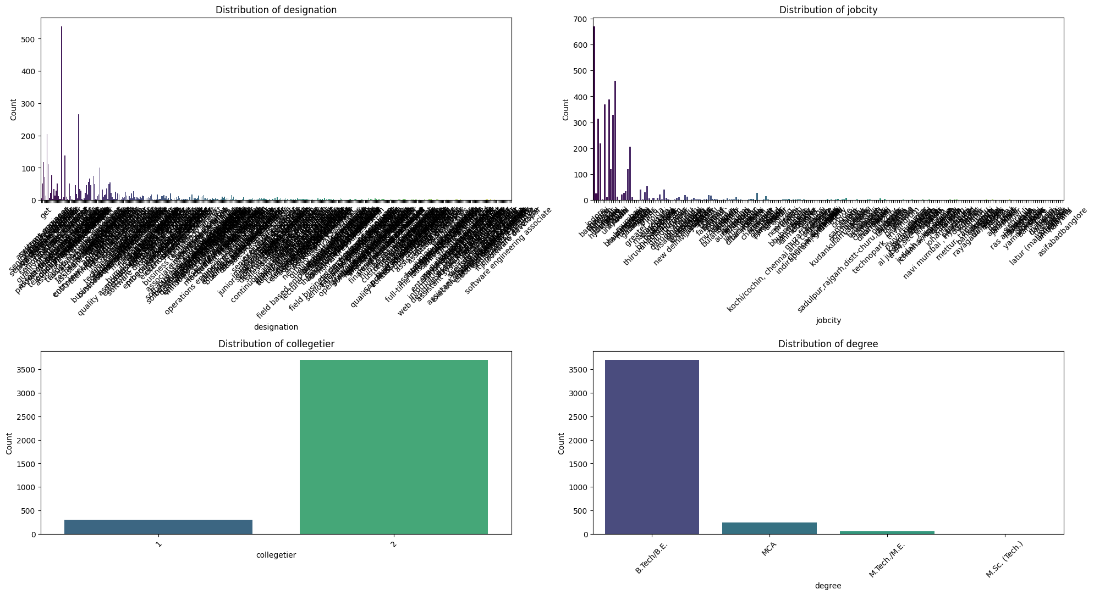

Slide 7
Insights from this analysis
Distribution of Job City
Skewed Distribution: The distribution of job cities seems to be skewed, with a few cities having significantly higher counts than others. This could indicate a concentration of job opportunities in specific locations.
Popular Cities: Cities like Kochi/Cochin, Chennai, and Bangalore appear to be more popular job destinations based on the plot
Distribution of Degree
Dominant Degree: B.Tech/B.E. seems to be the most common degree among the individuals in the dataset, as indicated by the significantly taller bar.
Fewer Master's Degrees: M.Tech/M.E. and M.Sc. (Tech) are represented to a lesser extent, suggesting that a smaller proportion of individuals hold these advanced degrees.

Slide 8
Distribution of College Tier
Bimodal Distribution:
The distribution of college tiers suggests a bimodal pattern, with two distinct peaks. This might imply that a significant portion of the dataset comes from either top-tier or lower-tier institutions, with fewer individuals from mid-tier colleges.
Overall, the analysis provides a glimpse into the characteristics of the dataset in terms of designations, job locations, college tiers, and degrees. Further exploration and analysis would be needed to draw more specific conclusions and uncover deeper insights.
BI-VARIATE ANALYSIS:
This analysis involves plotting of two columns and drawing insights from this analysis. Generally the plots used in this analysis are scatter plot, Box plot, grouped box plot depending on data type

Slide 9
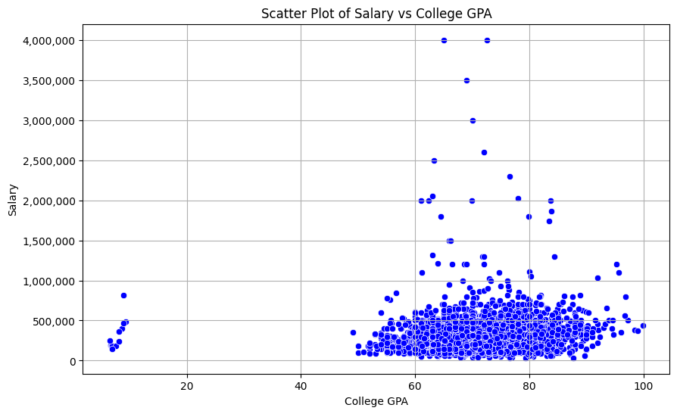
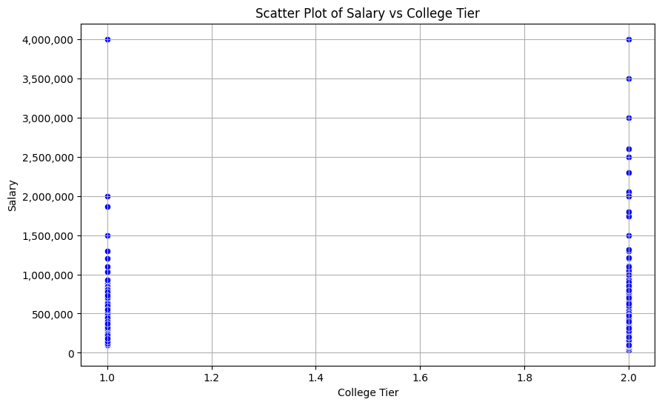

Slide 10
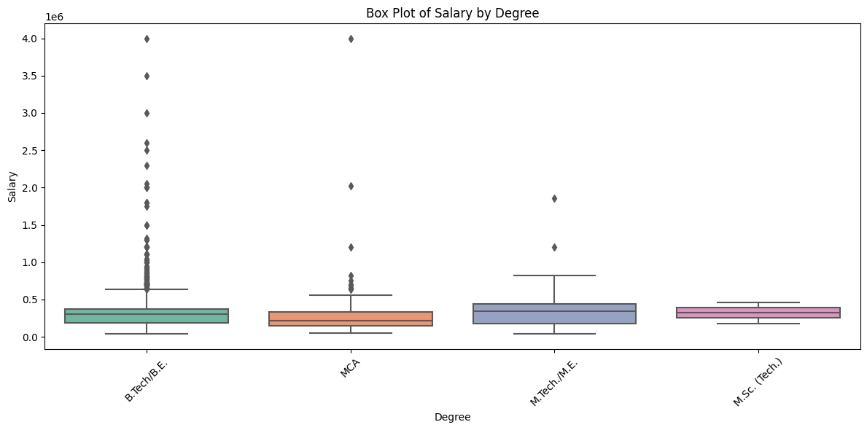

Slide 11
“After doing your Computer Science Engineering if you take up jobs as a Programming Analyst, Software Engineer, Hardware Engineer and Associate Engineer you can earn up to 2.5-3 lakhs as a fresh graduate.” Test this claim with the data given to you.
Is there a relationship between gender and specialization? (i.e. Does the preference of Specialisation depend on the Gender?)
From the data we have, Number of Computer Science graduates earning between 2.5 to 3 lakhs in Job designations like programming analyst, software engineer, Hardware engineer and Associate Engineer is 0.
Conclusion:
Major states offering good employment opportunities are Bangalore, Pune, Gurgaon, Mumbai.
Salaries are high for B. Tech/ B.E students compare to other degree graduates. Most of the people are having salary between 1.5 to 3 lakhs.

Slide 12

THANK YOU

