Slide 1
Manufacturing Analytics
Group-4 Names
KARRI VEDITHA
SWATHI S
KURVA SHEKAR
VANDANA BADOLE
LAVANKULA MOHAN SURYA PAVAN KUMAR
BUDDHABHUSHAN NAVNATH DONGARGAONKAR
AMIT KUMAR SAINI
1

Slide 2




This presentation outlines the journey of data through various tools: MySQL for storage, Excel for processing, and Power BI/Tableau for visualization.
Data Analysis & Visualization Workflow
2

Slide 3
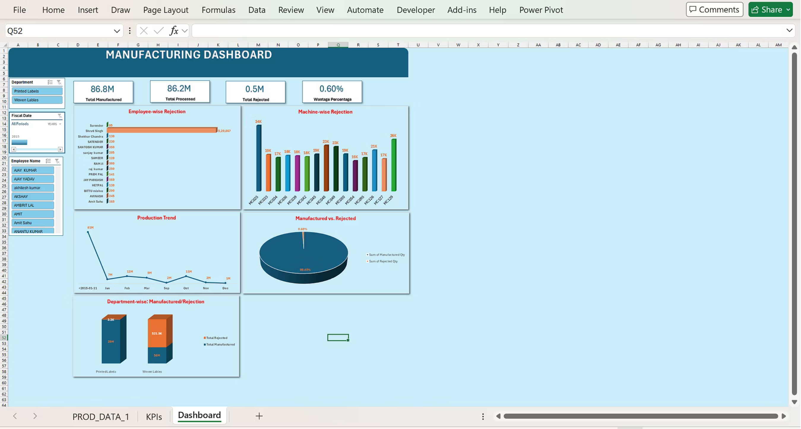
DASHBOARD: Microsoft Excel
The KPIs show that Total Manufactured is 86.8M, Total Processed is 86.2M, Total Rejected is 0.5M, and the Wastage Percentage is 0.60%, indicating overall good production performance with very low wastage.
3

Slide 4
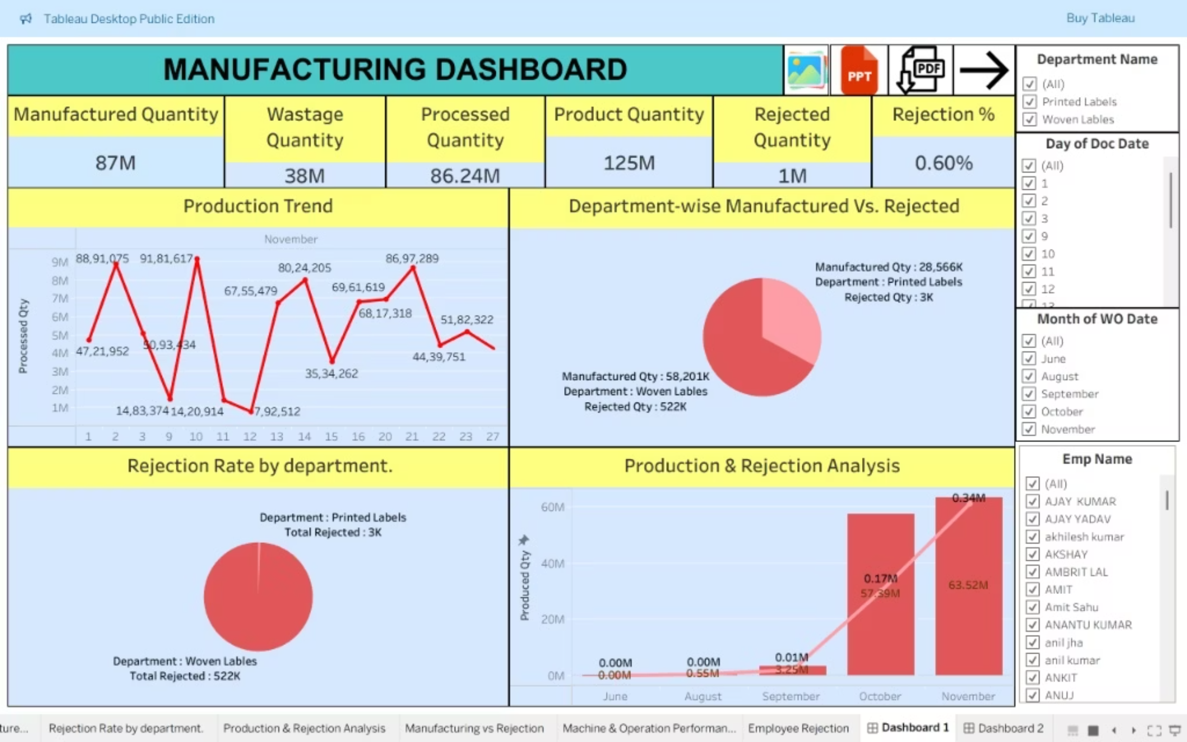
Production & Quality Insights Dashboard
Manufactured 87M, Processed 86.24M, Produced 125M, Rejected 1M, Rejection 0.60%, Wastage 38M.
4

Slide 5
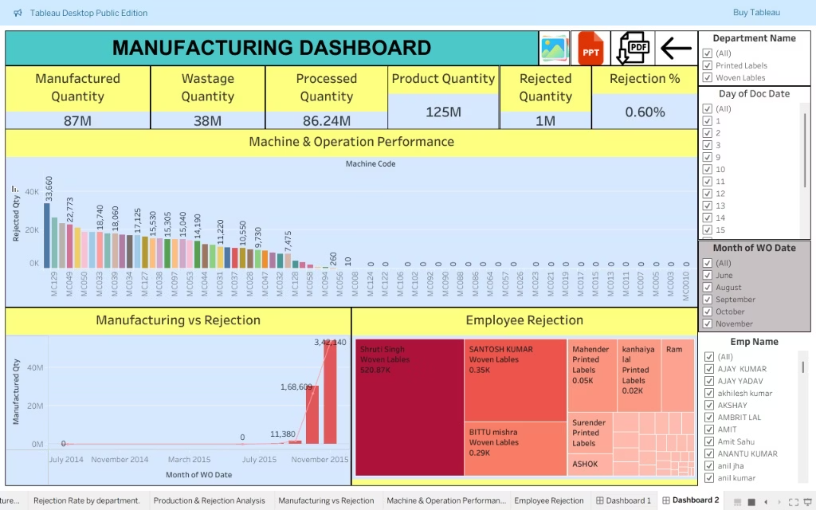
Category Performance: Tableau
This slide breaks down sales by Category (Furniture, Office Supplies, Technology) and Segment (Consumer, Corporate). It helps in understanding product-market fit.
This dashboard shows machine, production, and employee performance, highlighting high production, low rejection, and identifying problem areas.
5

Slide 6
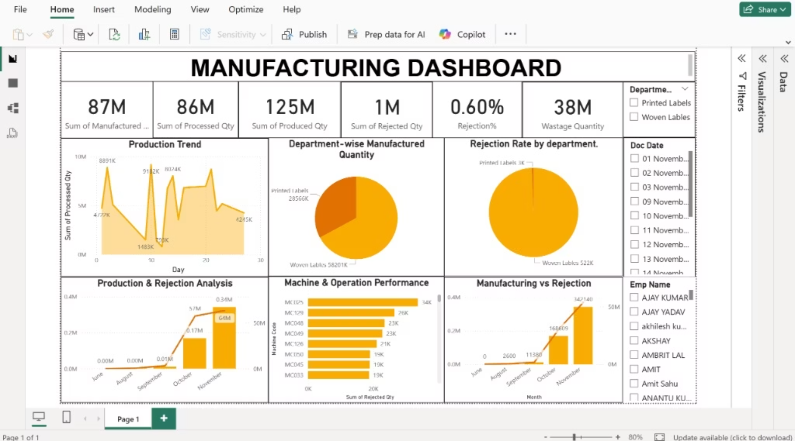
Dashboard: Power BI
The KPIs show that Total Manufactured is 87M, Total Processed is 86M, Total Produced is 125M, Total Rejected is 1M, the Rejection Percentage is 0.60%, and the Wastage Quantity is 38M, indicating overall production performance with low rejection rate.
6

Slide 7
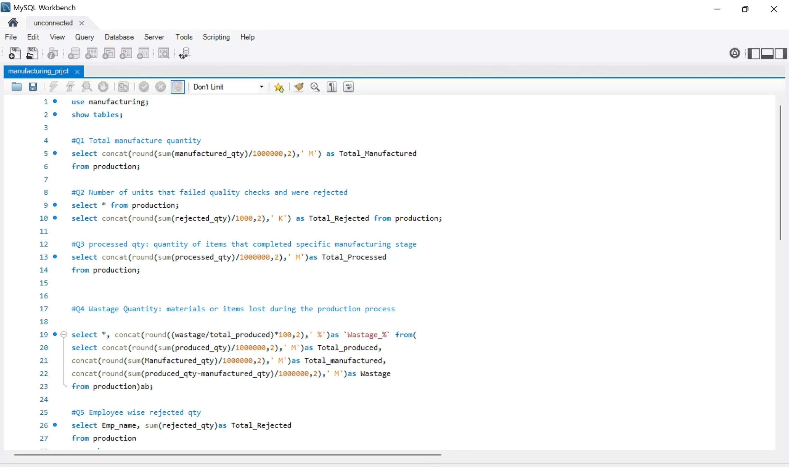
Data Storage: MySQL
MySQL is used as the foundational database. It stores structured information like customer records, product details, and transaction history in organized tables.
7

Slide 8
Description:
This dashboard shows overall manufacturing performance, including production, rejection, machines, and employees.
Conclusion:
Production is high, rejection is low, and problem areas can be easily identified.
8

